Slide 1

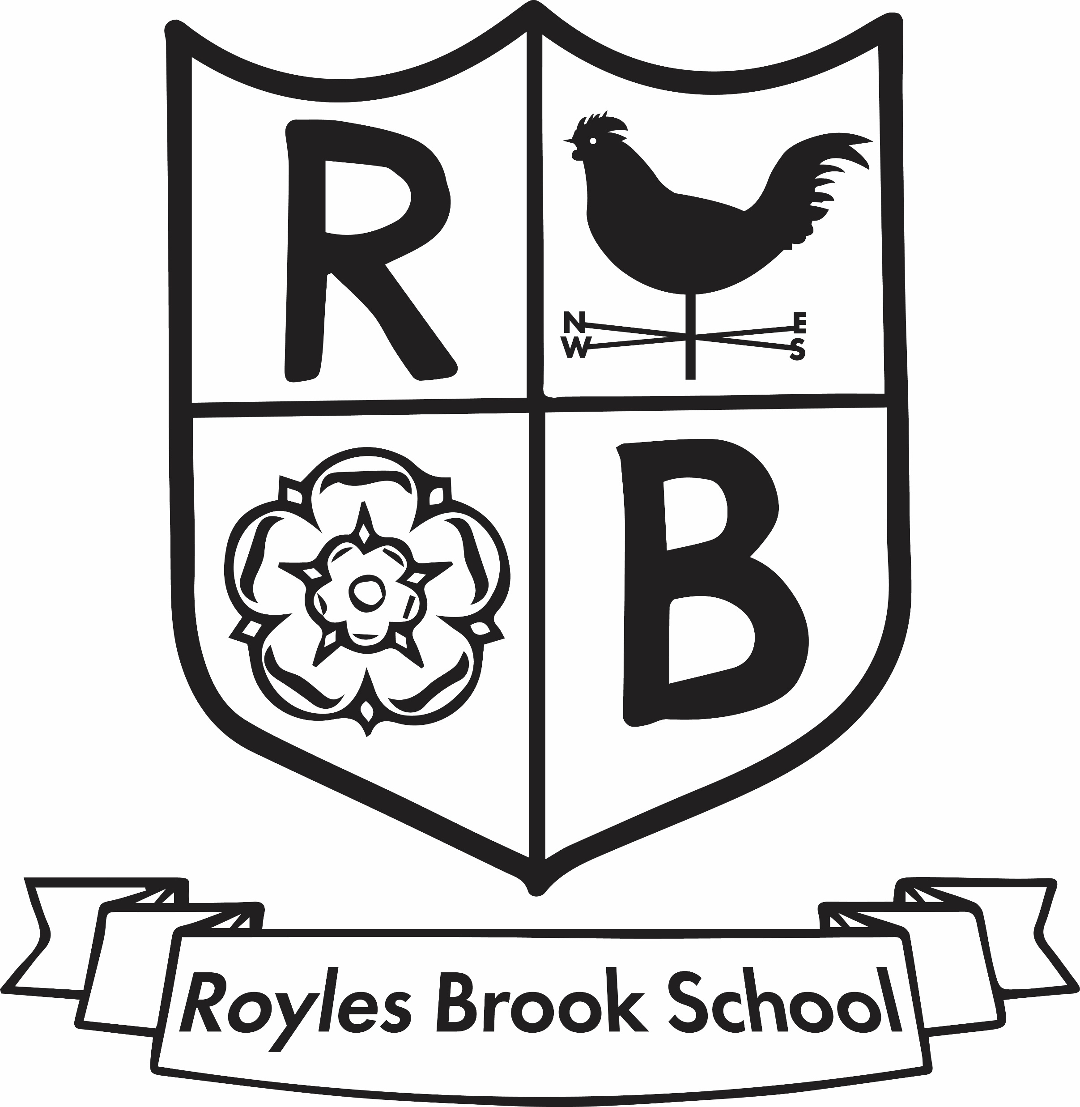
United Curriculum
Primary History

Slide 2
Principles of the History Curriculum
The United Curriculum for History provides all children, regardless of their background, with:
Coherent and chronological substantive knowledge of the history of Britain and the wider world, selected to build pupils’ understanding of three vertical concepts. These vertical concepts provide both a concrete lens through which to study and contextualise history, as well as use small steps to help pupils gain a deep understanding of complex, abstract ideas:
  Quest for knowledge
    How do people understand the world around them? What is believed; what is known; what scientific and technological developments are made at the time? How is knowledge stored and shared? What shapes people’s views about the world?
  Power, empire and democracy
    Who holds power, and what does this mean for different people in the civilisations? How is power wielded and legitimised? How are people’s rights different in different historical contexts?
  Community and family
    What is life like for different people – men, women and children – in different societies? How are these societies structured? How are family and community roles and relationships different in different historical contexts?
Opportunities for all pupils to see themselves reflected in the curriculum, but also to be taken beyond their own experiences. The history curriculum teaches pupils about civilisations from across the world, and always incorporates the experiences – positive and negative – of ethnic minorities in the history of Britain.
Grounding in core disciplinary and procedural knowledge, and the ability to approach challenging, historically-valid questions, giving pupils the ability for pupils to learn how to think, read and write like an historian.
An excitement for history, which inspires a curiosity to learn more about the past.

Slide 3
United Curriculum: History
Year 2
European
History:
Romans in Britain
Homes Through Time
European
History:
Ancient Rome
Global History:
Quest for Knowledge
N 3/4
Local History
Marvellous Me
& Look at Me
History of Transport
Great Fire of London
Year 5
Year 6
My Family History
European
History:
Local History
European
History:
Anglo-Saxons
On the Move
Explorers
Year 1
Year 3
Asian History:
Early Islamic
Civilisation
European
History:
Viking Age
On the Farm
European
History:
Prehistoric
Britain
North
American
History:
Ancient Maya
Global History:
Power, Empire & Democracy
R
Where We Live
Me and
My World
Castles, Knights & Dragons
African
History:
Ancient Egypt
Year
4
Key Stage 3
My Heroes
European
History:
Ancient Greece

Slide 4
United Curriculum: History
 | Reception | Year 1-2 | Year 2 | Year 3-4 | Year 4 | Year 5-6 | Year 6
 |  | Cycle A | Cycle B | Cycle A | Cycle B | Cycle A | Cycle B
Autumn | Me and my world [Aut1] Talking about different family members and their roles in more depth My heroes [Aut1] Comparing heroic characters from the past and present | What was life like for people in the past? (Aut2) Family trees, considering a theme/themes now and in living memory | Local history: community & family Considering how our local area has changed in living memory | European history: Prehistoric Britain (Aut2) | North American history: Ancient Maya | European history: Ancient Rome | European history: Settlement by Anglo-Saxons (Aut2)
Spring | Castles, knights and dragons [Spr1] Learning about historical figures in castles and comparing images of Queen Elizabeth II with that of historical queens | How did people travel in the past? Development of space, air, car and train travel (beyond living memory) | Where did people live in the past? How homes have changed over time (beyond living memory) | African history: Ancient Egypt | Asian history: Early Islamic Civilisation | European history: Roman Empire in Britain (Spr2) | European history: Viking age (Spr2)
Summer | Where we live [Sum1] Learning about familiar aspects of our locality from the past, using historic photographs and memories of older adults | Comparison of explorers (Sum2) Sacagawea and Michael Collins (specific periods of history) | Great Fire of London GFoL and its effects (specific period of history) | European history: Ancient Greece | European history: Local History | Global history: Quest for knowledge (Sum2) | Global history: Power, empire and democracy
Units that appear in a different place to that in the single-year planning have been highlighted in green; if it’s in a different year group it is highlighted in purple.

Slide 5
History in Our Local Context
History is taught in 6-lesson units, once a term (History alternates with Geography).
The United Curriculum is sequenced so that meaningful links are made between subjects, and the order of units allows these connections to be made. For example, pupils are taught about the Vikings in Britain in History in Spring 2, so that they can review and build upon knowledge of migration – and consider the push and pull factors behind Viking migration – after they have been taught about migration in Geography in Spring 1.
The United Curriculum for History has been adapted for Royles Brook by bringing in the history of our local area and considering the context of our pupils and the community.
For example:
In Year 1 & 2, we consider the local history of our area by looking at why we needed a windmill in Thornton
When learning about the History of Transport in Year 1 & 2, we focus on the railways and the impact of the Industrial Revolution in the North West
In Year 3 & 4, we revisit the local history of our local area and extend our understanding by exploring how Blackpool and Fleetwood used to be Victorian seaside towns
When learning about Ancient Greece in Y3 & 4, we visit Liverpool Museum to take part in a mythology workshop
When learning about Roman Britain in Year 5 & 6, we visit Ribchester Museum to extend pupils’ understanding

Slide 6
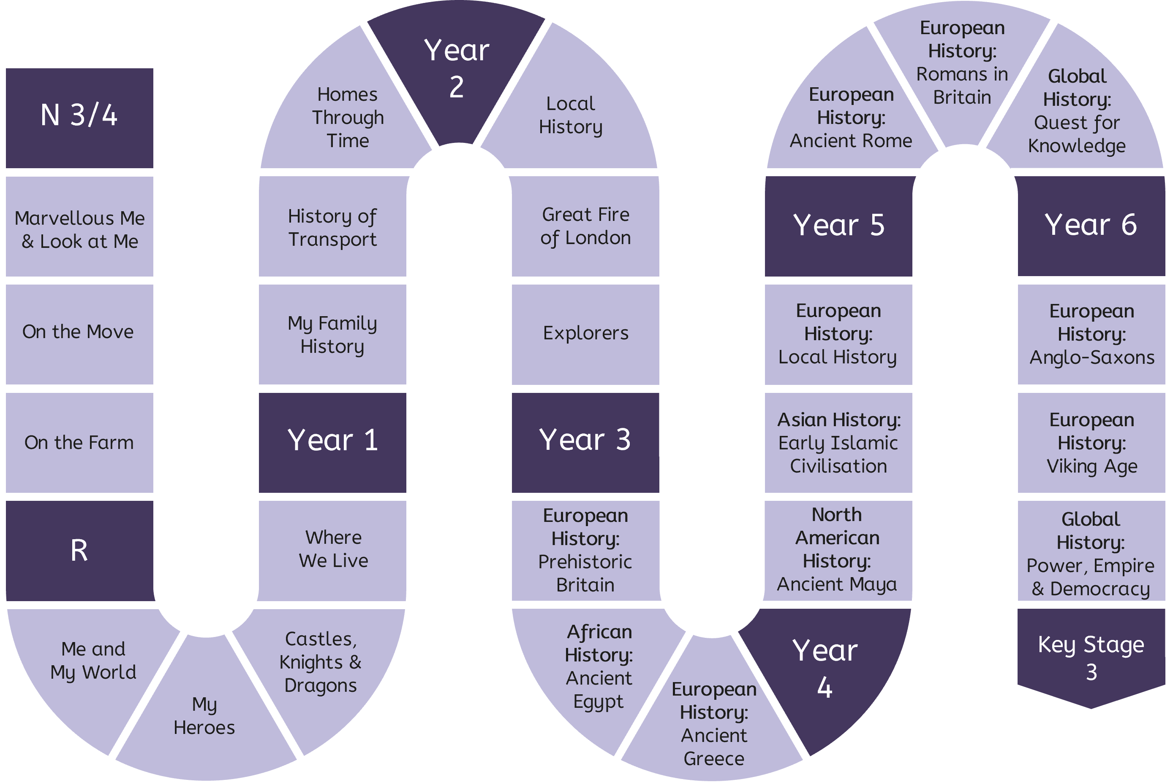

Progression in the History Curriculum
Vertical Concepts
The King or Queen (monarch) had power to make new rules in a country.
We learn about the news laws that King Charles II created after the great fire.
The imperial cult meant the emperor was seen as divine.
Power, Empire & Democracy
Institutional, economic, physical, intellectual and informal power can be used to control others. Romans used all of these to maintain control in Britannia.
Leaders can delegate power to regional and local leaders, as did the Roman emperor (and pharaohs and caliphs).
Quest for Knowledge
Community & Family
Evidence from Sutton Hoo shows how Anglo-Saxon kings held institutional, economic, physical, intellectual and informal power.
Disciplinary Knowledge
Historical Significance
Britain used institutional, economic, physical, intellectual and informal power to maintain control in India and Kenya.
Everyone has the power to make change. This can be through protests or other campaigns (see British civil rights movement) or using our personal power to challenge others’ prejudice.
Similarity & Difference
Change & Continuity
Cause & Consequence
The King is an important person where we live. We learn about King Charles III.
The early Islamic civilisation was an empire, led by the caliph.
Empires grow and shrink as the power of its leader changes. The empire grew and then shrank.
Evidence
People get their power in different ways. The pharaoh was believed to be half-man, half-god. He was believed to have divine status.
Empires are large areas of land controlled by one person or group of people. Ancient Egypt was an empire.
Chronology
Maya kings were seen to be half-man, half-god.
Power & Empires

Slide 7
Progression in the History Curriculum
Vertical Concepts
Governments that look democratic on paper can be autocratic in reality. Rome’s transition from kings, to republic to dictatorship to empire did not change much in practice.
The Roman empire was ruled by an autocratic emperor.
Power, Empire & Democracy
Quest for Knowledge
Community & Family
Boundaries of Anglo-Saxon kingdoms changed over time, reflecting changing power of their kings.
Disciplinary Knowledge
The Vikings organised themselves in ways that had autocratic and democratic features (things).
Boundaries of Viking territory in England changed over time.
Some places organise themselves in ways that have both autocratic and democratic features.
Historical Significance
Similarity & Difference
Change & Continuity
Cause & Consequence
Ancient Maya civilisation was divided into city-states.
The relationships between city-states in Maya civilisation were different to those in Ancient Greece.
Maya kings ruled autocratically.
Some places are ruled as an autocracy. The Egyptian pharaoh was autocratic and answerable to no one.
An autocracy is place where one person or one group can rule exactly as they want to forever.
Evidence
Democracy is a system of government where everyone has a say.
Some places are ruled as a democracy. We compare Athenian democracy with Spartan (and Egyptian) kings.
Not all democracies are the same. We compare UK with Athens.
City-states have independent identities and governments.
Chronology
Government & Democracy

Slide 8

Progression in the History Curriculum
‘Belief systems’ evolved in the Roman empire as it conquered new people with different beliefs. Early Romans believed in multiple gods, based on ancient Greek gods.
There can be tolerance or persecution of different beliefs.
Official ‘belief systems’ may change quickly but, in practice, individuals’ beliefs did not change that quickly.
The Roman emperor was worshipped like a god after he died.
Shared beliefs can be a way of uniting – to some extent – two peoples. Romans and Britons found some common ground at some temples.
Vertical Concepts
Many of the earliest civilisations across the world – including those who never shared ideas – held beliefs about the natural world.
Power, Empire & Democracy
Quest for Knowledge
People’s personal ‘belief systems’ can take on ideas from lots of places. The grave goods from Anglo-Saxon England suggest beliefs in the natural world existing alongside newer Christian ideas.
Community & Family
People today have different beliefs and celebrate them in different ways. We learn about different religious festivals and how they can be celebrated by families.
The Vikings believed in multiple gods, like Odin, Thor and Loki.
The Vikings believed in an afterlife called Valhalla.
Viking beliefs slowly evolved to incorporate more Christianity.
Disciplinary Knowledge
Historical Significance
Similarity & Difference
The caliph was the leader of the religion of Islam as well as the political empire.
Change & Continuity
Ancient Maya believed in multiple gods.
Ancient Maya worshipped their gods in temples built on top of pyramids.
Ancient Maya used blood sacrifices – and sometimes human sacrifices – to thank the gods for the sacrifices they made for humans.
Maya king was believed to be half man, half god,
Cause & Consequence
People in the past had different beliefs and worldviews to us.
Some knowledge and beliefs are based on the natural world. People held similar and different beliefs about an afterlife. Prehistoric grave goods show prehistoric Britons believed items would be needed in an afterlife.
Animal sacrifices could be an important part of worship. There is evidence of this in prehistoric Britain.
Ancient Greeks believed in multiple gods, like Zeus, Hera and Athena.
Ancient Greeks worshipped their gods in temples.
Evidence
Ancient Egyptians believed in an afterlife known as the Field of Reeds.
Ancient Egyptian grave goods show that people believed items would be needed for the afterlife. Grave goods belonging to the pharaoh have been found in pyramids.
Ancient Egyptians believed in multiple gods, like Horus, Isis and Osiris.
The pharaoh was believed to be half man, half god.
Chronology
Changing Worldviews

Slide 9
Progression in the History Curriculum
Vertical Concepts
There have been technological developments in the way we fight fires, since the Great Fire of London.
Different peoples hold different knowledge. Sacagawea knew more about the landscape than others on her expedition).
The knowledge we have today needed to be developed by someone or some people.
The pursuit of knowledge may come from necessity; as the Romans expanded their empire, they expanded technology (e.g. underfloor heating for colder parts of the empire).
As the Roman empire grew, they were exposed to more ideas that they could build on.
Power, Empire & Democracy
Quest for Knowledge
It has taken a very long time for the knowledge that people have today (about houses and the things inside them) to be developed.
The oral tradition – still the most dominant form of communication today – is the method of remembering and passing on all of the knowledge accumulated over thousands of generations by the spoken word
Different civilisations take different valid approaches to knowledge. Western science and the emphasis on the scientific method is not the dominant approach everywhere in the world.
The knowledge we have today has been shared and developed by lots of civilisations across the world.
Community & Family
The technology and other things that we have today have not always existed.
Disciplinary Knowledge
Historical Significance
Similarity & Difference
Some prehistoric Britons built stone structures like Stonehenge. There was no writing.
Deciding what knowledge is taught in schools is a contentious decision, and people have different opinions about it.
Change & Continuity
Cause & Consequence
The pursuit of knowledge is central part of beliefs in Islam.
The House of Wisdom at Baghdad allowed scholars from across Europe, Africa and Asia to share ideas.
The importance of the written word is shown because lots of knowledge was lost for a long time, as books were thrown into the river Tigris by the Mongols.
Different systems of writing were developed in history. They helped to share ideas over time and across bigger areas. Ancient Egyptians used hieroglyphics.
Ancient Egyptians built huge stone pyramids.
Ancient Greeks created new architectural orders and built temples to worship gods.
Ancient Greeks learnt things from the ancient Sumerians and built on this knowledge.
Ancient Maya used hieroglyphics.
Ancient Maya built large stone structures including step-pyramids, ball courts and observatories.
The ancient Maya developed very similar knowledge to people in Europe independently.
Evidence
Chronology
Knowledge

Slide 10

Progression in the History Curriculum
Vertical Concepts
In the Victorian period (before living memory), people lived in cramped houses like back-to-back houses.
In the Tudor period (before the Victorians) most people lived in rural areas.
Power, Empire & Democracy
In the past, communities were smaller because people could not travel so far.
Trains, aeroplanes, cars and space travel have changed the way people live.
Britain was difficult for the Romans to control because it was far from the centre of the empire.
Roman Britain was a diverse place, for example, the Aurelian Moors formed the earliest documented black community in the north of England.
The Romans and the Britons had some shared culture, including towns, food and religion.
Quest for Knowledge
Community & Family
Disciplinary Knowledge
My local community was different for families at different times in history.
In Scandinavia, Vikings lived in longhouses, in communities of farmers.
Historical Significance
Similarity & Difference
Conflict and prejudice within communities can impact on society, as well as individuals, over time.
The British Empire forcefully colonised places around the world and substantially changed the lives of many of the people it colonized.
Change & Continuity
Cause & Consequence
The move towards farming meant that prehistoric communities became more settled, larger.
Evidence
Communities can be brought together by geographical location, or by a shared identity. The people of the Early Islamic Empire were connected by their common identity and religion, as well as geographical (political) boundaries.
Trade can impact what a community looks like.
Chronology
Changing Communities

Slide 11
Progression in the History Curriculum
Vertical Concepts
Homes and the things we use in our homes have changed during the lives of the people in our community.
Features of homes at different times have meant that people have done everyday tasks differently.
Power, Empire & Democracy
1660s London was dirty, busy and cramped.
Different civilisations have different ideas about what a “family” is. Roman citizens were plebians (poorer) or patricians (wealthy).The extended family also included slaves.
Female citizens had very few rights compared to men.
Systems of slavery have existed in communities and civilisations across the world for a long time. Slaves could be taken from different communities based on their wealth.
Quest for Knowledge
Community & Family
Talk about the lives of the people in my community, including my family, and their roles in society.
Disciplinary Knowledge
Some aspects of life in my own community have changed over time and others have stayed the same.
The achievements of women have often been undervalued in different societies in the past, for example Hilda of Whitby.
During the Anglo-Saxon period, children were expected to help with domestic jobs, tend to animals, and assist with farming.
Historical Significance
Similarity & Difference
Change & Continuity
Viking women often faced obstacles to achieving the same things as men. They had some opportunities for education and power, but some parts of life were inaccessible to them.
Slaves could be taken from different communities based on their race, ethnicity or gender.
Cause & Consequence
In communities in the past, different people often had very defined roles.
In the earliest communities, families had to be self-sufficient, and did everything (hunt, cook, clean, build, heal) themselves. They were hunter-gatherers.
Agriculture (the farming of plants and animals) changed what community life looked like. In particular, the role of women in prehistoric Britain changed as communities became more settled and agriculture became more widespread.
The Ancient Egyptians relied on the Nile for farming and transport.
Working class people held many important jobs in Ancient Egypt, but they had little personal power.
Evidence
The education of children was highly valued in Early Islamic society and schools were established in communities, for example in mosques.
Chronology
Community Life

Slide 12

Progression in the History Curriculum
Vertical Concepts
Historians choose to study people or events from the past because they resulted in change and/or were important to people at the time and/or are remembered today.
We ask why we remember the Great Fire of London today: because of the short-term changes in the city, but also the longer-term impacts on building regulations and fire service that are relevant today.
Historians choose to study people or events from the past because they resulted in change.
We learn about Henry Ford or the Wright brothers because they created big changes in the way we travel.
Power, Empire & Democracy
Quest for Knowledge
The past is everything that has happened to everyone, but we only learn about some parts in history. The rest is known as silence.
We talk about why some civilisations are studied more than others, and how and why this is changing.
Community & Family
Disciplinary Knowledge
Historical Significance
Similarity & Difference
What historians consider to be significant is different to different people at different places and times. We, as historians, can recognise reasons for why we are studying something in a particular place or time.
We talk about how today’s context shapes what we learn about in history lessons, and why we are learning about (e.g.) the British civil rights movement in school, when the adults at home probably did not.
Change & Continuity
Cause & Consequence
Evidence
Historians can set their own criteria for what they consider to be significant and why it should be studied.
We make our own arguments as to why we – and next year’s Year 4 – should learn about the Early Islamic Civilisation.
Chronology

Slide 13

Progression in the History Curriculum
Vertical Concepts
Historians should recognise the similar and different experiences that individuals from the same community have based on their age, gender, race, wealth, sexuality and other characteristics.
We learn about the diversity of the Roman empire, and the range of experiences that people could have within it.
Power, Empire & Democracy
Historians study the way things were different in the past.
Quest for Knowledge
Community & Family
Disciplinary Knowledge
Historians can consider the similarities and differences between people in two historical civilisations.
We can compare the experiences of people in two different civilisations.
We learn about the ancient Maya and compare this civilisation with ancient Greece, e.g. city-states, beliefs and buildings.
Historical Significance
Similarity & Difference
Change & Continuity
Cause & Consequence
Similarities and differences exist between two individuals who lived in the past.
We learn about Sacagawea and Michael Collins, both American explorers who went on expeditions, and describe the similarities and differences of their experiences.
Historians sometimes group people together to make explanations easier, but every individual in the past had similar and different experiences.
We challenge the label of ‘ancient Greek’, and question whether all these people would have had similar experiences. We talk explicitly about the differences in city-states, and the different experiences of men, women and children in Athens’ democracy.
Evidence
Chronology

Slide 14

Progression in the History Curriculum
Vertical Concepts
Historians can describe changes that have happened over time.
We use photographs and artefacts to describe changes in living memory, focusing on schools, communication and/or toys.
Some changes happen more quickly than others. The world is changing more quickly in more recent history.
We visualise history on a timeline or roadmap, and notice how there are more differences between the changes in more recent times.
Historians describe how changes affect people’s lives.
Power, Empire & Democracy
Changes do not always follow one trajectory, and changes do not always mean progress.
We learn about how Rome grows and then shrinks; how the average Roman citizen gained more power in the republic and then less in the empire; and how Romans persecuted Christians more, and then less as the empire became more tolerant.
Changes can take place gradually (evolution) or very rapidly and completely (revolution).
We visualise some of the changes taking place in Rome on a graph, e.g. the size of the empire on the y-axis and the time along the x-axis. This helps us to see how the rate of changes could vary.
Quest for Knowledge
Community & Family
Disciplinary Knowledge
Historical Significance
Over time, some things about me stay the same and some things change.
We describe how we have changed since we were a baby.
Similarity & Difference
Historians can identify and analyse examples of resistance to change.
Historians' understanding of how and why changes took place develops over time.
Change & Continuity
Cause & Consequence
Evidence
Historians can describe changes that have happened over time.
Over time, some things about the place where I live have changed, and some things have stayed the same.
We use photographs to describe how the place we live has changed over time.
The impact of larger-scale changes can be seen in [my local area].
Chronology

Slide 15
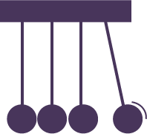
Progression in the History Curriculum
Vertical Concepts
Things in the past happened because something caused them to happen.
In the context of homes, we explore why homes may have been built in the way there were. For example, why were Victorian houses built back-to-back? (To save space, which was limited in some places).
Causes can be categorised as economic, physical, social, institutional, etc.
We learn about the ways that Romans kept control of Britannia, and group these ways into economic, physical, institutional, informal and intellectual.
Historians can argue that some causes are more important than others.
As historians, we discuss and give reasons for why we think one way of maintaining control was more effective than another.
Power, Empire & Democracy
Quest for Knowledge
Community & Family
In Understanding the World in particular, we explore the effects of pushing and pulling, and using forces to make things happen. In Personal, Social and Emotional Development, we start to explore the effects of our actions on other people.
Disciplinary Knowledge
Historical Significance
Historians interpret primary and secondary sources and build arguments to explain the causes of events.
Similarity & Difference
Change & Continuity
Cause & Consequence
Some things can have lots of causes.
We learn about facts of the Great Fire of London and identify, from this list, the many reasons as to why the fire burned for so long. (i.e. ‘the houses were built close together’ is one part of the answer to the question, but ‘the fire started in Pudding Lane’ is not). We also discuss and start to rank the identified reasons as to which one had the most impact.
Causes can be long-term conditions or short-term triggers.
We consider the reasons why the Great Fire of London burned for so long, and decide if they are long-term conditions (e.g. houses being built close together) or short-term triggers (e.g. the strong wind that blew on the day, which spread the fire quickly).
Evidence
Some things have lots of causes that are connected in some way.
We consider the reasons why the Egyptian pharaoh was so powerful and how they are connected and can be mutually supportive (e.g. they were often viewed as warrior kings who conquered other places, and this brought new wealth which was another reason as to why the pharaoh was powerful).
Chronology

Slide 16

Progression in the History Curriculum
Vertical Concepts
History is the study of humans who lived in the past. We can identify whether an image shows something that historians might study.
Historians learn about the past by interpreting sources.
Sources can be written, video/audio, images, artefacts or oral history We use a range of sources – including artefacts, images, oral history and some written text – to compare the past with the present.
Primary sources are sources that were created by someone who experience the event firsthand. Secondary sources are written about primary sources.
We use primary sources (e.g. photographs taken in the past) and secondary sources (e.g. leaflets about the history of our local area) to learn about our community in the past.
Power, Empire & Democracy
Quest for Knowledge
Historians need to cross-reference sources in order to build confidence in what they say.
We cross-reference two written sources as well as archaeological evidence and use these to say whether or not farming was taking place in Britain before the Romans’ arrival.
Community & Family
Disciplinary Knowledge
We can look at images and photographs to see how life was different in the past.
We look at photographs and images of castles and monarchs from the past and the present.
Archaeologists follow a very similar process to scientists.
We learn about Sutton Hoo and how archaeologists went about their investigation.
Historical Significance
Similarity & Difference
Local history archives can be an invaluable source of information for historians.
We use sources in our local area as part of our local history project.
Change & Continuity
Cause & Consequence
There are limits to what historians can learn from a collection of sources. We talk about why historians can never truly know what prehistoric Britons believed, even when using artefacts and ecofacts.
Archaeology is the branch of history that deals with remains of human life.
Archaeologists study artefacts, ecofacts and features. We consider how historians know about what life was like in prehistoric Britain, and about the artefacts, ecofacts and features they use.
Political maps change over time.
We learn about how the size and boundaries of the early Islamic civilisation changed over time, as the caliph lost or gained lands.
Evidence
Sources do not provide an objective account of what happened in history; historians need to consider the author and purpose and analyse it critically.
We consider an ancient Egypt relief depicting events of a battel, and an inscription in a pharaoh’s tomb. We consider the audience and purpose and talk about why we cannot take these sources as factual recordings.
Chronology

Slide 17
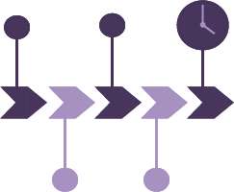
Progression in the History Curriculum
Vertical Concepts
We recognise historical periods or events using arrows on a blank timeline.
We place a small selection of sources in order, from most to least recent.
Power, Empire & Democracy
We decide whether a source shows life in a more or less recent time than another.
We put events from our daily routine in the order in which they usually happen.
We decide whether a source shows life in the past or present.
Now we are secure in negative numbers in mathematics, we can use AD (CE) and BC (BCE) accurately.
Quest for Knowledge
Community & Family
We add ‘millennium’ to our vocabulary of a way of describing time.
Disciplinary Knowledge
We give our age as a number of years.
Historical Significance
We use key dates to compare the timing of two events, considering how closely together or far apart they occurred.
Similarity & Difference
Change & Continuity
Cause & Consequence
We use vocabulary like, ‘now’, ‘then’, ‘before’, ‘after’ and ‘a long time ago’.
Evidence
We describe historical periods and time using dates [AD only] and as a given number of years ago (up to 1000, as per mathematics knowledge).
We place dates (AD only) on a timeline.
We convert between a year and a century.
We use vocabulary like ‘decade’ and ‘century’.
Chronology

Slide 18
Alignment to the National Curriculum
The below tables outlines where the statutory content from the National Curriculum is first taught across KS1 or KS2. The curriculum has been sequenced so that much of the content is reviewed in subsequent units. Pupils are taught disciplinary knowledge, including change, cause, similarity and difference and significance, throughout each unit. Careful attention has been paid to the mathematics Programmes of Study, as well as the content of the science and geography curriculum to ensure that pupils build on knowledge where appropriate.
KS1
Changes within living memory. Where appropriate, these should be used to reveal aspects of change in national life | Y1 Aut; Y1 Spr; Y1 Sum; Y2 Aut
Events beyond living memory that are significant nationally or globally [for example the Great Fire of London, the first aeroplane flight or events commemorated through festivals or anniversaries] | Y2 Spr
The lives of significant individuals in the past who have contributed to national and international achievements | Y1 Spr; Y2 Sum
Lives of significant individuals who can be used to compare aspects of life in other periods | Y2 Sum
Significant historical events, people and places in their own locality | Y2 Aut
KS2
Changes in Britain from the Stone Age to the Iron Age | Y3 Aut
The Roman Empire | Y5 Aut
The Roman Empire’s impact on Britain | Y5 Spr
Britain’s settlement by Anglo-Saxons and Scots | Y6 Aut
The Viking and Anglo-Saxon struggle for the Kingdom of England to the time of Edward the Confessor | Y6 Spr
A local history study | Y4 Sum
A study of an aspect or theme in Britain that extends pupils’ chronological understanding beyond 1066 | Y5 Sum; Y6 Sum
The achievements of the earliest civilisations – an overview of where and when the first civilisations appeared | Y5 Sum
The achievements of the earliest civilisations – a depth study of one of the following: Ancient Sumer, the Indus Valley, Ancient Egypt, the Shang Dynasty of Ancient China | Y3 Spr
Ancient Greece – a study of Greek life and achievements and their influence on the western world | Y3 Sum
A non-European society that provides contrast with British history – one study chosen from: Early Islamic Civilisation, including a study of Baghdad c. AD 900; Maya civilisation c. AD 900; Benin (West Africa) c. AD 900-1300 | Y4 Aut; Y4 Spr

Slide 19
Implementation
The implementation of the United Curriculum for History reflects our broader teaching and learning principles, found here.
For History in particular:
Content is always carefully situated within existing schemas. Every unit always begins with the chronological and geographical contexts, so that pupils can situate new knowledge in their broader understanding of people and places in the past.
Vertical concepts are used within lessons to connect learning about one civilisation to another. For example, when learning about Ancient Maya step-pyramids, pupils will review the stone structures of Stonehenge, Egyptian pyramids and Greek temples.
Opportunities for extended, scholarly writing appear throughout the curriculum. These have a clear purpose and audience and, crucially, allow pupils to write as a historian. For example, after considering the subjective nature of historical significance, pupils write to the head teacher to explain why they think it is important for all subsequent Year 4 classes to learn about the Early Islamic Civilisation.

Slide 20
Impact
The careful sequencing of the curriculum – and how concepts are gradually built over time – is the progression model. If pupils are keeping up with the curriculum, they are making progress. Formative assessment is prioritised and is focused on whether pupils are keeping up with the curriculum.
In general, this is done through:
Questioning in lessons. Teachers check understanding so they can fill gaps and address misconceptions as required.
Pupil conferencing with books. Subject leads and SLT talk to pupils about what they have learnt – both substantive and disciplinary knowledge – and how this connects to the vertical concepts that they have been developing in previous years and other subjects. For example, pupils in year 4 may be asked to talk about how Ancient Maya city-states were similar and different to Ancient Greek city-states, and how their belief systems compared with those of other civilisations.
Post-learning quizzes at the end of each unit. These give teachers an understanding of the knowledge that pupils can recall at the end of the unit, and can be used to identify any remaining gaps to be filled. These are generally simple recall questions, such as key features of belief systems in prehistoric Britain, or some of the reasons why people, places and events may be seen as significant.
Pre-learning quizzes at the start of each unit. These assess pupils’ understanding of the prior knowledge that is required to access the new content in the unit. These are used to identify gaps to be filled prior to teaching the new unit. For example, in a unit about the Roman Empire, pupils need to recall knowledge about the Ancient Greek gods and apply this to new knowledge about religion in Rome. This knowledge is assessed in the Pre-Learning Quiz, and teachers can plan to fill any identified gaps.

