Slide 1
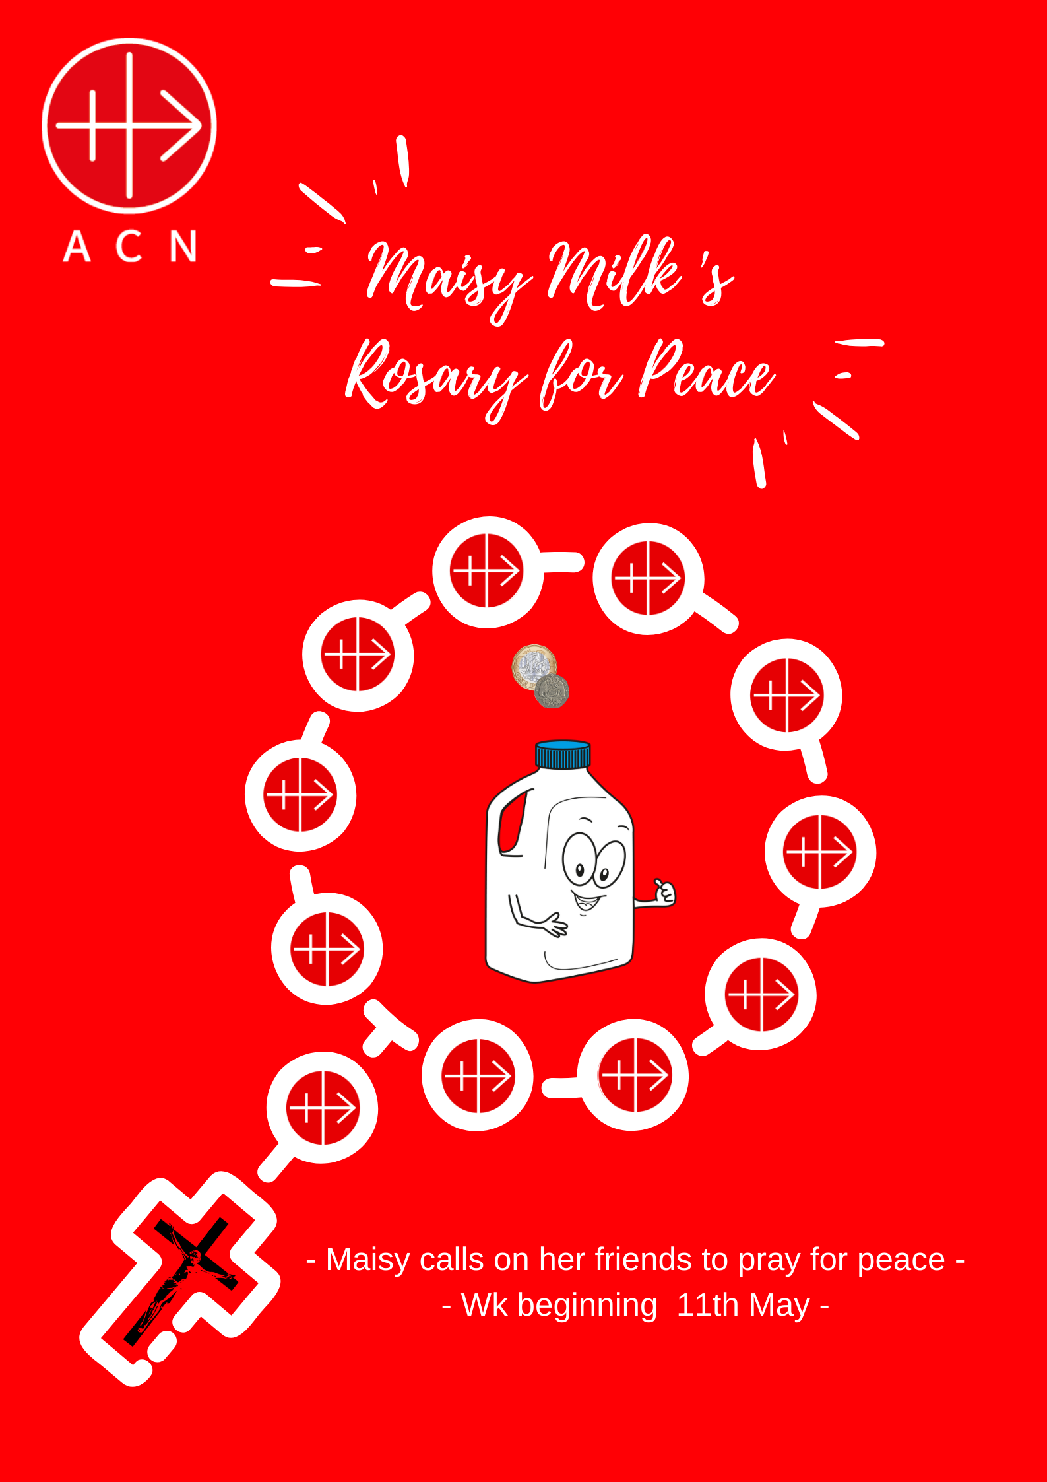

Slide 2
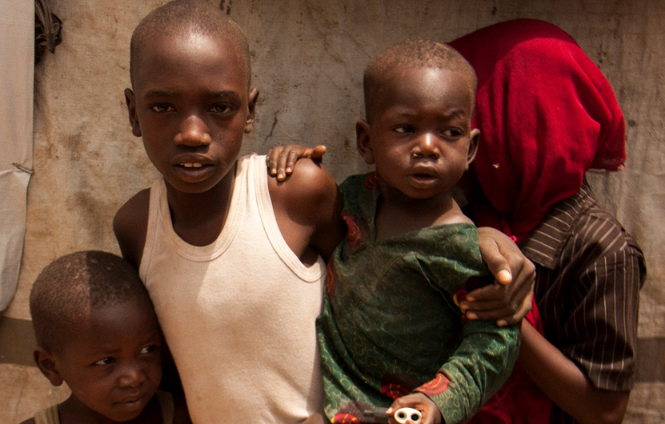
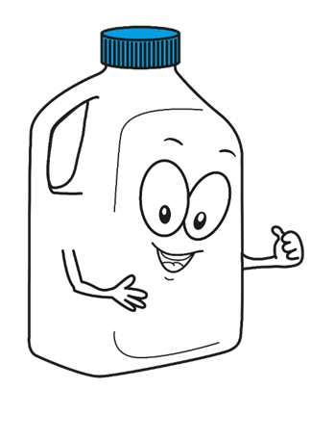

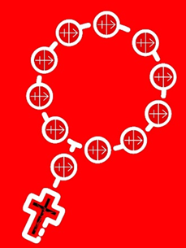
© Aid to the Church in Need
We ask Mary our Mother to watch over the orphans and keep them in her care.
Notes:
You can use these slides as a reflection and prayer focus for your decade of the Rosary per day.
Day 1: In Today’s Prayer Focus we pray for the Children in Maiduaguri, Nigeria, because of fighting in this country, there are over 15,000 children whose mums and dads have been killed. ACN, with your help is supporting the funding of an orphanage where the boys and girls can live, have a safe place to sleep, go to school and have something to eat.
In this decade, we ask Mary our Mother to watch over the orphans and keep them in her care.

Slide 3
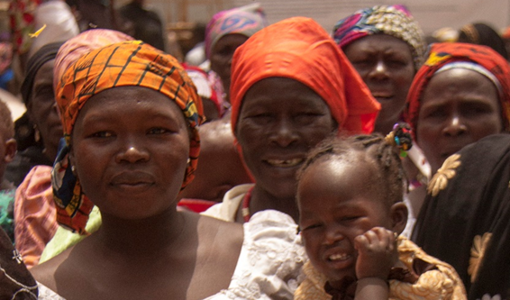
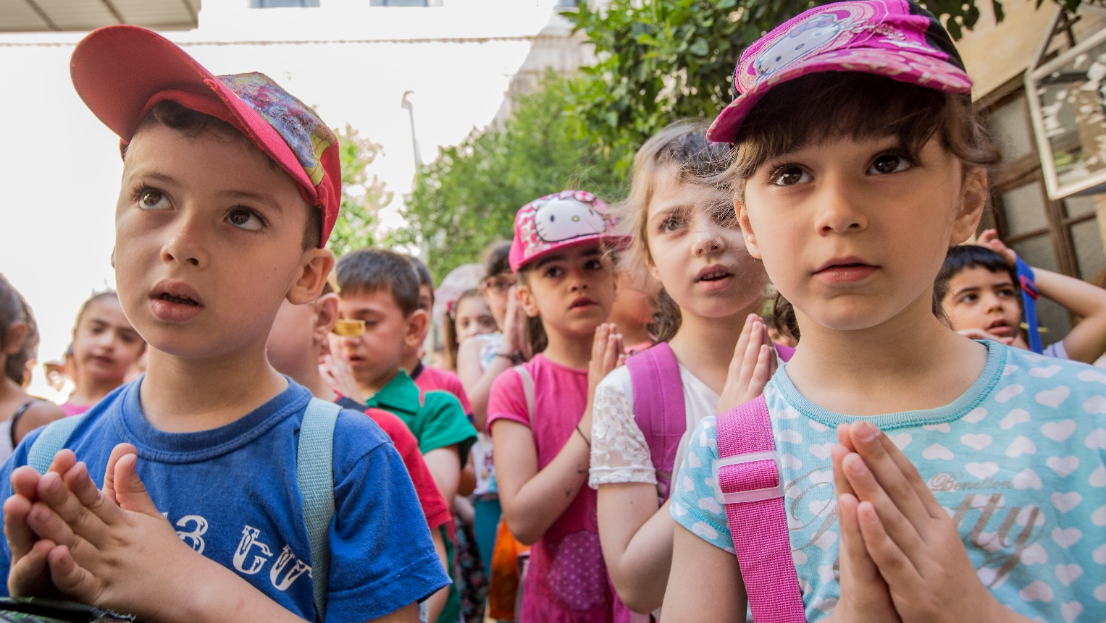
© Aid to the Church in Need
Mary please keep the women strong, healthy and happy so that they can look after their families.
Notes:
Day 2: In Today’s Prayer Focus we pray for the Mothers in Maiduaguri, Nigeria, because of fighting in this country, there are over 5,000 women whose husbands were killed. Most of the women have around nine children to look after without any money. ACN, with your help are supporting in sending the women back to school so that they can train for jobs enabling them to feed their children.
In this decade, we ask Mary our Mother to keep the women strong, healthy and happy so that they can look after their families.

Slide 4
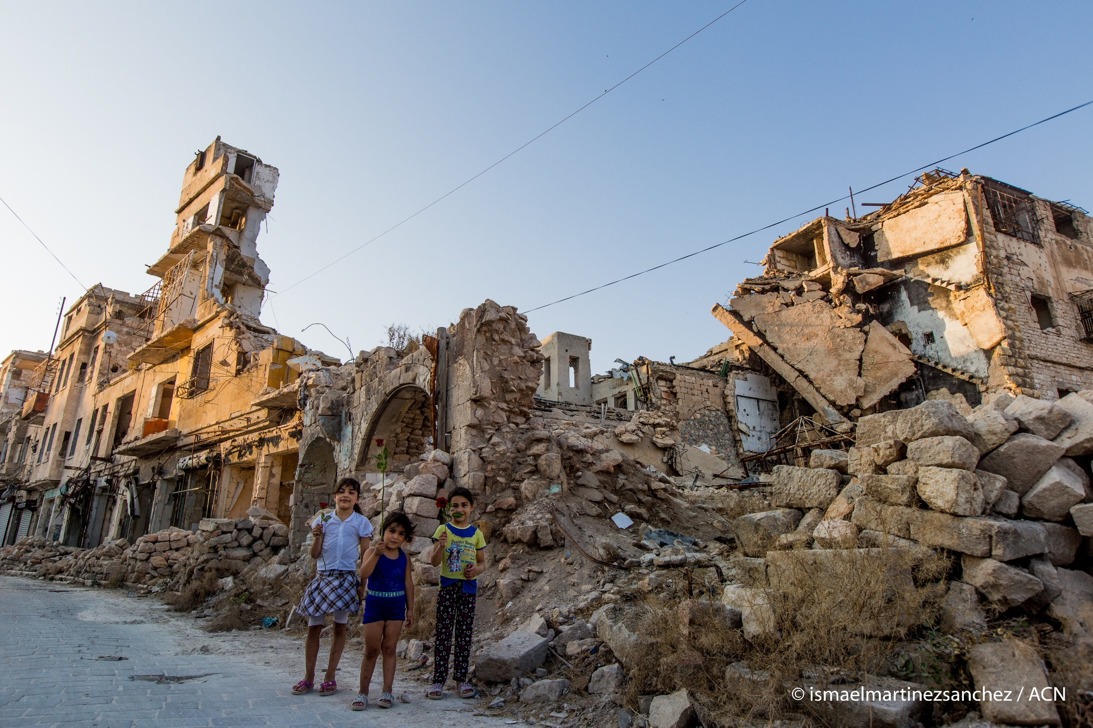

We pray for the families who are homeless and ask Mary our Mother to protect them and keep them safe.
Notes:
DAY 3: In Today’s Prayer Focus we pray for families in Syria whose lives have been destroyed by war. 12 million people have lost their houses because of the bombings. ACN, with your help is supporting to rebuild houses and Churches and find new homes for those who are still in the middle of the fighting.
In this decade, we pray for the families who are homeless and ask Mary our Mother to protect them and keep them safe.

Slide 5
© ismaelmartinezsanchez / ACN
We pray that there will be an end to the coronavirus pandemic and that all the fighting and wars stop and that our world finds peace.
Notes:
Day 4: In Today’s prayer focus we pray for peace in the lives of everyone in our world. We remember the sick and all those affected by the coronavirus pandemic. We also pray for those who are suffering because of war in their country. We pray that those who want to fight, understand that it is much better to be friends and love one another. Mary, as our Mother, please bless all those who suffer through illness or because of who they are and where they live.
In this decade, we pray that there will be an end to the coronavirus pandemic and that all the fighting and wars stop and that our world finds peace.

Slide 6
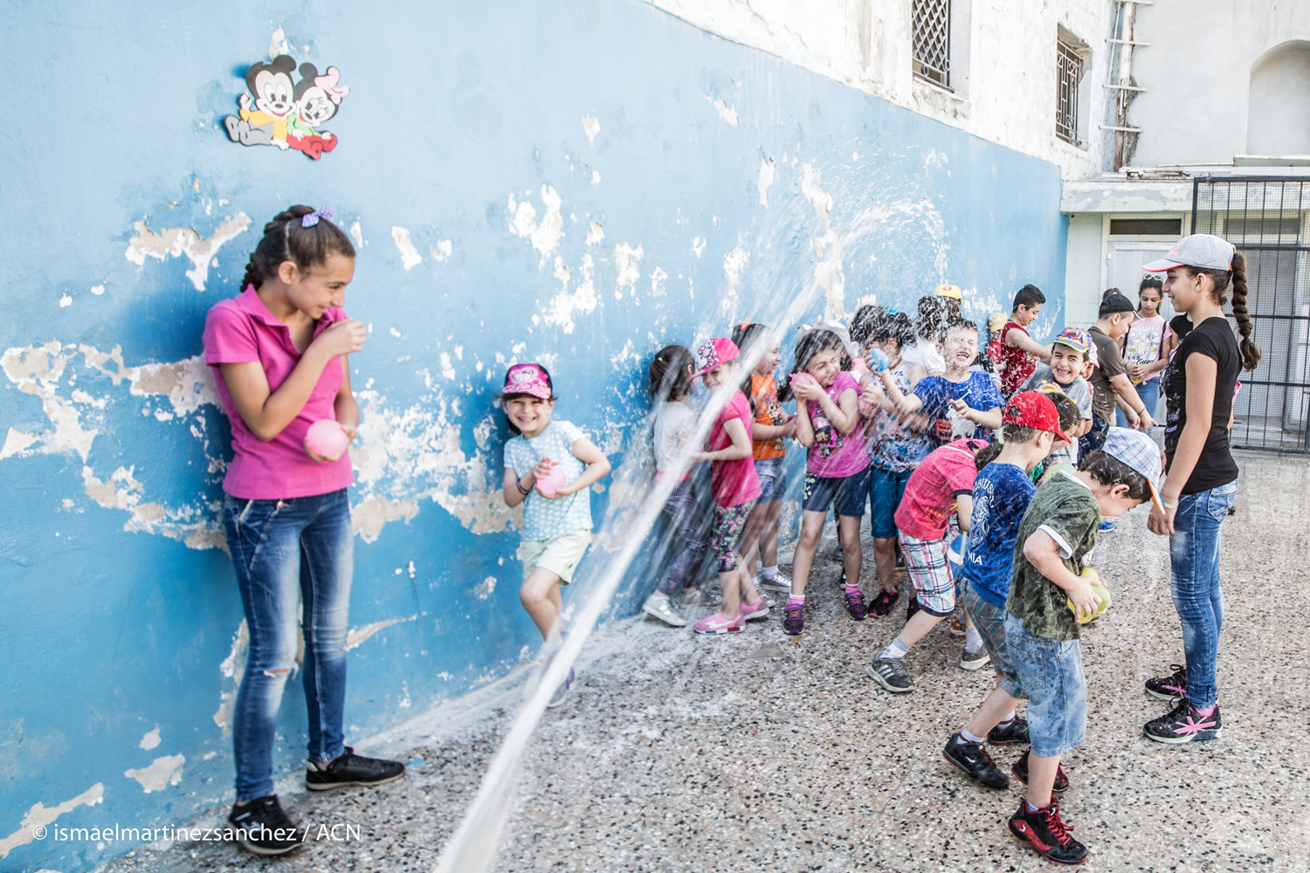
We ask Our Lady protect the children, doctors and teachers and help all of them to have a fun time in the summer camp.
.
Notes:
Day 5: In our final Daily Decade we pray for the children in Syria many of whom have lost their lives because of the war in their country. For many children in Syria it is not safe to play in the street, so ACN, with your help is supporting 130 children in attending a summer camp in Kassab. Whilst in the camp, the children are helped by doctors as many of them are having nightmares because of the terrible things that they have seen during the war. The children will also get to play and catch up with their schoolwork whilst living in a safe place.
During this decade, we ask Our Lady to protect the children, doctors and teachers and help all of them to have a fun time in the summer camp.

Slide 7
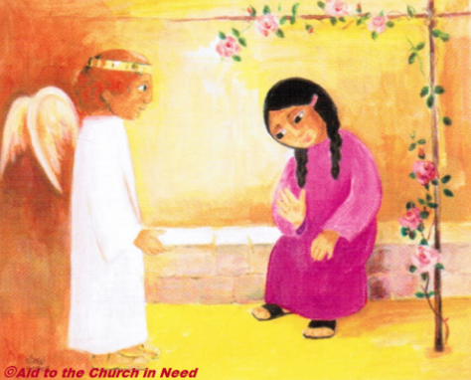
Notes:
The Annunciation

Slide 8
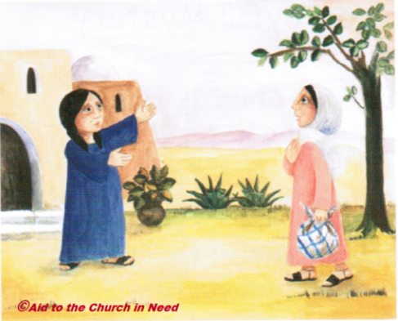
Notes:
The Visitation

Slide 9
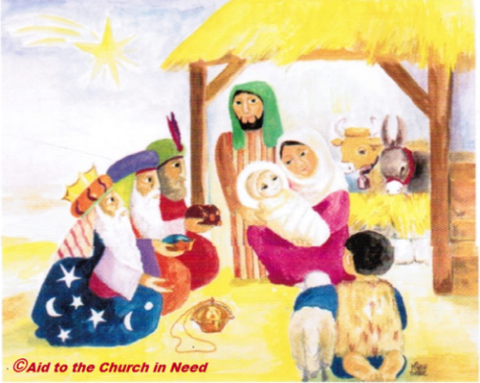
Notes:
The Nativity

Slide 10
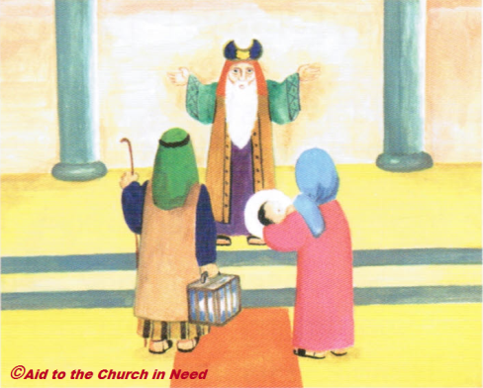
Notes:
The Presentation

Slide 11
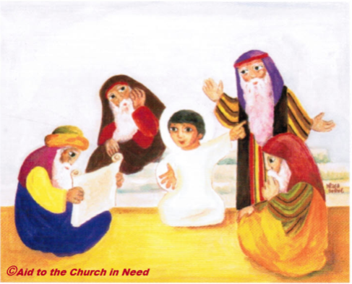
Notes:
The Finding of the Child Jesus in the Temple

Slide 12


Thank you for supporting our
Maisy Milk Rosary for Peace Initiative!
Don't forget to get your parents & carers to share you activities, tag us on twitter and facebook!
Tag us in your activities:
@ACNUK_NW
@ACN_Scotland
@ACN_Schools
A registered charity in England and Wales (1097984) and Scotland (SC040748) A Company Limited by Guarantee registered in England and Wales Company Number 4747666

