Slide 1


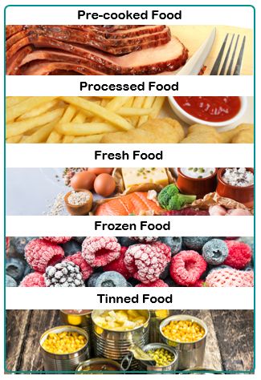
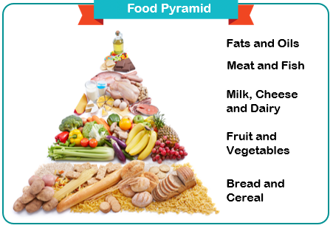
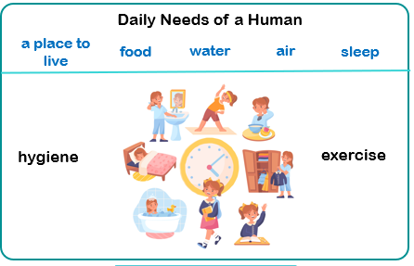


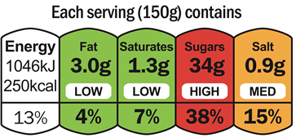
Knowledge Organiser – Animals including humans (Growth)
nutrition | food that provides nourishment to live and grow
healthy | being well and fit
protein | a food group, consisting of meat, seafood, eggs, nuts and more, which help the body repair cells
carbohydrate | a food group, including rice, bread and pasta, which give the body energy
dairy | a food group, including cheese, milk and yoghurt, which contains calcium to keeps our bones strong
fat | a food group that are important for energy but only needed in small amounts
exercise | activity requiring physical effort, carried out to improve health and fitness
hygiene | the things you can do to keep yourself and your surroundings clean
MAKING LINKS TO PREVIOUS LEARNING GOLDEN VOCABULARY
Balanced diet | A diet that contains the right amount of each food group
Survival | the state or fact of continuing to live or exist
Life cycle | The process of growth from birth to death

