Slide 1
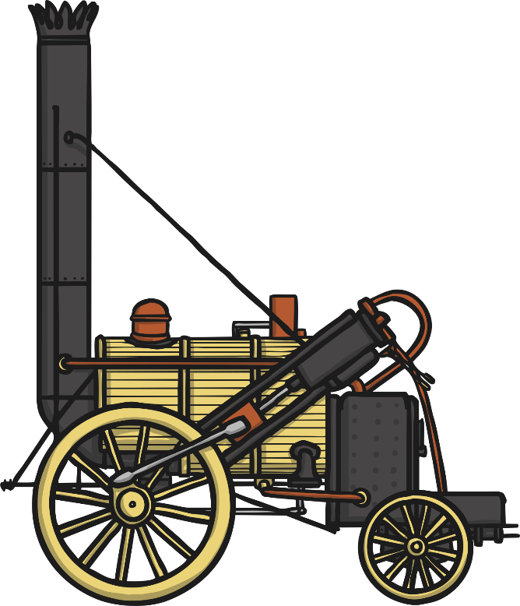
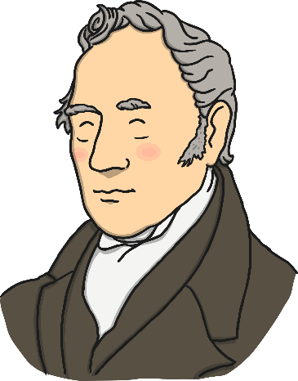


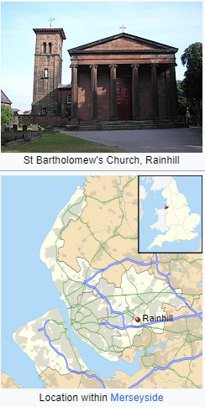
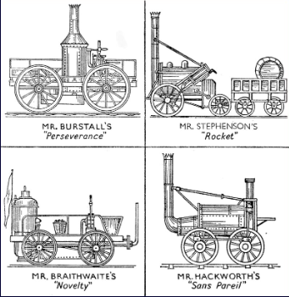
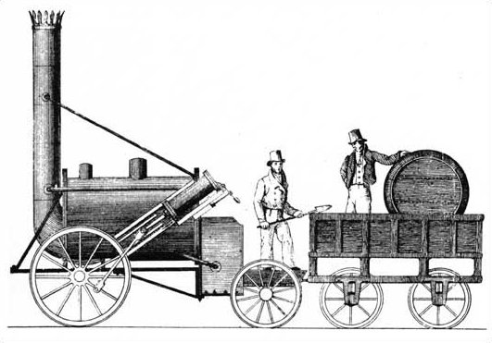
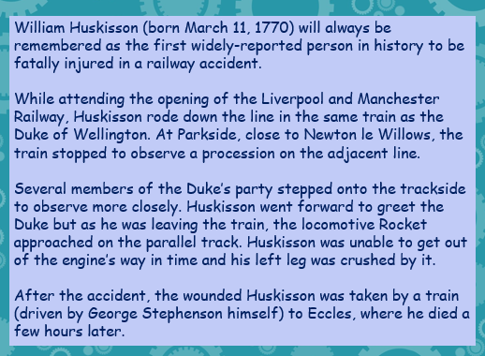
Rainhill Trials
KNOWLEDGE ORGANISER
ESSENTIAL RAINHILL TRIALS VOCABULARY
Travel | To move from one place to another.
locomotive | A railway engine.
railway​ | The parallel metal strips that trains travel on. A system of transport
Rocket​ | Stephenson’s locomotive train.
MP​ | Member of parliament.
trial | A competition to test the performance, qualities and suitability of entrants.
​effective | Successful in producing a desired result.
station | A place on a railway line where the train stops to let passengers on or off.
engineer | A person who designs, builds or maintains machinery.
engine | A machine with moving parts.
canals | A waterway constructed to allow the passage of boats.
cotton | A substance (from a cotton plant) which is used to make textile fibre and sewing thread.
transport | The process of transporting people or things.
trade | The process of buying and selling goods or services.
coal ​ | A black or brown sedimentary rock.
1829
George competed with two other engineers to find the best locomotive to run on the railway. With his son, Robert, he built the ‘Rocket’. It moved faster than the others, and it did not break down. Everyone agreed, the ‘Rocket’ had won!
1830
The line between Manchester and Liverpool opened in 1830 and people cheered for the Rocket. George Stephenson had become rich and famous.
1838
George’s son, Robert, built the first railway station between London and Birmingham. It was finished in 1838.
1848
George Stephenson died in 1848.
15,000- 10,000 BC | 15,000 BC- 10,000 BC | 6,000 BC | 4,500- 3,000 BC | 4,000- 3,000 BC | 2,750 BC | 3,500 – 3,350 BC | 2,500 BC
Rainhill
Rainhill is a village in the Metropolitan Borough of St Helens, Merseyside, England
Competitors
The Rocket
Stephenson's Rocket is an early steam locomotive of 0-2-2 wheel arrangement. It was built for and won the Rainhill Trials of the Liverpool and Manchester Railway (L&MR), held in October 1829 to show that improved locomotives would be more efficient than stationary steam engines.^{[7]} Rocket was designed and built by Robert Stephenson in 1829, and built at the Forth Street Works of his company in Newcastle upon Tyne.
William Huskisson
MAKING LINKS TO PREVIOUS LEARNING GOLDEN VOCABULARY
Great Explorers | Locomotives were the main form of transport.
Great Explorers | Liverpool saw tremendous growth due to it’s international trade.
St. Helens Past | Coal was used to power the locomotives.
© Vocabulary Ninja Ltd 2021

