Slide 1

Welcome to Year 3

Slide 2
The Year 3 Team
Mrs Gauckwin & Miss Davenport: Class Teachers
Miss Alla: Learning Assistants
Mr Goulding: Sports coach (Thursdays)
Mrs Spedding: Science (Thursdays)

Slide 3
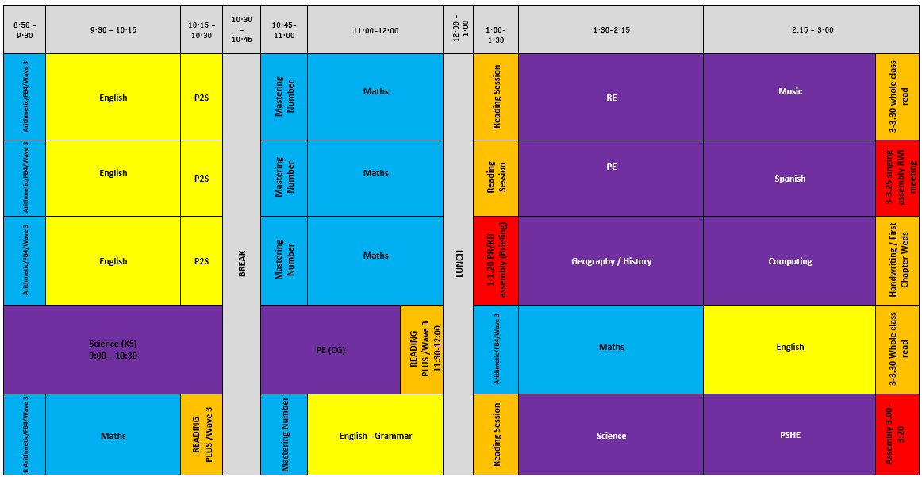
Timetable

Slide 4
Expectation
Children to wear full school uniform (policy on website) with book bags only
Hair tied back, no earrings
Following School rules
Come to school dressed in PE kit for ALL weathers
Ensure independence
MAGIC children; encourage children to have high aspirations for this year!
Golden rules established in class/around school. Behaviour policy online highlights rewards and sanctions
Handwriting and presentation expectations are high
To be equipped for the school day - reading record, reading books, water bottle, snack.

Slide 5
Expectations
Morning & afternoon routine in place to consolidate skills and provide further support/challenge if needed.
Classroom environment encourages independence, provides a calm environment without too many stimulants and celebrates learning.
No pencil cases. Everything has been provided by school and allows them to be more independent by having minimal stationary.

Slide 6
MAGIC Children
DOJOs
Certificates – 2x children per week
VIP
Behaviour:
Positive reinforcement
Name said in class/teacher look
Verbal warning
Initials on the board
Time out of class
Yellow cards
Sanctions - Reward days
Red and yellow cards

Slide 7


E-Safety
Pivotal to children’s learning that they are aware of e-safety.
Reminded at the start of every computing topic.
Importance of password protection
Various chat rooms, including Facebook.
Phones - Warning for home – e.g. Omegle (random video calls with strangers) & Whizz (like Tinder for children)

Slide 8
Independent Learners
In Year 3, your child should be able to:
Remember to bring their reading books and record in daily.
Look after their belongings - it is their responsibility to look for them if they are lost.
Look after school books that are brought home.
Start to take accountability, for example, remembering homework, timetabling responsibilities (P.E. days etc.), remembering lunchboxes and healthy snacks etc.

Slide 9
SEND
Mrs Hollman is the school SENDCO – she works Wed-Fri
SENDCo time is a Wednesday.
Adaptive and quality first teaching is for every child within school.
All children are taught within the classroom by their class teacher.
All children need to socialise with their peers and working in isolation does not provide this.
Fewer children are able to receive funding for individual support and this support is to support the individual with their peers.
Any child who has funding, the first £6,000 is provided by the school and we must explain exactly how that funding is used to enhance the learning of the individual.
Lots of our children have interventions in place to boost their learning. Some of these include: RWI 1:1, daily reading, IDL, Beat Dyslexia and handwriting practice, sensory diets/exercises
SEN register includes all children who: have an external agency involved, are 2 years academically behind their peers, have a diagnosis.
If you have concerns: speak with the class teacher, plan out steps together and re-meet to discuss progress, if necessary Mrs Hollman can then become involved if the class teacher deems it necessary.
SEN Support plans are reviewed every term with SMART targets in place.

Slide 10

What is adaptive teaching?

Slide 11
Homework
Reading - 4 times a week and signed in home reading record -this will be checked daily.
Times Tables Rock Stars – 30 minutes per week. Completed online.
Atom – to be confirmed – will replace Century homework

Slide 12
Reading
Will be read with at least once per week with either Miss Davenport, Mrs Gauckwin or Miss Alla (alternating each week)
Book bag book and pleasure books will be changed when they have been completed
It is important that the children have an understanding of what they are reading.
Now reading a whole class text at the end of the day. This is to develop children’s ‘love’ for reading. Also give time to share books the children have enjoyed – adapt our class library based on this.
Try to read books, magazines, newspapers together at home too
First chapter Wednesdays to share books we’ve read
Children can also bring books in to share with their friends in our book box

Slide 13
Equipment
Reading book & reading record - this should be in school every day.
PE - If your child cannot do P.E., a letter or message must be sent in.
Bags should only be book bag size NO bigger - these will be sent home.
Water bottles should only contain water.
Piercings must be covered up.
Hair must be tied back (boys and girls) using blue/dark bobbles/bows.
Please label all uniform, especially jumpers, cardigans and BOTH trainers.

Slide 14
Water bottles and snack
Clear water bottles - kept at the back of the room. No juice allowed.
Children can bring in fruit or toast for morning playtime snack.

Slide 15
Trips
We will have 3 trips across the year:
Light workshop - TBC
Residential – Spring 1
Ancient Egypt workshop – Summer 2 – in school
We will book ASAP and send further details when we can.

Slide 16
Working together
You can contact us by:
Send an email via the school office email - these do get emailed straight to us. Please do not use teacher’s personal emails.
Making an appointment via the office.
Parents evening.
Please try not to ask questions first thing in a morning.
Updates should be available via the school app and website.
We will endeavour to return any calls/messages within 48 working hours

Slide 17
Working together
We all want what is best for your children. If you can help us in any way
A spare half hour, half a day or a full day?
Good at art and craft?
If you can help us with any of these things please let us know.
We always have lots of ways of using an extra pair of hands!

Slide 18
Absences
New national framework for penalty notices for school absences.
We have seen a rise in the number of unauthorised absences being taken (especially through holidays): we have more than the Local Authority average and over half our children classed as persistently absent (90% and below) have taken unauthorised absences through holidays.
All holidays will be unauthorised.
Must have proof of any appointments, otherwise this will also be unauthorised. Can be a text message, letter, appointment card
Mild illness (sore throats, colds, etc.) please send them in. We will always call home if we feel they have deteriorated.
48 hours for vomiting and diarrhoea.
Try to make appointments outside school hours
Mr Taylor from the high school EWO (Education Welfare Officer) visits once per week

Slide 19
Dates for your diary
W/C Tuesday 4th November – Parents’ Evening
Wednesday 12th November: individual and sibling photograph day
W/C Monday 13th April – Parents’ Evening
Wednesday 20th May: Sports Day
Wednesday 3rd June: Reserve Sports Day
Further dates will be announced via school communications

