Slide 1


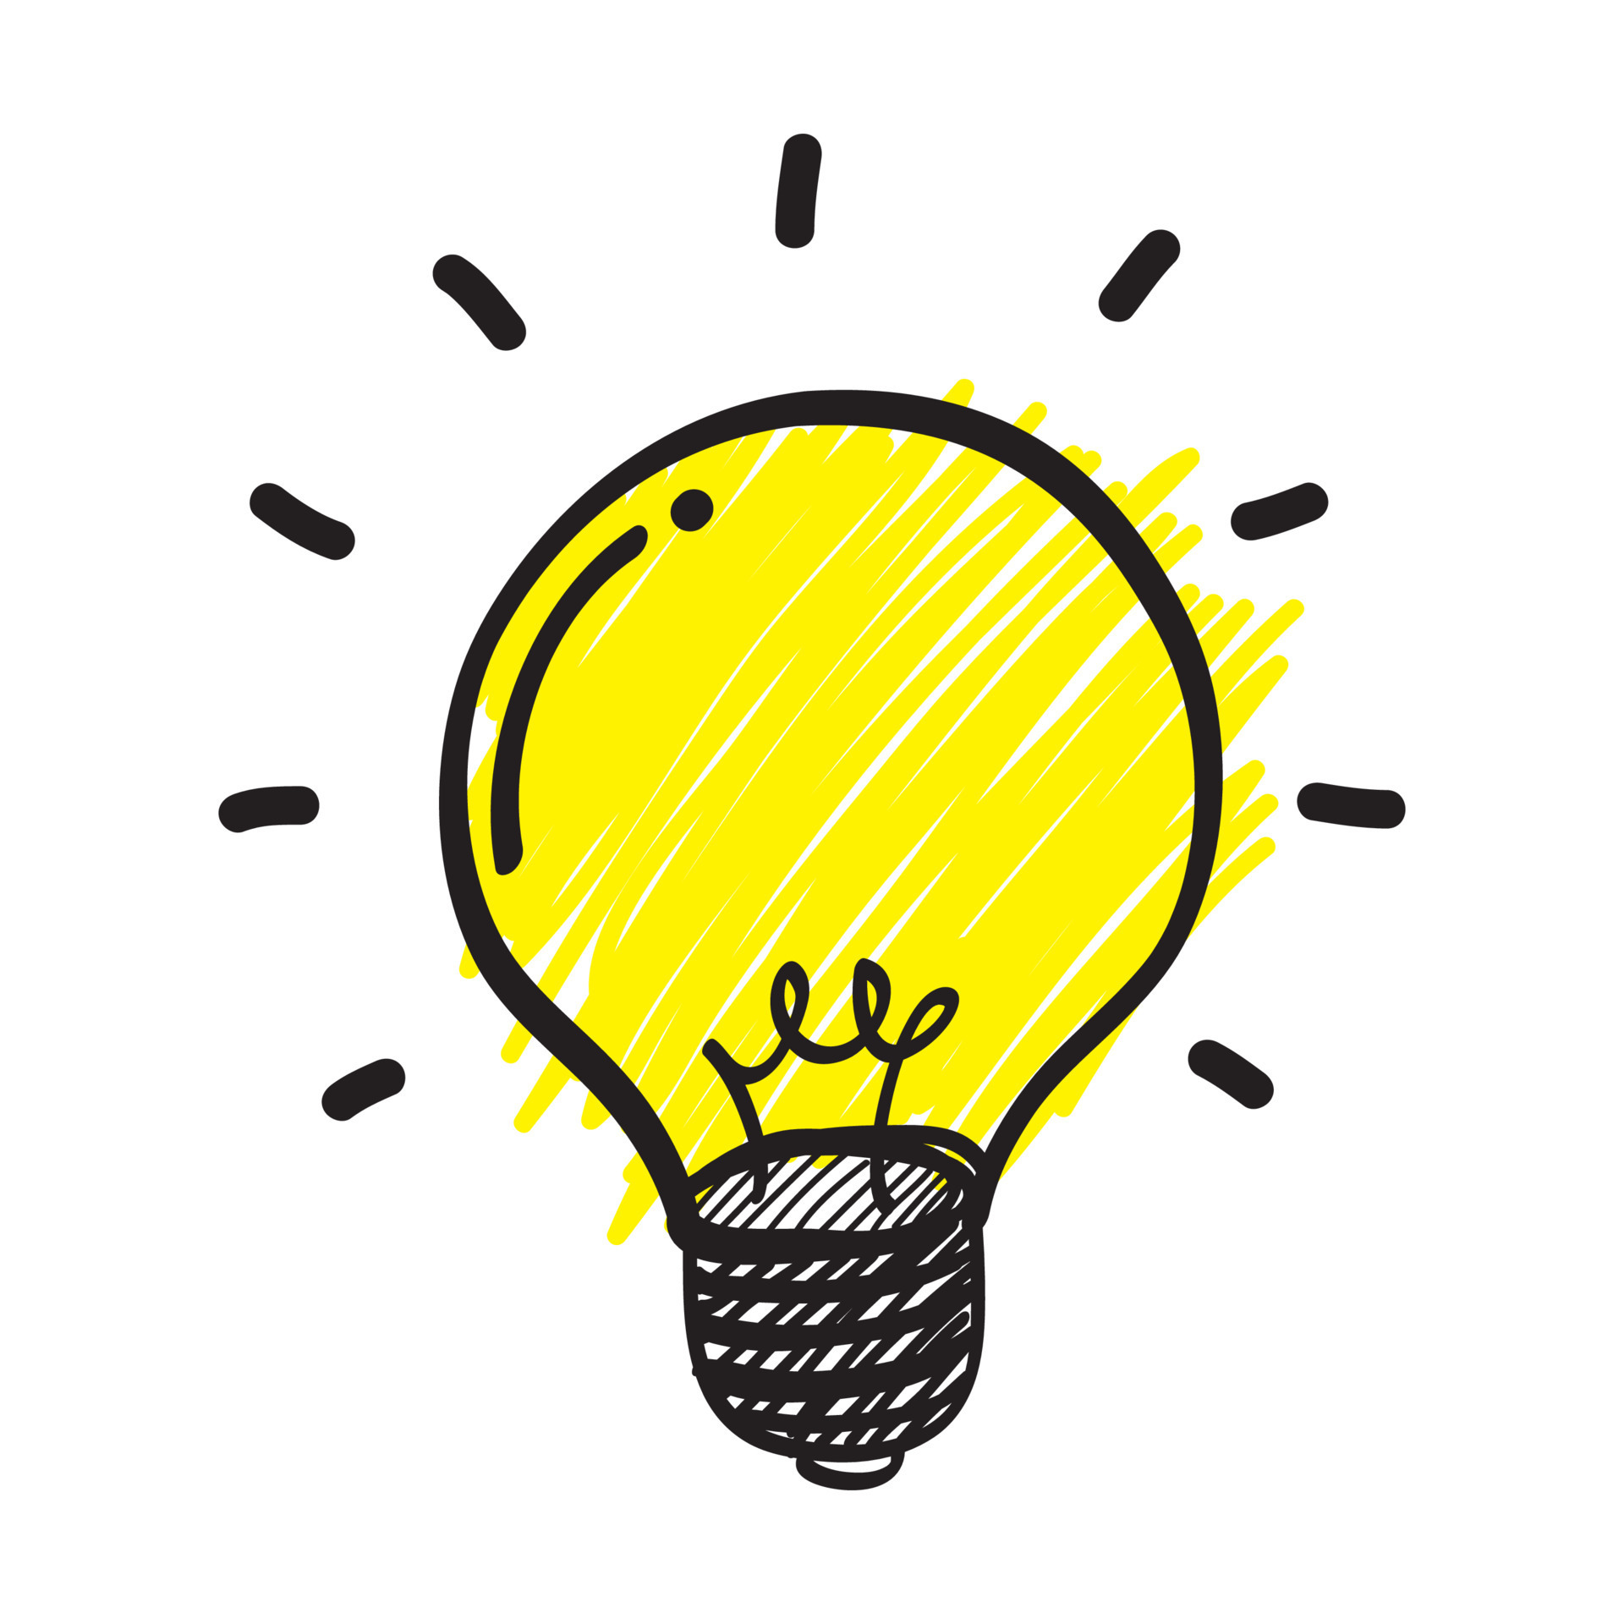
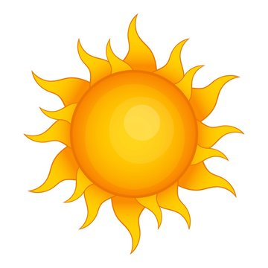
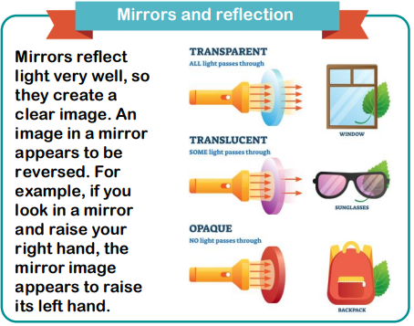
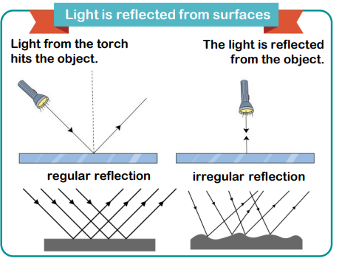
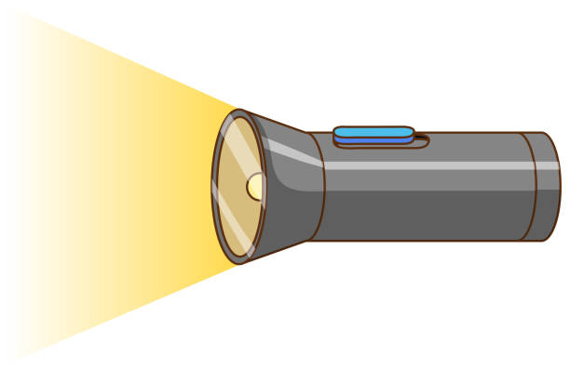
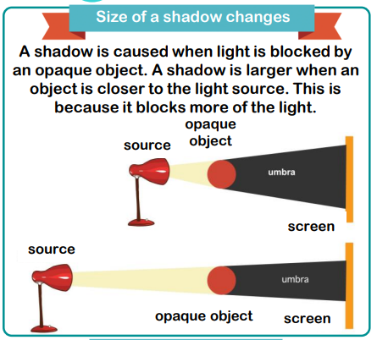
KNOWLEDGE ORGANISER
Light
ESSENTIAL PLANTS VOCABULARY
light | a form of energy that allows our eyes to see
reflect | the process that describes light bouncing off a surface
Vitamin D | a vitamin that come from sunlight or food and important for bone strength
ultraviolet rays | type of light that can be harmful
fluorescent | gives a highly visible reflection of light
high visibility | can be seen easily
shadow | a dark image that is formed when an object blocks the light
ray | a thin beam of light
cast | to throw or project
position | where something is placed
shape | the outline of something
puppet | a doll that looks like a person or an animal
temperature | how warm or cold something is
respire | to breathe
balanced | in good proportion
Key Facts
We need light to be able to see things. Light travels in a straight line. When light hits an object, it is reflected (bounces off). If the reflected light hits our eyes, we can see the object. Some surfaces and materials reflect light well. Other materials do not reflect light well. Reflective surfaces and materials can be very useful. Remember the Sun can be dangerous.
MAKING LINKS TO PREVIOUS LEARNING GOLDEN VOCABULARY
Seasonal Change (Y1) | In Summer, the temperature tends to be warmer.
Living things and their habitats (Y2) | All living things need to respire in order to survive.
Living things and their habitats (Y3) | To be healthy, you need to eat a balanced diet.
© Vocabulary Ninja Ltd 2021

