Slide 1

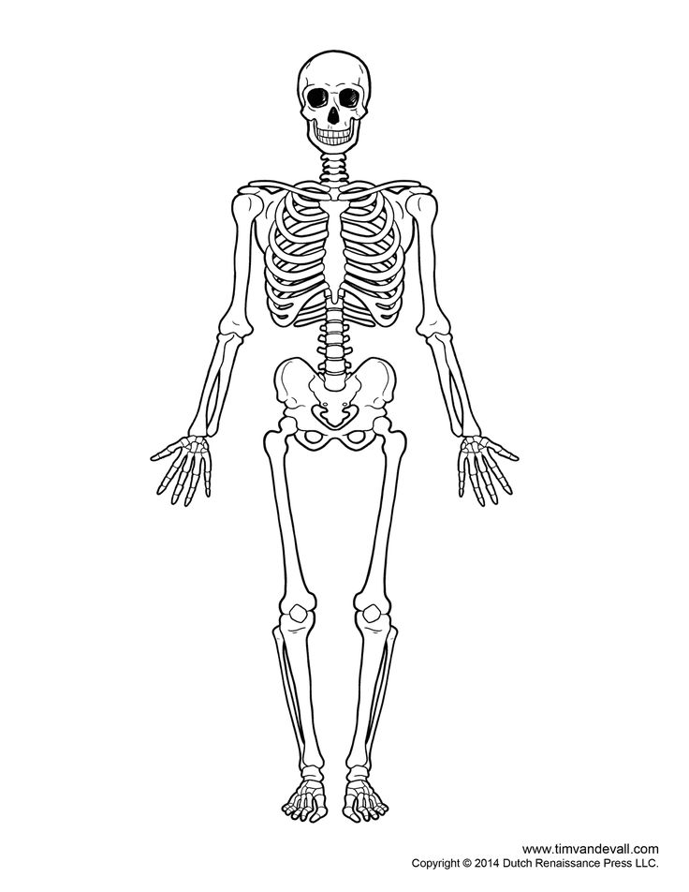

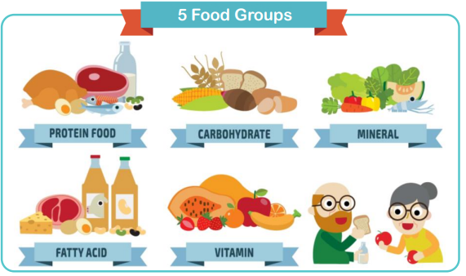
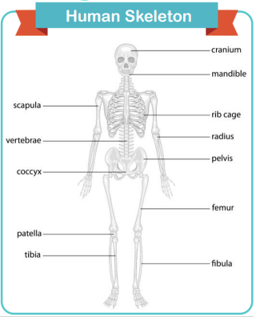
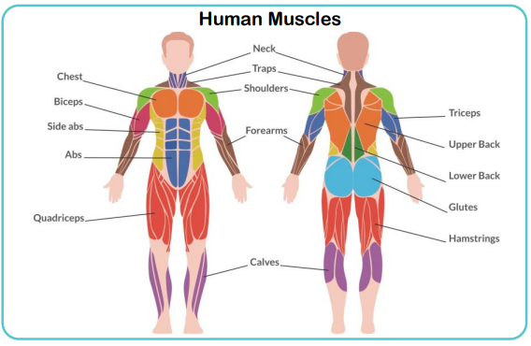
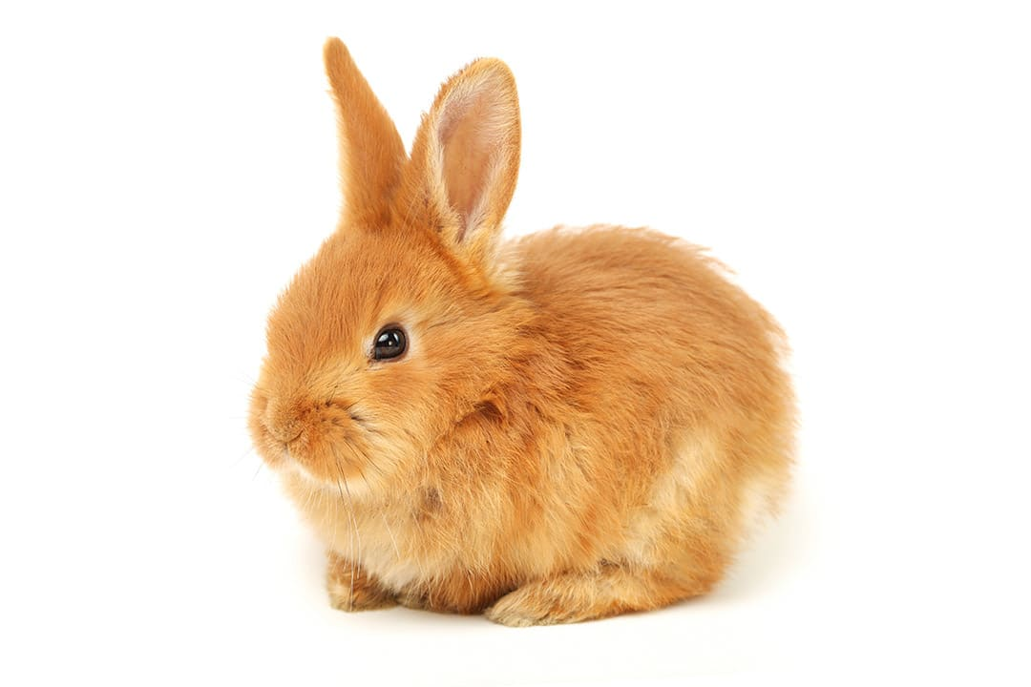
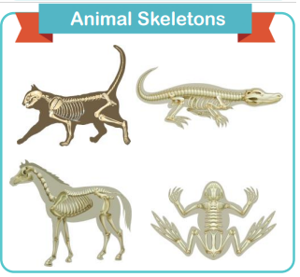
Animals, including humans
KNOWLEDGE ORGANISER
ESSENTIAL PLANTS VOCABULARY
vitamin | found in foods and are essential for the body’s growth, repair and building immunity
mineral | found in foods and help build strong bones and teeth
nutrition label | gives information about what the food contains
balanced | in good proportion
endoskeleton | animals with skeletons inside their body
exoskeleton | animals with skeletons outside their body
radius | one of the bones found in the lower arm
tibia | one of the bones in the lower leg
rib cage | the structure of bones protecting the lungs and heart
spine | the structure of bones that runs up the centre of the back
hamstring | muscles that run down the back of the le
biceps | muscles found in the upper arm
life cycle | a diagram showing the changes of a living thing
offspring | the child, or young, of an animal or plant
reproduction | the process of producing offspring
MAKING LINKS TO PREVIOUS LEARNING GOLDEN VOCABULARY
Animals, including humans (Y2) | Every living thing has a life cycle.
Animals, including humans (y2) | A mother looks after her offspring.
Animals, including humans (Y2) | Reproduction links to offspring.
© Vocabulary Ninja Ltd 2021

