Slide 1

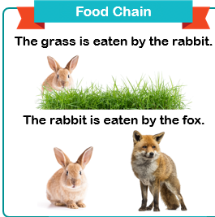
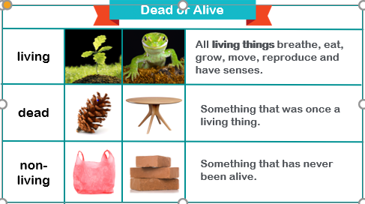
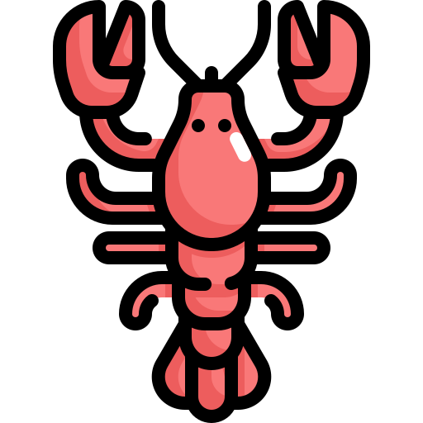
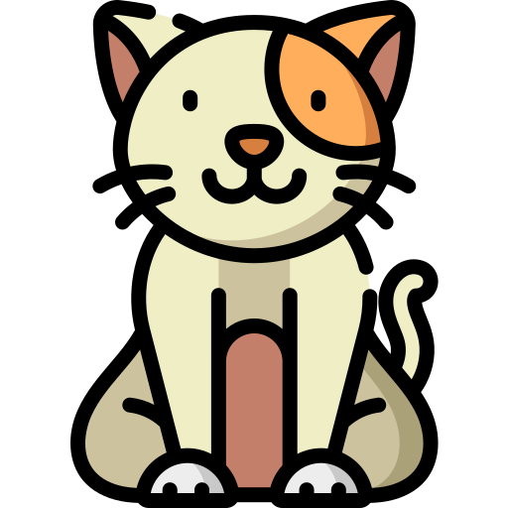

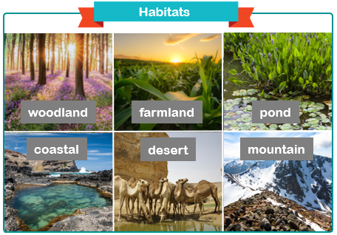
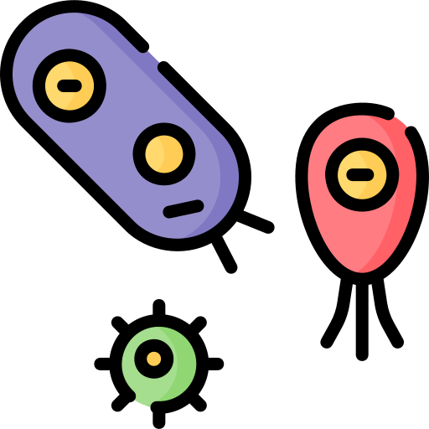
Living Things and Habitats
KNOWLEDGE ORGANISER
ESSENTIAL LIVING THINGS AND HABITATS VOCABULARY
reproduce | to create young, offspring or babies
excrete | to get rid of unwanted substances from the body
respire | to breathe
habitat | the natural place where an living thing can survive
microhabitat | a small natural area where a living thing can survive, found within larger habitats
survive | to remain alive
producer | a plant at the start of a food chain
consumer | a living thing that eats other living things
reproduce | to create young, offspring or babies
mammals | A warm-blooded vertebrate that typically gives birth to live young.
species | A group of living organisms consisting of similar individuals.
minibeast | A small creature that lives within a habitat, producing a microhabitat
classify | To arrange a group into categories based on qualities.
absorb | Take in or soak up substances
Classification
A Swedish scientist called Carl Linnaeus published a system for classifying living things which (after being adapted) is still used today. The number of living things on each level lessens, until it is the only species remaining.
Plants
There are many different types of plants. Flowering plants (plants that produce seed within a fruit to reproduce) Non-flowering plants (plants that use spores to reproduce and plants that use seeds to reproduce)
Microorganisms
Microorganisms are mainly bacteria, moulds, yeast and viruses. They are miniscule living things that can only be seen using a microscope. Microorganisms are found in and on our bodies, water and on many other objects. Some are helpful (bacteria in yoghurt and cheese and yeast in bread dough) and others are harmful (viruses like flu fungi such as mould).
MAKING LINKS TO PREVIOUS LEARNING GOLDEN VOCABULARY
Mini-beasts | There are many different minibeasts that live in different habitats.
Mini-beasts | Mini-beasts is a broad term. They can be classified into groups.
Materials | Some materials absorb liquids
Living Things Growth | The lifecycle of a living thing from reproduction to death

