Slide 1

Welcome to Year 2

Slide 2
The Year 2 Team
Mrs Bonney: Class Teacher
Mrs Kime: Learning Assistant (Weds- Fri AM)
Miss Appleton: Learning Assistant (Mon, Tues, Weds PM, Thurs PM)
Mr Goulding (Sports coach)

Slide 3
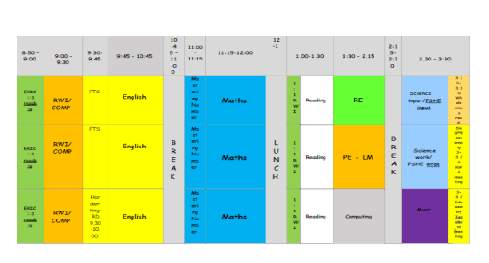
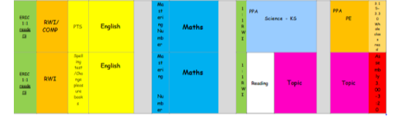
Timetable

Slide 4
Expectation
Children to wear full school uniform (policy on website) with book bags only
Hair tied back, no earrings
Following School rules.
Come to school dressed in PE kit for ALL weathers on a Tuesday and Thursday.
Ensure independence.
MAGIC children - Encourage children to have high aspirations for this year!
Golden rules established in class/around school. Behaviour policy online highlights rewards and sanctions (cover this later)
Handwriting and presentation expectations are high
To be equipped for the school day- Reading record, reading books, water bottle, snack.

Slide 5
Expectations
Morning & afternoon routine in place to consolidate skills and provide further support/challenge if needed.
Classroom environment encourages independence, provides a calm environment without too many stimulants and celebrates learning.
No pencil cases. Everything has been provided by school and allows them to be more independent by having minimal stationary.

Slide 6
MAGIC Children
DOJOs
Certificates
VIP
Cookie Bear
Behaviour:
Positive reinforcement
Name said in class/teacher look
Verbal warning
Initials on the board
Miss break time
Yellow cards
Sanctions- Reward days
Red and yellow cards
Sports competitions- competitive- help with lifts.

Slide 7
Worry box
Children are able to write down worries and adults check these regularly

Slide 8
Points to note:
Writing in print – precursive when ready – not an expectation for expected standard
Long term plans- online.
Groups- English and Maths places.

Slide 9
Independent Learners
In Year 2 your child should be able to:
Leave parents in the morning and come into school when the door opens
Remember to bring their reading books and record in daily
Look after their belongings- it is their responsibility to look for them if they are lost
Look after school books that are brought home
Return them every Friday to be changed

Slide 10
SEND
Mrs Hollman is the school SENDCO- works Wed-Fri
SENDCo time is a Wednesday.
Adaptive and quality first teaching is for every child within school.
All children are taught within the classroom by their class teacher.
All children need to socialise with their peers and working in isolation does not provide this.
Less children are able to receive funding for individual support and this support is to support the individual with their peers.
Any child who has funding, the first £6,000 is provided by the school and we must explain exactly how that funding is used to enhance the learning of the individual.
Lots of our children have interventions in place to boost their learning. Some of these include: RWI 1:1, daily reading, IDL, Beat Dyslexia, CEW practice, handwriting practice, sensory diets/exercises
SEN register includes all children who: have an external agency involved, are 2 years academically behind their peers, have a diagnosis.
If you have concerns: speak with the class teacher, plan out steps together and re-meet to discuss progress, if necessary Mrs Hollman can then become involved if the class teacher deems it necessary.
SEN Support plans are reviewed every term with SMART targets in place.

Slide 11

What is adaptive teaching?

Slide 12
Homework
Reading-3 times a week and signed in home reading record-This will be checked daily
Book bag book, RWI books, ORT and pleasure books are all changed on a Friday
Numbots-completed online- -TTRS will be allocated when your child is ready to learn multiplication tables
Phonics practise/spellings

Slide 13
Reading
Your child’s books will be changed once a week.
Listened to read 1:1 by Teacher or TA (will be recorded in their reading record)
Book bag book, RWI, ORT and pleasure books will be changed every Friday
It is important that the children have an understanding of what they are reading
Now reading a whole class text at the end of the day. This is to develop children’s ‘love’ for reading. Also give time to share books the children have enjoyed – adapt our class library based on this
Try to read books, magazines, newspapers together at home too

Slide 14
Equipment
Reading book & reading record-this should be in school every day.
PE If your child cannot do PE a letter must be sent in.
Bags should only be book bag size NO bigger-these will be sent home.
Water bottles should only contain water.
Piercings must be covered up.
Hair must be tied back (boys and girls) using blue/dark bobbles/bows.
Please label all uniform, especially jumpers, cardigans and BOTH trainers.

Slide 15
Water bottles and snack
CLEAR Water bottles- on the trolley, just outside the classroom. No juice allowed.
If a child needs a water bottle in class (for medical reasons), please speak to a member of the Y2 team.
Children can bring in fruit or toast for morning playtime.
In KS1 the children do have access to free fruit daily.
Milk- if you have paid for your child to have milk, they will have this at morning playtime.

Slide 16
Trips
3 trips across the year.
1 RE- In Autumn 2, we will visit Liverpool Cathedral
Spring term we will visit the Beatles Museum
Summer term we will visit Formby or Crosby Beach - TBC
We will book ASAP!
All trips are published on School Spider

Slide 17
Working together
You can contact us by:
Send an email via the school office email- these do get emailed straight to us. Please do not use teacher’s personal emails.
Making an appointment via the office.
Parents evening.
Please try not to ask questions first thing in a morning.
Updates should be available via the school app and website.
We will endeavour to return any calls/messages within 48 (working) hours

Slide 18
Working together
We all want what is best for your children. If you can help us in any way
A spare half hour, half a day or a full day?
Good at art and craft?
If you can help us with any of these things please let us know.
We always have lots of ways of using an extra pair of hands!

Slide 19
Absences
New national framework for penalty notices for school absences.
We have seen a rise in the number of unauthorised absences being taken (especially through holidays): we have more than the Local Authority average and over half our children classed as persistently absent (90% and below) have taken unauthorised absences through holidays.
All holidays will be unauthorised.
Must have proof of any appointments, otherwise this will also be unauthorised. Can be a text message, letter, appointment card
Mild illness (sore throats, colds, etc.) please send them in. We will always call home if we feel they have deteriorated.
48 hours for vomiting and diarrhoea.
Try to make appointments outside school hours
Mr Taylor from the high school EWO

Slide 20
Dates for your diary
Wednesday 25th September Rec & KS1 reading workshop for parents 5.30
Thursday 14th November: Individual and sibling photographs
Wednesday 18th December 9.30 AM KS1 Nativity
Wednesday 18th December 2.30PM KS1 Nativity
Week Commencing Monday 9th June: Phonics screening check week (Retest for Y2 children)
May – Y2 assessments (date TBC)
Wednesday 11th June: Class photograph day
Wednesday 18th June: Sports day
Wednesday 25th June: Reserve Sports day

Slide 21
FOBL
Friends of Brook Lodge help with our school funds in lots of different ways: subsidise coach fees on trips, new playground equipment, Reading books-constantly need updating due to lots of books not being returned.
If you can help in any way?
Ideas, volunteering at events, buying stock for events, asking and collecting donations for raffles. Any help at all, really does help. You can pass your email addresses/mobile numbers on to Mrs Eden.

Slide 22
Twitter/X
@BLclassof2030=Y1
@BLclassof2029=Y2
@BLclassof2028=Y3
@BLclassof2027=Y4
@BLclassof2026=Y5
@BLclassof2025=Y6
@BLclassof2031=Reception
@BLclassof2032=Tadpoles

Slide 23
Any Questions?

