Slide 1
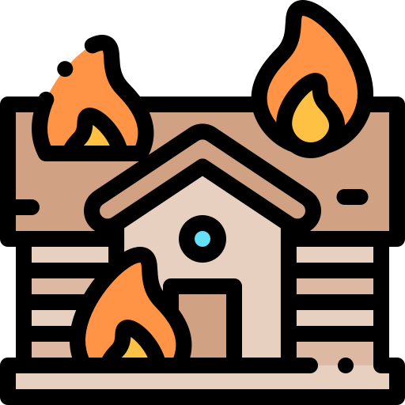










Great Fire of London
KNOWLEDGE
ORGANISER
ESSENTIAL GREAT FIRE OF LONDON NAME VOCABULARY
timber | Wood used for building or carpentry.
diary | A book that people write about their lives in.
building | A structure with a roof and walls.
Christianity | The religion based on the person and teachings of Jesus Christ..
reconstruct | Rebuilding something that has been demolished.
spread | Extending over a large area.
douse | To pour liquid over or extinguish something
bakery | A place where bread, cakes, etc. are made.
extinguish | To put out a fire.
lifetime | The period of time someone has been alive.
fire brigade | A group of people trained and employed to put out fires.
primary source | A first-hand account or piece or an object created at the time of the event.
capital | The city where the government of the country functions.
population | Population is the extent to which a place is populated or inhabited
Sunday 2nd September 1666 | Monday 3rd September 1666 | Tuesday 4th September 1666 | Wednesday 5th September 1666 | Thursday 6th September 1666
The fire starts at 1am. Samuel Pepys starts his diary. | The fire approaches the Tower of London. | St Paul’s Cathedral is destroyed by the fire. | The wind dies down and the fire starts to spread more slowly. | The fire is extinguished. Many people are left homeless.
When and Where Did it Start?
It started in a bakery on Pudding Lane on 2nd September 1666.
How was the Fire Fought?
People used leather buckets filled with water to fight the flames.
What Happened After the Fire?
Thousands of people were left homeless and many of them left London to live elsewhere. A fire brigade was set up to stop a fire destroying the city again. Houses were build further apart and made from stone. instead of wood.
They also used axes, fire-hooks and gunpowder to make fire breaks.
Fun fact! Some people buried their belongings underground to keep the safe.
Why did it Spread?
It hadn’t rained for months, which meant that the city was very dry. Many houses were also built from wood and were very close together. There was also no fire brigade,
How was the Fire Put Out?
After four days, the wind died down and changed direction.
St. Paul’s Cathedral
During the fire, St Paul’s Cathedral was destroyed. People reported seeing the roof tiles melting in the heat. After the fire, the cathedral Was reconstructed in the same location. This was actually the third time it had been seriously damaged by fires!
This meant that the fire could finally be put out!
Fun fact! Sir Christopher Wren designed a monument to remember the Great Fire of London.
MAKING LINKS TO PREVIOUS LEARNING GOLDEN VOCABULARY
Europe topic | Population is the extent to which a place is populated or inhabited
Our Country topic | A country is a nation with its own government
Our Country topic | The capital of the UK is London
Toys | Primary sources are. a first-hand account or piece or an object created at the time of the event.
Key People
Thomas Farriner | The fire started in Thomas Farriner’s bakery, as a bakery oven was left unattended.
Samuel Pepys | Samuel Pepys recorded the events of the fire in a diary. This is how we know the details of the event.
King Charles II | Charles II was the King of England. After the fire, he ordered houses to be built further apart.
country
A nation with its own government.

