Slide 1

Welcome to Year 6
Meet the Teacher 2026/27
Tuesday 8th September 2026
15:00 & 17:15

Slide 2
We are a church school and a village school. We are extremely proud of our school, our children and their success in all aspects of school life.
Our school is a place of education where a love of learning and life is nurtured, where standards are high and where partnerships enhance our achievements.
We hold strongly to our founding principles and values as a Church School and our place within a very special village community
Our school's vision
I came that they may have life and life in all its fullness. (John 10:10)
We will be a village school which provides an outstanding, rich and broad curriculum in our caring, Christian environment. We aspire for all to reach out to the wider community and world, as they achieve their full potential academically, socially, culturally and spiritually.
Our school's mission
And now these three remain: faith, hope and love. But the greatest of these is love. (Corinthians 13:13)
We celebrate all successes in our happy, inclusive and aspirational school. Our mission is underpinned by our Christian values: forgiveness, thankfulness and respect. These values are overarched by love.

Slide 3
Impact Curriculum
The IMPACT Curriculum at Turton Edgworth CE/Methodist Primary School
I-nclusive
M-ade to measure
P-rogressive
A-spirational
C-uriosity
T-urton Edgworth!
We have written our own bespoke curriculum at Turton Edgworth in order to ensure we meet the needs of our children and this unique community. The IMPACT Curriculum began with our own vision and mission statements and The National Curriculum and meets all the requirements of this; however, it is much more ambitious in all subjects. All learning begins in the EYFS.
We highlighted subjects in which had the strongest skillsets and combine the use of well-researched schemes of work and the knowledge of highly skilled leaders in school to ensure fidelity whilst creating a curriculum that delivers a positive IMPACT for our children.
The IMPACT Curriculum is sequential and progressive to ensure we have curious learners rooted in asking questions and finding solutions – it builds on children’s prior knowledge and experiences. The IMPACT Curriculum also takes into account our locality, and this is a golden thread throughout. It promotes a holistic approach to learning and growing (academically, socially, culturally and spiritually), is inclusive, accessible to all and delivers high quality teaching, learning and experiences resulting in high outcomes for learners.

Slide 4
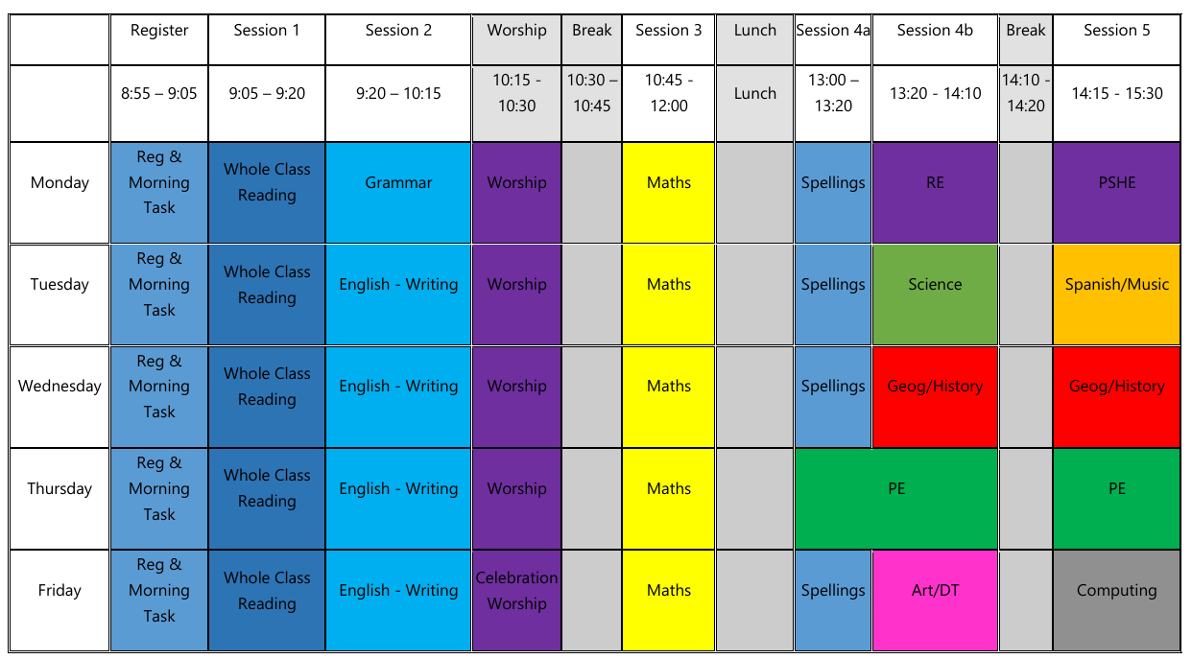
Our timetable

Slide 5
Attendance
As you all know, there has been a HUGE national push on this from the DfE since covid
Outstanding attendance and punctuality is essential in ensuring children reach their full potential
Please look at the “Attendance and minor illness” page on our website for more information: https://www.turtonandedgworthprimary.co.uk/page/attendance-minor-illness-and-leave-of-absence-requests/133825
DfE state that anything below 95% is “cause for concern” and below 90% is actually classed as “persistent absenteeism”
Headteachers are REQUIRED to speak with families in these instances
  In addition, ALL children’s registers will be sent home termly so families can keep up to date with their child’s attendance percentage

Slide 6
Punctuality
Being in school on time every day is essential for children to have a calm and settled start to their day
School doors are open between 8:50am-8:55am in order to try and support a reduction in congestion/traffic
After 8:55, please accompany your child in through the front entrance and sign them in using the electronic system. This is then marked in the register.
Illness
Most of our staff are also parents, so we understand that children can be ill and/or can complain of headaches/tummy aches – especially in the mornings!
Advice is to send children into school with minor ailments (tummy ache, headache, etc). If they’re unwell, school can send home
Main exceptions to this rule being (all NHS guidelines):
  Sickness (only return to school 48 hours after the LAST BOUT)
  Diarrhoea (only return to school 48 hours after the LAST BOUT)
  Impetigo (only return to school 48 hours after beginning antibiotics)
  Chicken pox (only return to school once the blisters have crusted/scabbed

Slide 7
Reading
Reading will continue to be taught through whole class teaching with some children doing additional group or individual reading sessions.
In Year 6 we try to raise the level of engagement with reading anything at all, not just school reading books.
We have decided to move away from the standard Reading Record as we have found that many are not used in KS2. We have decided to use a small note book as a way of keeping a list of books read and for the children and adults to note down what page the children are up to. These will also include some generic spelling/grammar information for reference through the year.
Reading books and Library books will continue to come home and we would be grateful if you could encourage reading at any level at home, either by your child reading to you or you reading to your child.

Slide 8
Reading Books
Reading is always a priority in school and we work hard to make sure that the books are pitched at the correct level for your child.
This may mean that sometimes your child may need to re-read a book/set of books throughout the year. We do not see re-reading as a negative, in fact we actually see it as beneficial as it helps to deepen understanding and positively impact progress. This is something which we share with the children regularly.
Re-reading helps to build fluency, automaticity and understanding, all of which are important skills that play a huge part in developing confident readers who can discuss and understand a variety of texts.
If your child is working through our specific fluency books they will read 2/3 chapters a week in school and it would be helpful if could ensure that they re-read those chapters again at home instead of reading ahead in the book. We do extensive preparation before each chapter to support children’s reading and comprehension, which is why re-reading at home is especially valuable.

Slide 9
Reading/Library Books
To ensure that our children have engaging books suitably matched to their correct level, it is important that we keep on top of our book stock.
📱 Lost or damaged books: You will be informed via text if a book is missing. We understand that it may simply have been forgotten at home, so please check before assuming it is lost.
Lost or damaged books will be charged at £5 directly via Arbor.
🛡️ Please help us protect books: Consider providing your child with a plastic reading folder. We have had many books damaged when water bottles have leaked inside school bags.
Thank you for helping us to look after our reading books and keep our stock available for everyone.

Slide 10
Spelling
In spelling, we aim to teach children how to spell accurately and identify mistakes, rather than simply learning lists of words they may rarely use or remember.
If you would like to support your child at home, the spelling overview for each half term can be found on the Year 6 class page in the Knowledge Organiser section.

Slide 11
Homework
We are adopting a new approach to homework that focuses on reinforcing the important key skills used across a variety of subjects.
Homework will focus on 3 core skills:
Reading
Spelling (key words and vocabulary, rather than spelling lists)
Multiplication tables
“Reading is the gateway for children that makes all other learning possible” – Children’s reading fluency helps with EVERY subject.
Analysis of children’s writing and spelling, across all subjects, has led to this change to improve overall structure
Multiplication – and related division – helps children to flourish in all areas of mathematics

Slide 12
Year 6 Homework
Reading (a school reading book, a Library book and/or a books at home) | Encourage reading every day Please encourage your child to record ALL reading in reading record
Spellings - | Pathways to Spell Year 6 Statutory Spellings Tested in school at random
Maths | Times Tables Rock Stars
SATs Specific | Learning By Questions

Slide 13

Year 6 Information
Uniform
Uniform: White shirt, tie, jumper/cardigan/hoodie with school logo, grey trousers/shorts, grey skirt, white socks, black shoes (no trainers).
Hair - children with shoulder length hair must tie it back. Staff will have bobbles in school if children forget so please don’t worry.
PE kit: Friday plus additional ad hoc days
Purple t-shirt, black shorts, black plimsolls/trainers for outdoors. Joggers and a jacket can be worn during colder months.
Children should ensure they wear their PE kit to school on PE days.

Slide 14
SATs
Year 6 SATs in England for 2026 will take place from Monday 10th May to Thursday 13th May 2027.
The tests assess pupils' reading, writing (spelling, punctuation, and grammar), and mathematics skills and are administered during normal school hours under exam conditions.
Key Dates:
Monday 10th May 2027: English Grammar, Punctuation, and Spelling (Papers 1 and 2)
Tuesday 11th May 2027: English Reading
Wednesday 12th May 2027: Mathematics (Papers 1 and 2)
Thursday 13th May 2027: Mathematics (Paper 3)

Slide 15
SATs
SATs are an opportunity for children to show what they know and can do.
We will prepare thoroughly in school through high-quality teaching, revision, practice questions and familiarisation with test formats.
🏫 In school, we will:
Continue to revisit and secure key Year 6 knowledge and skills.
Practise arithmetic, reasoning, reading and grammar regularly.
Use past SATs-style questions to develop confidence with different question types.
Teach children strategies for checking, managing time and tackling tricky questions.
Provide additional support and targeted intervention where needed.
Help children develop a positive and resilient attitude towards the tests.
🏠 At home, little and often is best!
Encourage your child to read regularly and talk about what they have read.
Practise times tables and key number facts.
Revisit spellings and grammar in short, manageable sessions.
Avoid putting pressure on children – confidence, sleep and wellbeing are just as important as revision.

Slide 16
SATs
Useful websites
GOV.UK – KS2 SATs information & past papers
KS2 National Curriculum Tests
SATs Papers.com – user friendly exam paper resource
www.sats-papers.co.uk
Oxford Owl – SATs advice and practice
Oxford Owl KS2 SATs
White Rose Maths – free Year 6 resources
White Rose Maths resources
Topmarks – Maths games and mental maths practice
Topmarks Maths Games
Topmarks – Hit the Button
Hit the Button
Maths Bot – Multitude of Maths Resources
mathsbot.com
⭐ Remember…
SATs are only one part of your child's journey.
Our aim is to help every child feel prepared, confident and proud of their progress.

Slide 17
Year 6 Information
PPA – Thurs PM
PE – Delivered by Miss Williams from Key PE Sports
Daily Healthy Snack (preferably fruit or veg) and a water bottle
Optional Tuck shop: Wednesday, Friday
Toast, Pancakes, Croissant, Milkshake etc

Slide 18
Year 6 Highlights
Bikeability – Friday 9th and 16th October
Parents’ Evenings - Tues 24th November 26 & Tues 23rd March 27
Robinwood Residential – Weds 17th – Fri 19th March 2027
Year 6 Production – Tues 13th July 14:00
Weds 14Th July 17:30

Slide 19
It’s your birthday? Then you can come to school in non-uniform!
Staff want to help mark children’s birthdays in school by allowing them – if they want to – to come to school in non-uniform on their birthday!
If your child has a birthday on a Saturday or Sunday, they are allowed to come to school on the Friday in non-uniform
If your child has a birthday during a school holiday (lucky!), then they are able to come to school in non-uniform on the last day of term before the holiday begins.
This is just a bit of fun for the children and they absolutely do not have to come in non-uniform if they don’t want to. We may even let the staff do it too!

Slide 20
How can you help? – Summary
Encourage children to read as much as possible
Promote independence
Reinforce the importance of appropriate behaviour for school
Ensure uniform is correct and clearly labelled
Talk to us - keep school informed of any changes in your child’s circumstances which may affect their learning.

Slide 21
Home-School Communication
If you have a questions or concerns relating to teaching and learning, no matter how big or small, please contact me in the following ways:
*Face to Face
*Email (office@turtonedgworth.blackburn.sch.uk)
*Reading record/note
*Phone message at the office
We kindly ask that any questions or uncertainties are checked with school directly, rather than shared on social media/messaging platforms, so everyone can be in receipt of the correct information

Slide 22
Home-School Communication
Class Teacher
Mr Darby
Key Stage Leader
Miss Valentine
Head teacher
Mr Wheatley

Slide 23
Thank you
Any questions?

