Slide 1
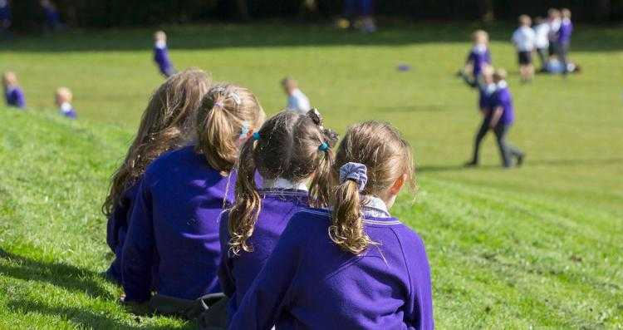
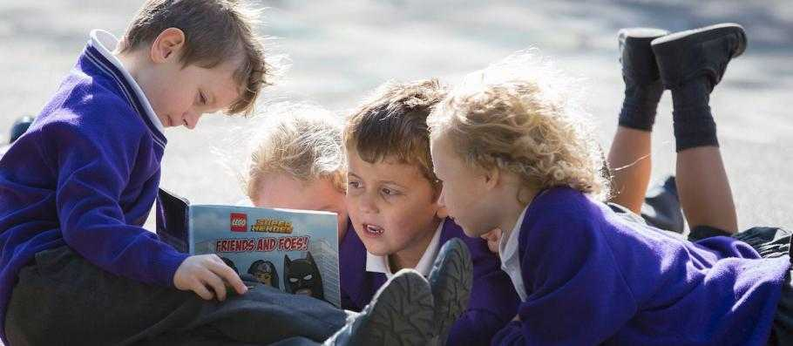
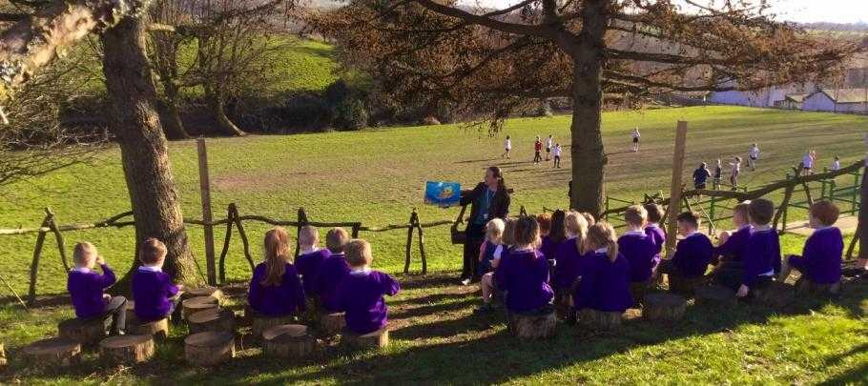

Welcome to Year 3
Miss Valentine

Slide 2

Who is who?
Miss Valentine
CLASS TEACHER
Mrs Sears
CLASS TEACHER- Mondays

Slide 3
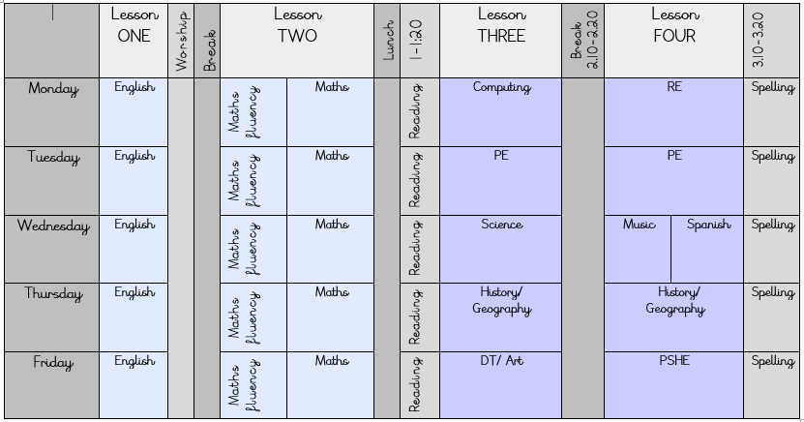
Timetable

Slide 4
Being in Year 3
Changes for your little one:
Tuck shop days- Monday, Wednesday and Friday
PE day- Tuesday
Spanish
Uniform- shirt and tie
Junior playground
Lunch times

Slide 5
Homework
Homework across the whole school will look a little different this year:
- Spellings
- TT Rockstars
- Reading (fluency focus similarly to Year 2)

Slide 6
New whole-school approach to homework & spelling
We are adopting a new approach to homework that focuses on reinforcing the important key skills that are used across a variety of subjects. From this year, all homework will focus on 3 core skills:
  Reading
  Spelling (key words and vocabulary, rather than spelling lists)
  Multiplication tables
“Reading is the gateway for children that makes all other learning possible” – children’s reading fluency helps with EVERY subject. (Also, refer to slide about the importance of ‘re-reading’ books)
Analysing children’s writing and spelling, in all subjects, has led us to do research on the best ways to improve overall structure
Multiplication – and related division – helps children to flourish in all areas of mathematics

Slide 7
Spellings
• This year we have made a change and spellings will be based upon the 300 HFW.
Why?
• High-frequency words are the words that appear most often in printed materials. Students are encouraged to recognize these words by sight, without having to “sound them out.” Learning to recognize high-frequency words by sight is critical to developing fluency in reading. Students should be able to read these words individually and in sentences and stories.
• Automatic recognition of high frequency words provides an essential starting point for your child becoming a confident reader. It is important to note that
• 12 high frequency words make up 25% of words we read and write.
• 100 high frequency words make up 50% of words we read and write.
• 300 high frequency words account for 75% of words we read and write.
• They may seem easy but they are very important and we are finding that many children are still not confident in these and do not class themselves as “good spellers”
• Spelling anxiety with homework and tests.
• Spelling WILL still be taught and assessed during lessons as we do with other subjects.
• We ask if you could help in the learning of these words and we have broken them down to 6 words each week with some repetition throughout the year to ensure they are fully embedded into the children’s long term memory.

Slide 8
Reading Books
Reading is always a priority in school and we work hard to make sure that the books are pitched at the correct level for your child.
This may mean that sometimes your child may need to re-read a book/set of books throughout the year.
Re-reading helps to build fluency, automaticity and understanding all of which are important skills that play a huge part in developing confident readers who can discuss and understanding a variety of texts.

Slide 9
Reading/Library Books
A note from Mrs Waddington:
To ensure that our children have books which are engaging and are
pitched correctly it is important that we keep on top of our book stock.
This is why lost/damaged books will be charged at £5.
You will be informed of a missing book via a text as we understand it could just be that you have forgotten it.
Damaged books will be a straight fine via text/email.
Please do consider protecting your child’s book with a plastic reading folder as we have had many damaged through water bottles leaking in bags.

Slide 10
It’s your birthday? Then you can come to school in non-uniform!
Staff want to help mark children’s birthdays in school by allowing them – if they want to – to come to school in non-uniform on their birthday!
If your child has a birthday on a Saturday or Sunday, they are allowed to come to school on the Friday in non-uniform
If your child has a birthday during a school holiday, then they are able to come to school in non-uniform on the last day of term before the holiday begins.
This is just a bit of fun for the children and they absolutely do not have to come in non-uniform if they don’t want to. We may even let the staff do it too!

Slide 11

A final note from me…
I am so excited to take your children
on their next big adventure as they
move into the juniors at Turton and Edgworth.
I know this next big step might seem daunting but I promise that this year will be filled with so many wonderful experiences, exciting learning, magical memories and lots of fun filled adventures.
Are there any questions?

