Slide 1

Welcome to Year 4
Meet the Teacher 2025

Slide 2
Year 4 Staff
Miss Luttrell: Monday –Wednesday
Mrs Hayes: Thursday - Friday
Mrs French: Monday – Friday in year 4
Miss Avanzi: Part of each day in year 4
Miss McGuinness: Monday – Friday in Year 3 and 4

Slide 3
The school day
Start time- 8.55am
Being in school on time every day is essential for children to have a calm and settled start to their day
School doors are open between 8:50am-8:55am in order to try and support a reduction in congestion/traffic
After 8:55, please accompany your child in through the front entrance and sign them in using the electronic system. This is then marked in the register
Finish- 3.30pm
Year 3 and 4 children will be dismissed from their classes by an adult at the end of the day. Only brothers and sisters over the age of 14 should collect children and if another parent/carer is collecting your child, please let us know or inform the office.

Slide 4
Attendance
As you all know, there has been a HUGE national push on this from the DfE since covid. This is continuing this year.
Outstanding attendance and punctuality is essential in ensuring children reach their full potential
Please look at the “Attendance and minor illness” page on our website for more information:
DfE state that anything below 95% is “cause for concern” and below 90% is actually classed as “persistent absenteeism”
Headteachers are REQUIRED to speak with families in these instances
  In addition, ALL children’s registers will be sent home termly so families can keep up to date with their child’s attendance percentage

Slide 5
Illness
Most of our staff are also parents, so we understand that children can be ill and/or can complain of headaches/tummy aches – especially in the mornings!
Advice is to send children into school with minor ailments (tummy ache, headache, etc). If they’re unwell, school can send home.
Main exceptions to this rule being (all NHS guidelines):
  Sickness (only return to school 48 hours after the LAST BOUGHT)
  Diarrhoea (only return to school 48 hours after the LAST BOUGHT)
  Impetigo (only return to school 48 hours after beginning antibiotics)
  Chicken pox (only return to school once the blisters have crusted/scabbed

Slide 6
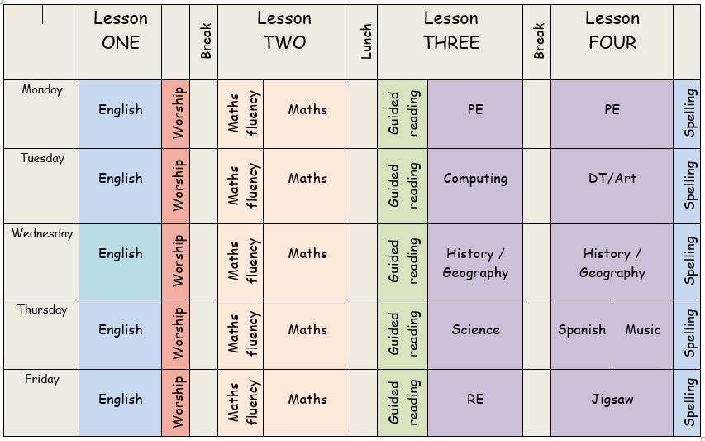
Timetable

Slide 7

Learning

Slide 8

Reading
Reading will continue to be taught through whole class teaching with some children doing additional group or individual reading sessions.
This year we are going to try and raise the level in engagement with reading school reading books. We are currently in the process of setting up a new reward system which will be shared once the final pieces of the puzzle are in place.
We have decided to move away from the standard Reading Record as we have found that many are not used in KS2. We have decided to use a small note book as a way of keeping a list of books read and for the children and adults to note down what page the children are up to. These will also have the HFW homework word list stuck in each half term. Some year groups lower down school will still have Reading Records.
Reading books and Library books will continue to come home and we would be grateful if you could encourage reading at any level at home, either by your child reading to you or you reading to your child.

Slide 9
Reading/Library Books
Reading is always a priority in school and we work hard to make sure that the books are pitched at the correct level for your child.
This may mean that sometimes your child may need to re-read a book/set of books throughout the year. We do not see re-reading as a negative, we actually see it as a positive to help deepen understanding and positively impact progress. This is something which we share with the children regularly.
Re-reading helps to build fluency, automaticity and understanding all of which are important skills that play a huge part in developing confident readers who can discuss and understanding a variety of texts.
If your child is working through our specific fluency books they will read 2/3 chapters a week in school and it is helpful if you re-read those chapters again at home instead of reading ahead in the book.
We do a lot of work prior to reading each chapter which underpins the children’s ability to read and comprehend the text they are about to work through hence why re-reading is more valuable to your child from a home perspective.

Slide 10
Reading/Library Books
To ensure that our children have books which are engaging and are pitched correctly it is important that we keep on top of our book stock.
This is why lost/damaged books will be charged at £5.
You will be informed of a missing book via a text as we understand it could just be that you have forgotten it.
Damaged books will be a straight fine via text/email.
Please do consider protecting your child’s book with a plastic reading folder as we have had many damaged through water bottles leaking in bags.

Slide 11
Spelling
Spelling of the HFW will continue to come home as they did last year. From monitoring the progress in children’s writing we have found that this has had a positive impact in improving standards.
This is only a small section of our spelling curriculum and we continue to teach the National Curriculum for each year groups spelling.
On each class page on our website, you will find a breakdown of the spelling rules which will be taught each week. There are also a list of example words to match the rule.
In spelling we aim to teach children how to spell and spot mistakes rather than a list of words which they may never use in their writing and are likely to forget as they are not applying them.
If you wish to help at home with your child’s spelling you can find the spelling overview for each half term on your child’s class page in the knowledge organiser section. Alongside this there are a list of ideas of how you can support your child at home with their spelling through games and activities.

Slide 12
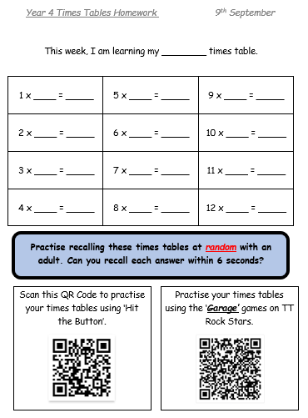

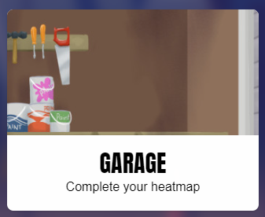
Times Tables

Slide 13

Multiplication Tables Check
By the end of Year 4 all children are expected to know their times tables up to 12 x 12 by heart
June 2026
25 questions
6 seconds for each question with a
3 second gap in-between each one

Slide 14
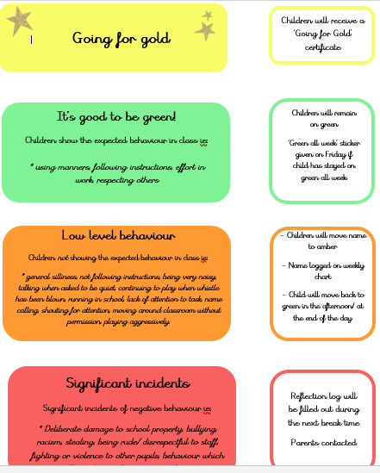
It’s good to be green!
Head Teachers Award
Dojo points
Green all week stickers
Star of the Week
Gold
certificates
Edgworth Authors

Slide 15
General information
Tuck shop: Monday, Wednesday, Friday
Healthy snack: preferably fruit/ veg. Bottles of water only please (no juice) in school.
Uniform: White shirt, tie, jumper/ cardigan with school logo, grey
trousers/ shorts, grey skirt, white socks, black shoes (no
trainers)
PE kit: School PE kit, black plimsolls. Joggers and a
jacket can be worn during colder months.
* All children will come into school in their PE kit.
* Plimsols should be left in school.
Hair- children with shoulder length hair must tie it up. Staff will have bobbles in school if children forget so please don’t worry.
- No toys or items from home in school.

Slide 16
General information
It’s your birthday? Then you can come to school in non-uniform!
Staff want to help mark children’s birthdays in school by allowing them – if they want to – to come to school in non-uniform on their birthday!
If your child has a birthday on a Saturday or Sunday, they are allowed to come to school on the Friday in non-uniform
If your child has a birthday during a school holiday (lucky!), then they are able to come to school in non-uniform on the last day of term before the holiday begins. For example, Autumn half-term is Mon 28th Oct – Fri 1st Nov, so on Fri 25th Oct (last school day) they would be able to come to school in non-uniform
This is just a bit of fun for the children and they absolutely do not have to come in non-uniform if they don’t want to. We may even let the staff do it too!

Slide 17

Home-School Communication
If you have a question or concern, no matter how big or small, please contact us in school.
*Reading record/note
*Phone call
*Email
*In person before or after school
Class Teacher
Key Stage Leader:
Miss Valentine
Head teacher:
Mr Wheatley

Slide 18
Thank you!
If you have any questions, please don't hesitate to ask.

