Slide 1


Welcome to Year 1
Gruffalo Class

Slide 2
Staff in Year 1
Miss Partington
Mrs Hegg
Mrs Hayes (Wednesday morning only)
Miss Williams (Wednesday afternoon only)
Mrs Sears (Thursday morning only)

Slide 3
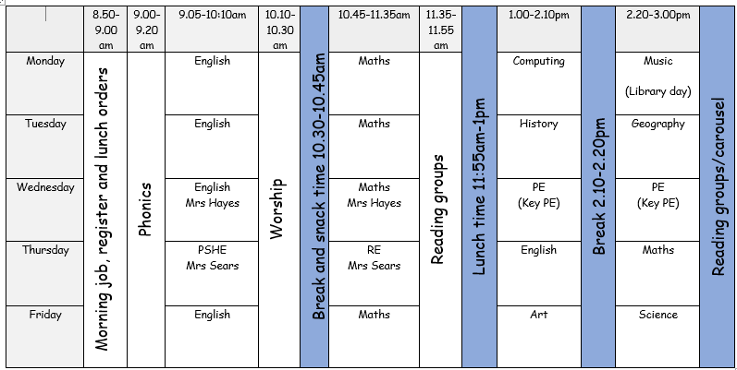
Timetable

Slide 4
PE
PE is taught every Wednesday afternoon with Miss Williams.
Please send your child to school in their PE kit on this day.
Please can all items of clothing be labelled to avoid anything going missing. Thank you.

Slide 5
Thursday AM
Mrs Sears will teach Year 1 every Thursday morning.

Slide 6
Reading
Reading folders will still come home every Wednesday with a new book. Folders should be sent into school everyday.

Slide 7
Reading
Reading is always a priority in school and we work hard to make sure that the books are pitched at the correct level for your child. ​
​
This may mean that sometimes your child may need to re-read a book/set of books throughout the year.​
​
Re-reading helps to build fluency and understanding all of which are important skills that play a huge part in developing confident readers who can discuss and understanding a variety of texts.​

Slide 8
Reading
Please read as much as possible at home and make a note in the reading record when you have read.

Slide 9
Library
Year 1 will visit the library every Monday afternoon.

Slide 10
Books
To ensure that our children have books which are engaging and are pitched correctly it is important that we keep on top of our book stock. ​
​This is why lost/damaged books will be charged at £5.​
​You will be informed of a missing book via a text as we understand it could just be that you have forgotten it.​
​Damaged books will be a straight fine via text/email.​
​Please do consider protecting your child’s book with a plastic reading folder as we have had many damaged through water bottles leaking in bags.

Slide 11
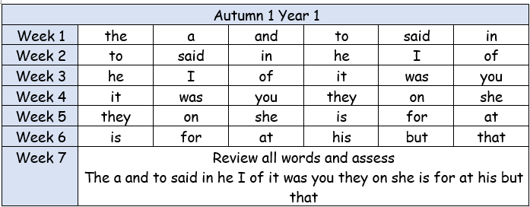
Spelling
Spellings will be based on the 300 high frequency words.
A list will be sent home at the start of each half term for you to practice with your child.

Slide 12


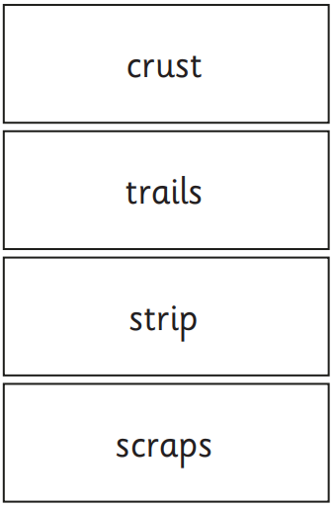
Phonics screening
June 2026

Slide 13
Uniform
Please make sure all your child’s clothes, shoes and any other belongings are named.

Slide 14
Snack
Two healthy snacks from home or a piece of fruit from school.
Milk is available through Mrs Page.

Slide 15
Show and tell
Children will still get the opportunity to share news or show something to the class.

Slide 16
Birthdays!
To help celebrate birthdays we are inviting all children and staff to wear their own clothes ☺

Slide 17
Encouraging positivity
Lucky ducks
Happy mail
Gold certificate

Slide 18
Date for your diary!
Autumn craft session
Thursday 23rd October 9-10am

Slide 19
Parents evening
Tuesday 25th November
Mrs Page will send an email to arrange a time.

Slide 20
Any questions?

