Slide 1

Reception Intake Meeting
2025-2026

Slide 2
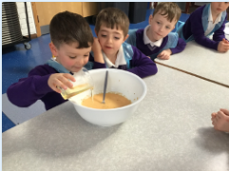
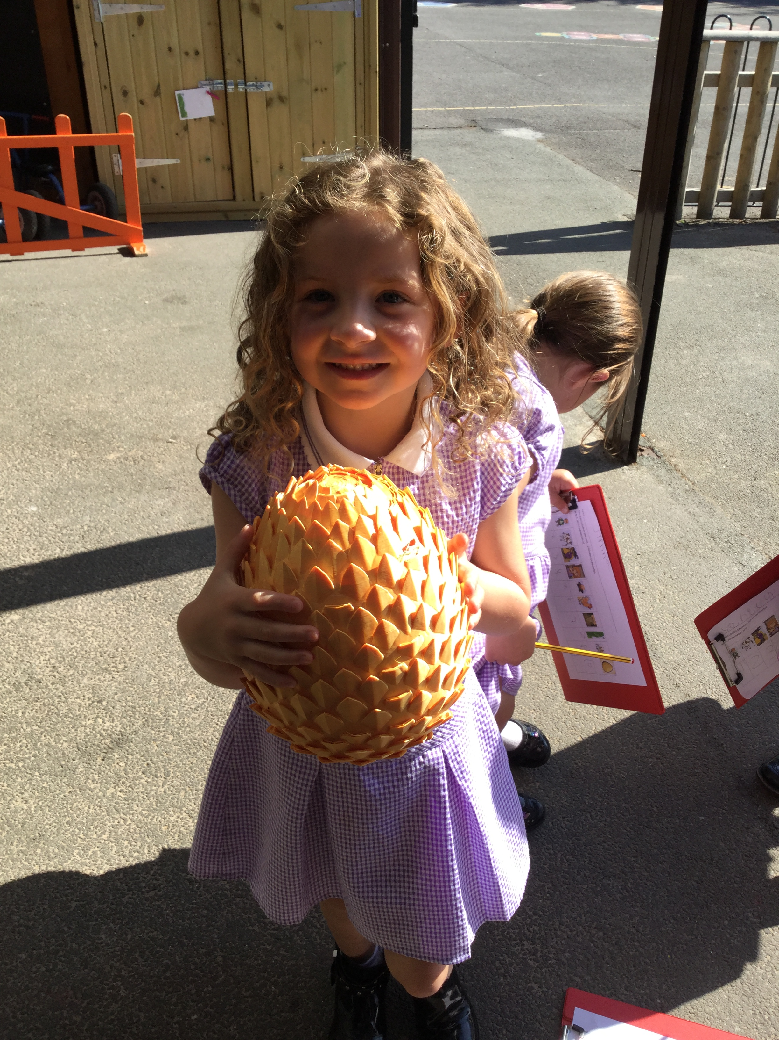
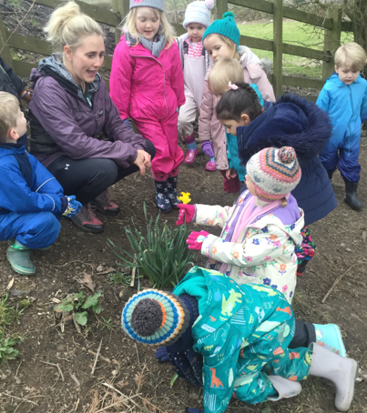
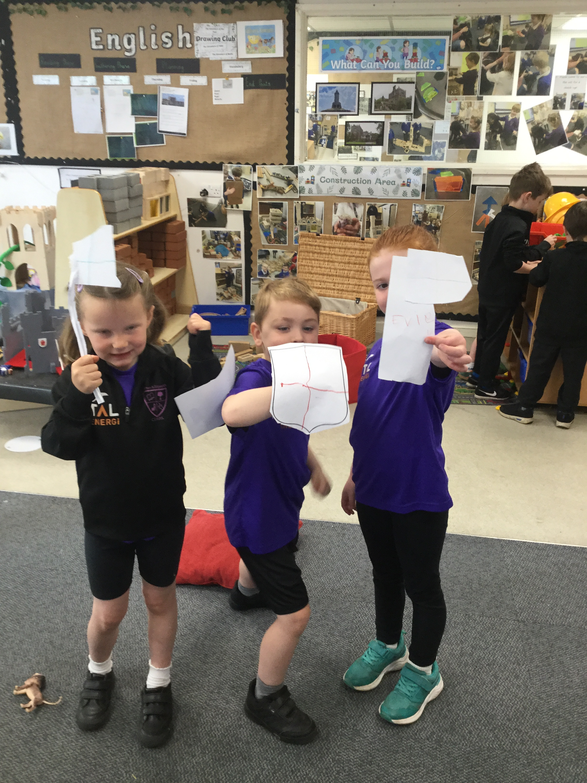
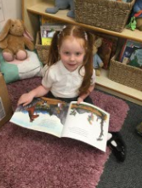
Welcome!

Slide 3
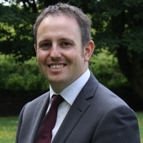
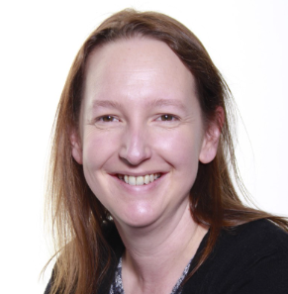
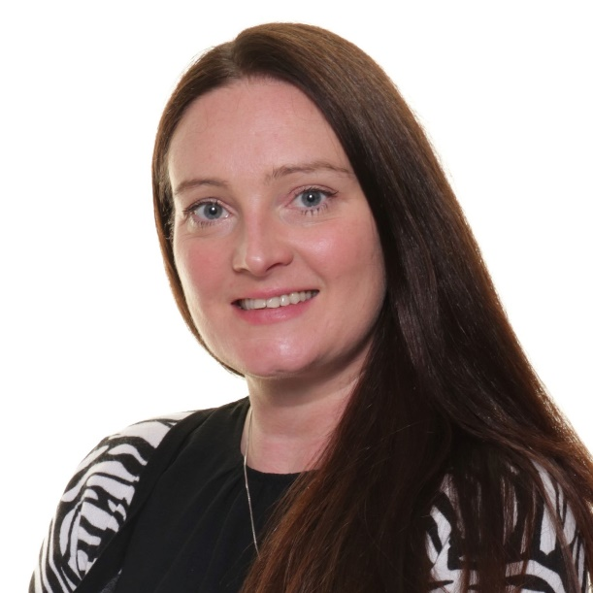

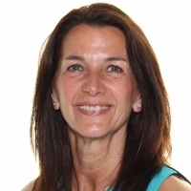
Meet the team
Mr Wheatley
Headteacher
Mrs Carr
Deputy Headteacher
Reception Class Teacher
Miss Partington
KS1 leader
Year 1 Class Teacher
Mrs Page
Office
Mrs Sears
SENDCO

Slide 4

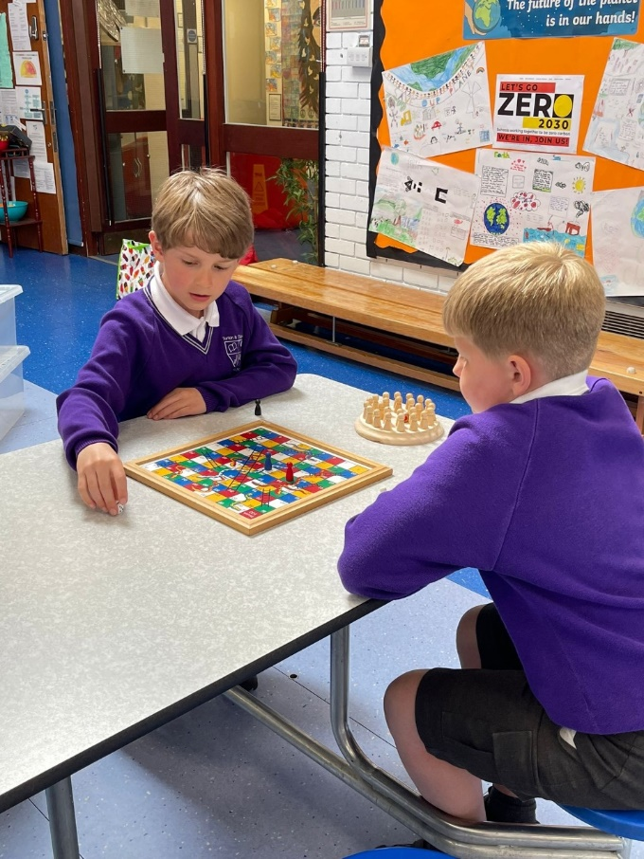
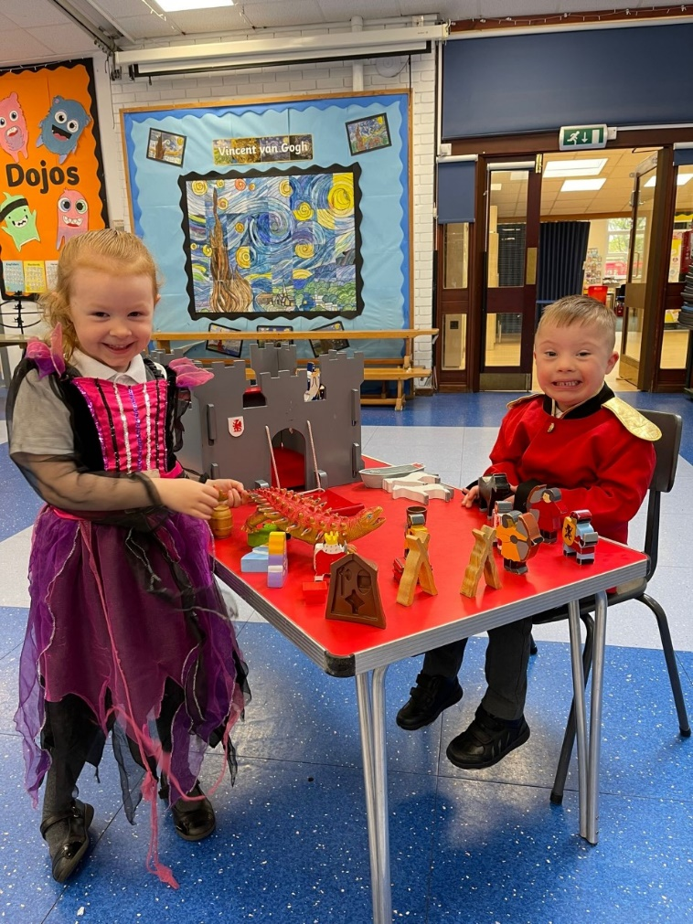
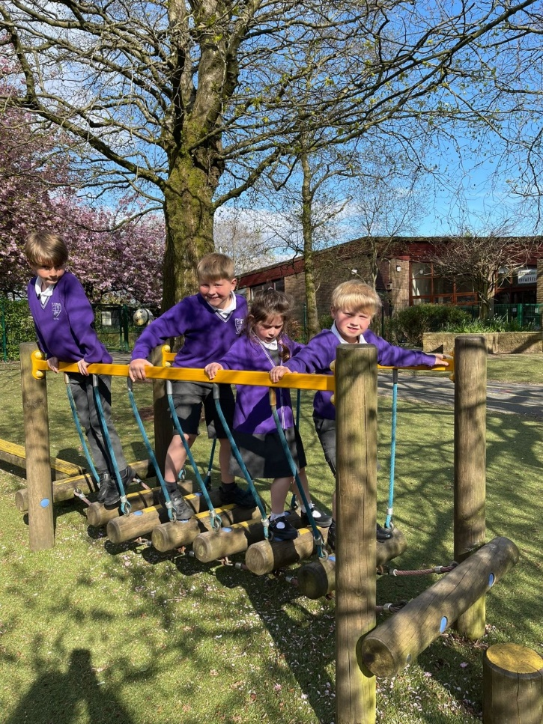
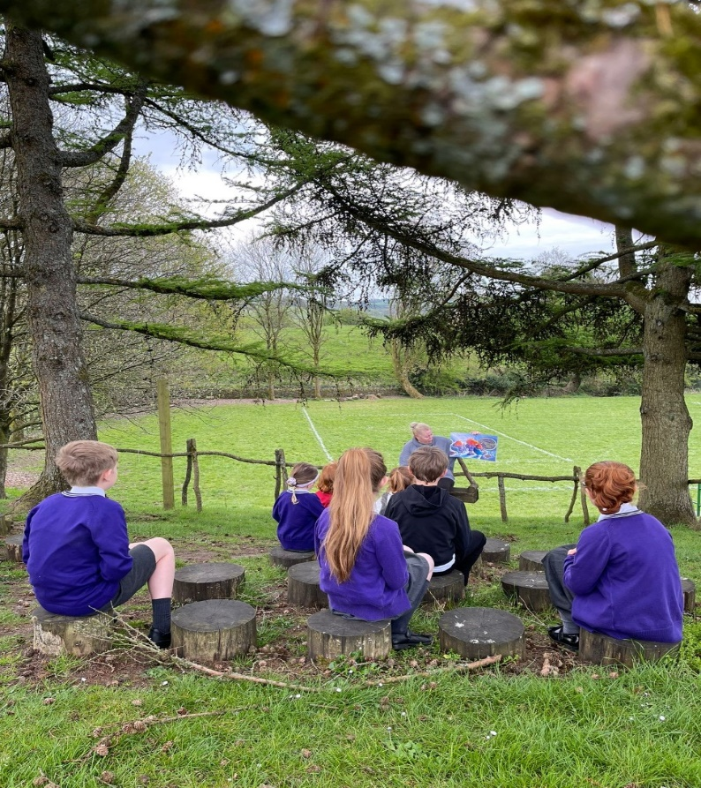
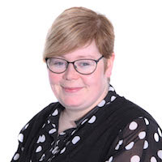
Kids Zone!
Beth McGuinness
Manager

Slide 5
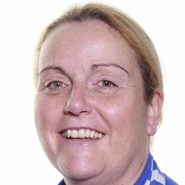
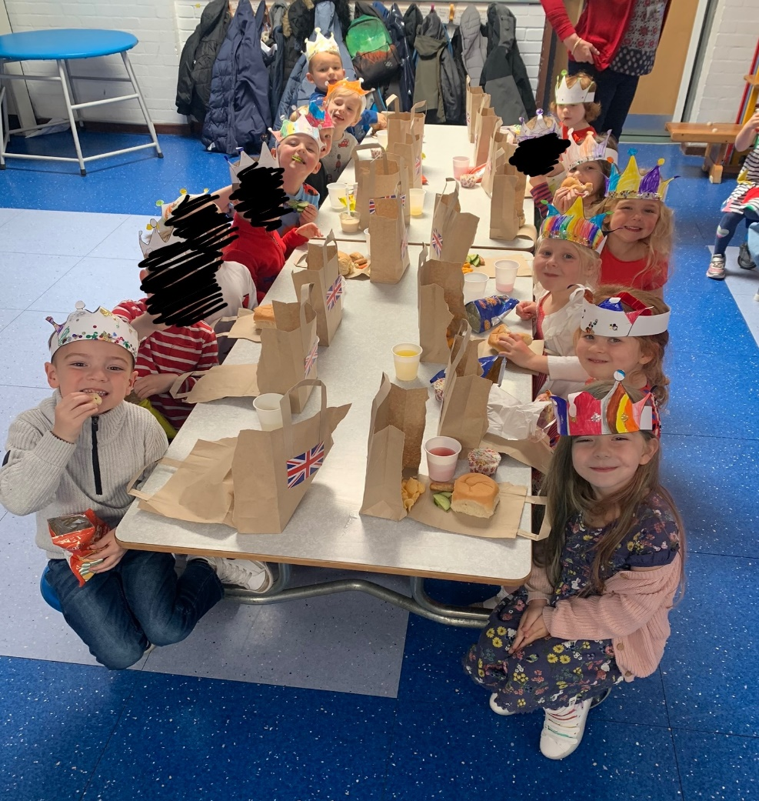


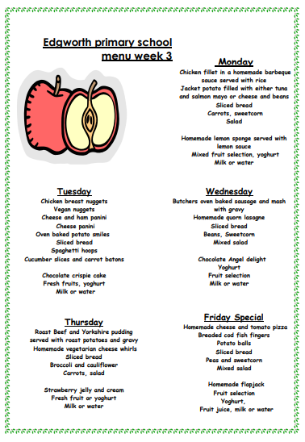
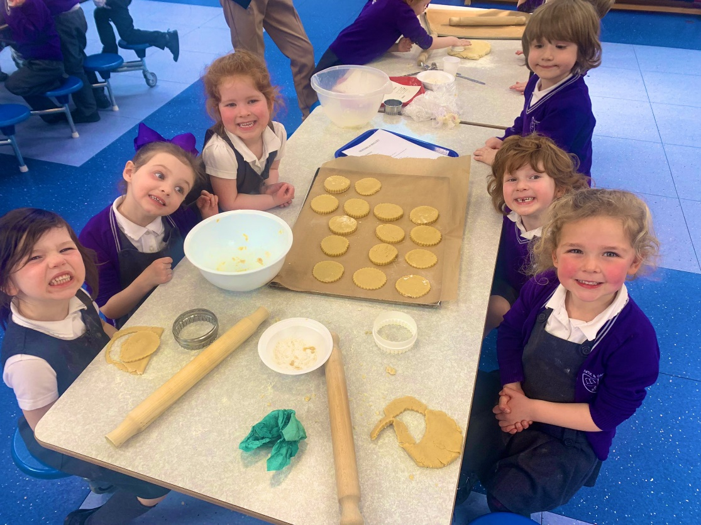
School meals
Mrs Appleton
Manager

Slide 6
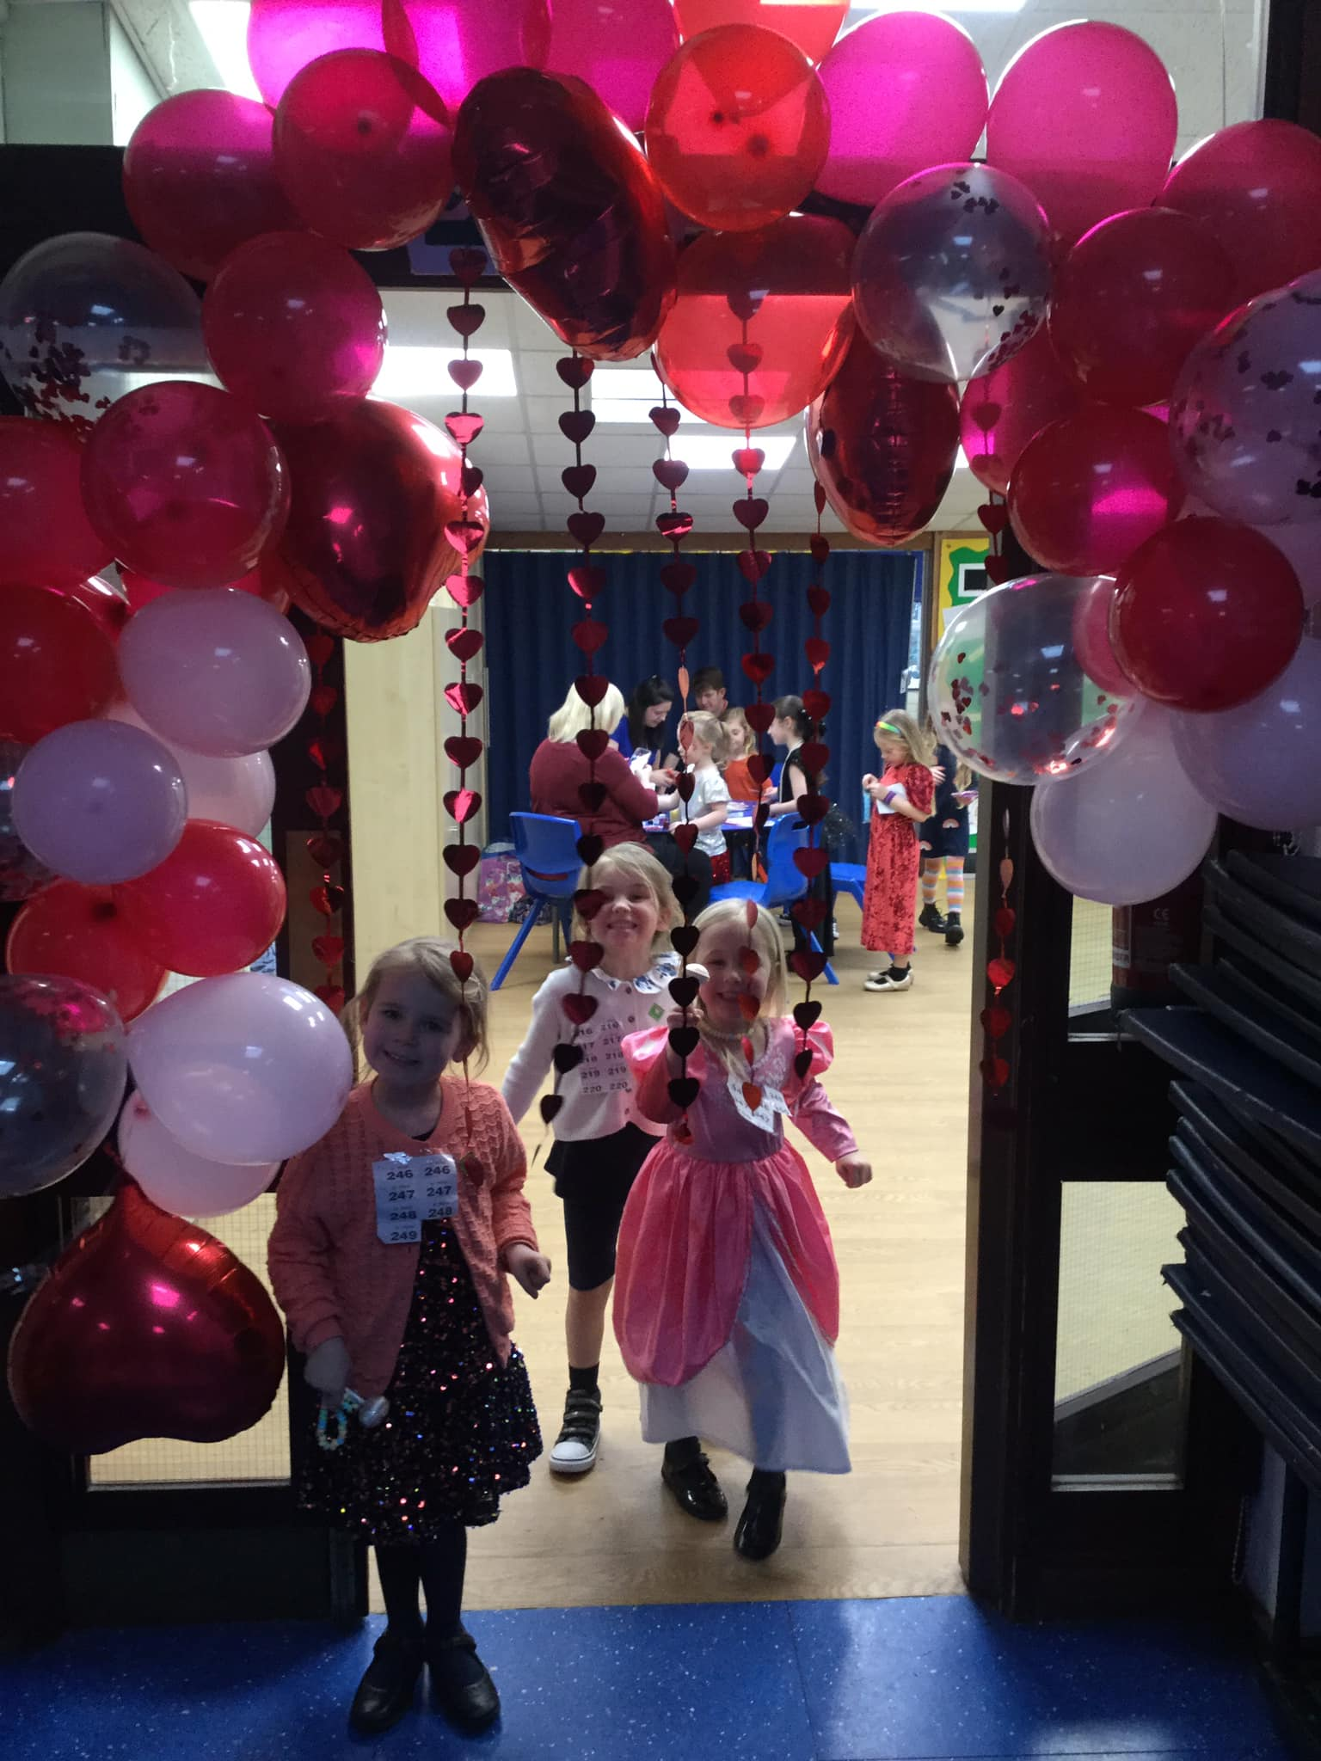
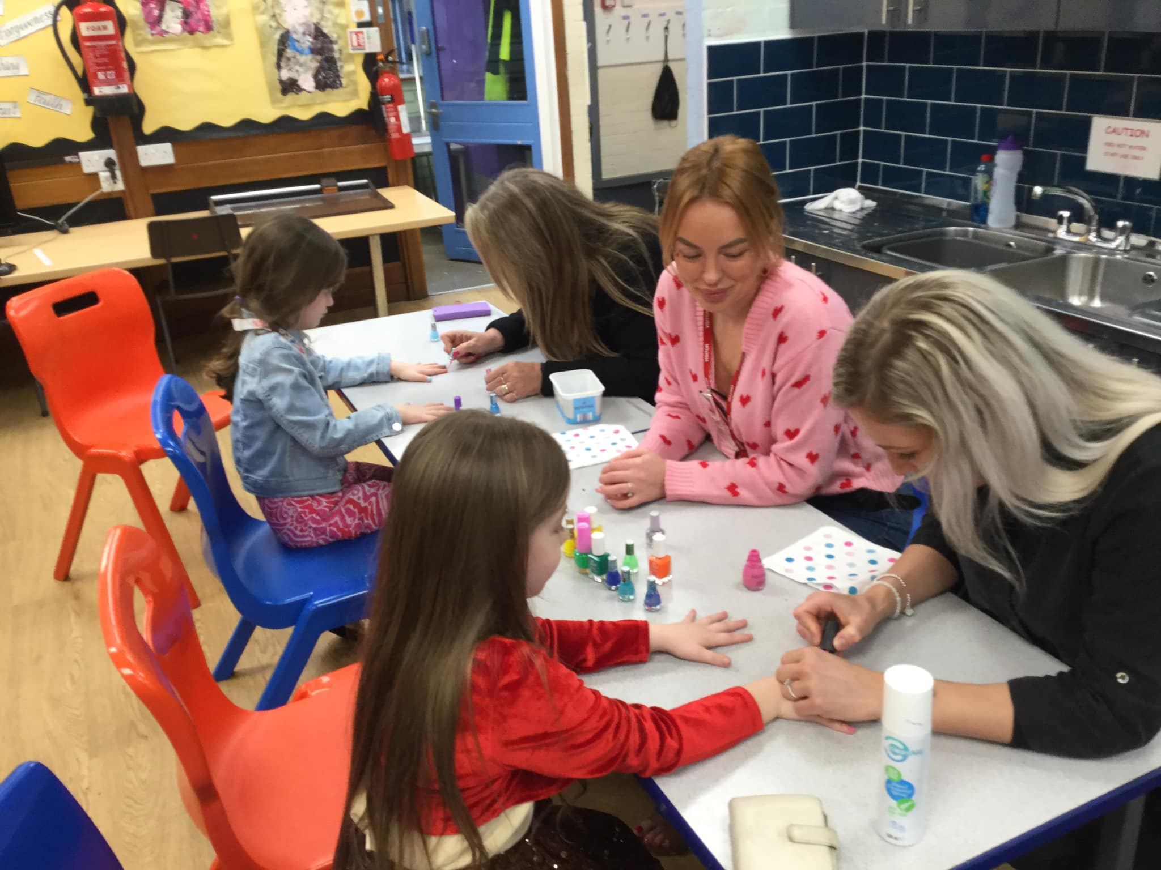
PTFA –Small but mighty!

Slide 7
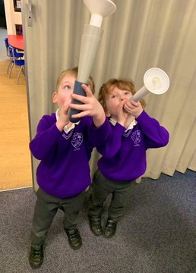
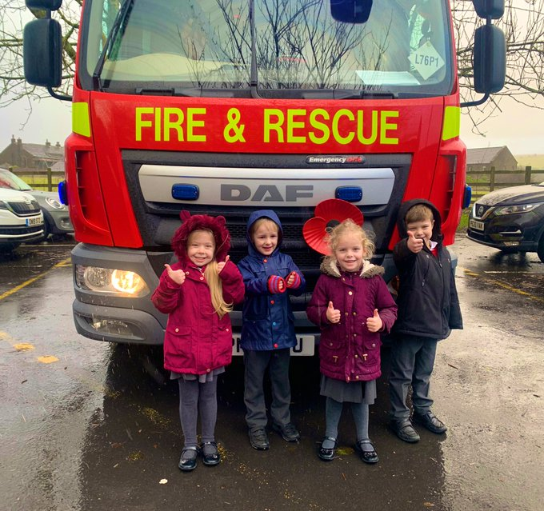
The new intake process
Important dates & Welcome Packs
June/July-Nursery visits
3rd June-New intake evening for families
2nd July-Half day visit for children-’move up day’
2nd July-Forms returned to school
3rd September-Start school

Slide 8
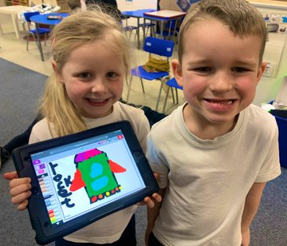
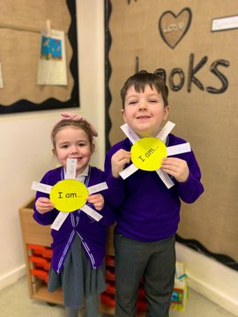
Early years foundation stage
The foundation stage refers to Nursery and Reception children. Reception follows on very closely from the excellent foundations laid in Nursery.
Children still get the opportunity to take part in well planned and organised play, both inside and outside.
Children at this age learn best from practical activities. However, gradually over the year they will begin to do some more formal written work so they are prepared for the move into Year 1.

Slide 9
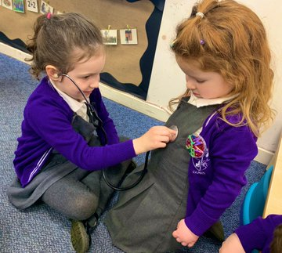
Early years foundation stage
How do children learn in Reception?
There are three characteristics of effective learning:
Playing and exploring
Active learning
Creating and thinking critically

Slide 10
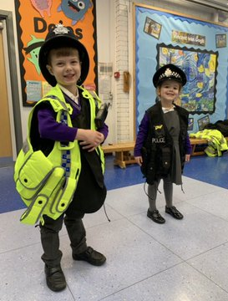
Early years foundation stage
What are the areas of learning and development? EYFS lays strong foundations for our whole school curriculum. Learning begins on day 1!
There are seven areas of learning and development:
Communication and language
Physical development
Personal, social and emotional development
Literacy
Mathematics
Understanding the world
Expressive arts and design

Slide 11
Baseline assessment
The reception baseline assessment (RBA) is a short, task-based assessment of your child's early literacy, communication, language and mathematics skills when they begin school.
The assessment shows how schools are helping their pupils to progress between reception and year 6.

Slide 12
The school day
Kids Zone | 7:15am-8:55am
Registration | 8:55am
Session 1 | 9:00am-10:20am
Snack time | 10:20am-10:30am
Outside break time | 10:30am-10:45am
Session 2 | 10:45am-11:50am
Lunch time | 11:50am-1:00pm
Session 3 | 1:00pm-2:00pm
Outside break time | 2:00pm-2:10pm
Session 4 | 2:10pm-3:00pm
Worship | 3:00pm-3:30pm
End of the school day | 3:30pm
Kids Zone | 3:30pm-6:00pm

Slide 13
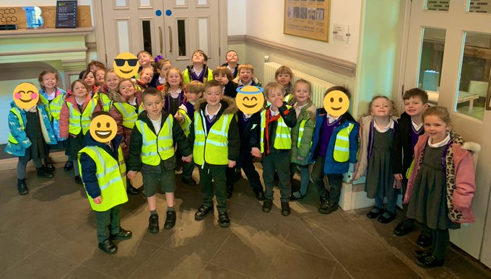
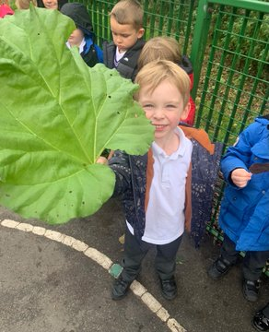
End of the day
At 3.30pm we will bring the children to the door.
If you are running late please ring school and let us know.
If somebody new is going to be picking up your child please let us know or we will not be able to let the children go home until we have confirmed who they are.

Slide 14


Snack and milk
Infant children are offered a piece of fruit during the day.
Your child is allowed to bring a drink (not fizzy) into school and parents also have the option to purchase milk for their child. Milk costs £4.00 per term and is pre-ordered via the Arbor website.
Children can bring a healthy snack to eat at morning break. On Tuesdays and Thursdays, children can buy toast at 20p a slice. Purse/wallet/named envelope please.

Slide 15
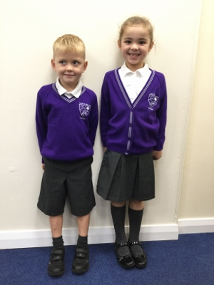
School uniform and PE kit
Girls - Infants (Reception, Year 1 and 2)
Dark grey dress, skirt or trousers, white polo shirt (can be logo'd or plain), purple logo'd cardigan or jumper, grey or white socks, dark shoes.
Boys - Infants (Reception, Year 1 and 2)
Dark grey trousers or shorts, white polo shirt (can be logo'd or plain), purple logo'd cardigan or jumper, grey or white socks and dark shoes.
Girls - Juniors (Years 3-6)
Dark grey dress, skirt or trousers, white shirt, purple/silver tie, purple logo'd cardigan or jumper, grey or white tights or socks, dark shoes.
Boys - Juniors (Years 3-6)
Dark grey trousers or shorts, white shirt, purple/silver tie, purple logo'd cardigan or jumper, grey or white socks, dark shoes.
All available from Whittakers – also PE jogging bottoms/ hoodie with school logo

Slide 16
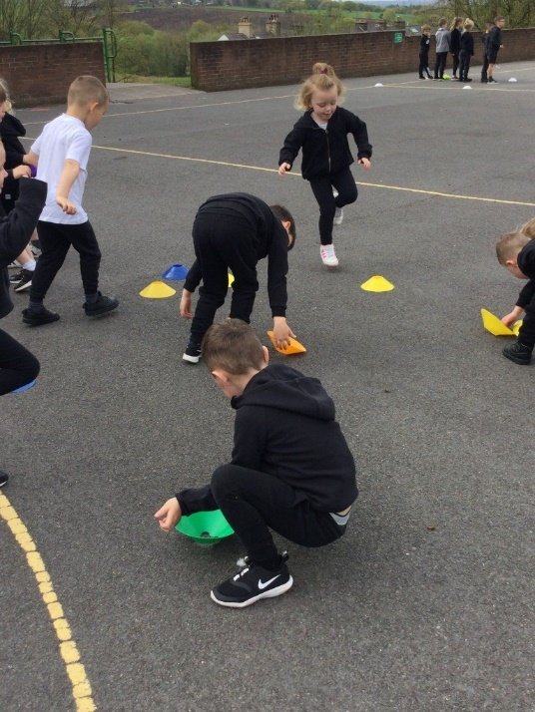
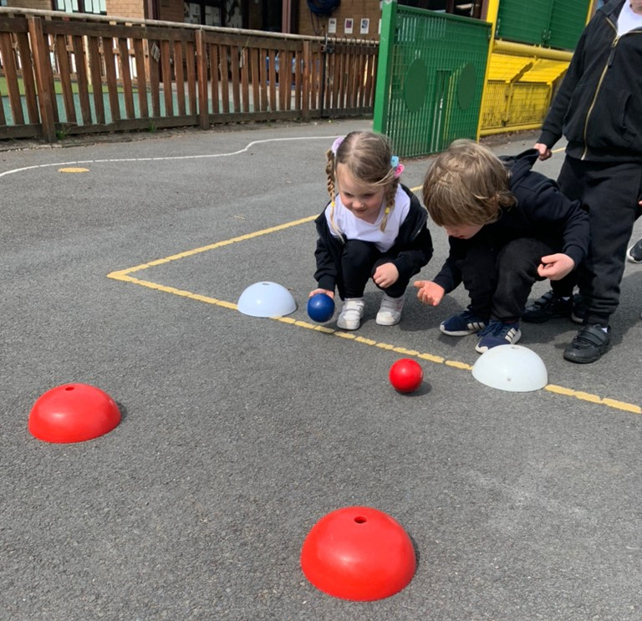
School uniform and PE kit
P.E. Uniform - all pupils
PE Uniform (purple t-shirt and half zip training top) available from LPES: https://www.lpes.uk/
Vital Energi – Kindly sponsored school so PE kits have their logo
Plain black shorts or joggers, school socks, black pumps and trainers.
Pumps will be kept in school in a bag. Children will come to school in PE uniform and trainers.
Available from Whittakers – PE jogging bottoms/ hoodie with school logo
Trainers are not allowed to be worn during PE in the hall but can be worn outside.
You are welcome to view our School Uniform Policy in the Policy section of this website.
Please label everything!!

Slide 17

Parent partnership
This is so important to us!
We aim to achieve an effective partnership with parents and from today’s meeting onwards we hope parents see our school as a welcoming place and continue to be involved in their children’s learning. A successful partnership is a two way process with opportunities for knowledge, experience and information to flow both ways.
Please come and tell us anything that might help us to look after your child. Late nights, illness and things going on at home can all affect children. Please make us aware of any issues so we can act accordingly and support your child as best we can.

Slide 18
Parent partnership
During the year we will invite you to join us for:
-Parents’ evenings
-Open days
-Parent activity sessions (Christmas Craft etc)
-Information evenings (phonics, reading and maths)
-Performances (Christmas)
-Class assemblies
-PTFA events
- September Phonics/Maths information evening

Slide 19
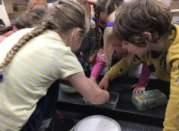

Tapestry
Tapestry is an online journal to help record all the learning and fun of children's early years education.
Tapestry builds a very special record of a child's experiences, development and learning journey through their early years.
Teachers and parents can upload to Tapestry.
You will receive an activation email in September. Look out for this in junk.

Slide 20
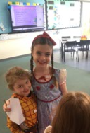
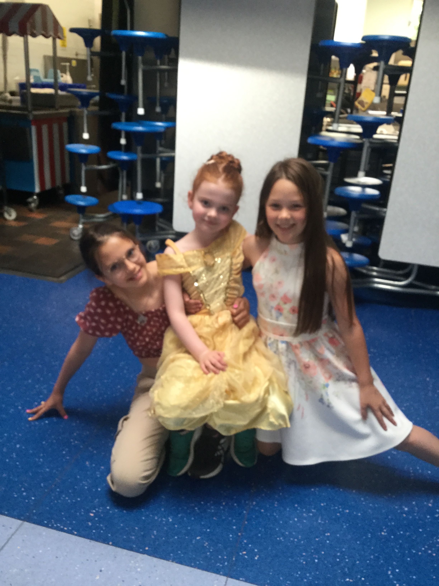
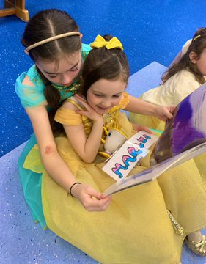
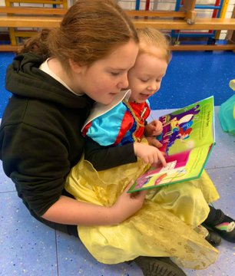
Year 6 buddies
Letters in packs

Slide 21
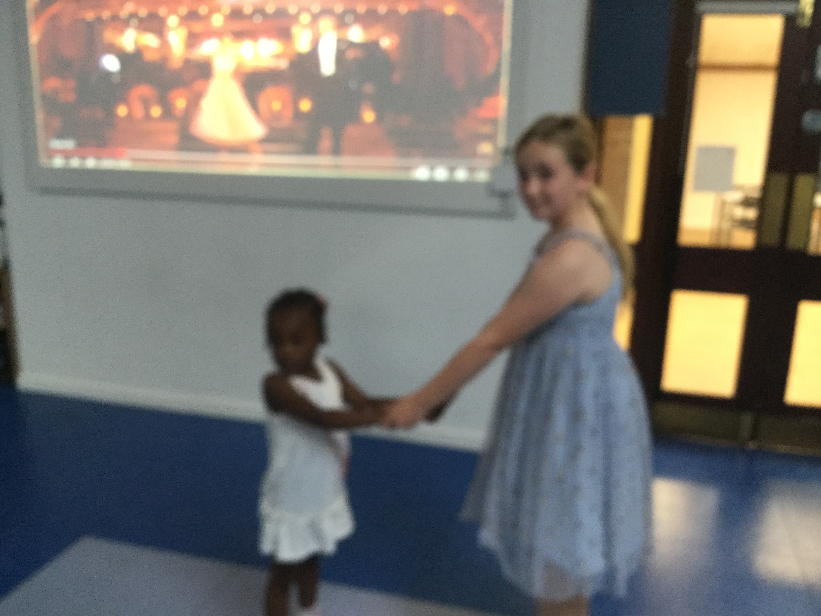
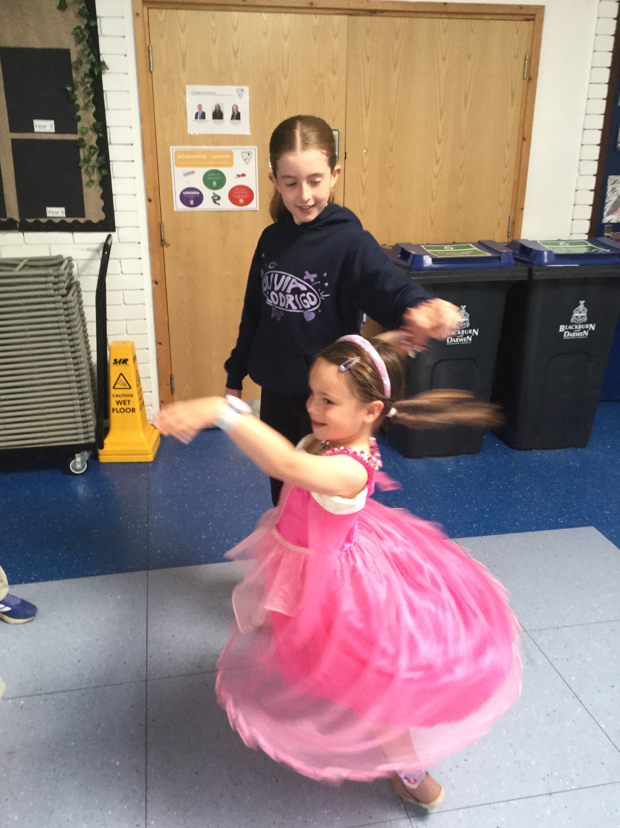
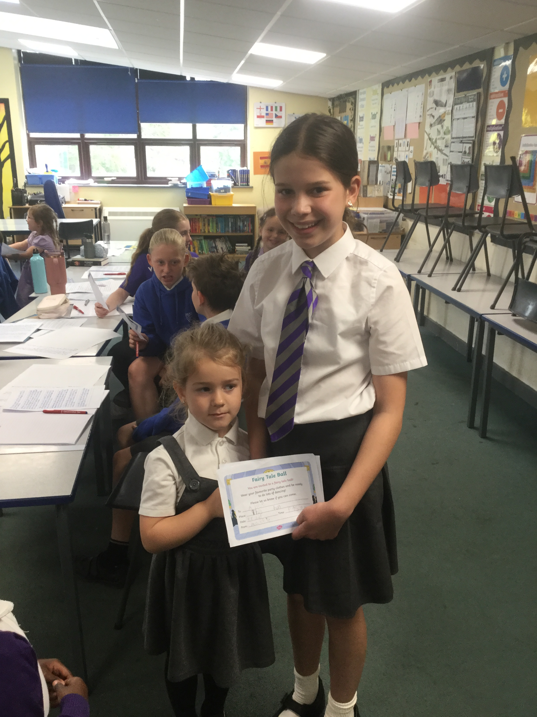
Year 6 buddies and ambassadors

Slide 22
Your child’s achievements
We love to help celebrate the important times and achievements of all children in our school family.
Each child will have a day that they can ‘show and tell.’ They are also invited to bring any certificates into celebration worship on a Friday afternoon.
You can also use Tapestry to upload any photos for the children to share with us.

Slide 23
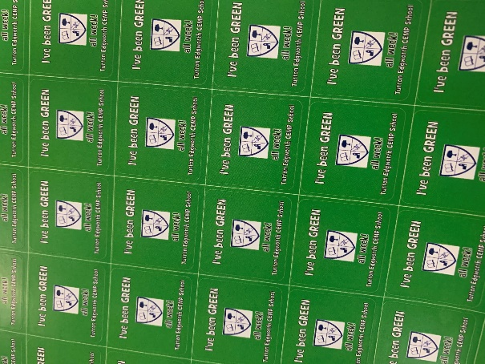
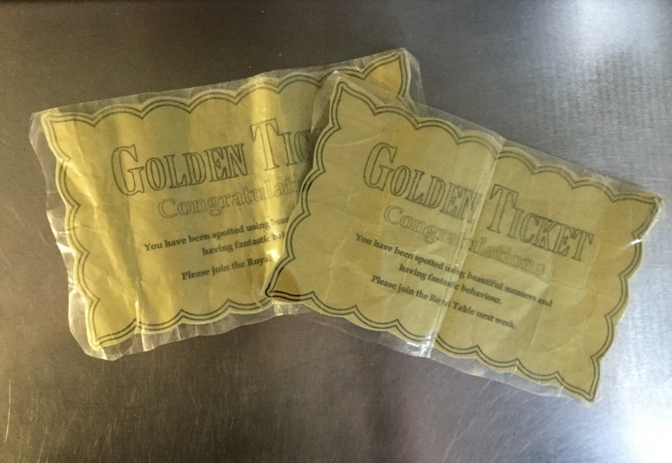


Celebrations

Slide 24
Questions
Thank you for attending our meeting this evening. If you have any questions, please do not hesitate to ask us.
School website: http://www.turtonandedgworthprimary.co.uk/
School email: office@turtonedgworth.blackburn.sch.uk
School telephone: 01204 852932
School Facebook: Turton Edgworth CE/Methodist Primary School

