Slide 1
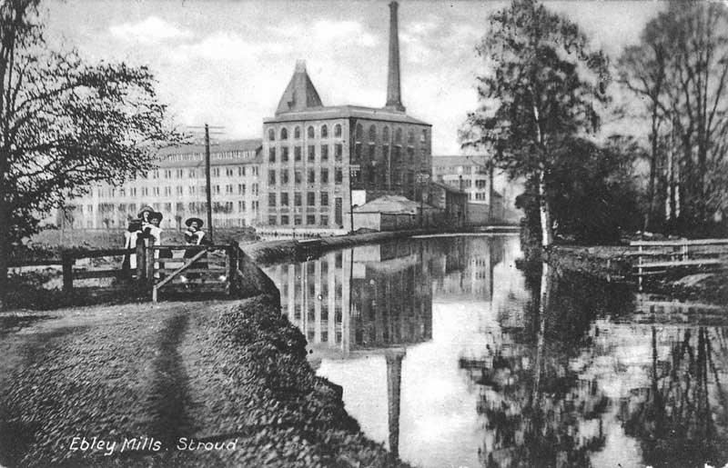

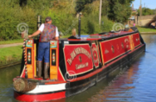





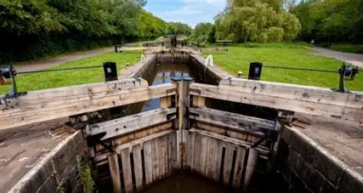
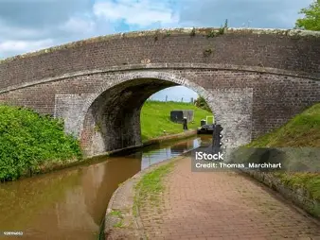
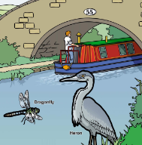
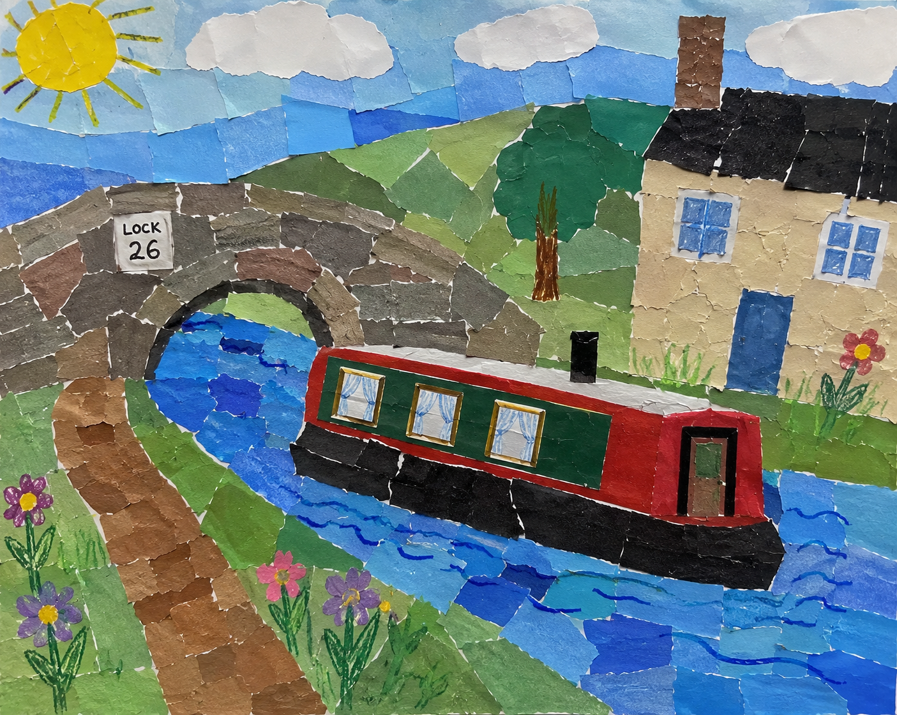
Diamond and Ruby Class Homework Ideas Term 1
Make your own canal narrowboat out of junk materials, don’t forget to give it a name. Watch this video for inspiration.
Junk Jodie Canal Boat | Junk Jodie Arts and Crafts
Research what wildlife can be found in, on and around the canal waterways and make a poster. This link will give you lots of ideas about what can be found.
A-Z of UK animal species along our canals and rivers | Canal & River Trust
Make an ABC of what you could spot around the canal.
Can you complete an A-Z?
Using junk materials make a canal lock or bridge.
Create a canal college - collect safe materials such as:
leaves
grasses
paper
cardboard/magazines
and create a picture of a canal scene.

