Slide 1
End of Key Stage One Assessments 2023
MATHS

Slide 2
What are end of key stage one assessments?
What you might know as SATs or Standard Attainment Tests, are national curriculum tests that are usually taken by children at the end of key stage one.
These are just part of the picture.
All children are assessed during the last term of year 2 to judge what they have learned over the course of key stage one (years 1 and 2).
Teachers judge whether each child in their class has achieved the expected standards for the end of key stage one.
Teachers will use a range of evidence to support their judgements, including the children’s results in their national curriculum tests, as well as independent work in class.
Teachers will judge what a child is able to do independently and align this with the national expectations for a child at the end of key stage one.
Contents

Slide 3
Teacher Assessments
Maths

Slide 4
Standards in Maths
Pre Key Stage
Not yet working at Key Stage 1 standards
Working Towards Expected Standards
Working within Key Stage 1 standards but not yet reaching the expected standards
Working at Expected Standards
Working at the expected standard for children at the end of Key Stage 1
Working at Greater Depth within the expected Standards
Working at a deeper level (with more understanding) within standards expected for Key Stage 1

Slide 5
Standards in Maths
How evidence is collected
Watching children complete tasks
Making notes and annotations
Completing maths tasks (practical)
Maths books (written work)

Slide 6
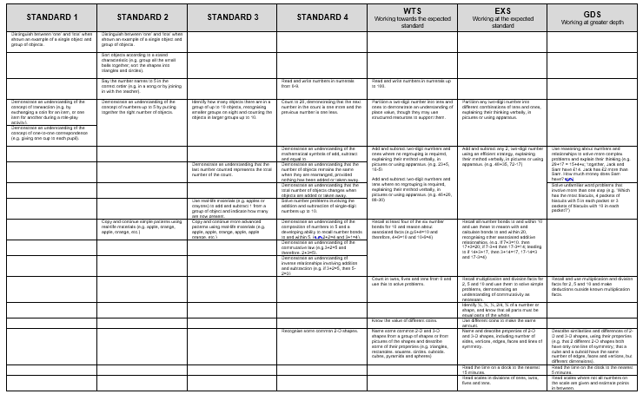

Slide 7
Standards in Maths
Pre Key Stage 1
https://assets.publishing.service.gov.uk/government/uploads/system/uploads/attachment_data/file/1109303/2021_Pre-key_stage_1_-_pupils_working_below_the_national_curriculum_assessment_standard.pdf

Slide 8
Standards in Maths
Working Towards the Expected Standard
Working at the Expected Standard
Working at Greater Depth Within the Expected Standard
https://assets.publishing.service.gov.uk/government/uploads/system/uploads/attachment_data/file/763056/2018_key_stage_1_teacher_assessment_exemplification_mathematics.pdf

Slide 9
Key Stage 1 Assessments
“SATs Tests”

Slide 10
What are children tested on?
Maths
Paper 1 - Arithmetic (approximately 20 minutes)
Addition, subtraction, multiplication and division, including finding fractions.
Paper 2 - Reasoning (approximately 35 minutes)
Solving problems and reasoning. 5 questions are read aloud and children have approximately 30 minutes to answer the rest of the questions independently.
English Reading
Both reading papers contain a variety of texts which increase in difficulty. Paper 2 is more challenging that paper 1.
Paper 1 (approximately 30 minutes)
Short sections of text for the children to read with questions underneath for them to answer.
Paper 2 (approximately 40 minutes)
A reading booklet with texts and a question booklet to record answers in.
Contents

Slide 11

When and how do the tests happen?
The national window for administering these tests is the month of May.
We will administer assessments over the weeks of: 15 May 2022 and 22 May 2023.
We will not tell the children they are being tested or call them tests.
The children will work on the assessments in their own classroom in smaller groups to allow them to space out. Some children may not take part in the assessment at that time.
The assessments will be timetabled across the weeks to prevent the children feeling overwhelmed. To them, it will be like a usual English or maths lesson.
There is no writing test. The teachers will make a judgement using the children’s writing over the course of year 2.
Contents

Slide 12

What happens with the results?
Test results are not routinely shared with parents or published; they inform overall teacher assessments.
Unlike year 6 test results, year 2 results are not a definitive judgement. Teacher assessment can include all the work a child has done in key stage one and the test result merely supports this judgement.
The school will report all the teacher assessments to the local authority by the end of June 2023; we do not need to report individual test scores.
Teacher assessments of pupil attainment will be shared with parents in the end of year reports, published in July 2023.
We will not tell the children they are being tested or call them tests.
The children will work on the assessments in their own classroom in smaller groups to allow them to space out.
The assessments will be timetabled across the weeks to prevent the children feeling overwhelmed. To them, it will be like a usual English or maths lesson.
There is no writing test. The teachers will make a judgement using the children’s writing over the course of year 2
Contents

Slide 13
Mathematics
Children will sit two tests: Paper 1 and Paper 2:
Paper 1: Arithmetic - lasts approximately 20 minutes (but this is not strictly timed). It covers calculation methods for all operations.
Paper 2: Reasoning - lasts for approximately 35 minutes, which includes time for five aural questions. Pupils will still require calculation skills and questions will be varied including multiple choice, matching, true/false, completing a chart or table or drawing a shape. Some questions will also require children to show or explain their working out.
chapter
menu
next page

Slide 14
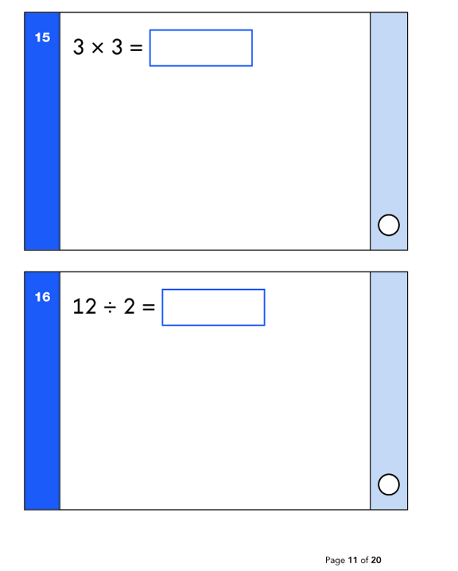
Maths: Sample Questions
Maths Paper 1: Arithmetic
chapter
menu
next page

Slide 15
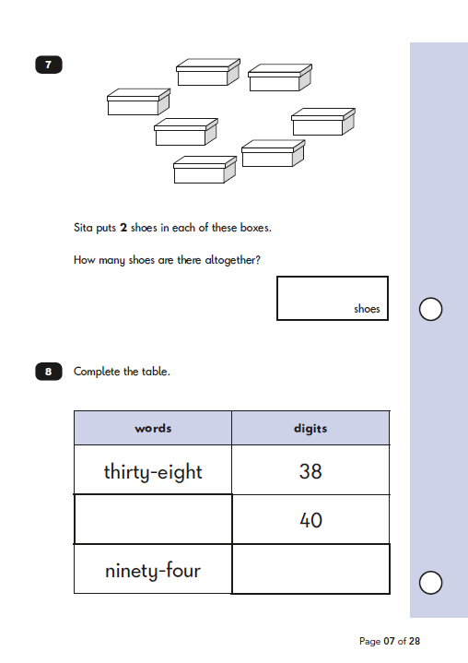
Maths: Sample Questions
Maths Paper 2: Reasoning
chapter
menu
next page

Slide 16
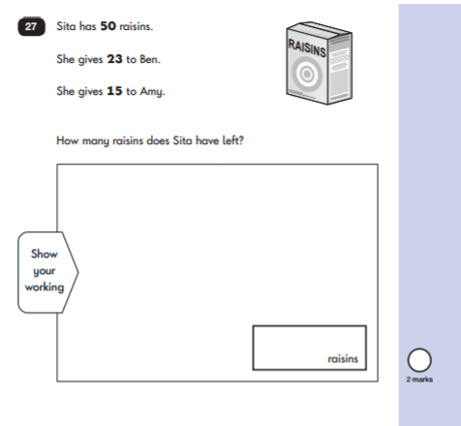
Maths: Sample Questions
Maths Paper 2: Reasoning
chapter
menu
next page

Slide 17
click to see all text
How to Help Your Child with Maths
Play times tables games.
Play mental maths games including counting in different amounts, forwards and backwards.
Encourage opportunities for telling the time.
Encourage opportunities for counting coins and money e.g. finding amounts or calculating change when shopping.
Look for numbers on street signs, car registrations and anywhere else.
Look for examples of 2D and 3D shapes around the home.
Identify, weigh or measure quantities and amounts in the kitchen or in recipes.
Play games involving numbers or logic, such as dominoes, card games,
draughts or chess.
Play times tables games (timestables.co.uk)
Play mental maths games including counting in different amounts, forwards and backwards.
Encourage opportunities for telling the time.
Encourage opportunities for counting coins and money e.g. finding amounts or calculating change when shopping.
Look for numbers on street signs, car registrations and anywhere else.
Look for examples of 2D and 3D shapes around the home.
Identify, weigh or measure quantities and amounts in the kitchen or in recipes.
Use online activities like BBC Bitesize, Komodo, Doodle Maths (and lots of other free app) to practise skills at home.
Download practice SATs papers free from https://www.sats-papers.co.uk/
chapter
menu
next page

