Slide 1
End of Key Stage One Assessments 2023
READING

Slide 2
What are end of key stage one assessments?
What you might know as SATs or Standard Attainment Tests, are national curriculum tests that are usually taken by children at the end of key stage one.
These are just part of the picture.
All children are assessed during the last term of year 2 to judge what they have learned over the course of key stage one (years 1 and 2).
Teachers judge whether each child in their class has achieved the expected standards for the end of key stage one.
Teachers will use a range of evidence to support their judgements, including the children’s results in their national curriculum tests, as well as independent work in class.
Teachers will judge what a child is able to do independently and align this with the national expectations for a child at the end of key stage one.
Contents

Slide 3
Teacher Assessments
Reading

Slide 4
Standards in Reading
Pre Key Stage
Not yet working at Key Stage 1 standards
Working Towards Expected Standards
Working within Key Stage 1 standards but not yet reaching the expected standards
Working at Expected Standards
Working at the expected standard for children at the end of Key Stage 1
Working at Greater Depth within the expected Standards
Working at a deeper level (with more understanding) within standards expected for Key Stage 1

Slide 5
Standards in Reading
How evidence is collected
Listening to children read
Making notes and annotations
Completing reading tasks
Reading comprehensions

Slide 6
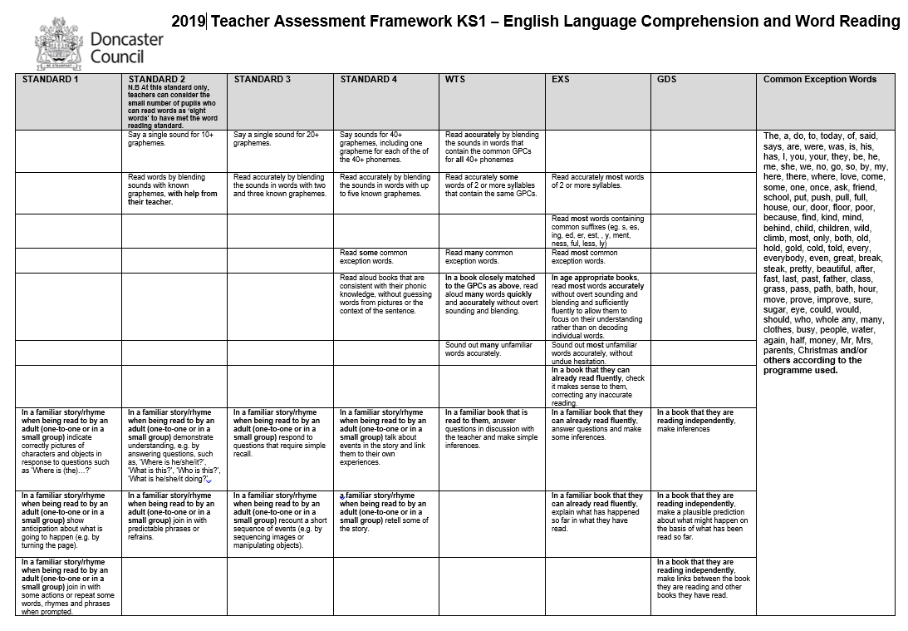

Slide 7
Standards in Reading
Pre Key Stage 1
https://www.gov.uk/government/publications/pre-key-stage-english-language-comprehension-and-reading-exemplification

Slide 8
Standards in Reading
Working Towards the Expected Standard
https://www.gov.uk/government/publications/ks1-english-reading-exemplification-working-towards-the-expected-standard
https://youtu.be/p-L6vauvhu4

Slide 9
Standards in Reading
Working at the Expected Standard
https://www.gov.uk/government/publications/ks1-english-reading-exemplification-working-at-the-expected-standard
https://youtu.be/HXfgMv5hTrs

Slide 10
Standards in Reading
Working at Greater Depth Within the Expected Standards
https://www.gov.uk/government/publications/ks1-english-reading-exemplification-working-at-greater-depth-within-the-expected-standard
https://youtu.be/_m-i4fRBjCU

Slide 11
Key Stage 1 Assessments
“SATs Tests”

Slide 12
What are children tested on?
Maths
Paper 1 - Arithmetic (approximately 20 minutes)
Addition, subtraction, multiplication and division, including finding fractions.
Paper 2 - Reasoning (approximately 35 minutes)
Solving problems and reasoning. 5 questions are read aloud and children have approximately 30 minutes to answer the rest of the questions independently.
English Reading
Both reading papers contain a variety of texts which increase in difficulty. Paper 2 is more challenging that paper 1.
Paper 1 (approximately 30 minutes)
Short sections of text for the children to read with questions underneath for them to answer.
Paper 2 (approximately 40 minutes)
A reading booklet with texts and a question booklet to record answers in.
Contents

Slide 13

When and how do the tests happen?
The national window for administering these tests is the month of May.
We will administer assessments over the weeks of: 15 May 2022 and 22 May 2023.
We will not tell the children they are being tested or call them tests.
The children will work on the assessments in their own classroom in smaller groups to allow them to space out. Some children may not take part in the assessment at that time.
The assessments will be timetabled across the weeks to prevent the children feeling overwhelmed. To them, it will be like a usual English or maths lesson.
There is no writing test. The teachers will make a judgement using the children’s writing over the course of year 2.
Contents

Slide 14

What happens with the results?
Test results are not routinely shared with parents or published; they inform overall teacher assessments.
Unlike year 6 test results, year 2 results are not a definitive judgement. Teacher assessment can include all the work a child has done in key stage one and the test result merely supports this judgement.
The school will report all the teacher assessments to the local authority by the end of June 2023; we do not need to report individual test scores.
Teacher assessments of pupil attainment will be shared with parents in the end of year reports, published in July 2023.
We will not tell the children they are being tested or call them tests.
The children will work on the assessments in their own classroom in smaller groups to allow them to space out.
The assessments will be timetabled across the weeks to prevent the children feeling overwhelmed. To them, it will be like a usual English or maths lesson.
There is no writing test. The teachers will make a judgement using the children’s writing over the course of year 2
Contents

Slide 15
click to see all text
Reading
The Reading Test consists of two separate papers:
Paper 1 – consists of a combined reading prompt and answer booklet. The paper includes a list of useful words and some practice questions for teachers to use to introduce the contexts and question types to pupils. The test takes approximately 30 minutes to complete, but is not strictly timed.
Paper 2 – consists of an answer booklet and a separate reading booklet. There are no practice questions on this paper. Teachers can use their discretion to stop the test early if a pupil is struggling. The test takes approximately 40 minutes to complete, but is not strictly timed.
The texts will cover a range of poetry, fiction and non-fiction.
The Reading Test consists of two separate papers:
Paper 1 – consists of a combined reading prompt and answer booklet. The paper includes a list of useful words and some practice questions for teachers to use to introduce the contexts and question types to pupils. The test takes approximately 30 minutes to complete, but is not strictly timed.
Paper 2 – consists of an answer booklet and a separate reading booklet. There are no practice questions on this paper. Teachers can use their discretion to stop the test early if a pupil is struggling. The test takes approximately 40 minutes to complete, but is not strictly timed.
The texts will cover a range of poetry, fiction and non-fiction.
chapter
menu
next page

Slide 16
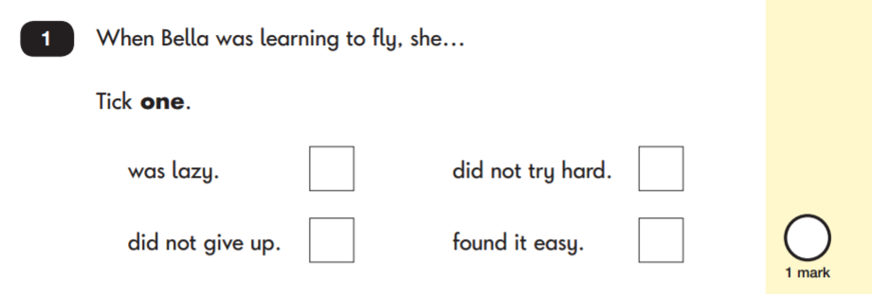
Reading: Sample Questions
Questions are designed to assess the comprehension and understanding of a child’s reading.
There are a variety of question types:
Multiple Choice
chapter
menu
next page

Slide 17
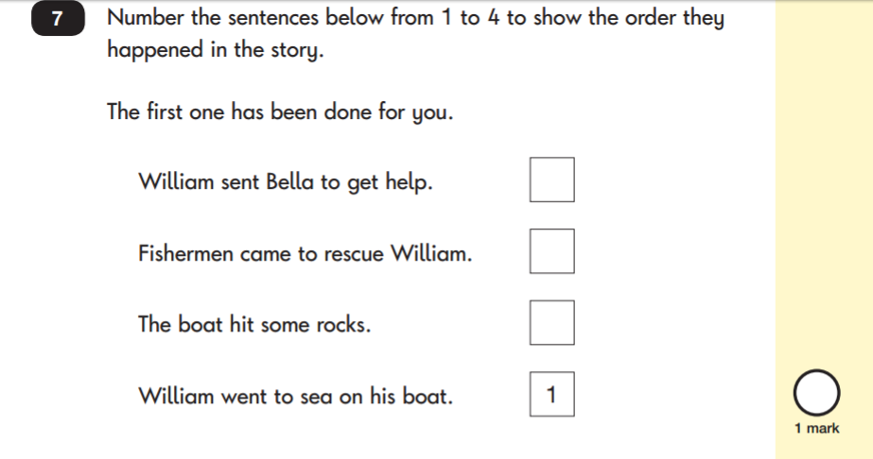
Reading: Sample Questions
Ranking/Ordering
chapter
menu
next page

Slide 18
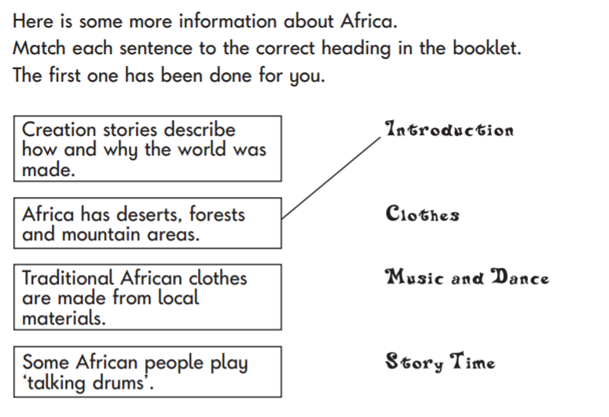
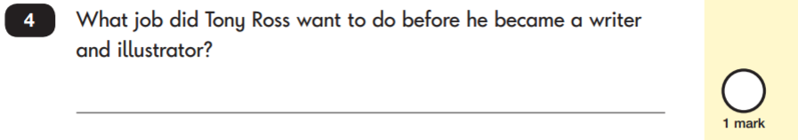
Reading: Sample Questions
Matching/Labelling
Short-Answer Questions
chapter
menu
next page

Slide 19
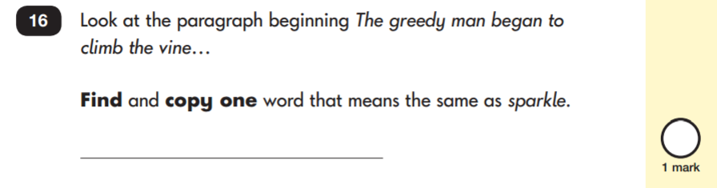
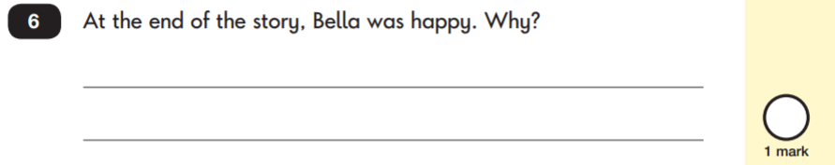
click to see all text
Reading: Sample Questions
Find and Copy Questions
Open-Ended Questions
chapter
menu
next page

Slide 20
click to see all text
How to Help Your Child with Reading
Listening to your child read can take many forms:
First and foremost, focus developing an enjoyment and love of reading.
Enjoy stories together – reading stories to your child is equally as important as listening to your child read.
Read a little at a time but often, rather than rarely but for long periods of time!
Talk about the story before, during and afterwards – discuss the plot, the characters, their feelings and actions, how it makes you feel, predict what will happen and encourage your child to have their own opinions.
Look up definitions of words together – you could use a dictionary, the Internet or an app on a phone or tablet.
All reading is valuable – it doesn’t have to be just stories. Reading can involve anything from fiction and non-fiction, poetry, newspapers, magazines, football programmes, TV guides.
Visit the local library - it’s free!
Listening to your child read can take many forms:
First and foremost, focus developing an enjoyment and love of reading.
Enjoy stories together – reading stories to your child is equally as important as listening to your child read.
Read a little at a time but often, rather than rarely but for long periods of time!
Talk about the story before, during and afterwards – discuss the plot, the characters, their feelings and actions, how it makes you feel, predict what will happen and encourage your child to have their own opinions.
Look up definitions of words together – you could use a dictionary, the Internet or an app on a phone or tablet.
All reading is valuable – it doesn’t have to be just stories. Reading can involve anything from fiction and non-fiction, poetry, newspapers, magazines, football programmes, TV guides.
Visit the local library - it’s free!
chapter
menu
next page

Slide 21
How can I help my child?
Download practice SATs papers free from https://www.sats-papers.co.uk/
Listen to your child read daily. Ask questions and talk about what they have read. Make sure they understand what they are reading.
Use online activities like BBC Bitesize, Reading Eggs App, Teacher Your Monster to Read App (and lots of other free app) to practise skills at home.
Support your child to complete any home learning tasks, such as reading comprehensions.
Contents

