Slide 1

RWI Phonics For Parents and Carers
Notes:
Explain that RWI is part of a bigger picture, we are only focussing on phonics can also inc comprehension and spelling.

Slide 2
Phonological Awareness
Phonemic awareness is part of phonological awareness. It involves hearing and manipulating the smallest unit of sound.
General sound discrimination-environmental sounds, instrumental sounds, body percussion.
Rhythm and Rhyme
Spot and suggest rhymes
Recognise words with the same initial sound
Count or clap the number of syllables in a word
Voice sounds
Oral blending and segmenting

Slide 3
What is Read Write Inc?
-Read Write Inc. is a systematic and structured approach to teaching phonics, reading and writing.
-Meets the demands of the national curriculum, giving your children the best chance of success in the national tests.
Reading
– learn 44 sounds and the corresponding letters/letter
groups using simple picture prompts
– learn to read words using sound blending
-story books align with sounds learnt in class
Writing
– learn to write the letters/letter groups which represent the
44 sounds
– learn to write words by saying the sounds and graphemes
– write simple sentences I a-m F-r-e-d

Slide 4
Why Read Write Inc?
Proven record for success
Systematic and structured programme
Early success in reading
Training and ongoing support for staff
Focused on the child and what they know.
Regular assessment so children who are making progress and/or slipping back are identified quickly.

Slide 5

Through a child’s eyes

Slide 6
A bit of technical knowledge…
The focus is on the child being able to say the pure sounds.
Watch the RWI sound pronunciation guide: https://www.youtube.com/watch?v=TkXcabDUg7Q&t=61s

Slide 7
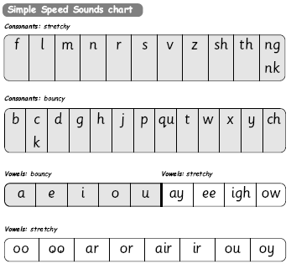
The simple sound chart
Notes:
Go through these sounds quickly with parents using My Turn/Your Turn.
Stress you must not use letter names at this stage – just pure sounds.
Emphasise getting rid of ‘ugh’ to help blending. Parents usually love this bit! Make it fun! Set 1 then long vowels in Set 2.
Explain that when the children are taught the sounds they use the cards and a multi-sensory approach – hold up the cards again.

Slide 8
It gets more complicated
It would be easy if we only had to learn Set 1 and Set 2 sounds….however….we have Set 3 as well…

Slide 9
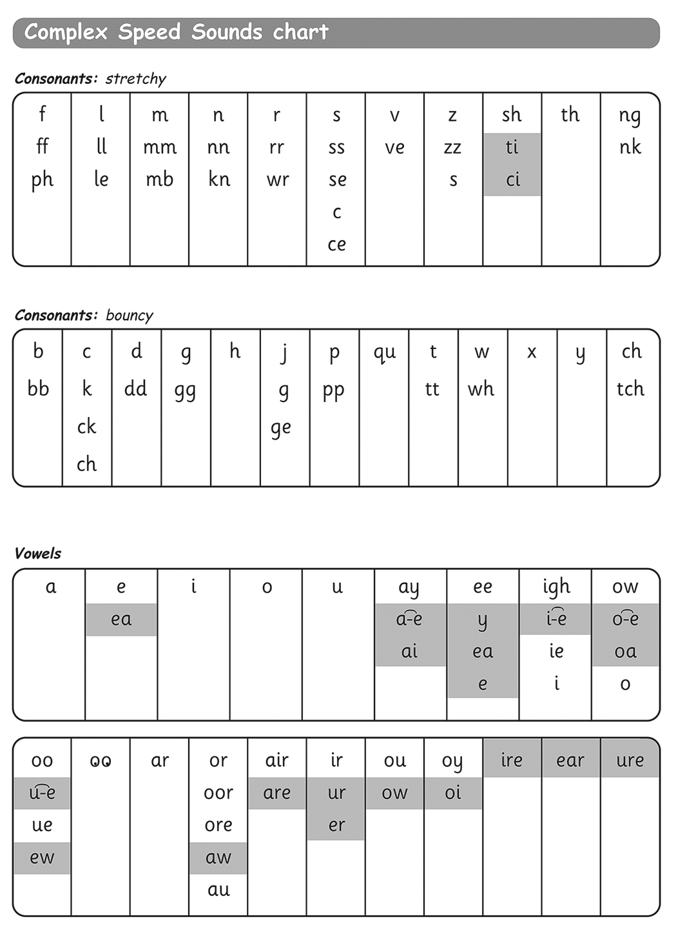
Complex Speed sound chart
Notes:
Explain again the sound boxes and say this chart show the many different graphemes for the same sounds! No other language has as many to learn! Pink graphemes are Set 3 – explain they only learn these once they know all of Set 1 & 2 effortlessly – systematic and structured!

Slide 10
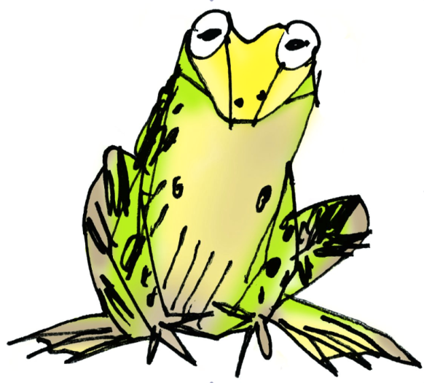
How does phonics help us read?
Say “hello” to Fred.
Fred can only talk in sounds...
He says “c_a_t.” Not cat.
We call this Fred Talk.
We use Fred Talk to help us read green words:
Green words e.g. run, shop, truck
https://www.youtube.com/watch?app=desktop&v=dEzfpod5w_Q
Notes:
Remember Fred toy

Slide 11
How does phonics help us read?
There are also red words. Words that we can’t segment and blend (Fred talk). The children have to learn where the grotty grapheme is.
Red words e.g. the, I, no, go, he, she, we, me, be, my, her said, to

Slide 12

Assisted Blending
Bridges the gap between children knowing the sounds and reading.
Review the sounds
Blend orally without speed sounds cards
Blending with speeds sounds cards
Magnetic letters and whiteboards
Independent Blending
Introduce the green word cards
Review the words (without dots and dashes)
Spelling

Slide 13
Ditties
Children have to be confident when reading speed sounds.
Segmenting the words into sounds and then blending them to read. e.g. c – a – t = cat
Be able to read basic repetitive sentences that build up confidence.

Slide 14
Story Books
Children work on the differentiated books during their RWI lessons. Using and applying the sounds that they are taught.
Books that come home have been read in school.

Slide 15
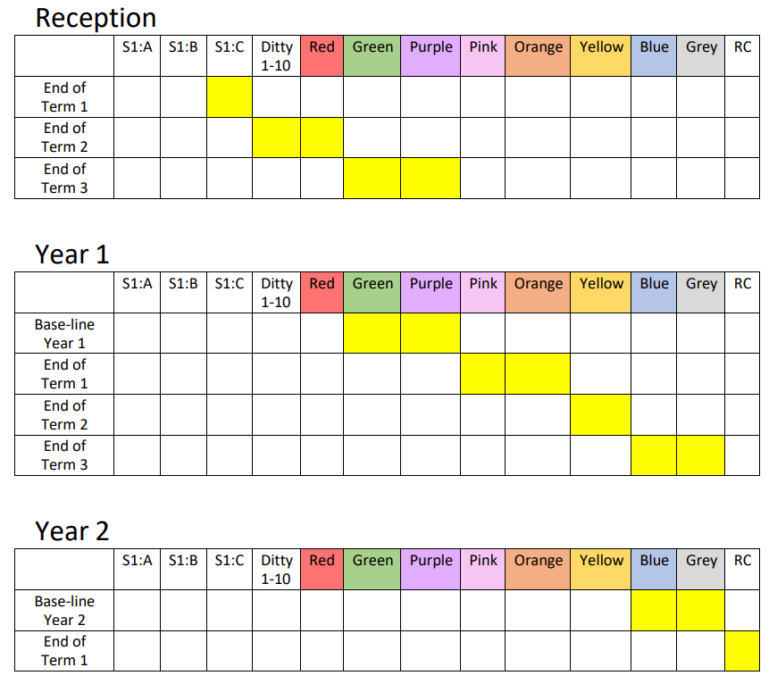
RWI
Expectations

Slide 16
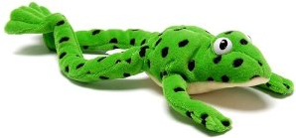
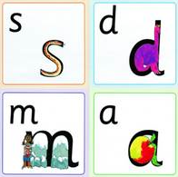
Helping at home
Read favourite stories over and over again
Read some stories at a higher level than they can read themselves.
Listen to them reading their take home Phonics storybooks.
Practise pronouncing sounds: Remember no ‘fuh’ and ‘luh’!
Have fun with Fred Talk e.g. “what a tidy r-oo-m!”
Notes:
Give a couple of examples e.g. Where is your c_oa_t? Time for b_e_d! Make sure your child can tell you what the word is.
Use only single syllable words (no Fred Talking multi-syllabic words) and only the last word in a sentence or it gets very silly! E.g. P_u_t o_n y_our b_l_ue c_oa_t (you’ll never get out!).

Slide 17
Online Resources
Ruth Miskin
https://home.oxfordowl.co.uk/reading/reading-schemes-oxford-levels/read-write-inc-phonics-guide/
Free e-books for home reading:
https://www.oxfordowl.co.uk/home/reading-site/find-a-book/library-page?view=image&query=&type=book&age_group=&level=&level_select=&book_type=&series=Read+Write+Inc.#

Slide 18
Teach a child to read
and keep that child reading [and talking]
and we will change everything.
And I mean everything.
Jeanette Winterson

