Slide 1
Welcome!

Slide 2
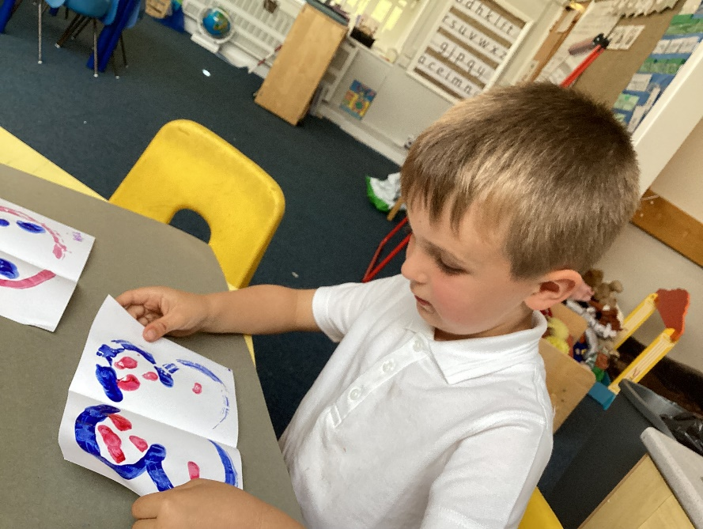
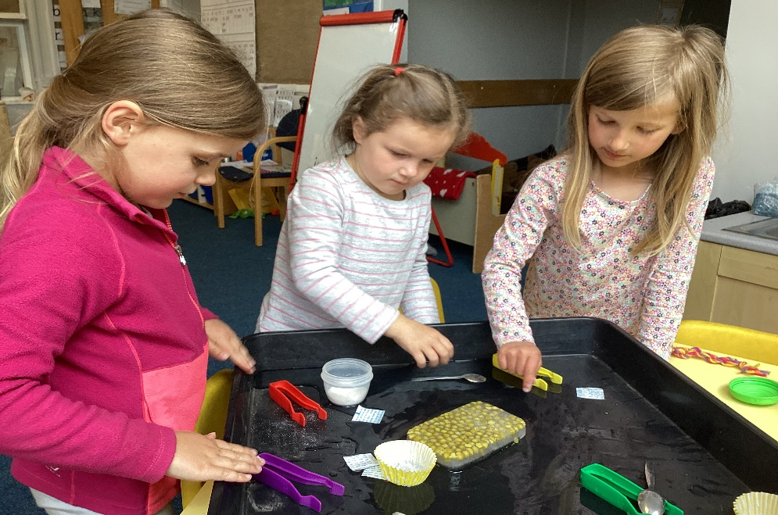
Foundation Stage
The Early Years Foundation Stage Curriculum is based on the recognition that children learn best through
play and active learning.
Notes:
English books after

Slide 3
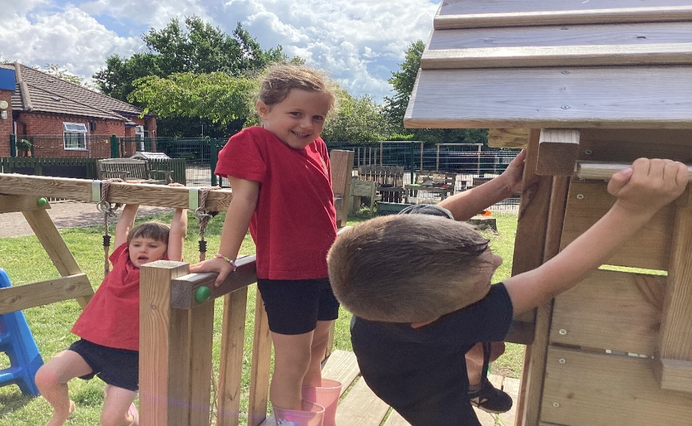
Characteristics of Effective Learning
Playing and Learning – Engagement
Active Learning – Motivation
Creating and Thinking Critically - Thinking

Slide 4
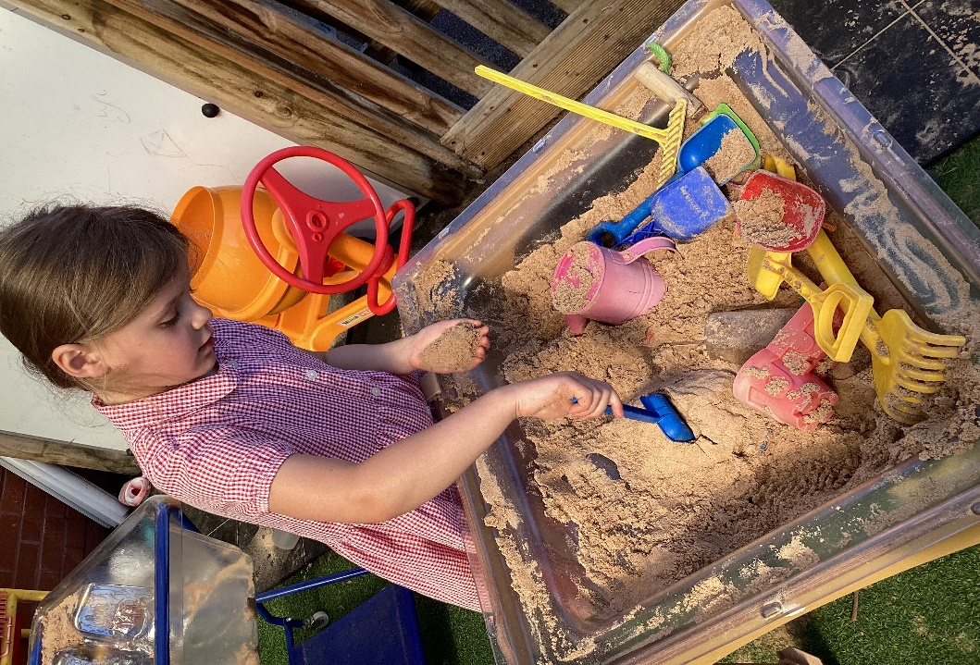
Areas of Learning
There are 7 areas of learning.
All areas of learning and development are important.
Three areas are crucial to ignite children’s curiosity and enthusiasm for learning.
These are called the PRIME AREAS. These areas are:
Communication and language
Physical development
Personal Social and
Emotional development

Slide 5
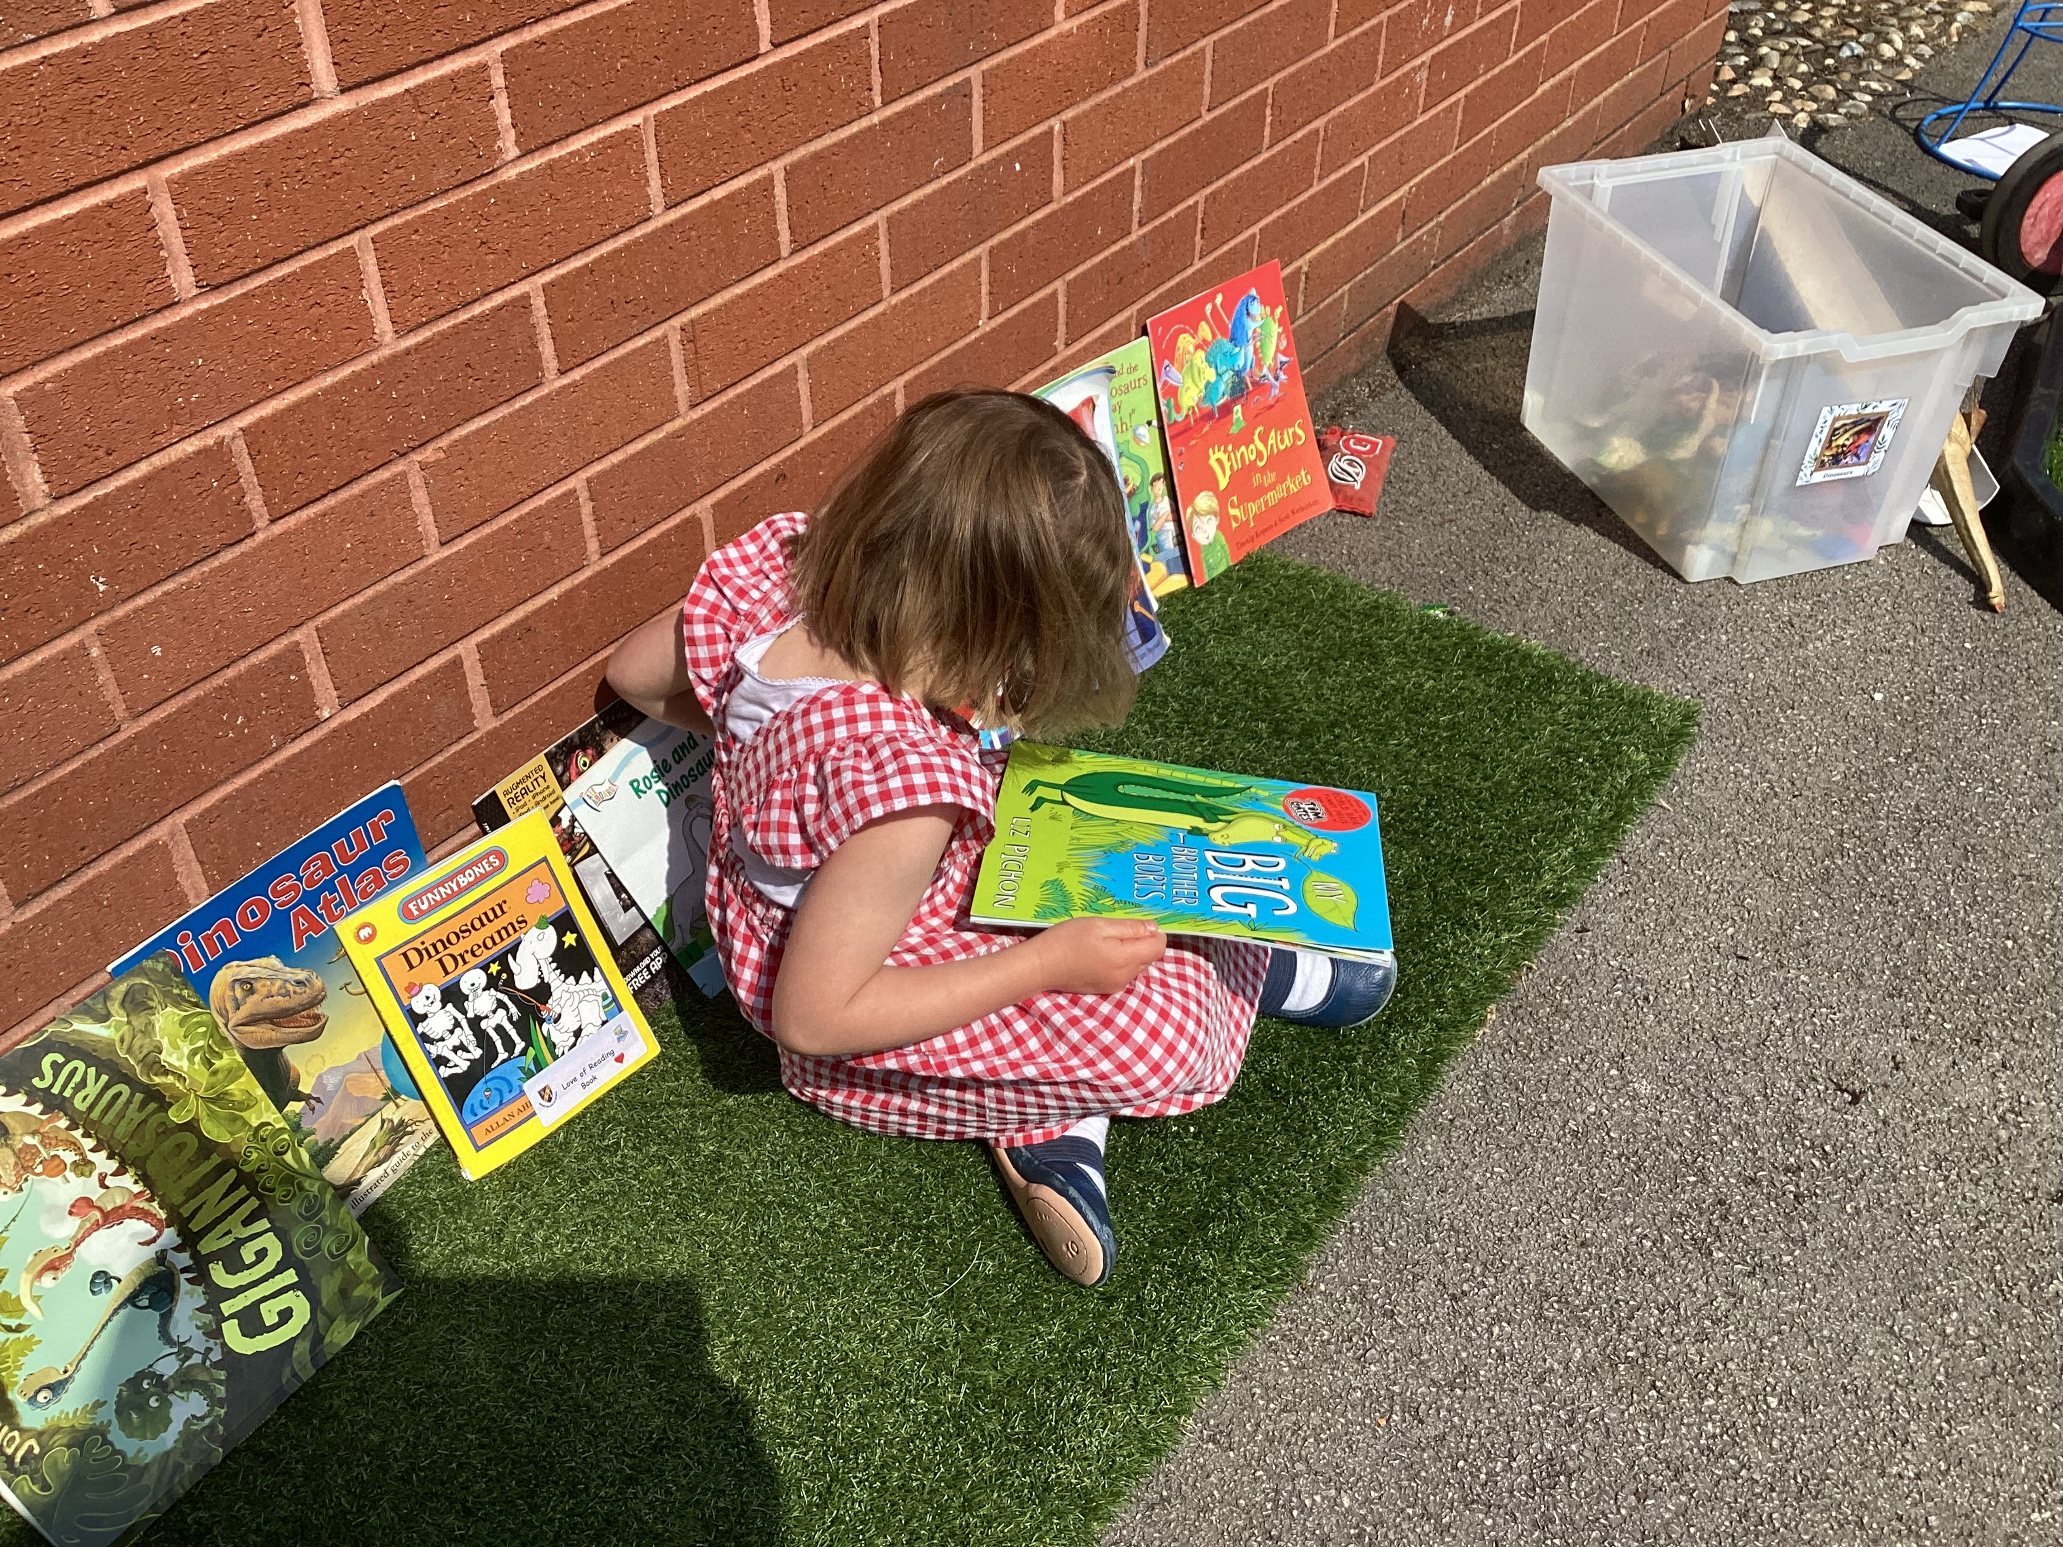
Areas of Learning
There are 4 SPECIFIC areas where the prime areas are strengthened and applied.
Literacy
Maths
Understanding of the world
Expressive art and design

Slide 6
The first few weeks
We will find out what the children
already know & can do
& use this information to create a baseline or your children and adapt teaching to meet their needs and interests.

Slide 7
Observations
Children applying their learning and showing this independently
We use Teams to record and share observations and work – on their own and in groups – this is used for WOW moments!
Homework- This will be set on Teams – the main focus is reading.
We strive for five.

Slide 8
Transition
July 3rd Children are invited into Robins class for the afternoon.
1:15pm – 2:45pm
Drop off /collection from the main entrance or they can go back to Preschool if they are booked in.
Please let me know of any interests to help settle your child.

Slide 9
September
School Opens Tuesday 3rd September
Tuesday 3rd: 8.40 – 12.00
Wednesday 4th: 8.40 – 1pm
Thursday 5th onwards
Full days – 8.40 – 3.15

Slide 10
Picking up/Dropping off
Drop at 8:40am
Pick up at 3:15pm
Please let us know if you are running late.
S4YC run a before and afterschool club.

Slide 11
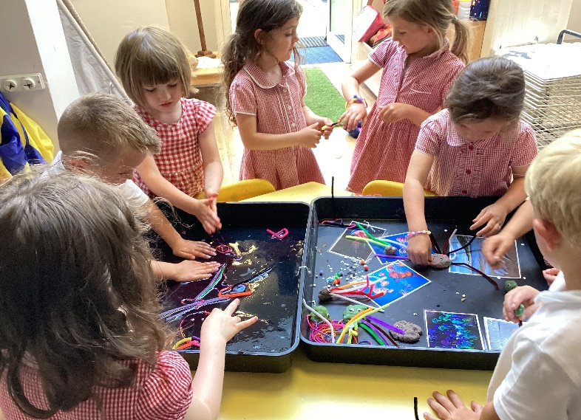
A Day in the Life of a Reception Child
Register
Worship
Maths / Literacy (Play based)
Phonics
Break time
Maths / Literacy (Play based)
Story
Lunch time
Wider Curriculum (PE, RE, PSHE etc.)
Break time
Play and Learn – Interventions through play

Slide 12
School Dinner and Snacks
Free school meals for all children
Can bring packed lunch
If your child is eligible for free school meals, please still fill in forms.
Please send you child in with a healthy snack for morning break.
Children need to bring in their own named water bottle with water only.
In afternoons, the children will receive free fruit.
NO NUTS! We are a nut free school. Please check any cereal bars etc. for nuts.

Slide 13
Uniform
Available in Neston Uniform shop
Black or grey skirt/dress/trousers/shorts
White polo neck t-shirt
Red sweatshirt/cardigan
Summer dresses – Red
Black sensible shoes

Slide 14
PE
Black shorts, red t-shirt and black pumps
Plain black tracksuit/trainers
Children are asked to come in on PE day with their PE kit.
PLEASE LABEL EVERYTHING!

Slide 15
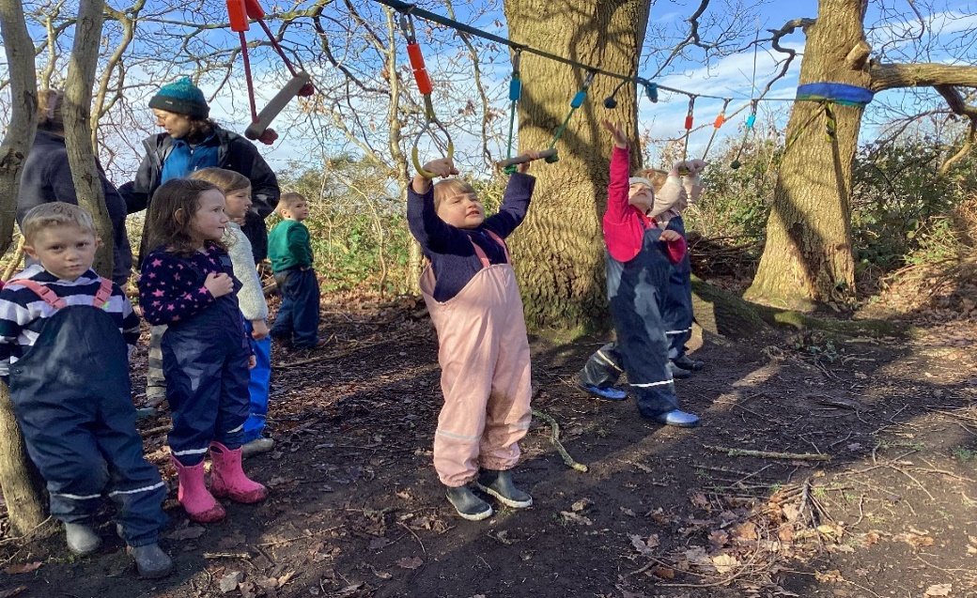
Forest School/
Outdoor activities.
We are lucky to have a fabulous outdoor environment and forest area
If you have spare wellies at home it would be great to keep them in school so that we can be flexible about when we go outside.

Slide 16
Communication with School
School spider
Office – Phone or email admin@bishopwilson.Cheshire.sch.uk
Teacher – through the chat on Teams
Facebook Page: Bishop Wilson C of E Primary
  School

Slide 17
Celebrating behaviour and working hard
Dojo points
Friday prayer and praise collective worship

Slide 18

Reading and Phonics
Read Write Inc. (RWI)
Learn sounds and rhymes
Reading books normally
after Set 1 sounds are secure

Slide 19
Breakfast and Afterschool Club
Breakfast club is run by S4YC at preschool on site. This is open from 7.45am
S4YC will collect the children from their class and take them to afterschool club which is available until 6pm daily.
Contact number is : 07940956871

Slide 20
Thank you!

