Slide 1
Meet the teacher
Welcome to
Owls Class
Mr Morris & Mrs Parkinson

Slide 2

Who are we?
The joy of the Lord is Your Strength
Nehemiah 8:10
Within God’s family we nurture, teach and support each other, opening doors for all.
The joy of the Lord and our Christian values help us to flourish in school and in our community; as communicators, explorers, readers and believers

Slide 3

Main School Priorities for the coming year
Build on our curriculum developments with new staff – ensure exciting opportunities and consistency throughout school.
Utilise recent developments of school grounds to provide additional opportunities for children.
Continue to develop an adaptive and informed approach to teaching and learning

Slide 4

Through our curriculum we are …
Communicators
Explorers
Readers
Believers

Slide 5

Culture Crew

Slide 6
Topic outline for this year will be:
Autumn – The Stone Age and Iron Age
Spring – European Countries and The Romans
Summer – Volcanoes, Mountains and Earthquakes

Slide 7
Trips / Residential
Autumn – Roundhouse trip
Spring – Chester
Summer – Liverpool

Slide 8
Forest School
Robins – Every Wednesday morning, all year
Owls – Wednesday afternoons – Autumn 1, Spring 1, Summer 1
Eagles - Wednesday afternoons – Autumn 2, Spring 2, Summer 2

Slide 9
Daily Routine
Arrival: 8.40 drop off at classroom door.
Register 8.45
Morning break: Please send a healthy snack if required (No nuts allowed)
Lunch menu – on the website/newsletter 12.00 – 1.00pm
Home time:3.15 – collect from classroom door.

Slide 10
PE will usually be on :
Wednesday (unless it is our turn for Forest School) and Tuesday
Your child will need the following items named:
White or red t-shirt , black shorts (and jogging bottoms), trainers (for outside PE), pumps (for indoor PE). Please can they also wear a school jumper/cardigan.
Children to come into school on PE days in their PE kit (no ‘own clothes/football club kits).
Notes:
EMPHASISE that proper PE kit is needed – for PE lessons and for clubs
Swimming will be Thursdays 10-10.30

Slide 11


Reading in Owls Class:
Each child is expected to ‘Strive for five’ – this means reading at least 5 times a week at home.
Reading records are provided for recording what is read and when.
Our class will have rewards for those who stay on top of their reading – please help your child by completing the reading record.
Phonics books will be given out on a Friday and are to be returned the following Friday

Slide 12
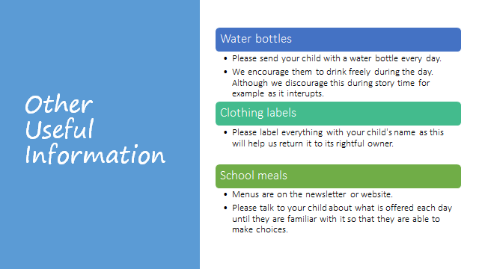

Slide 13



School rules

Slide 14
Reward system at Bishop Wilson:
Most days – assuming they have been positive ones – a child should earn dojos. These are turned into points and can be saved up or spent by children at the end of each term.
Each week, we will pick two of our children to receive an award for a special achievement. One for our Curriculum Drivers/CERB and one for our Christian Values.
Parents of children receiving certificates are notified a week in advance so that they can attend the Celebration Worship on a Friday.

Slide 15
Home Learning:
Each week, homework will always be to read at least 5 times, learn their spellings and practise times tables. Some weeks, children may also be set a task on maths.co.uk or spag.com. Details will be shared on our class Teams when this is the case.
Homework will be set on Friday and returned the following Friday.
Every Friday, children are to bring in their reading
records with the expectation that they have read
at least 5 times and have 5 signatures to confirm this.
Every Friday, children will be tested on that week’s spellings that they should have been learning at home as well as in school.
Every Friday, children will have a times tables test and
so will need to regularly be practicing these at home too.

Slide 16
Time off school:
In case of illness: phone school office before 9.30am or send in an absence request on school spider (easiest way).
Requested time off school: please email the school office (or use school website) to explain why it is exceptional. A leaflet explaining fixed penalty notices will be sent out with the first newsletter of the school year.
We do monitor late arrivals and those who have regular time off school and will be in touch where necessary to offer support.

Slide 17
Medication:
All medication (prescribed and non-prescribed) needs to be handed into the school office and a medication form needs completing by the parent/carer.

Slide 18

PTA:
Involving yourself with the PTA is important
If you would like to get involved please email Mr Orford who will pass your details on to the PTA
We need your support ~ thank you.

Slide 19
If you feel that we haven’t kept our part of the home school agreement please let us know.
If you have questions, concerns or compliments please let us know.
Parental ‘What’s app’ groups are very helpful but please come directly to school staff with questions.
#PARTNERSHIP

Slide 20
Who to speak to at Bishop Wilson …
First port of call should always be your child’s teacher.
Mr Orford is Head of School hos@bishopwilson.cheshire.sch.uk
Mrs Davies is Executive Headteacher for Christ Church and Bishop Wilson Primary School Freda.davies@bwccf.Cheshire.sch.uk
Mrs Blockley is our SENCO for Christ Church and Bishop Wilson
senco@bwccf.cheshire.sch.uk
For emergency information sharing please speak directly to staff or contact Mrs Johnson in the school office on 0151 336 3396, admin@bishopwilson.Cheshire.sch.uk

