Slide 1
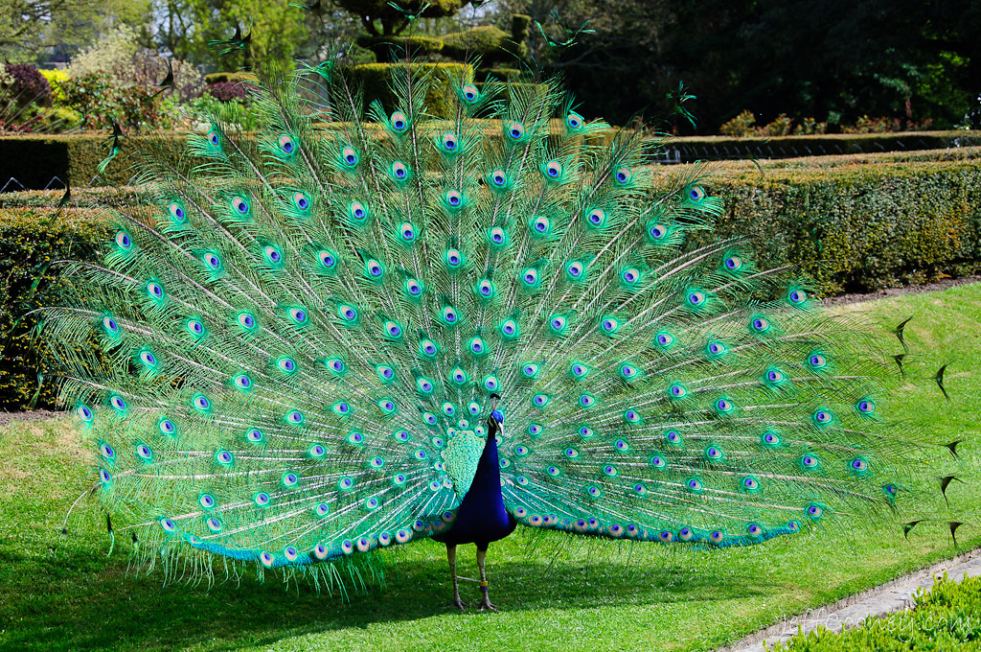
Curriculum Evening
Peacocks Class – Year 2
This Photo by Unknown Author is licensed under CC BY-NC-ND

Slide 2
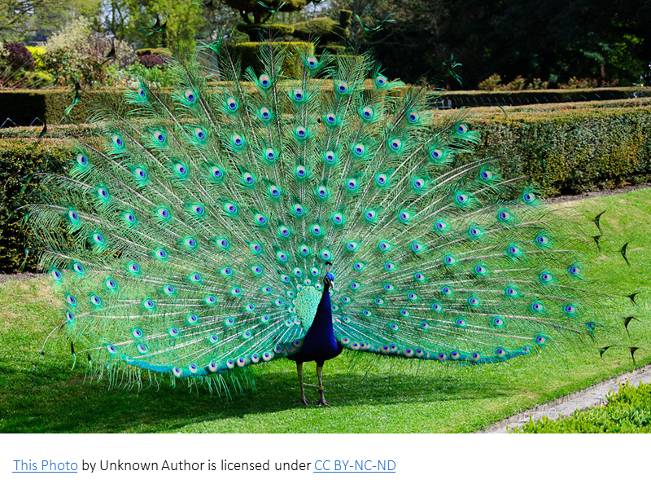
Who are the teachers in the class?
Mrs Lomax – Class Teacher
Mrs Solkar – PPA cover
Mrs Wood and Mrs Marr– TAs
Miss Taylor – volunteer
Mr Atlay – student teacher (until mid December)

Slide 3

A Typical Day in Year 2
8.45 – 9.00 Morning Maths, Spelling Practice and Registers
9.00 – 9.20 Assembly
9.20-10.15 Maths
10.15-10.30 Break
10.30-11.00 Phonics
11.00-11.45 English
11.45 -1.00 Lunch
1.00-1.30 Register, Guided Reading or Handwriting
1.30-2.15 Topic lesson
2.15-2.25 Break
2.25-3.30 Topic lesson

Slide 4
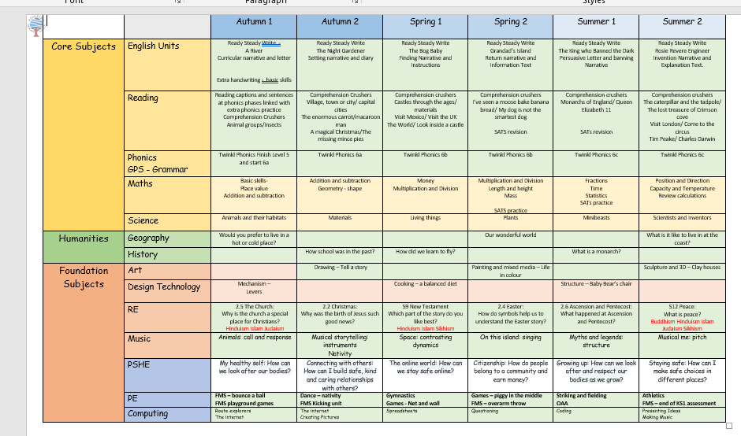
Curriculum Overview

Slide 5
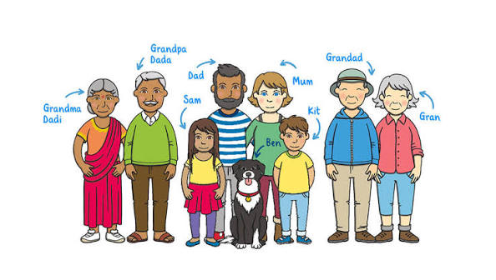
Phonics in Year 2
We use Twinkl Phonics and most Year 2 children are learning Phase 6 after finishing and recapping Phase 5. Phase 6 lasts for 30 weeks and is a mix of alternative graphemes and spelling rules. It also teaches the Year 2 common exception words and there is a grammar element every week. We use Rhino Readers as our main home reading scheme in KS1 as this fits with Twinkl phonics.

Slide 6

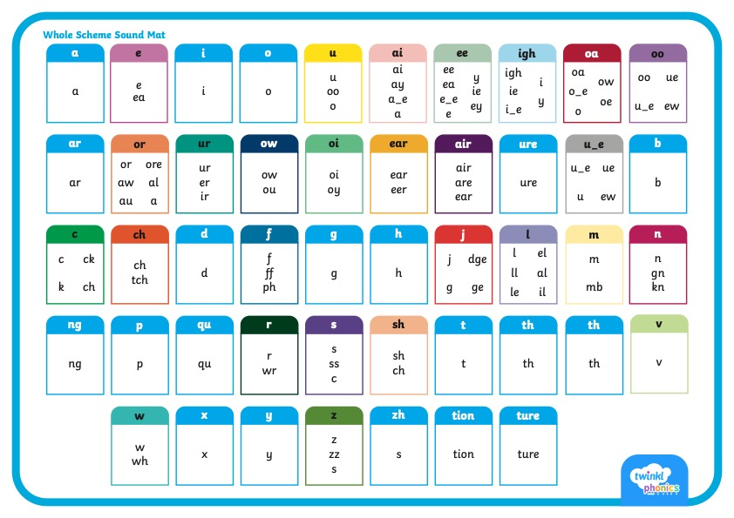
      Did You Know…?
There are 26 letters in the alphabet but there are 44 sounds and over 100 different ways of spelling them.
This is why English is one of the most complex languages to learn!

Slide 7


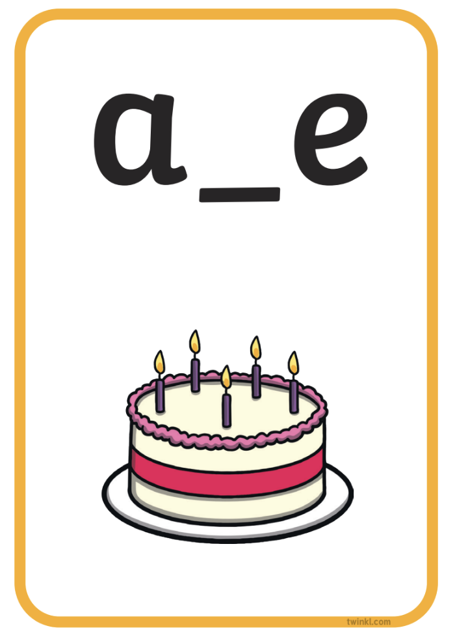


Phonics Terminology
Here is some of the terminology you might hear as your children begin to learn phonics.
Phoneme | the smallest unit of sound in words
Grapheme | the written representation of a sound
GPC (Grapheme-Phoneme Correspondence) | being able to match a phoneme with the correct grapheme and vice versa
Blending | joining individual speech sounds together to read a word
Segmenting | breaking down words into individual speech sounds to spell a word
Digraph | two letters making one sound e.g. ‘sh’
Trigraph | three letters making one sound e.g. ‘igh’
Split Digraph | two letters making one sound which are divided by a consonant e.g. the i_e sound in the word ‘side’
Tricky/Common Exception Words | words that are not fully decodable such as ‘the’ and ‘was’
Sound buttons | circles or spots that can be written underneath a sound to support reading
Sound bars | lines that can be written underneath digraphs or trigraphs to show that the letters make one sound
Mnemonic | a visual prompt to help children remember a sound

Slide 8



      How You Can Help Your Child at Home
Work on listening skills, taking turns and encouraging your child to look at you when you are speaking.
Practise segmenting and blending words.
Look for familiar sounds and words in the world around you. Such as, when in the supermarket, can your child find words on your shopping list or recognise letters on food packaging?
When outside, can they recognise letters on street names or on car number plates?
When in the house, can they recognise letters or words in magazines or letters you receive?

Slide 9
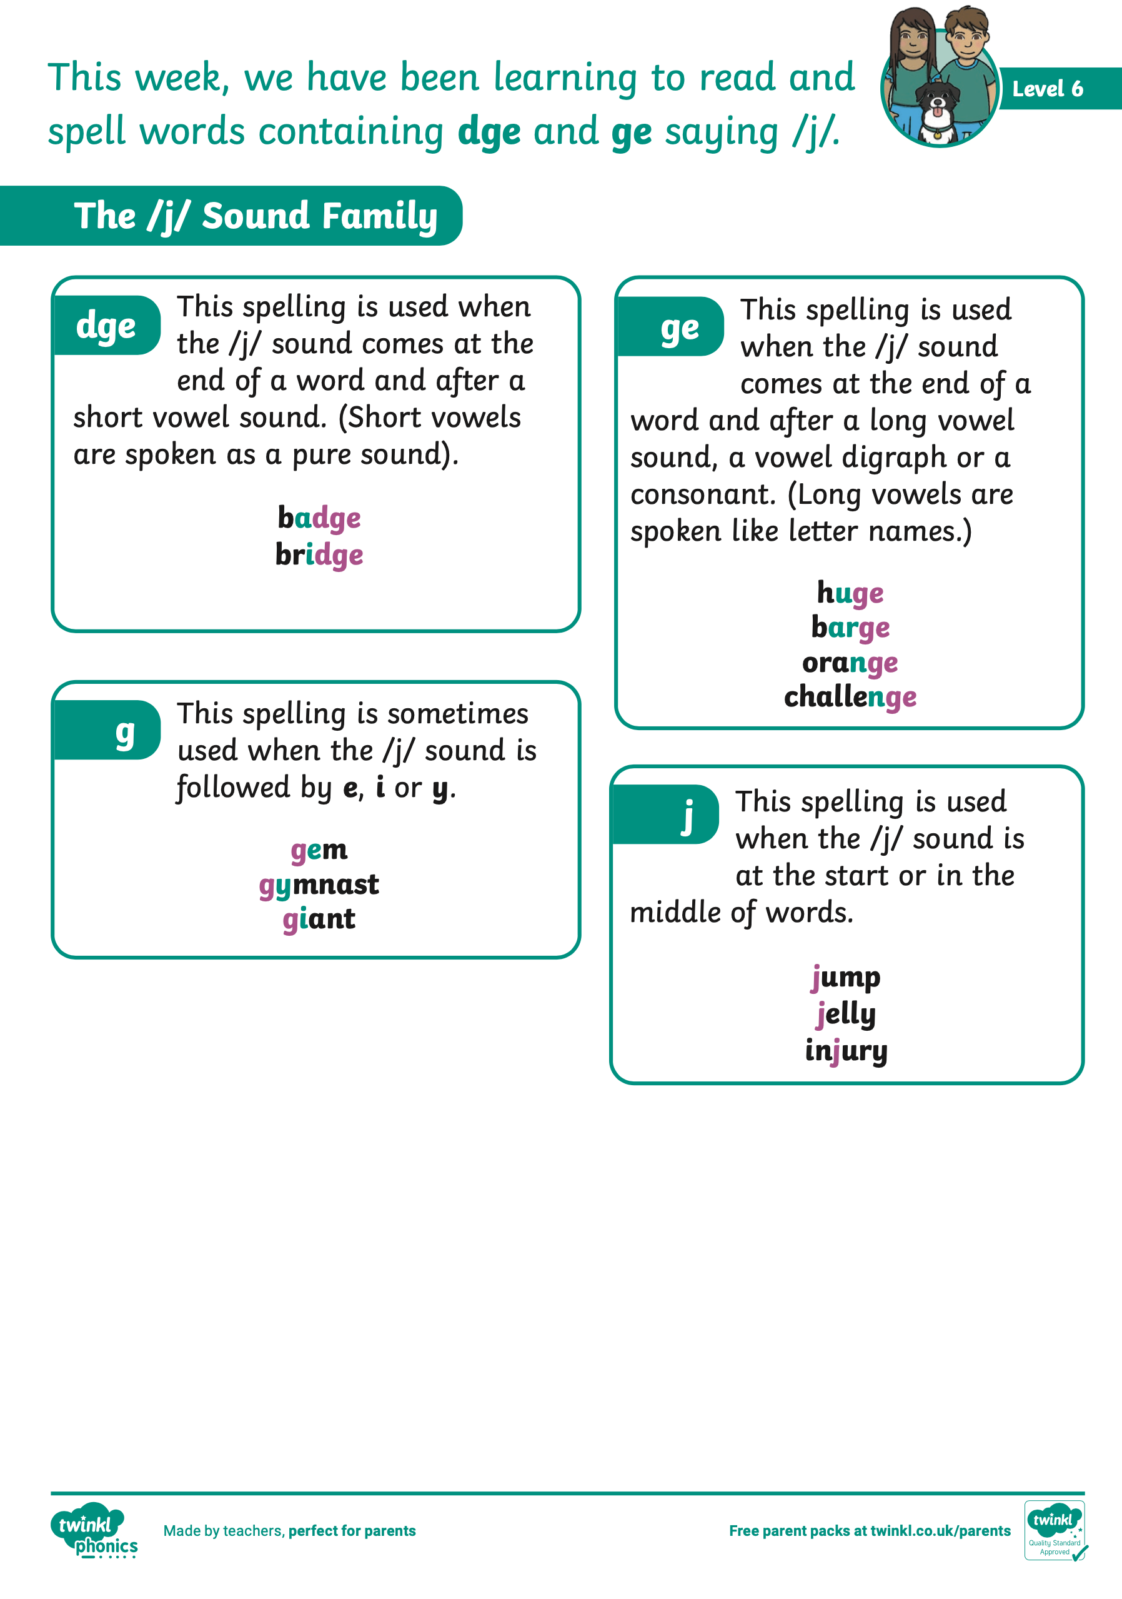
      How You Can Help Your Child at Home
Practise the new sounds and graphemes your child is learning. Remember to use ‘pure’ sounds when pronouncing the sounds and model the correct letter formation as is taught in school.
Support your child to complete any homework they bring home.
Read to and with your child every day.
Finally, remember to ask your child’s class teacher if you are unsure about any aspect of your child’s phonics learning. A consistent approach is important.

Slide 10
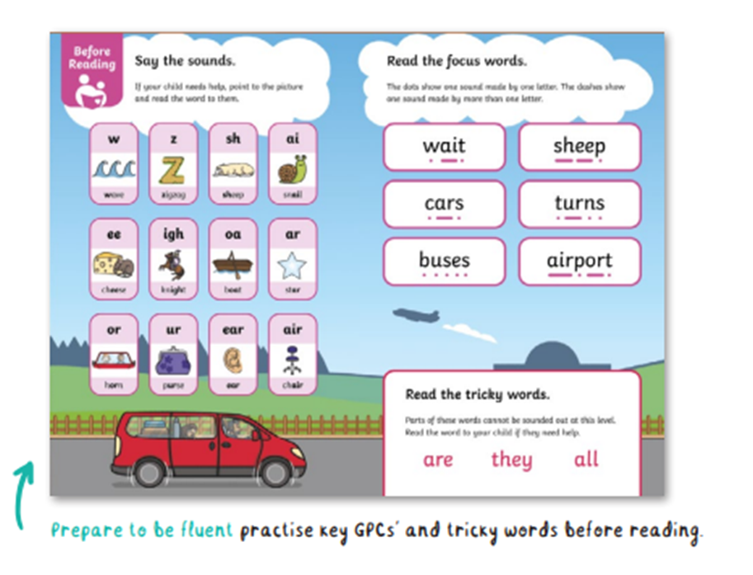
Rhino Readers - Decodable books match to children’s phonic knowledge
Your child will already have been taught most of the sounds and tricky words you can see on the page. However, they’re quite likely to need a reminder, so don’t panic if you need to tell them again!
Practise quick recall - point to the sound cards and ask your child to say them, then repeat with the tricky words.
Try to keep this pacy - it’s an introduction to reading rather than a lesson in itself.
If you find your child is really struggling to remember the sound cards, it could be a pointer that they need a little more work on this part of their phonics - something to flag up with their teacher.
Notes:
With the emphasis on decodable books being matched to children’s phonic knowledge, you can assume that your child will already have been taught all the sounds and tricky words you can see on the page. However, they’re quite likely to need a reminder, so don’t panic if you need to tell them again!
You can use this page to practise quick recall - point to the sound cards and ask your child to say them, then repeat with the tricky words. Try to keep this pacy - it’s an introduction to reading rather than a lesson in itself. If you find your child is really struggling to remember the sound cards, it could be a pointer that they need a little more work on this part of their phonics - something to flag up with their teacher.

Slide 11

Expect to read the book a few times
Children love the process of getting familiar with a book and will often ask for a favourite story over and over again - the reason being, we’re asking them to practise so many skills, and they need repeated opportunities to master them all.
The first time a child reads a book, it’s really all about decoding the words and building them into sentences. On the first reading, Parents will be the ‘expert’
The second (third, or fourth!) time, you’ll transfer that role to your child. They’ll love taking charge of the discussion and explaining what’s happening in the book - and, because the reading process is smoother and easier with practice, it won’t feel like so much hard work to them.
Subsequent reads - dig deeper into comprehension, especially anything that requires children to think about the whole text rather than just the words on the page.
It’s also a fab chance to help your child read with fluency and emphasis - what’s sometimes called a ‘storyteller voice’.
Lowers cognitive load
Improves reading fluency and prediction
Vocabulary growth
Deeper comprehension
Emotional security
Notes:
Expect to read the book a few times
Once you know your learner can talk about the book subject and are able to recognise the letter sounds and tricky words, it’s time to get reading. As adults, we tend to see a book like a meal: we read it, digest it, and then we look for something new. But children love the process of getting familiar with a book and will often ask for a favourite story over and over again - the reason being, we’re asking them to practise so many skills, and they need repeated opportunities to master them all.
The first time a child reads a book, it’s really all about decoding the words and building them into sentences. This will quite literally be one word at a time at the early levels. It’s perfectly normal to have to read the word or sentence a few times before it all comes out fluently in the right order. With the Rhino Readers phonics books, the detailed supporting illustrations will be your friend, helping your child make sense of the narrative - so make sure you take a little time to look at the pictures before launching into the words.
On the first reading, you’ll be the ‘expert’ - but when you’re back with the book the second (third, or fourth!) time, you’ll transfer that role to your child. They’ll love taking charge of the discussion and explaining what’s happening in the book - and, because the reading process is smoother and easier with practice, it won’t feel like so much hard work to them.
These subsequent reads are the perfect time to dig deeper into comprehension, especially anything that requires children to think about the whole text rather than just the words on the page. It’s also a fab chance to help your child read with fluency and emphasis - what’s sometimes called a ‘storyteller voice’.

Slide 12
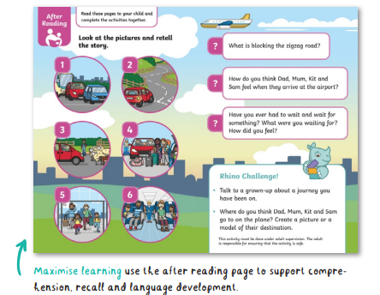
Understanding the text
Rhino Readers decodable books have an after-reading page. The questions provided are a great way to check key reading competencies: comprehension, vocabulary, sequencing and inference.

Slide 13

Top tips
Make sure your child is the one holding the book and doing the page turning.
Encourage them to flick backwards and forwards through the book to take ownership - they’ve done the hard work, and now the book is theirs to command.
Reading is best done in short burst regularly – 5-10 mins daily is best.
If your child is tired they may be reluctant to read so try to read before they’re too tired to concentrate. Find the best time that fits with you and your child.
Notes:
make sure your child is the one holding the book and doing the page turning. Encourage them to flick backwards and forwards through the book to take ownership - they’ve done the hard work, and now the book is theirs to command. We’ve kept everything here appropriate to the level of the book and, of course, closely followed the EYFS Framework and National Curriculum programmes of study when setting the after-reading activities.
Reading can - and should - lead beyond the book itself, and our Rhino Challenges are designed to be the next step. There’s a selection of ideas for each decodable book covering all bases, from arts and crafts, to drama and research. They’re designed to be fun while ensuring children cement their learning, have the chance to improve their language skills and make links to other things they’re knowledgeable about.

Slide 14
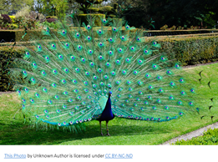
Reading Records
Please comment on which pages your child has read and how they have done. It is helpful to write when they have finished the book as the books all have different number of pages. E.g. Read p20 to end.
Comments you could make: If your child has struggled with any words please write the words they have struggled with. You could write about anything your child has enjoyed or their favourite part. You could comment on their attitude to the book or on improvements e.g. Daisy found this book difficult and wasn’t keen to finish it or Daisy read with improved fluency.
If for any reason your child’s book hasn’t been changed on a Monday and they have finished the book please let me know.

Slide 15
Why Reading matters?
* Improves language skills
* Boosts concentration, focus and memory
* Encourages creativity and imagination
* Builds empathy and emotional connection
* Reading for pleasure promotes positive mental wellbeing
* Helps children access other areas of the curriculum and further learning
* Regular readers achieve up to 30% better results than non-readers
Notes:
Progress in School: By age 16, children who read regularly for pleasure show significantly more progress in vocabulary, mathematics, and spelling than their peers. This effect is a stronger predictor of cognitive development than the educational background of their parents. [1]
Testing Scores: Data tracking children aged 8 to 18 shows that those who actively enjoy reading achieve noticeably higher standardized reading scores (averaging 109.13) compared to non-readers (averaging 102.65). [1]
The Word Gap: Children who are read to daily at home enter school having heard roughly 296,000 words by age 5, compared to just 4,600 words for children who are never read to. This creates a massive developmental baseline difference before formal education even begins

Slide 16
Readers at Age 7 (Proficient / Developing Fluency)
• Decoding Skills: Can sound out unfamiliar words using phonics, recognize common sight words automatically, and handle multi-syllable words or unusual patterns (like eye or beautiful).
• Fluency & Comprehension: Read aloud with expression, pace, and self-monitoring—meaning they notice when a sentence does not make sense and go back to fix it.
• Independence & Choice: Often enjoy picking out early chapter books, graphic novels, or short non-fiction, and can answer questions about a text.
• Cognitive Momentum: Because reading feels rewarding, they read more often. This builds vocabulary, background knowledge, and general confidence. Research shows young readers score significantly higher on standardized reading tests.

Slide 17
The importance of fluency in Year 2
Reading fluency is the critical bridge that transforms basic word decoding into genuine reading comprehension.
Why Fluency Matters
Frees Cognitive Energy: When word recognition becomes automatic, your brain stops struggling with individual letters and sounds. This frees up mental space to focus on the actual meaning of the text.
Drives Comprehension: Research shows a strong link between fluent reading and deep understanding. Without fluency, readers get stuck processing mechanics and miss the message.

Slide 18
El Cuento de Caperucita Roja
Había una vez una niña dulce a la que todos llamaban Caperucita Roja porque siempre llevaba una capa roja que le regaló su abuela. Un día, su mamá le preparó una canasta con comida y le dijo:—Llévale esta canasta a tu abuela, que se siente enferma. Pero recuerda: no hables con extraños, no te salgas del camino y ve directamente a su casa .La abuela vivía al otro lado del espeso bosque. Caperucita caminaba alegremente cuando un lobo astuto se asomó entre los árboles y le preguntó a dónde iba. La niña inocente le dijo que iba a visitar a su abuela.

Slide 19
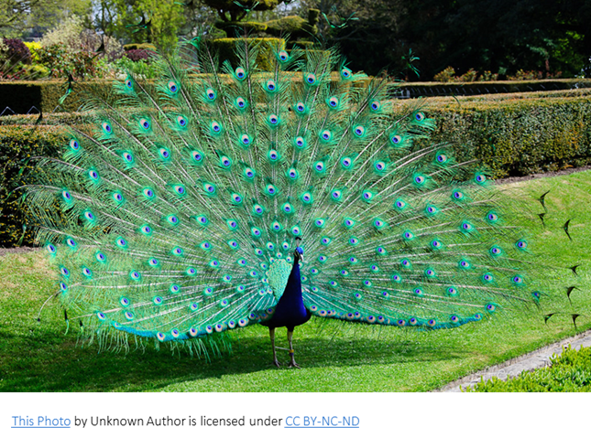
The importance of understanding the vocabulary.
Young Aurelia—customarily designated by the crimson hooded mantle adorning her shoulders—traversed the labyrinthine depths of the primeval woodland. Entrusted by her maternal progenitor with a wicker hamper containing culinary confections destined for her maternal grandmother’s domicile, she was explicitly admonished to eschew deviations and maintain steadfast vigilance against malicious interlopers.

Slide 20
Reading for enjoyment
Boosts Confidence: It improves vocabulary, listening stamina, and comprehension without the stress of formal assessment.
Builds Habits: Early reading enjoyment is a strong indicator of future happiness, literacy growth, and academic success.
Values Choice: Allowing children to pick what interests them—whether that means picture books, comics, non-fiction animal books, or football stats—makes reading feel rewarding.
We have a fantastic school library with a wide range of books – Please ensure your child brings their books in on Mondays.
We also have a class book corner with a variety of books and we use the school library service and book bus to supplement this.
Brilliant Book Awards.

Slide 21
Practical Ways to Encourage KS1 Reading
• Read Aloud Together: Do not stop reading to children just because they can decode words. Share stories out loud using fun voices, take turns reading pages, or read dialogue together.
• Use Audiobooks: Audiobooks let children experience rich stories above their current reading level and keep them engaged during car journeys.
• Model the Habit: Let children see adults reading books, newspapers, or magazines so they know reading is a lifelong adult pleasure too.
• Explore Curated Booklists: Find age-appropriate recommendations and themed collections through the BooksForTopics Reading for Pleasure Guides or explore structured tips on the Oxford Owl Parent Guide.

Slide 22
Writing at Ashleigh Primary School
What is Ready Steady Write?
High-Quality Literature: Units are anchored around rich, inspiring books that capture children's imaginations.
Talk-Centred Approach: Speaking, drama, and vocabulary exploration come before writing. Children discuss, retell, and structure their ideas orally before putting pen to paper.
Modelled & Shared Writing: Teachers explicitly model how to craft sentences, use grammar, and spell words, so children know what success looks like.
Drafting and Editing: Children learn to review, evaluate, and improve their own writing.
Support for All Learners: The scheme is designed to support English as an Additional Language (EAL), Special Educational Needs and Disabilities (SEND), and lower-attaining pupils through targeted scaffolding.

Slide 23
How Parents Can Support at Home
Talk About Stories: Ask your child to retell the stories they are reading or learning about in school using their own words.
Build Vocabulary: Talk about new or interesting words discovered in books and use them in everyday conversations.
Read Together Daily: Shared reading strengthens language comprehension, sentence structure, and a natural love for writing.
Celebrate Mark-Making and Writing: Encourage younger children to draw, label, or write simple notes, focus on effort, and keep writing fun.
Practice correct letter formation
Practice spellings

Slide 24
Maths
Year 2 Curriculum Topics by Term
Autumn Term:
  Place Value (numbers to 100)
  Addition and Subtraction
  Shape (properties of 2D and 3D shapes)
  Money (identifying coins, notes, and calculating totals/change)
Spring Term:
  Multiplication and Division (2, 5, and 10 times tables, arrays)
  Length and Height
  Mass, Capacity, and Temperature
  Fractions (finding halves, quarters, and thirds)
Summer Term:
  Time (telling the time to the nearest 5 minutes, quarter past/to)
  Position and Direction
  Problem-solving and consolidation of all four operations

Slide 25
Maths – How can I help at home?
Practice number bonds When children know the answer to simple number bonds e.g. 2+3 = 5
6+4 = 10 2+7 =9 it makes it much easier for the next stage of maths.
Counting skills Knowing that they don’t need to count all the objects but can count on. Counting on in steps e.g. 2s, 5s, 10s.
Place value knowing what the digits in numbers mean and why that is important e.g. the difference between 13 and 31.
Number formation Children need to be able to form numbers correctly so their answers can be read.
Use Everyday Maths: Count objects, measure ingredients while baking, or count money when shopping.
Access Free Resources: You can download free parent guides, workbooks, and small-step activity sheets directly from White Rose Education.
https://whiteroseeducation.com/parent-pupil-resources/maths/maths-with-michael
https://whiteroseeducation.com/parent-pupil-resources/maths/home-learning?year=year-2-new
Use Support Apps: White Rose offers the free 1-Minute Maths app to build quick recall of number facts and times tables.

Slide 26

Homework
Homework is given out at the start of the term in the form of a grid. At least 6 pieces (approx. 1 a week) should be completed over the half term including the 4 in the grey boxes. It is up to you when they are completed as long as they are done by the end of each half term.
Reading books – changed weekly usually on Mondays, should be read more than once in the week to build fluency and comprehension, little and often is usually best.
Spellings – between 10 and 12 a week, given out on Fridays for the test on the following Friday, also available on Spelling Shed.
TT Rockstars – once children begin to learn multiplication and division (after Christmas) it is helpful to regularly practice them – we learn 2x, 5x and 10x tables in Year 2 as well as counting in 3s which leads to 3x table. This is the same log in as Numberbots.

Slide 27
Important Information
Library – Mondays
Reading books – change on Mondays. Books should be in school every day.
Spellings – Fridays
PE Days – Mondays and Thursdays. Earrings need to be taken out or covered with plasters/microtape.
Outdoor learning – Wednesday afternoons once a half term.
Water bottles – should be in school daily. Water only – no juice.

Slide 28
Expectations and Standards
Behaviour
We have school rules and we have created class rules together.
We use positive behaviour strategies such as praise, dojos, golden ties and stickers.
We may also use golden time as a reward for excellent behaviour all week.
Attitude to learning and effort
This is key – They drive growth and progress.

Slide 29
Expectations and Standards continued
Behaviour expectations
Always try their best and take pride in their work
Treat everyone with kindness and respect
Listen and follow instructions
Don’t distract others from learning
Toileting
We encourage children to go to the toilet and break and lunch times so that they don’t miss out on valuable learning time. We do let children go to the toilet during lessons if needed and understand some children may have medical needs meaning they need to go in lesson time or more frequently. We allow one boy and one girl at a time during lesson time to try to prevent any incidents in the toilets so at times your child may have to wait a short time before going.

Slide 30
Expectations and Standards continued…
Presentation
We strive for high quality presentation and spend time teaching the children how to set out their work. This presentation also includes appearance.
Homework
We expect every child to read a minimum of three times a week. Children should be completing their reading book each week. Spelling should be practiced every week. Homework grids should be completed in a half term and your child should hand in to the teacher when a piece has been done and at the start of each half term.

Slide 31
Expectations and Standards continued…
Attendance and punctuality
It is really important that your child attends school regularly.
We have morning activities that run from 8.45 until 9.00 – morning maths and spelling- and it is important that your child is on time to get this valuable practice time. Some morning we do not have assembly so children may also miss out on lesson time if they arrive after 9am.
Independence and Organisation
We are helping your child to develop independence and organisation skills.
High expectations + hard work + a positive mindset = progress
Notes:
Monitors
Responsible for bringing things to school
Looking after their things

Slide 32
Building resilience
It is important that our children develop resilience.
Children will:
make mistakes
Find things difficult
Face challenges
Sometimes get things wrong
And that is absolutely OK. At Ashleigh we want children to understand that mistakes are part of learning.

Slide 33
Building resilience
We want to develop children who:
Keep going
Ask for help
Learn from mistakes
Take responsibility
Believe in themselves
Give their very best

Slide 34
Online Safety
We cover this within our computing lessons as it is imperative that children know how to stay safe online.
https://www.nspcc.org.uk/keeping-children-safe/online-safety/
Age Appropriate Games – Minecraft, BBC games, Roblox Kids (game chat disabled), Spelling Shed, TT Rockstars, White Rose Maths
Social Media – Restricted to age 13 plus currently and Age 16 plus from Spring 2027
Screen time for a 6 or 7 year old – recommended maximum of 2 hours a day.
Gaming - can cause sleep disruption, eye strain, sedentary lifestyle, stranger contact and grooming, cyberbullying and harassment, financial (in game spending), addiction, attention and mood issues.
Talking to a trusted adult – If they see anything that they don’t like then tell a trusted adult. This is taught in school and please reinforce at home.
Works best when school and parents are working together.

Slide 35
Parents Evenings and Communication
We have parents evening twice a year – usually in October/November and March/April.
We give out mid year and End of Year reports with information on how your child is doing.
My email address is lisa.lomax@ashleigh.blackburn.sch.uk or I can be contacted through the school office. I endeavour to reply as soon as possible but if you contact me in the evening or weekends it may be the next working day when I reply.
I am also available on the playground ramp on every afternoon but please could I ask that you allow me to make sure most children have gone with their parents/grandparents.

Slide 36
SATs?
It is no longer a government requirement to do Year 2 SATs.
We will do in house assessments termly with the children like other Year groups within school. In Autumn and Spring this is NFER and in Summer this is the Year 2 SATs.
Secret Agents Tasks – In the past we have rebranded SATs as Secret Agent Tasks. We will try to keep the parts that the children enjoy such as dressing up as Secret Agents.

Slide 37
Exciting things in Year 2
Outdoor learning – half termly
Infant Nativity – December
PTFA events
Parties
Brilliant Book Awards
World Book Day – March
Secret Agents
Trips – Manchester Science and Industry Museum
Sports day
End of year fun - chosen by the children. Last year included film afternoon, French day and a water fight on the field!

Slide 38
Developing the whole child
Education is about much more than English and Maths.
We want our children to develop:
Confidence
Independence
Resilience
Creativity
Team work
Communication skills
Kindness
Respect
Leadership
A love of learning

Slide 39
School Uniform
Name, Name, Name everything! And check regularly that the name hasn’t come out.
Blue v neck jumper, cardigan or hoodie with Ashleigh Badge
White shirt or blouse with collar
School tie – infants: elastic
Grey school trousers, shorts, pinafore or pleated skirt
In summer blue gingham summer dress
Grey or white socks
Black shoes
Haircuts - children should keep long hair tied back at all times using a blue bobble or hair coloured bobble and it should be in a sensible style, no tram lines etc
We expect out children to look smart around school and be ready for school.

Slide 40
PE Kit
PE top with Ashleigh badge in your child’s team colours
Black or navy shorts
Pumps or trainers
Optional – School three quarter zip top in Navy
Long hair must be tied back.
Earrings should ideally be taken out or if not they must be covered with a plaster. This is for safety reasons.

Slide 41
Equipment and expectations
Children need to bring a water bottle to school every day and it should be pre filled with water. Children can refill bottles in the afternoon if needed. No juice please.
Outdoor learning- clothes appropriate for the weather and that you don’t mind getting muddy!
Footwear: walking boots or wellies.
All in one suits or waterproof coats and trousers in wet and cold weather.
In colder months - hats, scarves, gloves and layers.
In warmer months- sun cream and sun hat. Allergy medication if needed.

Slide 42
Working together
Parents and schools have different roles, but we are working towards the same goals.
Together we can:
Support learning
Build confidence
Develop resilience
Encourage positive behaviour
Raise standards
Celebrate success
Help every child reach their potential
Strong School + Strong Home Partnership = Stronger Outcomes for Children

Slide 43
Contacting Mrs Lomax
My email address is lisa.lomax@ashleigh.blackburn.sch.uk or I can be contacted through the school office.
I am also available on the playground ramp on every afternoon but please could I ask that you allow me to make sure most children have gone with their parents/grandparents.
Further information is available on out school website.
Thanks you for coming.
Any Questions?

