Slide 1
Year 2 Curriculum Parents Meeting
2022-2023

Slide 2

Secret Agent Tasks
YEAR 2 Parents Information
Ashleigh primary school

Slide 3
SATs – Secret Agent Tasks
We believe that children’s well-being and mental health should be at the forefront of their education.
With this in mind we are not going to be mentioning SATs in our classes – instead we shall be completing Secret Agent Tasks – to see if we are good enough to become Secret Agents.

Slide 4
What are SATs?
At the end of Key Stage 1 (Year 2), children are required to be assessed in different areas of Maths and English (unless they are working significantly below the national standard).
Schools must submit teacher assessments in Reading, Writing, Maths and Science to the government.
As part of the assessment process the children will have a ‘testing week’.
HOWEVER - the tests themselves are not used as the final judgement. They are just one small piece of the puzzle.

Slide 5
When do SATS TAKE PLACE?
The school is required to administer SATs throughout May, and all schools in England will be carrying out SATs at this time.
If children are absent, they will have to do the test on their return to school.
We aim to make the SATs as non-threatening as possible, therefore they will take place in KS1 classrooms, with your child’s class teacher or an adult they work with regularly.
We will not make a big deal of the SATs tests other than doing the Secret Agent Tasks as part of our Secret Agent Training Programme that week.

Slide 6
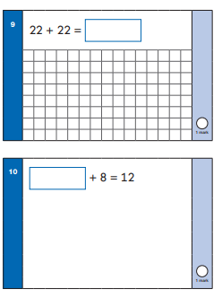
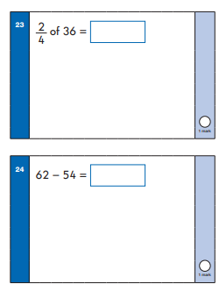
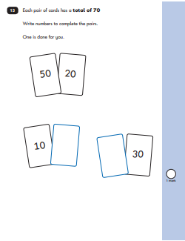
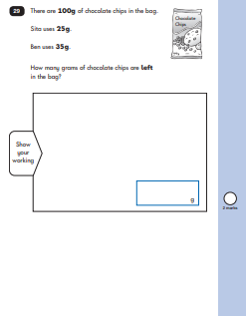
Maths
The children will be assessed in arithmetic and reasoning (problem solving).
They will need to show a range of knowledge including place value, shape, measure (inc time and money), fractions, addition, subtraction, multiplication and division.
They will need to know their 2, 3, 5 and 10 times tables.

Slide 7
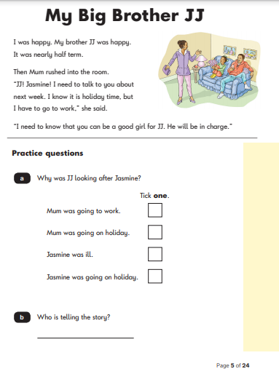
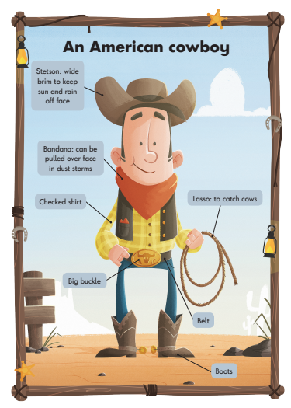
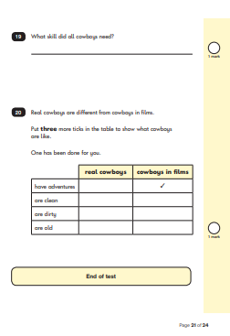
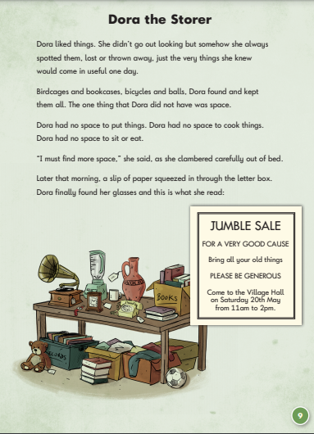
Reading
The children will be assessed on reading fluency and understanding as well as comprehension skills. They will need to be able to deduce things from the text – using a range of skills including; retrieval, sequencing and inference.
There are 2 test papers. They cover Fiction and Non-Fiction.

Slide 8
WRITING
write simple, coherent narratives about personal experiences and those of others (real or fictional)
write about real events, recording these simply and clearly
demarcate most sentences in their writing with capital letters and full stops, and use question marks correctly when required
use present and past tense mostly correctly and consistently
use co-ordination (e.g. or / and / but) and some subordination (e.g. when / if / that / because) to join clauses
segment spoken words into phonemes and represent these by graphemes, spelling many of these words correctly and making phonically-plausible attempts at others
spell many common exception words*
form capital letters and digits of the correct size, orientation and relationship to one
another and to lower-case letters
use spacing between words that reflects the size of the letters.

Slide 9
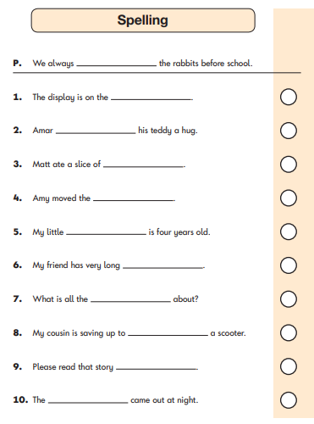
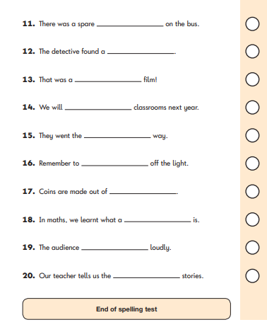
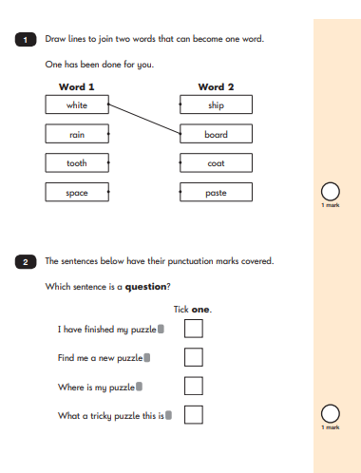
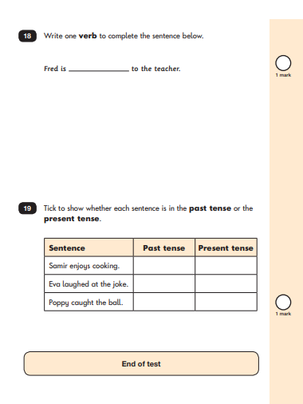
SPAG
2 papers. Paper 1 – spelling Paper 2 – Grammar, Punctuation and Spelling

Slide 10
How can you support your child
First and foremost, support and reassure your child that there is nothing to worry about and that they should always just try their best with all aspects of their learning. Praise and encourage! Please do not mention the SATs week at home – but you can always ask them how their Secret Agent Training is going.
Ensure your child has the best possible attendance at school.
Support your child with any homework tasks.
Reading, spelling and arithmetic (e.g. times tables) are always good to practise.
Talk to your child about what they have learnt at school and what book(s) they are reading (the character, the plot, their opinion).
Make sure your child has a good sleep and healthy breakfast every morning!
If your child is concerned about ANY aspect of their learning please speak to me straight away – You can always email or fill in the class contact form if we can’t speak face to face – We are here to help and support your child.

Slide 11
Please note
Whilst SATs are statutory, teachers will be assessing your child’s progress throughout the year.
This means that the scores that your child achieves in the SATs are just one part of the assessment process.
Your child’s final end of year results are determined by the teacher and not the tests!

