Slide 1









Year 1 Curriculum Evening
at
Ashleigh
Building Stronger School–Home Partnerships

Slide 2



Our Vision
The aim is to give you a much clearer understanding of:
  What your child will learn throughout the year
  What expectations and standards look like
  How you can support learning at home
  The routines and experiences your child will have
  The important role you play in your child's education
We want you to leave feeling informed, reassured and excited about the year ahead.

Slide 3

Welcome to year 1
Who’s Who
Miss Youd – Class Teacher Tuesday PM, Wednesday, Thursday, Friday
Mrs Hartley – Class Teacher Monday, Tuesday AM
Miss Briggs – Teaching Assistant – AM
Mrs McLeod – Teaching Assistant Monday PM, Wednesday PM, Friday PM
Notes:
Introduce everyone!

Slide 4
A typical Day in Year 1
  8:45am – Quiet independent reading time
  8:55am – Register
  9:00am – Assembly
  9:25am – Maths
  10:15am – Morning Break including milk and fruit
  10:30am – Handwriting
  10:45am – English
  11:45am – Lunchtime
  1:00pm – Register
  1:05pm – Phonics
  1:30pm – Foundation Subjects (Science, Art, DT, History, Geography, PE, PSHE, Music, Computing)
  2:15pm – Afternoon break
  2:30pm – Foundation Subjects (Science, Art, DT, History, Geography, PE, PSHE, Music, Computing)
  3:15pm – Home time routine
  3:30pm - Home
Notes:
A typical day, sometimes can change due to other events in school, but generally this is what a day will look like. A focus on reading each morning helps children settle into school calmly, and allows classroom staff to read 1:1 with pupils. Consistency is key throughout the week with mornings staying the same.

Slide 5
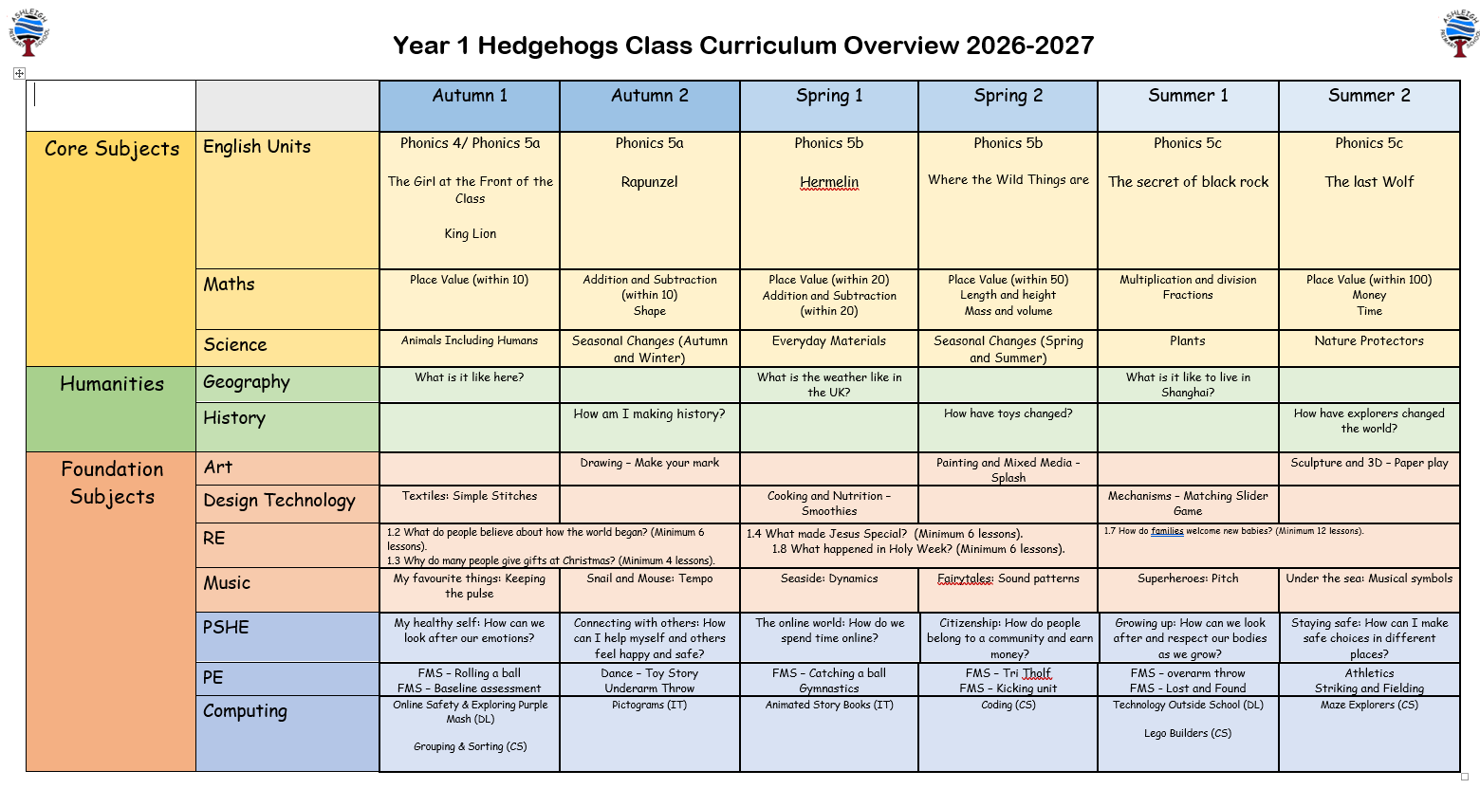
Curriculum Overview
Notes:
Subjects and terms. A copy of this is on our class page on the website.

Slide 6
Reading
We use the Rhino Readers home reading scheme.
It is important to read regularly at home. It helps to develop vocabulary, comprehension and understanding which are all key parts of a child’s learning.
Please return the home reading book daily, and sign the record once you have read. We will check and change home reading books on a Friday.
We promote reading for enjoyment by sharing stories and visiting the library.
Children visit the library on a Tuesday, so please return books weekly.
Reading is not just about being able to read the words. Children need to understand what they are reading, develop their vocabulary and talk about texts deeper, for example predicting a story.
Notes:
Rhino Readers, links to our Phonics scheme.
Important to read regularly at home to develop fluency and understanding.
Return reading books each day and sign every time it is read at home.
We change pupil books on a Friday.
We also have the wonderful school library and we visit there on a Tuesday afternoon. Please return books each Tuesday.
Importance of developing comprehension – what the pupils have read and how they make sense of it. As you are reading try to ask questions such as “what does that word mean?” or ”why is that character feeling sad?”

Slide 7
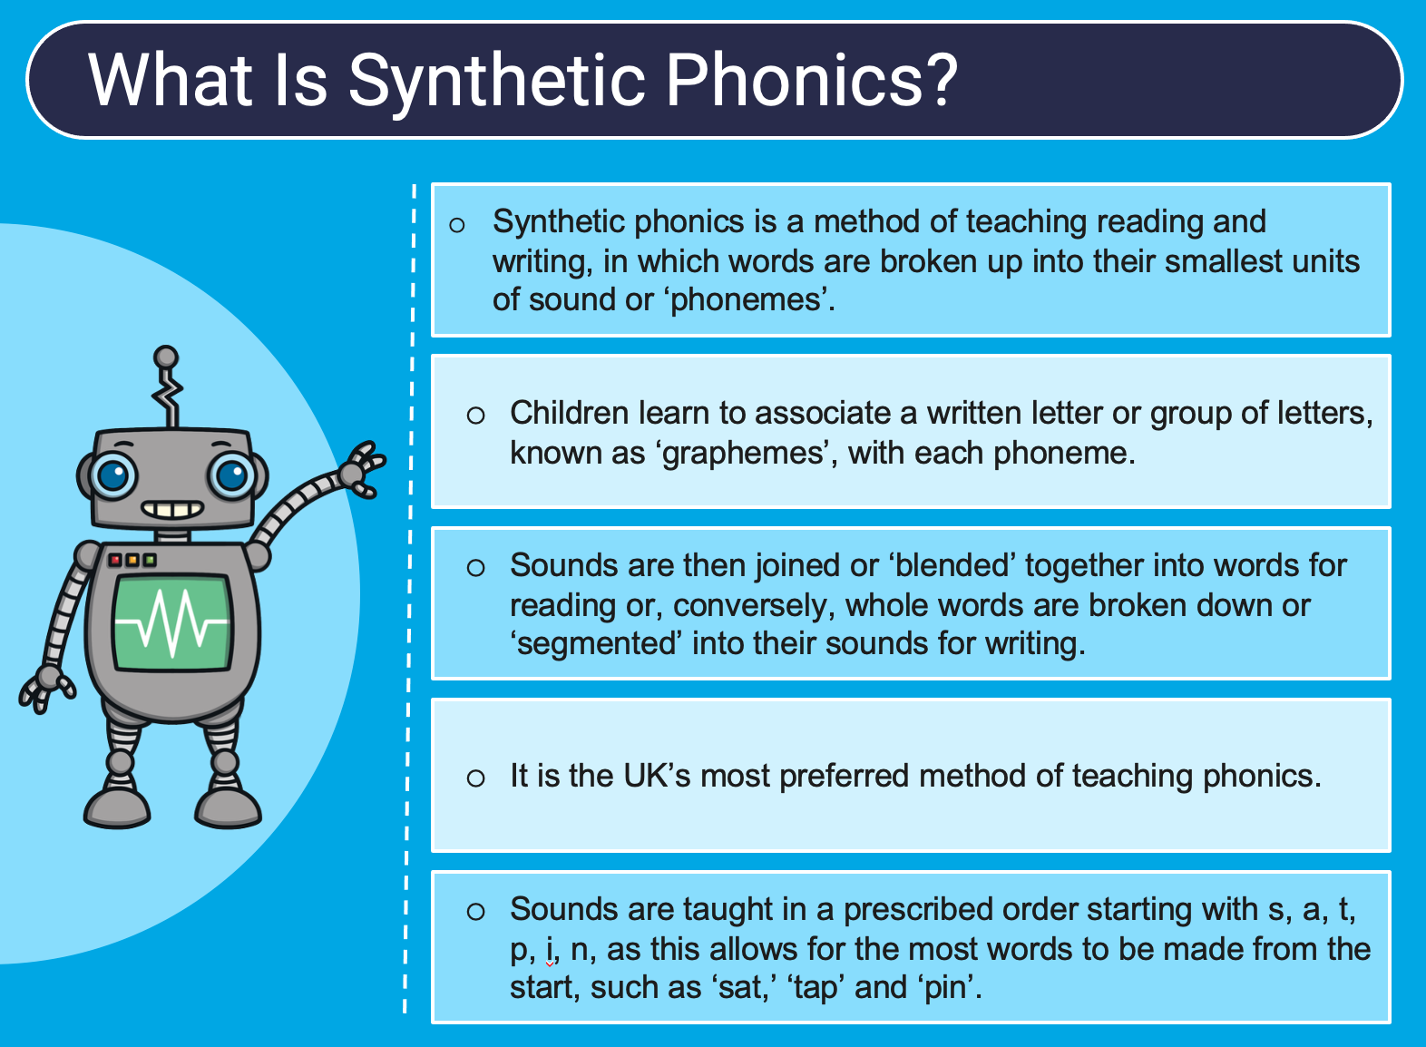
Phonics
Phonics is how we teach the pupils to read words. There are 26 letters of the alphabet, but 44 sounds with 100 ways of spelling them! It is taught systematically, starting in the Early Years.
Phonics is taught daily and we follow the Twinkl Phonics Scheme of Work.
Notes:
Phonics is an integral part of Year 1. We teach Phonics daily and apply our learning in other subjects too such as spelling words in English, reading facts in Science or reading key words in Geography.

Slide 8
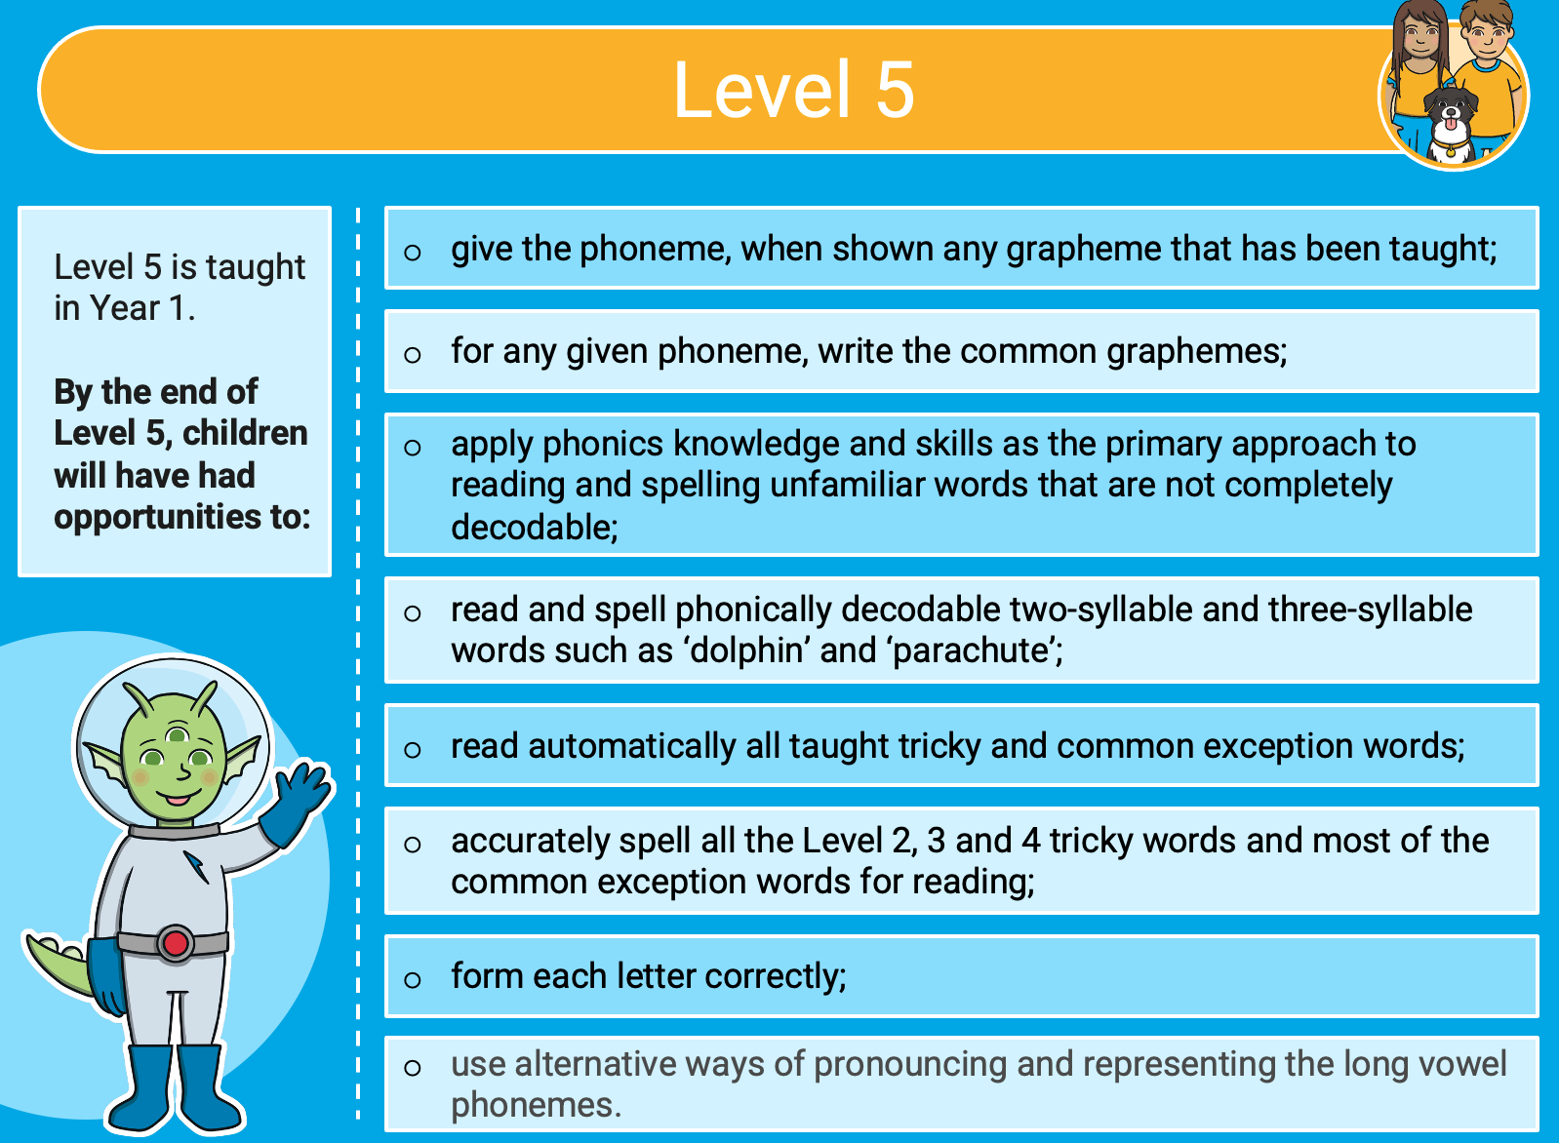
Phonics
Notes:
Level 5 is covered in Year 1.

Slide 9
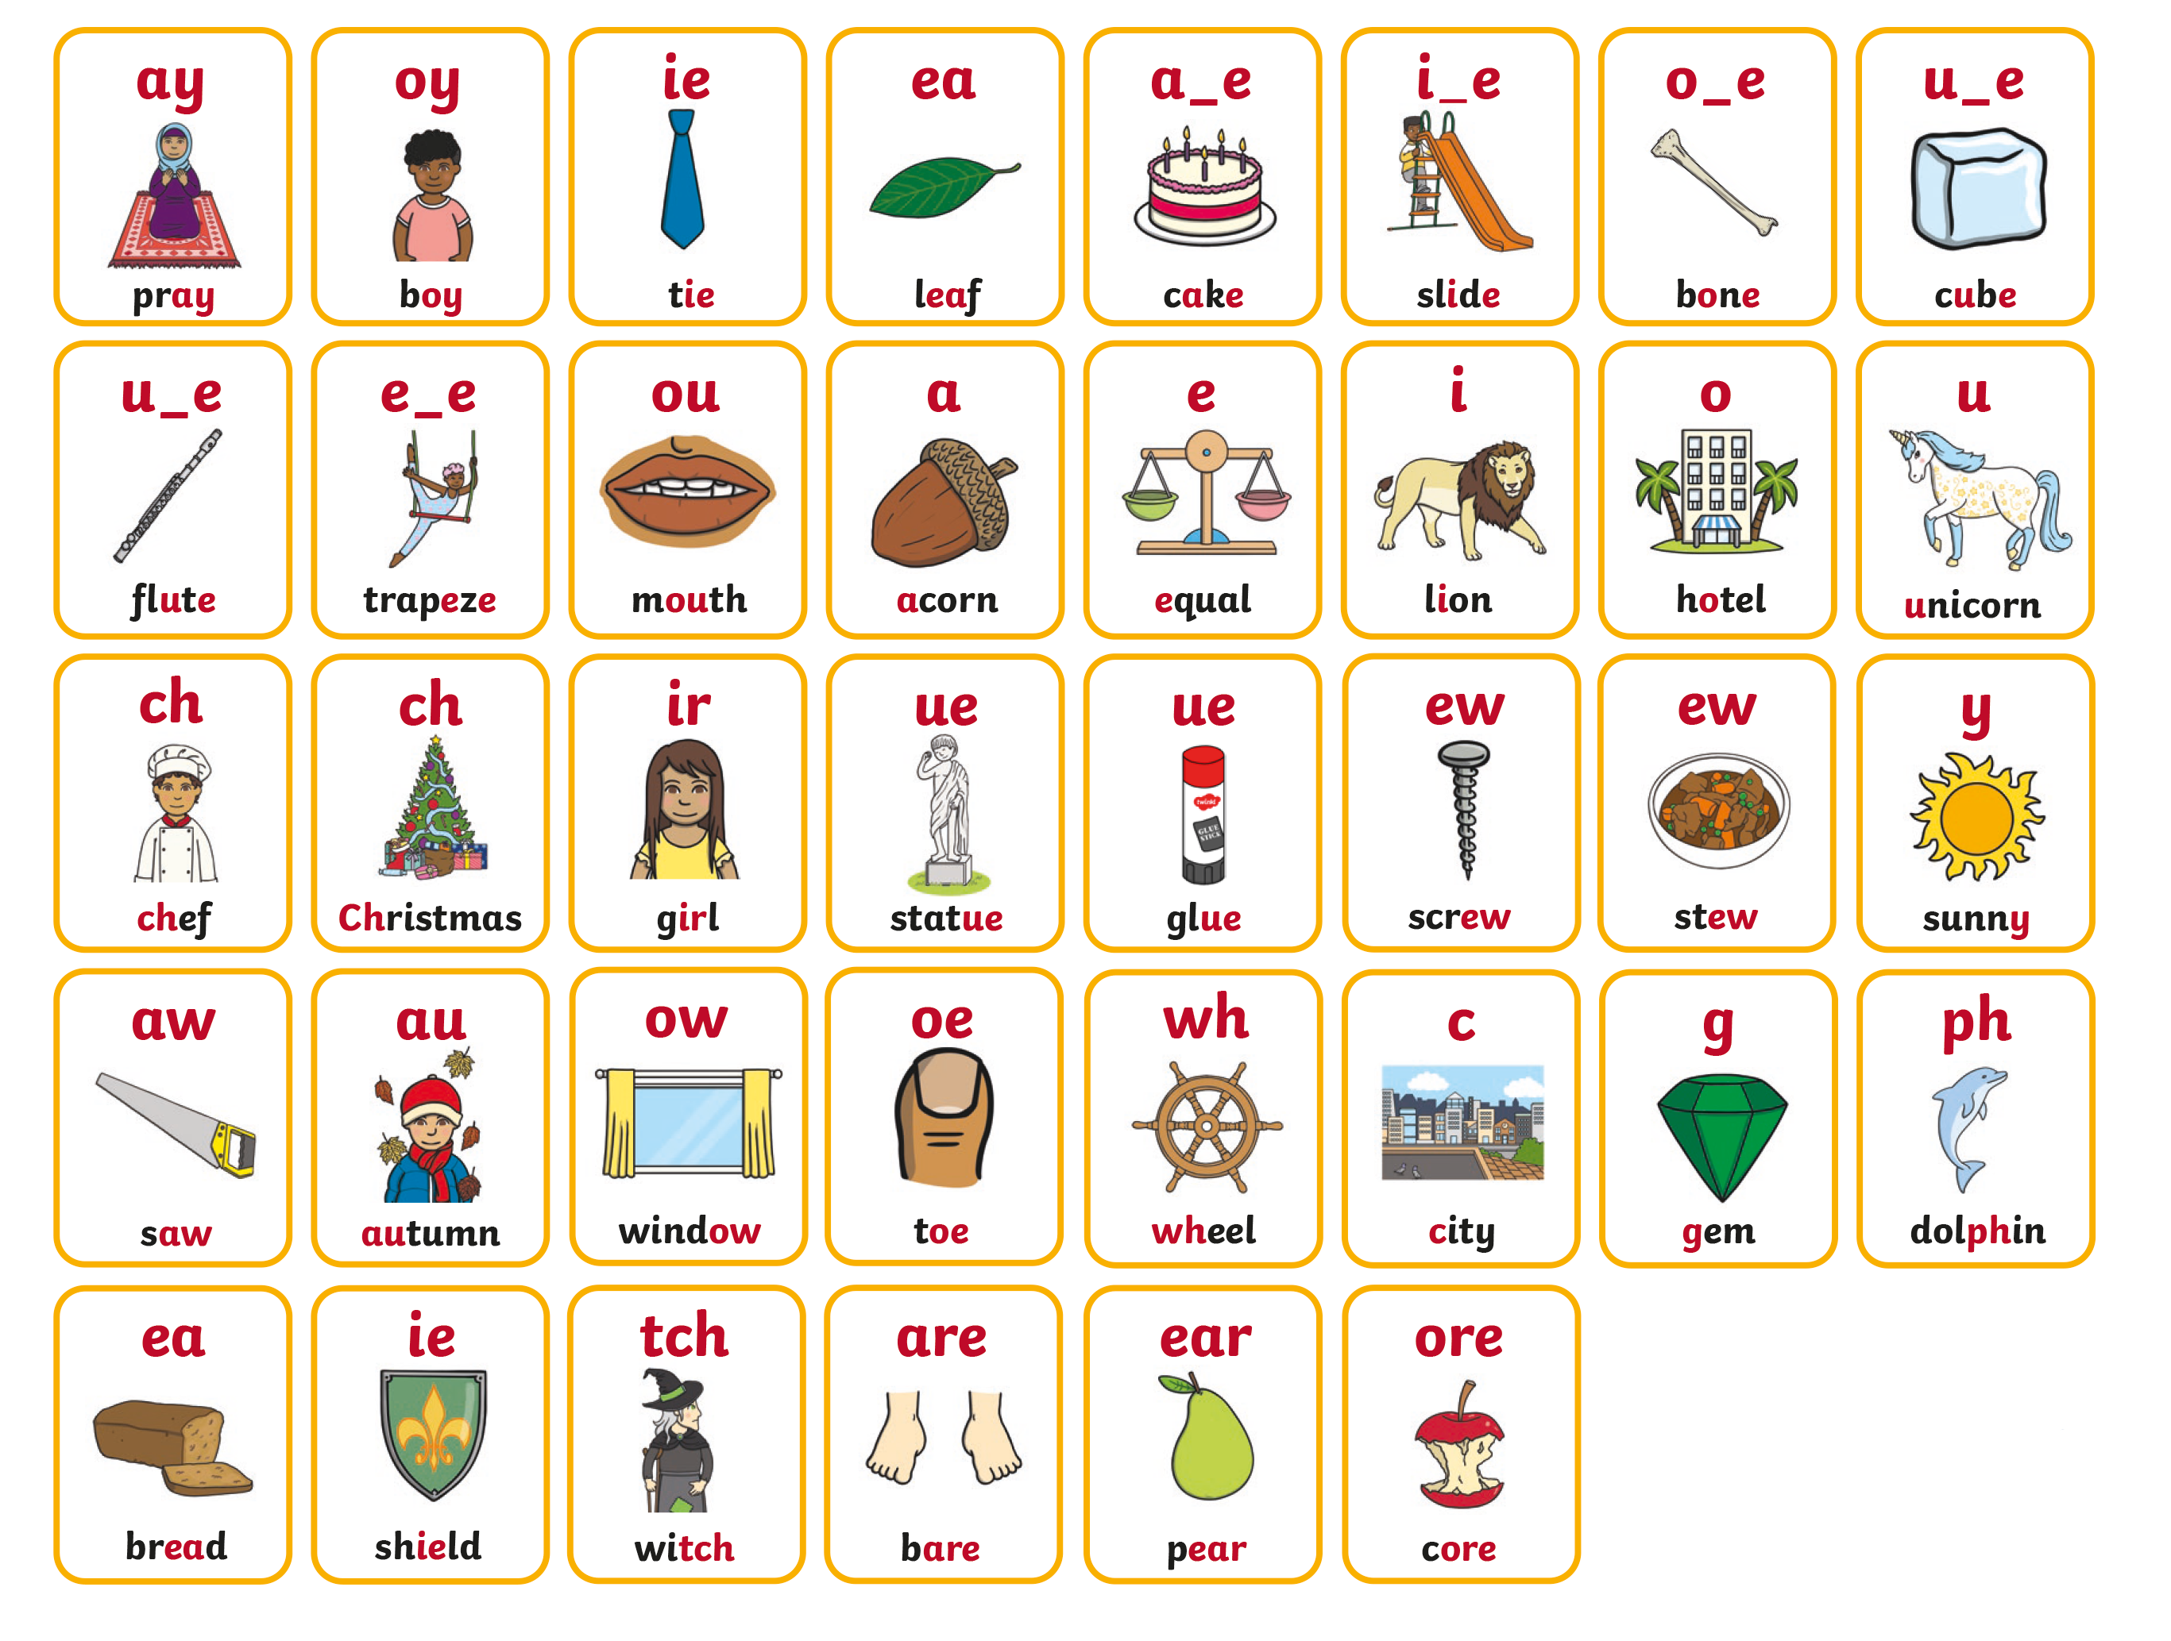
Phonics
These are the sounds that will be covered in Year 1 (Level 5 of the Twinkl Phonics Scheme).
There is generally one/two sounds taught per week.
Phonics bookmarks will be shared with children at the beginning of a new week, with focus words for the week.
Notes:
These are the level 5 sounds.

Slide 10
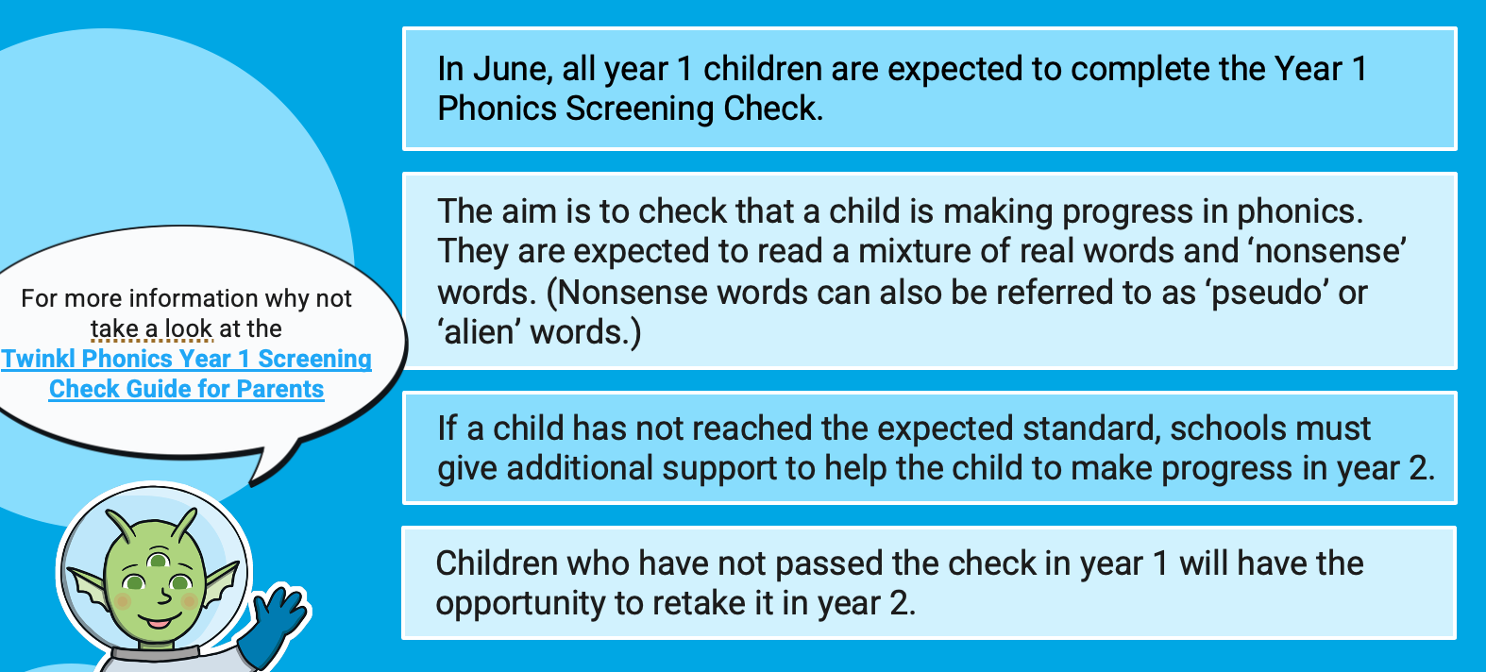
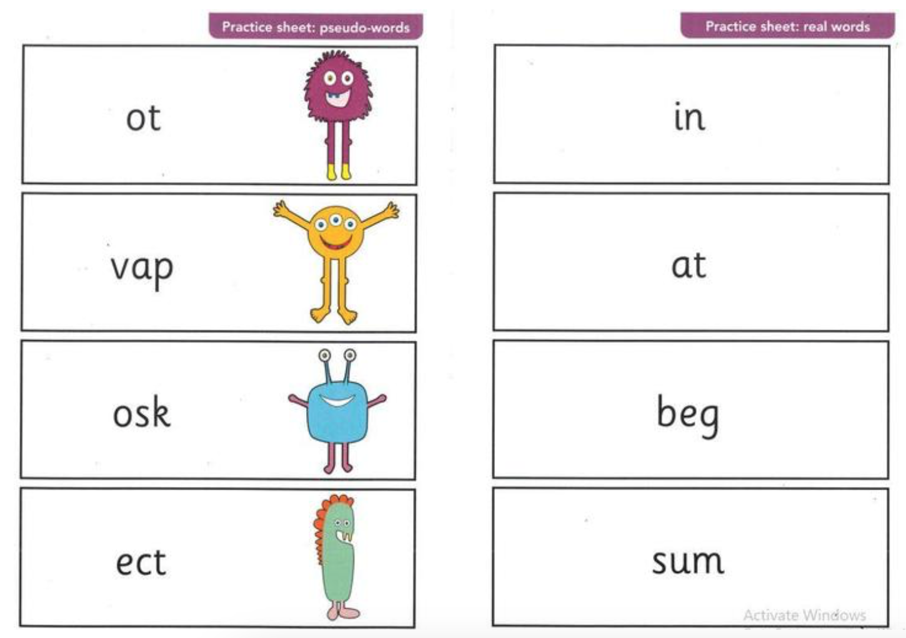
Phonics Screening
Notes:
-Phonics Screening handout gives more information.

Slide 11
Maths
In Year 1, children develop their confidence with numbers and begin to build strong foundations in maths. They learn to count, read and write numbers, add and subtract, recognise simple patterns, explore shapes and measurements, and begin to understand multiplication and division. Children are encouraged to use practical resources, explain their thinking and solve problems in different ways. The focus is on making maths enjoyable while developing accuracy, reasoning and confidence.
We teach Maths every morning and follow the White Rose Scheme of Learning.

Slide 12
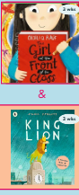
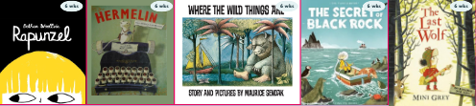
English
Ready Steady Write is a fun and engaging approach to teaching writing in Year 1. Children explore high-quality stories, poems and texts, using them as inspiration for their own writing. Through the scheme, children develop their vocabulary, sentence structure, spelling, punctuation and handwriting skills. They are encouraged to talk about ideas, build confidence in expressing themselves and gradually become more independent writers. The approach also helps children to develop a love of reading and writing while making links between the stories they enjoy and their own experiences.
Sentence Accuracy – daily
Say, Count, Build, Reread

Slide 13
Learning at Home
Regular Home Reading.
Homework grid every half term.
After October half term, weekly spelling lists (words taken from the Phonics learning for previous weeks).
Any other opportunities such as PhonicsPlay online games, TopMarks and ICT Games.

Slide 14
Building Resilience
We want to develop children who:
Keep going.
Ask for help.
Learn from mistakes.
Take responsibility.
Believe in themselves.
Give their very best.
In Year 1, we develop the pupil’s independence. We want them to be able to become responsible for their own belongings and develop their self-help skills successfully – preparing them for their journey through school.

Slide 15
Behaviour Expectations
Sunshine, happy cloud and sad cloud.
Lots of stickers and dojo points.
Hannah the Hedgehog!
We encourage the Ashleigh School Code, which is displayed in every classroom. We want pupils to feel safe and encourage them to take responsibility for their own actions.

Slide 16
Online Safety
Online safety is important, even for young children. Please talk to your child about using the internet safely and always supervise them when they are online. Encourage them to tell a trusted adult if they see something that worries or upsets them. Check that games, apps and websites are age-appropriate, use parental controls where possible, and remind your child never to share personal information, such as their name, address or school, online.

Slide 17
Parent Evenings and Communication
Parents evenings.
Reports – mid and end of year.
Informal communication – teachers greet and dismiss every day, contact through the school office.
Miss Youd – natalie.youd@ashleigh.blackburn.sch.uk
Mrs Hartley – sarah.hartley@ashleigh.blackburn.sch.uk

Slide 18
Assessments
In Year 1 the pupils will take the Phonics Screening check.
In Spring and Summer we complete assessments with the pupils. We use this data to inform their reports. They help us to identify any gaps in learning.
Throughout every subject we use various assessments such as short quizzes or games which are age-appropriate. We again use this data to inform our next steps and show us how the children have progressed.

Slide 19
Exciting Things!
Educational Visits
Outdoor learning – every half term, watch out for a School Spider message.
Christmas! Nativity play and parties! Other seasonal activities around Easter.
Toothbrushing scheme

Slide 20
Developing the Whole Child
Education is about much more than English and Maths. We are
developing the whole child.
We want our children to develop:
Confidence
Independence
Resilience
Creativity
Teamwork
Communication skills
Kindness
Respect
Leadership
A love of learning

Slide 21
Uniform
Reminder:
Correct school uniform.
PE kit – label everything!
Blue bag – please avoid large keyrings as they can become bulky, broken and the children like to swap them!
Names in clothing.

Slide 22
Our Aim
Inform, Inspire & Engage
  Make parents feel part of the journey.
  Build positive relationships from the beginning.
  Create a shared understanding of what we want to achieve.
And most importantly...

Slide 23
Together, let’s make this the very best year yet for every child at Ashleigh — filled with learning, opportunity, happiness and success.
#TeamAshleigh

