Slide 1
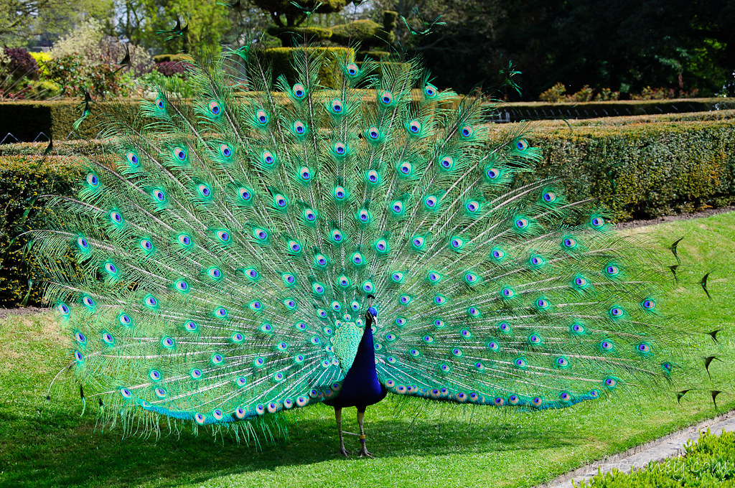
Meet the Teacher
Peacocks Class – Year 2
This Photo by Unknown Author is licensed under CC BY-NC-ND

Slide 2
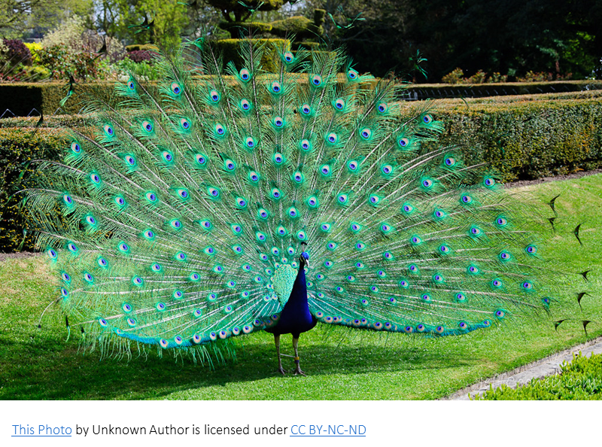
Who are the teachers in the class?
Mrs Lomax
Mrs Solkar – PPA cover
Mrs Marr and Mrs Metcalfe – TAs
Mrs Eckersley and Mrs Haydock – 1 to 1 supports

Slide 3
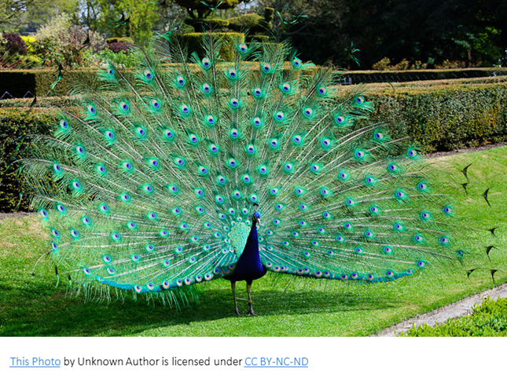
Year 2 Curriculum
English –
Building fluency and comprehension in reading including being able to infer.
Writing narratives and information texts that include descriptive language (adjectives, adverbs…) introduce speech, use of a variety of conjunctions to join sentences..
Form letters correctly including clear ascenders (b, d, f, h, k, l, t) and descenders (f, g, j, p, q, y) and begin to join letters.
Learning and using grammar such as nouns, verbs, adjectives, adverbs, conjunctions, contractions, alphabetical order, plurals, sentence types, expanded noun phrases…
Phonics –
Continues throughout Year 2 learning new alternative graphemes and spelling rules.

Slide 4
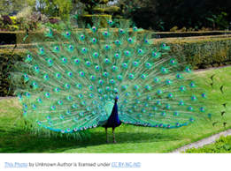
Year 2 Curriculum continued…
Maths –
includes working with number to 100, all four operations – introducing multiplication and division, fractions including fractions of numbers, measurements using standard units, positional and directional language, time to the nearest 5 minutes, 2D and 3D shapes and their properties, money including calculating with money.
Science - Animals including Humans, Plants, Materials, Living things and their habitats, Scientists and Inventors, Biodiversity – minibeasts.
Other subject topics include – comparing hot and cold places, balanced diet and making wraps, the history of flight, Coding, making clay houses, making Ferris wheels…

Slide 5
SATs?
It is no longer a government requirement to do Year 2 SATs.
We will do in house assessments termly with the children like other Year groups within school.
Secret Agents Tasks – In the past we have rebranded SATs as Secret Agent Tasks. We will try to keep the parts that the children enjoy such as dressing up as Secret Agents.

Slide 6
Homework
Homework is given out at the start of the term in the form of a grid. At least 6 pieces (approx. 1 a week) should be completed over the half term including the 4 in the grey boxes. It is up to you when they are completed as long as they are done by the end of each half term.
Reading books – changed weekly usually on Mondays, should be read more than once in the week to build fluency and comprehension, little and often is usually best.
Spellings – between 10 and 12 a week, given out on Mondays for the test on the following Monday, also available on Spelling Shed.
TT Rockstars – once children begin to learn multiplication and division (after Christmas) it is helpful to regularly practice them – we learn 2x, 5x and 10x tables in Year 2 as well as counting in 3s which leads to 3x table. This is the same log in as Numberbots.

Slide 7
Important Information
Library – Mondays
Reading books – change on Mondays. Books should be in school every day.
Spellings – Mondays
PE Days – Tuesdays and Thursdays. Earrings need to be taken out or covered with plasters/microtape.
Outdoor learning – Wednesday afternoons once a half term. First one is next Wednesday.
Water bottles – should be in school daily. Water only – no juice.

Slide 8
Behaviour
We have created class rules together.
We use positive behaviour strategies such as praise, dojos, golden ties and stickers.
We may also use golden time as a reward for excellent behaviour all week.

Slide 9
Contacting Mrs Lomax
My email address is lisa.lomax@ashleigh.blackburn.sch.uk or I can be contacted through the school office.
I am also available on the playground ramp on every afternoon but please could I ask that you allow me to make sure most children have gone with their parents/grandparents.
Thanks you for coming.
Any Questions?

