Slide 1


Accelerated Reader
A guide for parents

Slide 2
Why Accelerated Reader at Treales?
Children are taught to decode words through phonics. At Treales, we use Red Rose Phonics which is Lancashire literacy team’s scheme based on Letters and Sounds.
This is taught systematically until the end of Year 1. Some children may need to continue to be taught phonics into year 2 and KS2. We use Lancashire catch up and bounce back programmes to support this.
Children in Reception and Year 1 take home reading books that are closely matched to the phonics they are being taught in school and the phonics they need to focus and practice further from assessments.
From Year 2 children become increasingly independent readers and historically have moved towards being a free reader.
Whilst children have been regularly read with, taught reading in class and reading for pleasure in school encouraged, reading has less of a focus than it has for younger children.
Children are unaware of appropriate books and often link length and difficulty.
Reading outside of lessons has not been tracked or supported systematically.
Accelerated Reader allows us to do this.

Slide 3
Who is Accelerated Reader for?
EVERYONE!
All children can use Accelerated Reader, even children who continue with phonics teaching. Children can have a phonics reader and an accelerated reader book.
Reading is the key for the whole curriculum and wider learning and is one of Treales primary goals – everyone should leave Treales enjoying reading and being able to read well.

Slide 4
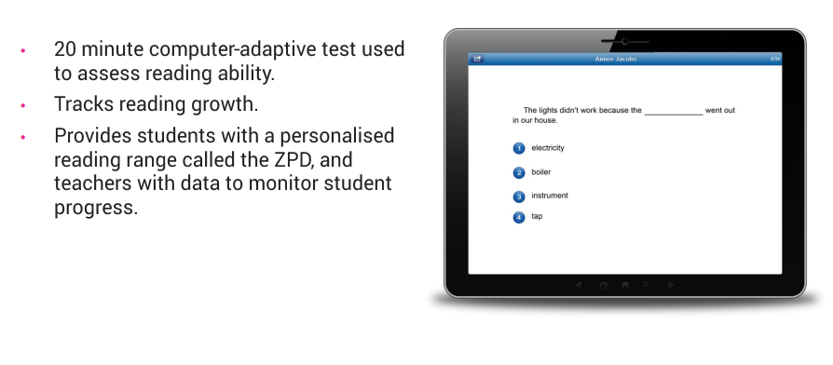
Star Reading

Slide 5
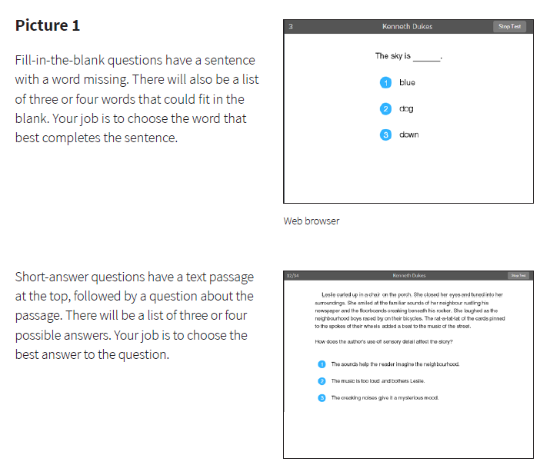

Slide 6
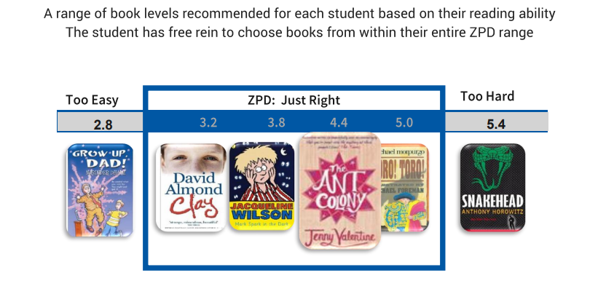
Zone of Proximal Development (ZPD)

Slide 7
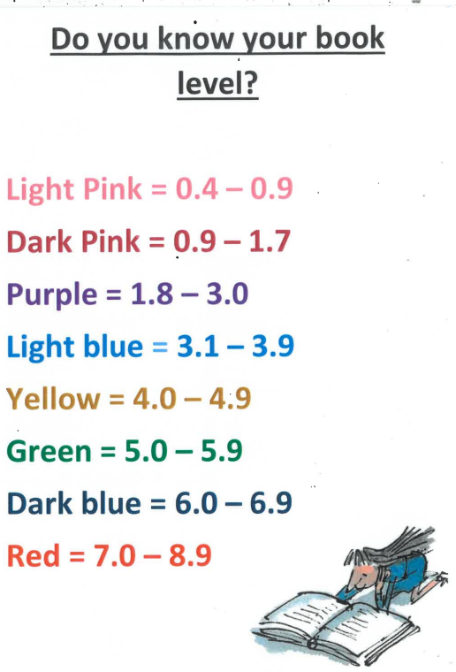
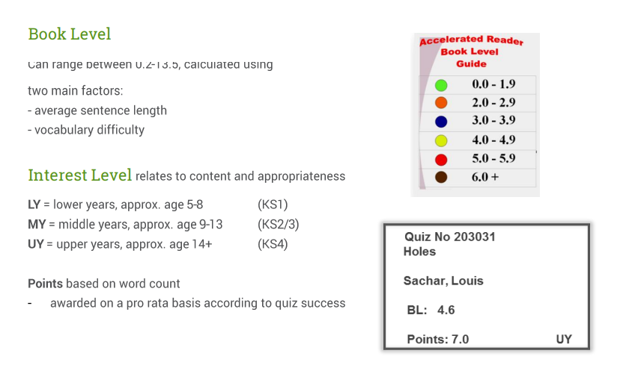
Book Levels

Slide 8
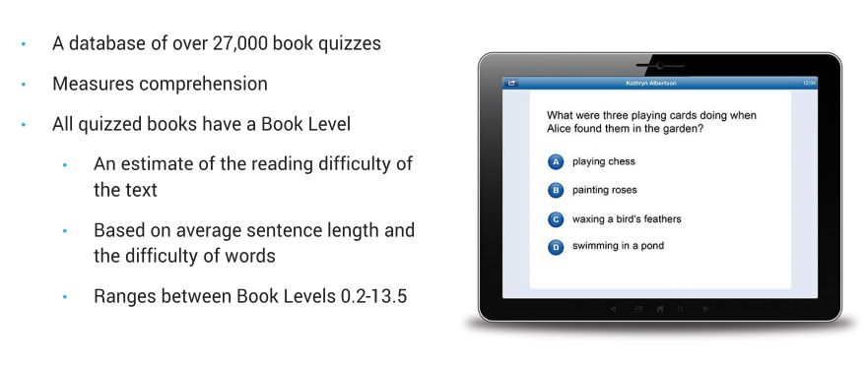
Renaissance Accelerated Reader

Slide 9
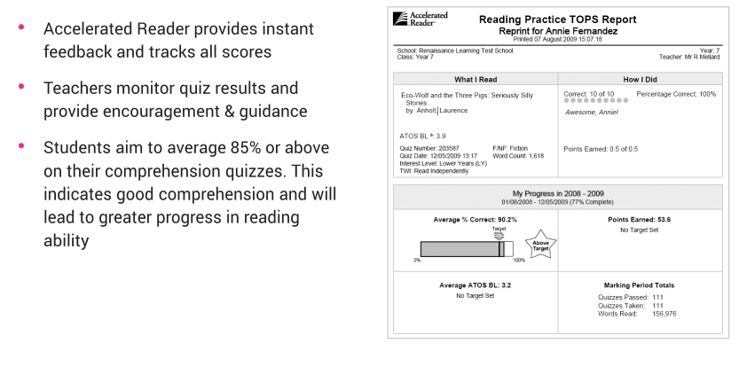
Teachers monitor pupil’s progress

Slide 10
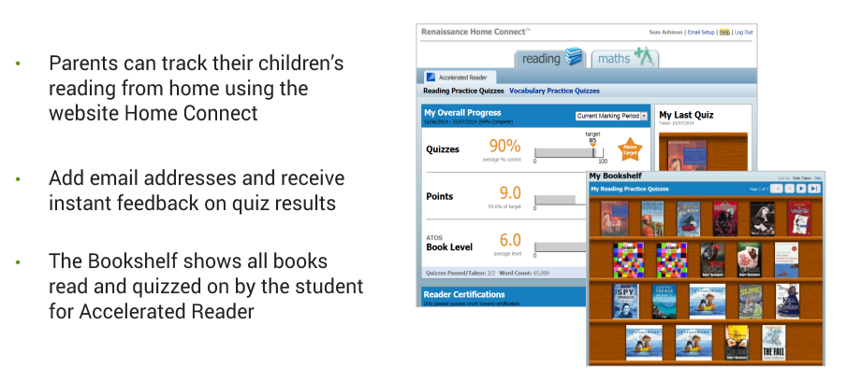
Home Connect

Slide 11
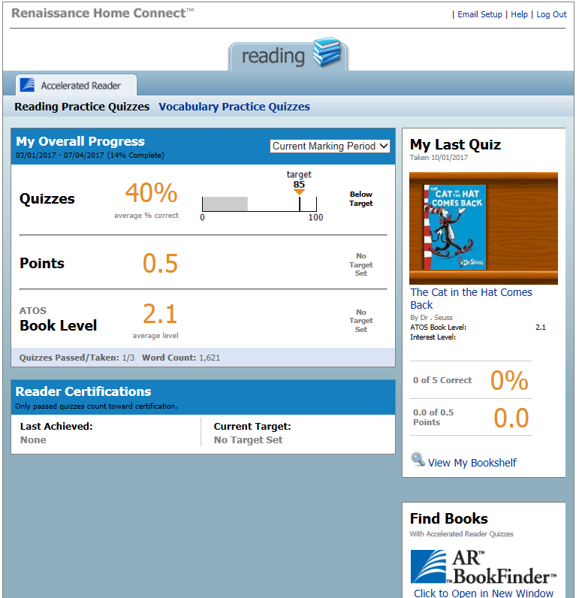
Average quiz score
Points earned
Average book level.
Last book read and quizzed on. Include % correct and points earned from book.

Slide 12
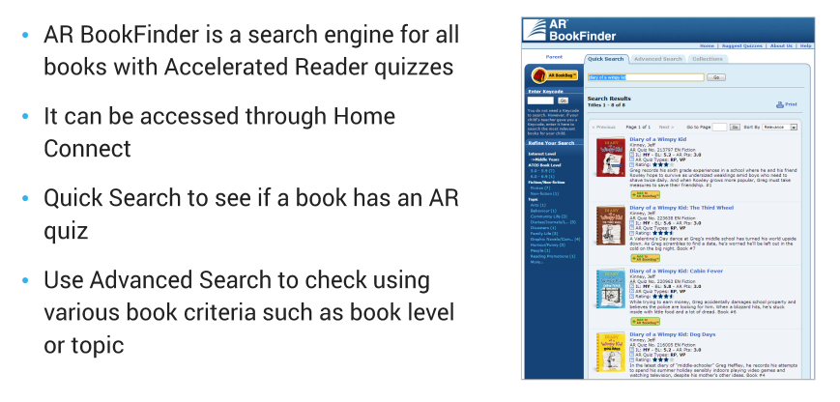
AR BookFinder

Slide 13
MyON
Online book library
Links directly to Accelerated Reader quizzes.
Same login as AR
https://www.myon.co.uk/index.html

Slide 14
Next Steps…
Children completed STAR assessments in the first week of term.
Children in Y3-6 know their ZPD and have been choosing books within this.
Children in Y3-6 have been taking AR quizzes when they have finished their books
Teachers have been ensuring there is 20 minutes in the school day dedicated to reading.
NOW
Children can quiz on books at home.
Children can quiz on books that have been read to them (ideal for Y1 and Y2 to get to know the system)
Children can use AR BookFinder to see if they have books at home they can read and quiz on
Children can use MyON to read and quiz (books and articles)
Parents can login to Home Connect to see how their child is getting on and offer further support in choosing books and quizzing
School will retest using STAR in December

