Slide 1


Slide 2
Meet the Staff
Mrs Taylor
Teacher
Miss Gibbons
Tuesday Teacher
Mrs Skeffington
Year 6 Teaching Assistant
Miss Coffey
Monday aftewrnoons

Slide 3
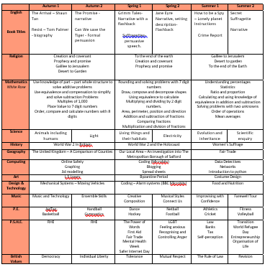
What we will be covering this year:

Slide 4
Homework
1 maths
1 GPS
1 reading
1 curriculum map
10 minutes of reading
Spelling shed
Times tables rockstars

Slide 5
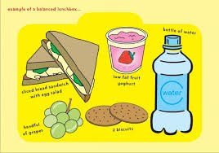
School lunches
If your child is bringing in a packed lunch to school please make sure it is a balanced meal.
Children do not need to bring in a drink for lunch – we will provide water.

Slide 6
PE
Monday and Wednesday
Monday is Jag tag and Wednesday is dodge ball.

Slide 7
School Uniform
Children are to wear the correct uniform every day, including appropriate footwear (PLAIN black trainers – see next slide.)
Simple watch (no Smart watches)
One pair of plain studs (no hooped or dangling earrings)
No nail varnish or acrylic/gel nails
No rucksacks/pencil cases. School will provide a reading folder.

Slide 8
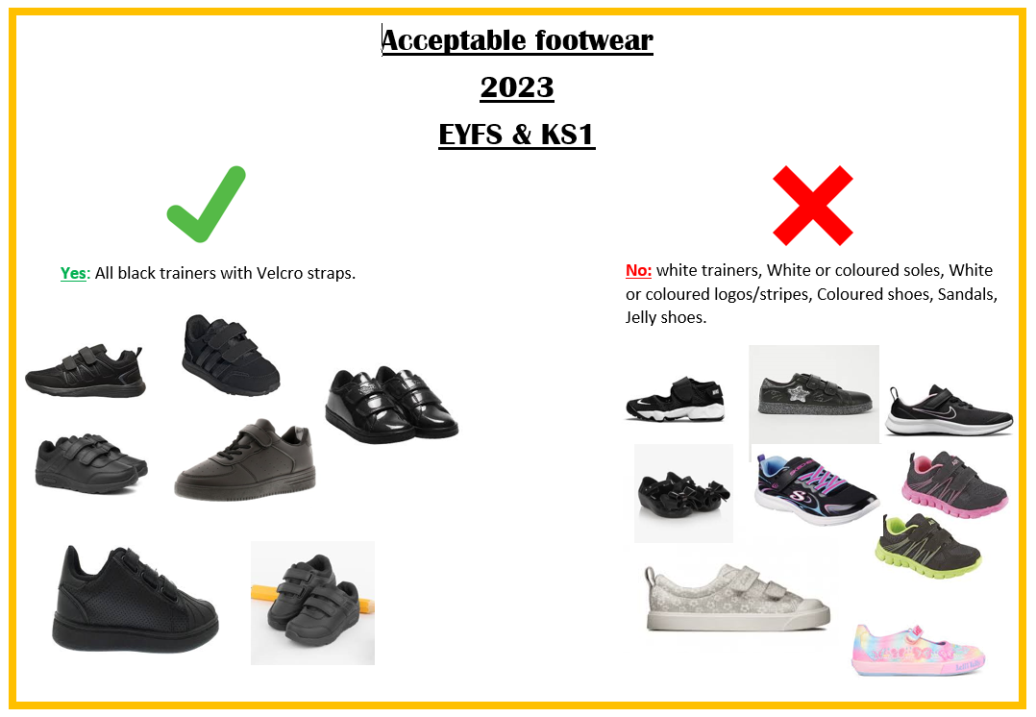
Acceptable footwear
2024
EYFS & KS1

Slide 9


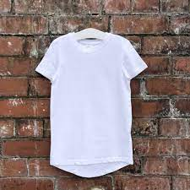



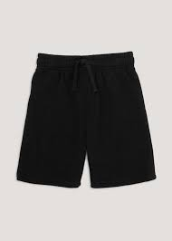



2024
PE uniform: wear to school on PE days which are
Jewellery is not to be worn at all, including stud earrings.
2023
KS2
Yes: All plain black shorts, leggings, joggers
All plain white T shirts
No: White or coloured logos / stripes / patterns.
No hoodies or tracksuit tops

Slide 10

Behaviour
Ready Respectful Safe
Weekly certificates
Tea party
House Points
We have noticed some children are flagging particularly in the
afternoons. As you know, regular bedtimes are paramount to good
concentration and great work! An average 10 year old needs at least 10 hours sleep a night.

Slide 11
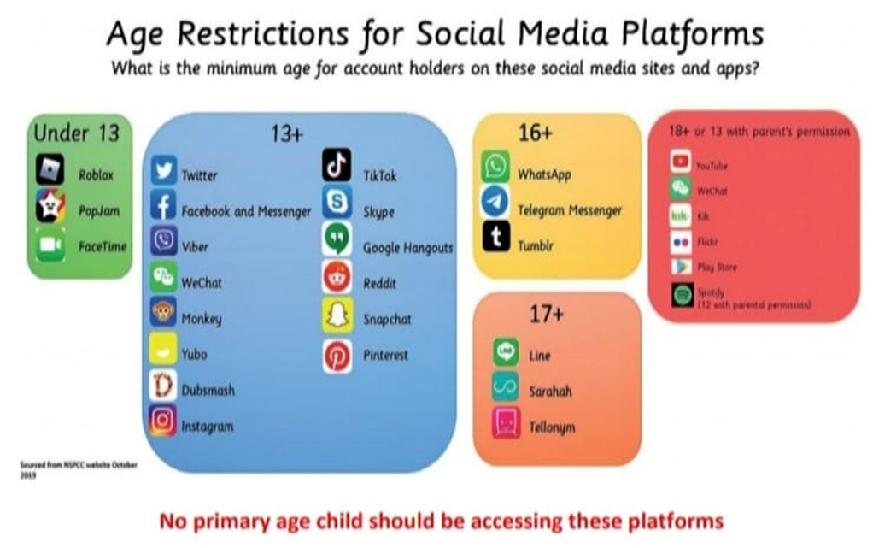
Online safety
SMART Rules in school
Social media guidelines state

Slide 12
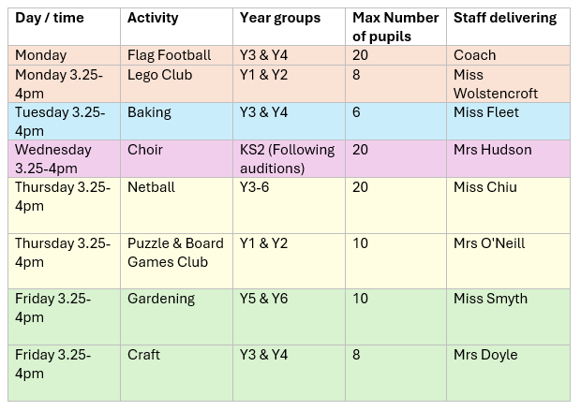
Extra Curricular Clubs
Please note all clubs finish at 4pm. Please be prompt picking up your child.

Slide 13
Keep in touch
The Year 6 page on the school website will be regularly updated, so please keep having a look at all the exciting things we are doing!
Come and speak me…I don’t bite!!

Slide 14
School Facebook page
Tool for sharing positive news
Not for communication/negative comments
Please complete online media permission form

Slide 15
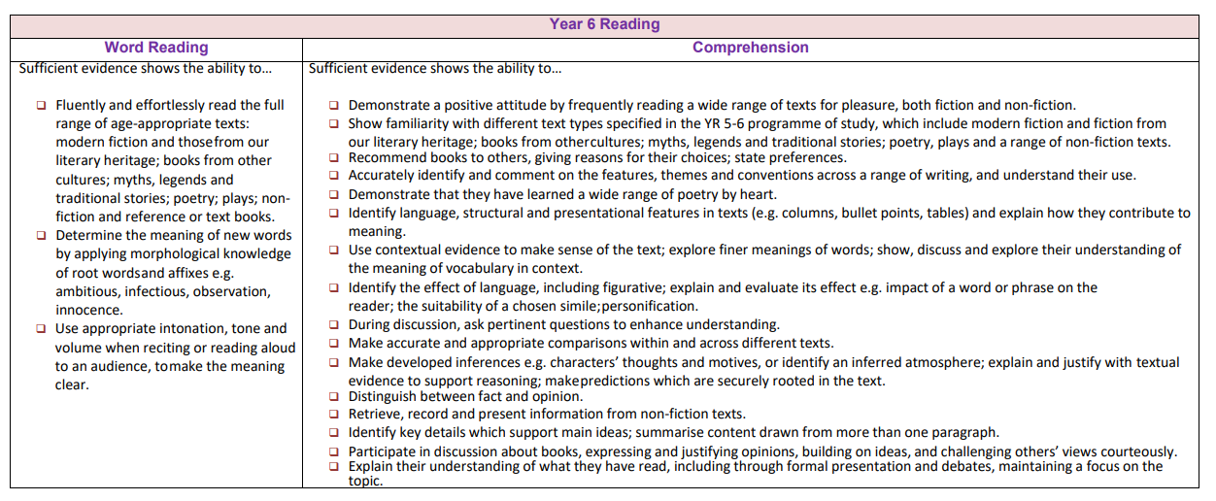
Curriculum expectations

Slide 16
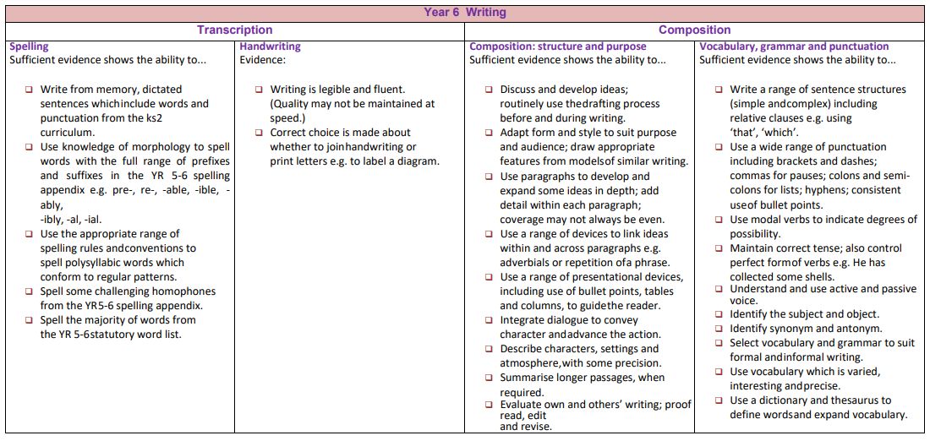
Curriculum expectations

Slide 17
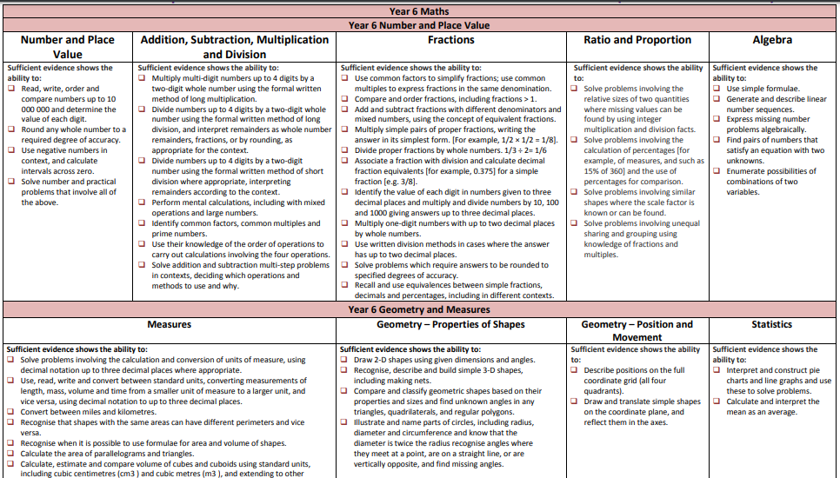
Curriculum expectations

Slide 18

Home – school partnership
These are our ambitions for your children:
Supporting your child with home learning helps reinforce what they have learned in school and gives them more opportunities to succeed.
Celebration Assembly
Parents will be invited if child has received an award.

Slide 19

Thank you for listening, any questions?

