Slide 1


Slide 2
Meet the Staff
Miss Pounder
Teacher
Miss Smyth
& Mr Cunningham
Teaching Assistants
Miss Gibbons and Mrs Walker
Cover staff

Slide 3
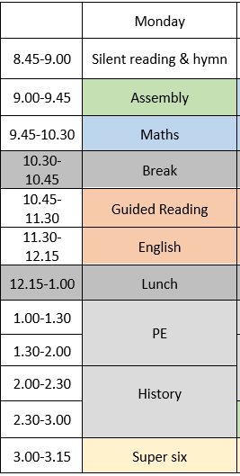
Reading books need to be in school every day

Slide 4

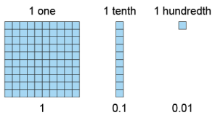




Autumn Learning
Decimal fractions
Ancient Kingdom of Benin
PSHE -Growing and Changing

Slide 5
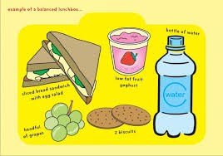
School Lunches
A balanced meal for packed lunches.
Water bottles are provided by school and water is available at lunch time.

Slide 6
School Uniform
Children are to wear the correct uniform every day, including appropriate footwear (all black footwear).
PE uniform: Wear to school on PE days which are Monday and Wednesday. All black shorts/trousers and shoes, all white t-shirt.
Simple watch (no Smart watches)​
One pair of plain studs (no hooped or dangling earrings)​
No nail varnish or acrylic/gel nails​.
A school bag is preferred for children to carry their reading book and homework in. No pencil cases please.

Slide 7
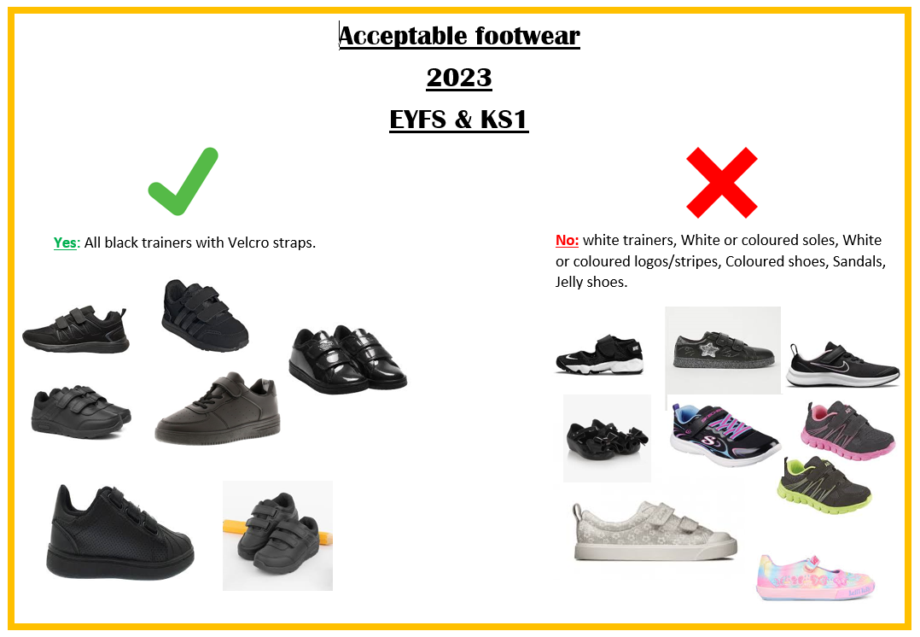
Acceptable footwear

Slide 8
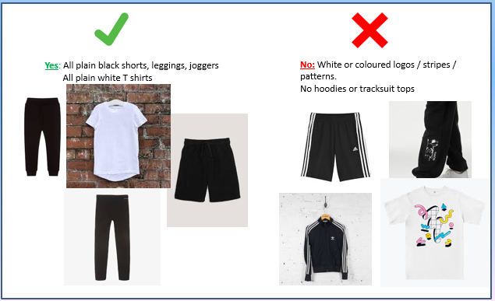
Acceptable
PE kit

Slide 9

Behaviour
Ready, Respectful, Safe
Gospel Values
Weekly certificates
House Points to spend in the shop
Tea party

Slide 10
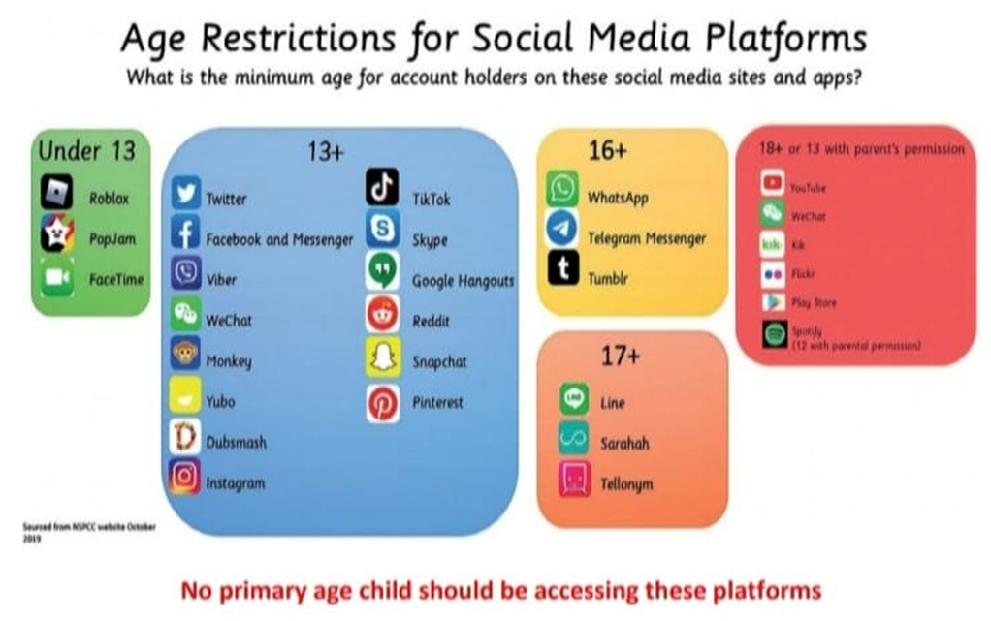
Online safety
SMART Rules in school
Social media guidelines state:

Slide 11
Home Learning
READING – How can you help your child at home?
Encourage reading a variety of texts
Listen to your child read every day
Encourage children to look up unfamiliar words
Ask your child questions about the texts they are reading
Please sign your child's reading record when they have read.

Slide 12

Home Learning
TIMES TABLES
Times tables are a huge part of maths in Year 5. They are key number facts that are relevant to the four operations, fractions, percentages and much more.
Children who don't know their times tables tend to struggle in these areas and don't pick up strategies as quickly as those who do. Committing key facts to long-term memory is likely to help pupils learn more complex ideas.

Slide 13
Home Learning
HOMEWORK
Homework will be given out on a Friday to be handed back in on Wednesday. They will have English and Maths.
There is research to say that the struggle in retrieving information from memory strengthens recall and enhances learning. The homework that we send home aims to do this by practising prior learning.
Children can ask for help on a Monday and Tuesday in school but please not on the day that it is due in.

Slide 14
Extra Curricular Clubs
Breakfast club - Everyday
Choir - Wednesday
Netball - Thursday
Gardening - Friday
Homework - Everyday
Please note all clubs finish at 4pm. Please be prompt picking up your child.

Slide 15
School Facebook page
Tool for sharing positive news
Not for communication/negative comments
Please complete online media permission form. No children's faces will be posted going forward.

Slide 16
Curriculum expectations
Reading
  Developing fluency, confidence and a love of reading through a range of high-quality fiction, non-fiction and poetry.
  Developing key comprehension skills, including:
    Retrieval – finding and recalling information from the text.
    Inference – using clues in the text and their own knowledge to work out how characters are feeling or why events happen.
    Vocabulary – exploring the meaning and impact of words and phrases.
    Prediction – using evidence to suggest what might happen next.
    Summarising – identifying and explaining the main ideas.
    Explaining and justifying answers using evidence from the text.

Slide 17
Curriculum expectations
Writing
Exploring a range of high-quality texts and genres to inspire writing.
Developing skills in planning, drafting, editing and improving work.
Using ambitious vocabulary, varied sentence structures and accurate punctuation and grammar.
Writing for a range of purposes and audiences, including narratives, descriptions, explanations and persuasive writing.

Slide 18
Curriculum expectations
Maths
Building confidence and fluency with number, including place value and the four operations.
Developing reasoning and problem-solving skills.
Applying mathematical knowledge across areas including fractions, decimals, percentages, measurement, geometry and statistics.
Continuing to develop rapid recall of key number facts and times tables.

Slide 19

Thank you for coming ☺

