Slide 1
Welcome to Year 4!
Miss Chan - Class teacher
Mrs Pickavance – Wednesday teacher
Miss Smyth, Ms Dickinson – Teaching assistants

Slide 2
Curriculum

Slide 3
Homework
Spellings, punctuation, grammar
Maths
Times tables – TTRS
Topic – optional and creative
Read every evening and sign the reading record.

Slide 4
Uniform
Plain black trainers or school shoes, grey trousers or skirt, polo shirt and St. Sebastian's logo jumper or cardigan.
P.E - White Top, Black shorts / leggings and black trainers
No hoop earrings
No nail varnish or acrylic / gel nails.
A simple watch – no smart watches

Slide 5
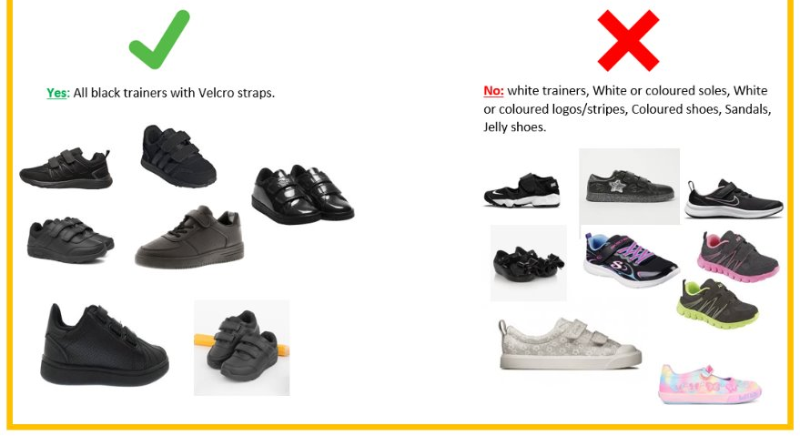
Acceptable footwear

Slide 6
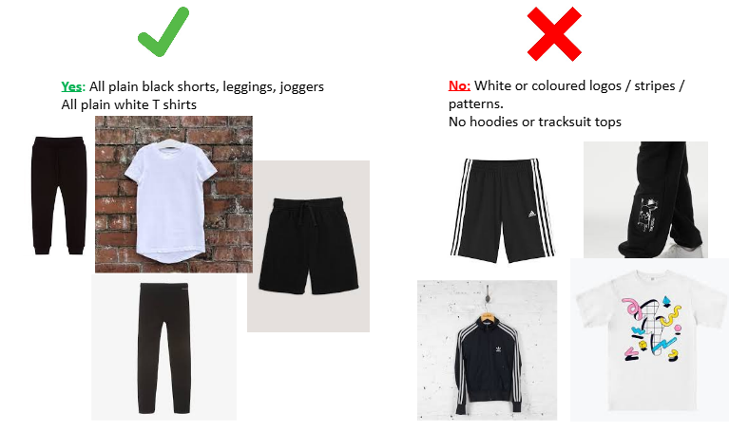
P.E - Monday and Wednesday – swimming
No jewellery.

Slide 7
School bags
Bring your own school bag
Reading records.
Guided reading books.
Your child also needs a coat.
Do not bring toys or fidgets into school.

Slide 8
School Council, Laudato Si
School Council - They take leadership in our school regarding decisions, fundraisers, talent shows.
Laudato Si – They take leadership in our school regarding caring for our school environment and outdoor areas.

Slide 9
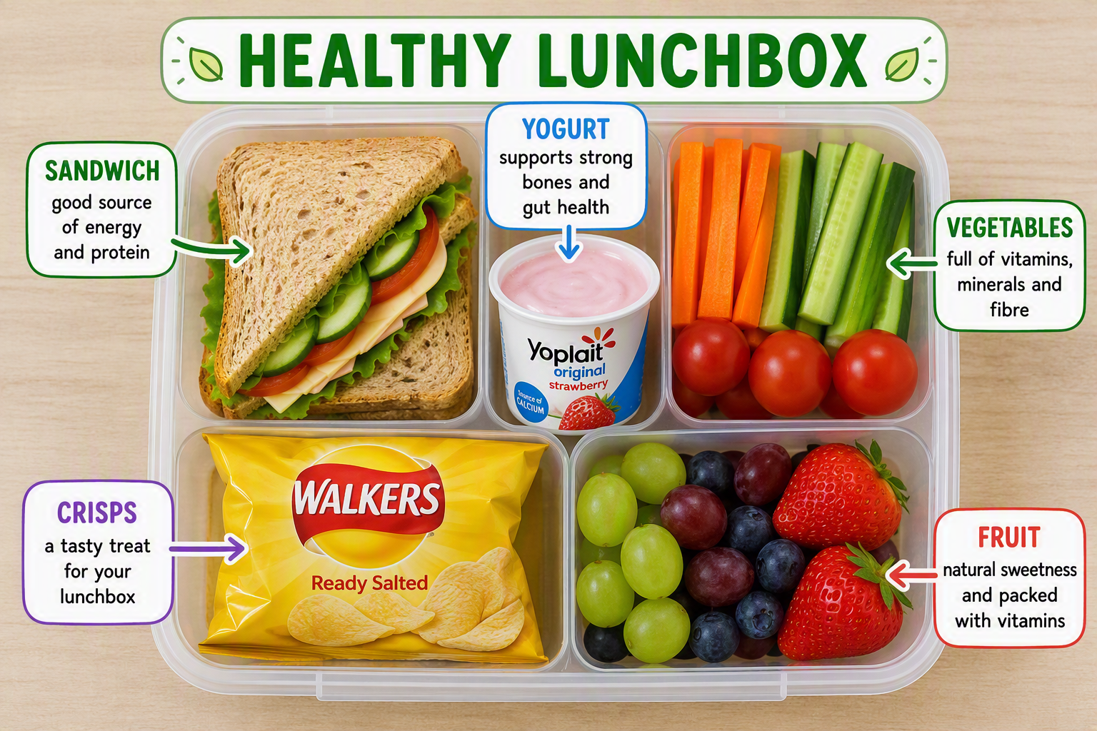
Lunches

Slide 10

Home – school partnership
This is our curriculum intent and ambitions for your children.
The importance of learning at both home and school allows your child to be the best that they can be.

