Slide 1



Slide 2
Meet the Staff
Miss Chiu – Year 3 Class Teacher
Mrs Walker – Teacher Assistant
Miss Platt – Monday Afternoon

Slide 3
School Day
The gates open between 8:40am and close at 8:45am. The school day begins at 8:45am.
The school day finishes at 3:15pm.
After school clubs finish at 4:00pm or 4:15pm.

Slide 4
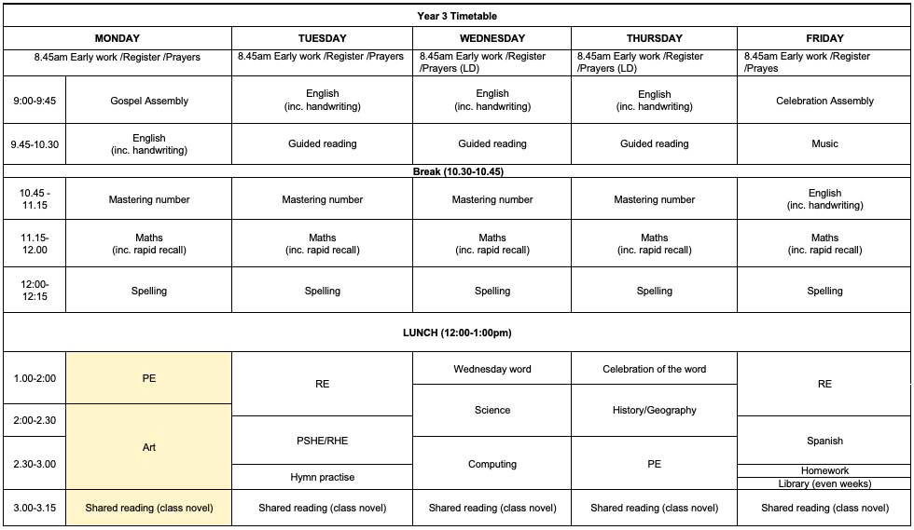
What we will be covering weekly

Slide 5
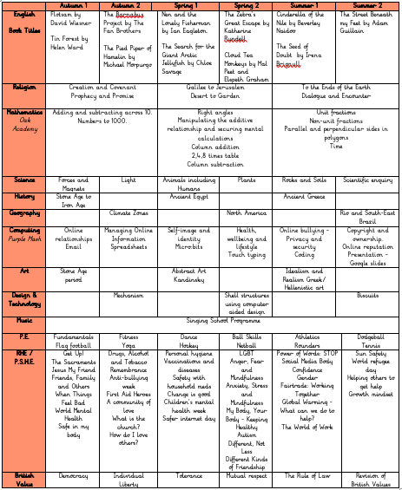
What we will be covering over the year

Slide 6
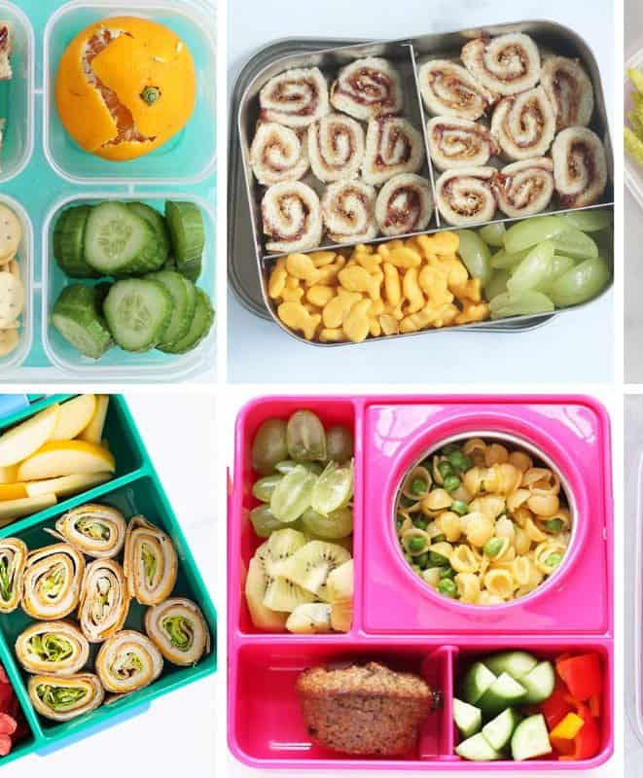
School lunches
If your child is bringing in a packed lunch to school, please make sure it is a balanced meal.
Children do not need to bring in a drink for lunch – we provide water.
We also provide water bottles, so any other water bottles do not need to be brought into school.

Slide 7
School Uniform
Children are to wear the correct uniform everyday, including appropriate footwear (all black footwear). Please make sure all everything is labelled with your child’s name and year group.
Simple watch (no Smart watches), One pair of plain studs (no hooped or dangling earrings), No nail varnish or acrylic/gel nails.
No pencil cases/water bottles. Children can bring their own school bags into school.

Slide 8
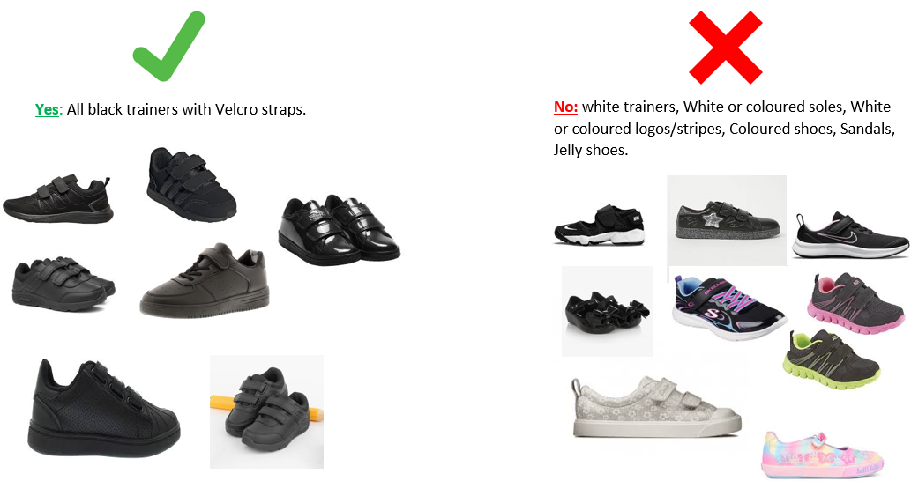

Slide 9
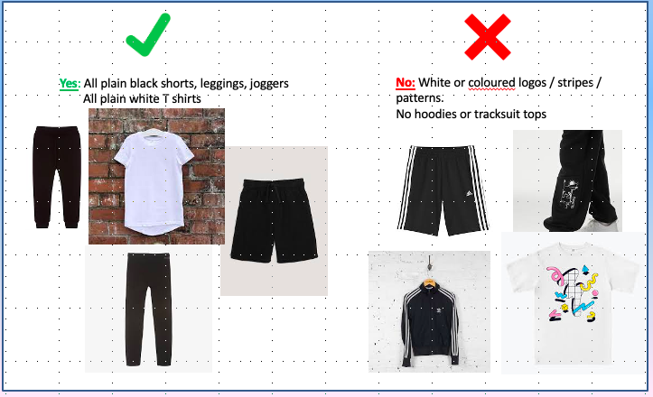
PE Uniform
PE uniform: Wear to school on PE days which are on Mondays and Thursdays (all black shorts/trouser and shoes, and a white t-shirt.

Slide 10
Behaviour
Ready, Respectful , Safe
Weekly certificates
Tea party
House points
Celebration Assembly – Parents of selected children are invited
We have noticed some children are flagging particularly in the afternoons. As you know, regular bedtimes are paramount to good concentration and great work! An average 10-year-old needs at least 10 hours sleep a night.

Slide 11
Home Learning
READING – Please hear your child read every night and sign in the reading record books.
HOME LEARNING – Children will be given a homework grid at the start of each half term and they can select what they would like to complete.

Slide 12
Extra Curricular Clubs
Monday
Flag Football
Baking
Thursday
Netball
Friday
Crafts
Please make sure children bring their PE kits in a separate bag.
Charge of £5 for the half term/term for all clubs (to contribute to the cost of resources)

Slide 13
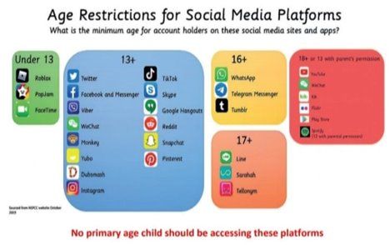
Online Safety
SMART Rules in school

Slide 14
Keep in touch
The Year 3 page on the school website will be regularly updated, so please keep having a look at all the exciting things we are doing!

Slide 15
School Facebook Page
Tools for sharing positive news.
Not for communication/negative comments.
Please complete the online media permission form.

Slide 16
Curriculum Expectations

Slide 17
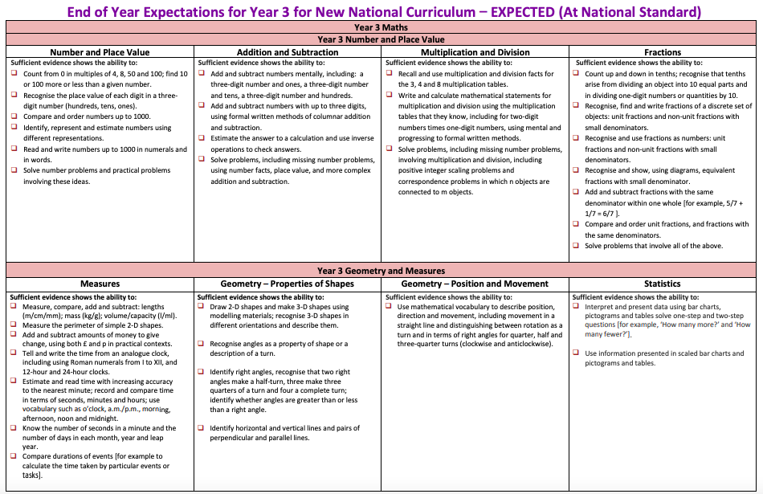

Slide 18
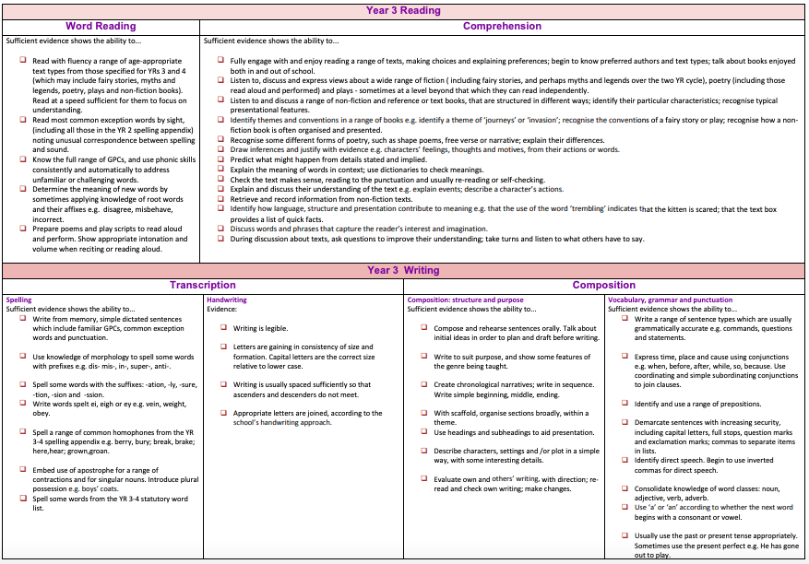

Slide 19

Thank you for listening.
Any questions?

