Slide 1


Slide 2
Meet the Staff
Mrs O’Neill Mrs Pickavance
Teacher Tuesday Teacher
Miss Johnson (am) and Miss Kaseke
Year 1 Teaching Assistants

Slide 3
What we will be covering this year:

Slide 4
Homework
Maths
English
Spellings
Curriculum map
10 minutes of reading every night

Slide 5
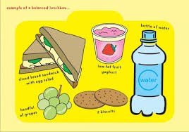
School lunches
If your child is bringing in a packed lunch to school please make sure it is a balanced meal.
Children do not need to bring in a drink for lunch – we will provide water.

Slide 6
School Uniform
Children are to wear the correct uniform every day, including appropriate footwear (PLAIN black trainers – see next slide.)
Simple watch (no Smart watches)
One pair of plain studs (no hooped or dangling earrings)
No nail varnish or acrylic/gel nails

Slide 7
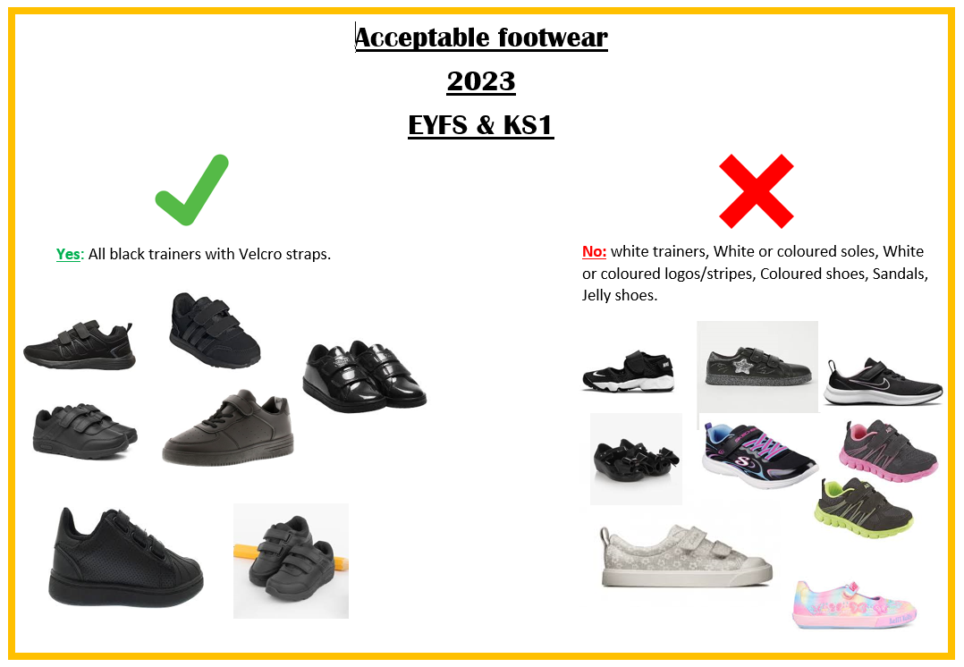
Acceptable footwear
2026

Slide 8
PE
Tuesday and Thursday

Slide 9


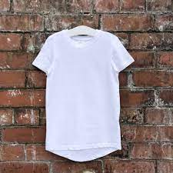







2024
PE uniform: wear to school on PE days which are
Jewellery is not to be worn at all, including stud earrings.
2023
KS2
Yes: All plain black shorts, leggings, joggers
All plain white T shirts
No: White or coloured logos / stripes / patterns.
No hoodies or tracksuit tops

Slide 10

Behaviour
Ready Respectful Safe
Weekly certificates
Tea party
House Points

Slide 11
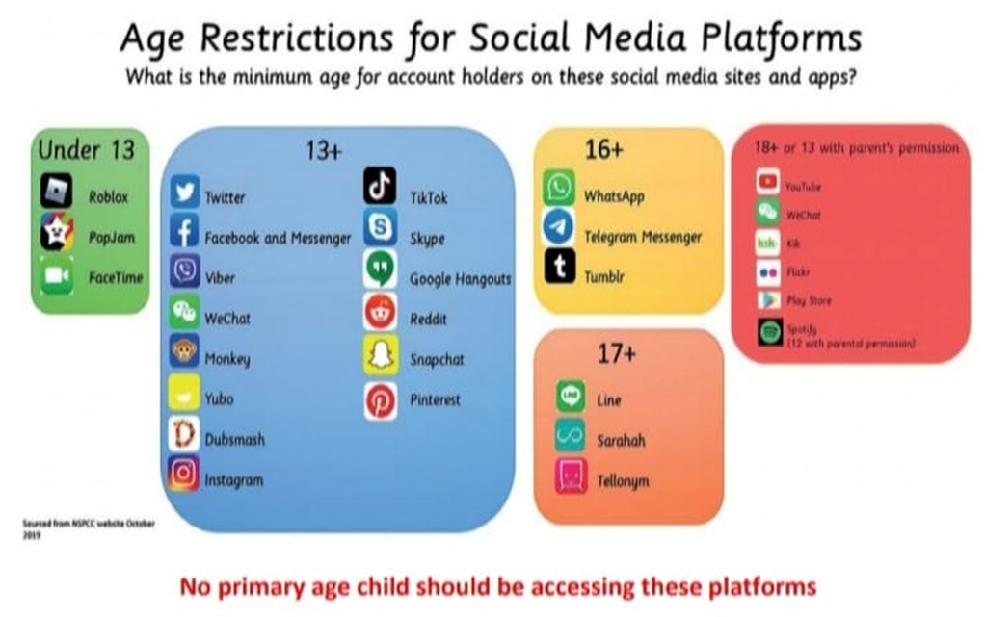
Online safety
SMART Rules in school
Social media guidelines state

Slide 12
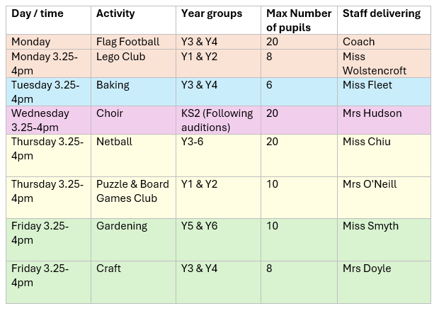
Extra Curricular Clubs
Please note all clubs finish at 4pm. Please be prompt picking up your child.

Slide 13
Keep in touch
Facebook – This will be updated regularly with what your child is doing in school. Please like our posts.
School website - This will be updated regularly with what your child is doing in school.
Tapestry – We will continue to use Tapestry as a form of communication and for additional homework. Please check this regularly.
Come and speak me…I don’t bite!!

Slide 14
Curriculum expectations
Reading By the end of Year 1, children are expected to: ✅ Know and use their phonics to read unfamiliar words ✅ Read common exception words by sight ✅ Read simple books fluently and with increasing confidence ✅ Talk about characters, events and information in texts ✅ Answer questions about what they have read

Slide 15
Curriculum expectations
Writing ✅ Form letters correctly and sit them on the line ✅ Use capital letters, full stops, question marks and exclamation marks ✅ Write simple sentences that make sense ✅ Use phonics to spell unfamiliar words ✅ Spell common exception words and key Year 1 words

Slide 16
Curriculum expectations
Maths ✅ Count forwards and backwards to 100 ✅ Understand place value within 100 ✅ Add and subtract within 20 and beyond ✅ Recognise, name and describe 2D and 3D shapes ✅ Measure length, mass, capacity and time ✅ Count in 2s, 5s and 10s

Slide 17
Parent Support at Home
📚 Read with your child every day ✏️ Practise spellings and handwriting 🔢 Help your child recall number bonds to 10 and 20 🗣 Encourage your child to talk about their learning ⭐ Celebrate effort as well as achievement

Slide 18
Curriculum expectations
This was just a brief overview of some of the expectations for Year 1. Please take a copy of the curriculum handout, which provides more detailed information about the learning objectives and skills your child will be working towards throughout the year.
If you have any questions about the curriculum or how you can support your child at home, please do not hesitate to ask. We look forward to working together to help your child have a happy and successful year in Year 1.

Slide 19

Home – school partnership
These are our ambitions for your children:
Supporting your child with home learning helps reinforce what they have learned in school and gives them more opportunities to succeed.
Celebration Assembly
Parents will be invited if child has received an award.

Slide 20

Thank you for listening, any questions?

