Slide 1

Welcome to Year 2

Slide 2
Meet the Staff
Miss Munro
Year 2 Teacher
Mrs Walker
Mrs Kerr
Mr Cunningham
Year 2 Teaching Assistants

Slide 3
 | Monday | Tuesday | Wednesday | Thursday (Mrs Pickavance) | Friday
8.45-9.00 | Individual reading | Individual reading | Individual reading | Individual reading | Individual reading
9.00-9.45 | Assembly | English inc handwriting | English inc Handwriting | History | Assembly Guided Reading
 | Guided Reading
9.45-10.30 | Phonics | Phonics | Phonics | Phonics | Phonics
10.30-10.45 | Break | Break | Break | Break | Break
10.45-11.30 | Maths inc rapid recall | Maths inc rapid recall | Maths inc rapid recall | Science | Maths inc rapid recall
11.30-12.00 | English | Guided Reading | Guided Reading | Guided Reading | English
12.00-1.00 | Lunch | Lunch | Lunch | Lunch | Lunch
1.00-1.15 | Spelling | Spelling | Spelling | Spelling | Mastering number
1.15-1.30 | Mastering Number | Mastering Number | Mastering Number | Prayer and Liturgy | PE
1.30-2.00 | Library/ Handwriting | English till 2.05pm | Maths | Computing
2.00-2.30 | RE | PE 2.10 – 2.45pm | RE | PSHE | RE
2.30 – 3.00 | RE | Hymn Practise 2.45pm | RE | Music | Art
3.00-3.15 | Super six | Super six | Super six | Super six | Super six
We have PE on a Tuesday and a Friday.

Slide 4
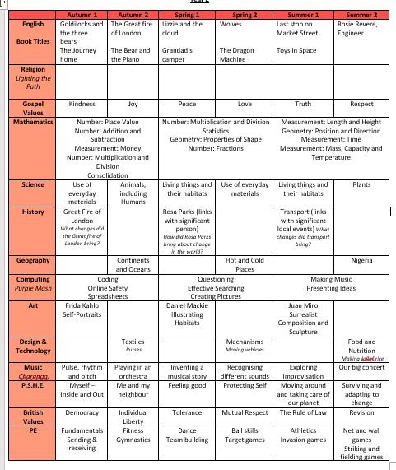
What we will be covering this year: show curriculum overview

Slide 5
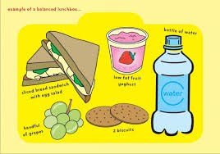
School lunches
If your child is bringing in a packed lunch to school please make sure it is a balanced meal.
Children do not need to bring in a drink for lunch – we will provide water.

Slide 6
School Uniform
Children are to wear the correct uniform every day, including appropriate footwear (PLAIN black trainers – see next slide.)
Simple watch (no Smart watches)
One pair of plain studs (no hooped or dangling earrings)
No nail varnish or acrylic/gel nails
No rucksacks/pencil cases. School will provide a reading folder.

Slide 7
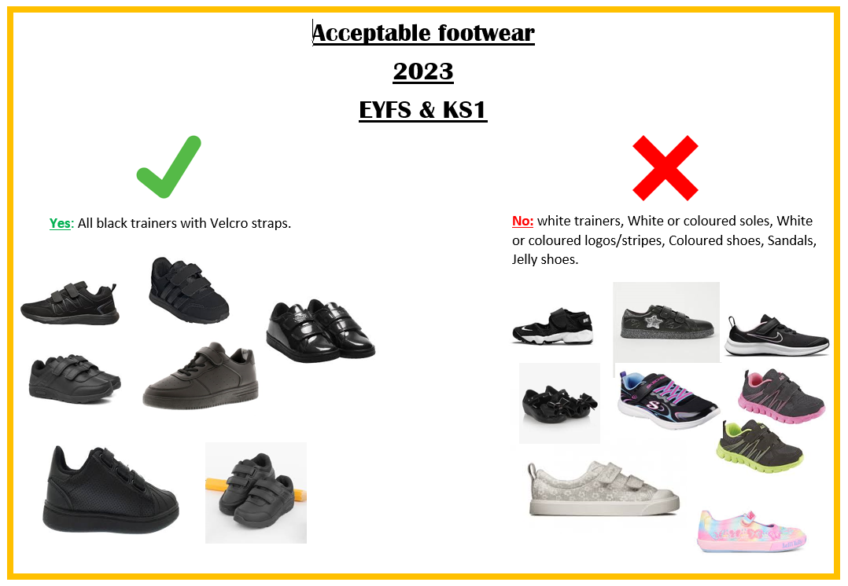
Acceptable footwear
2026
EYFS & KS1

Slide 8


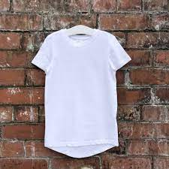
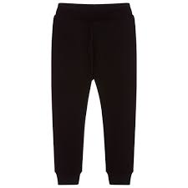
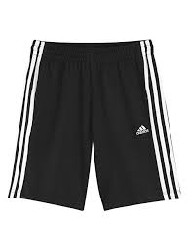
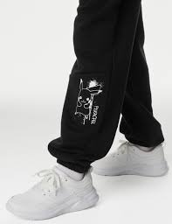
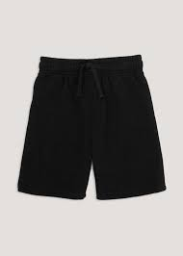

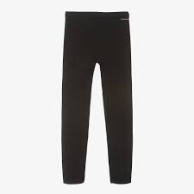

2026
PE uniform: wear to school on PE days which are
Jewellery is not to be worn at all, including stud earrings.
2023
KS2
Yes: All plain black shorts, leggings, joggers
All plain white T shirts
No: White or coloured logos / stripes / patterns.
No hoodies or tracksuit tops

Slide 9

Behaviour
Ready Respectful Safe
Weekly certificates
Tea party
House Points
We have noticed some children are flagging particularly in the
afternoons. As you know, regular bedtimes are paramount to good
concentration and great work!

Slide 10
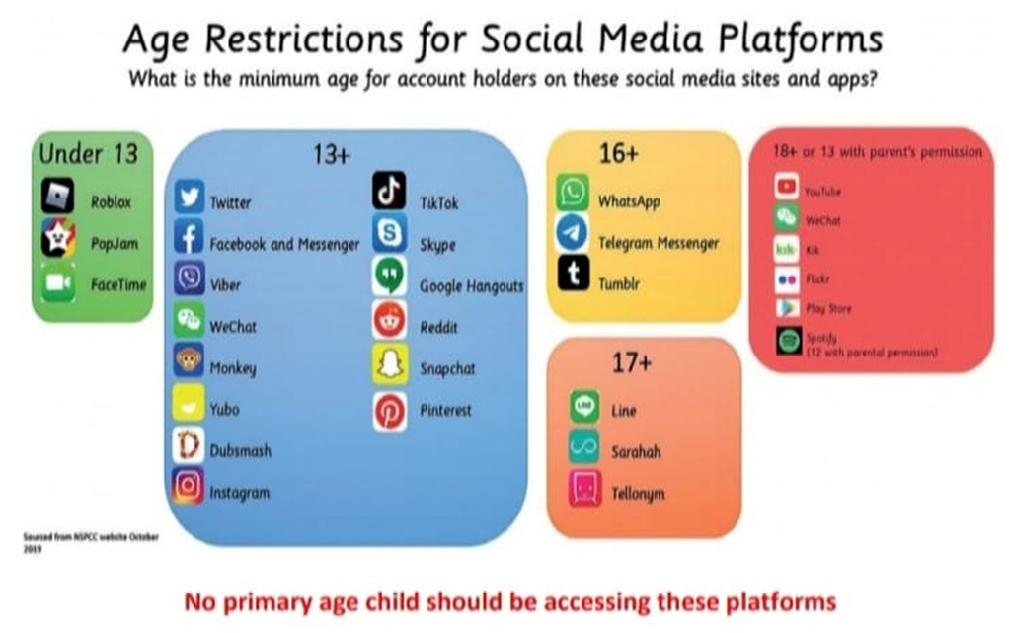
Online safety
SMART Rules in school
Social media guidelines state

Slide 11
Keep in touch
The Year 2 page on the school website will be regularly updated, so please keep having a look at all the exciting things we are doing!

Slide 12
School Facebook page
Tool for sharing positive news
Not for communication/negative comments

Slide 13
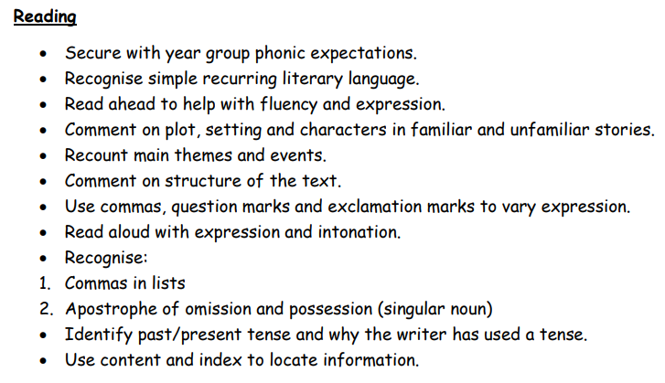
Curriculum expectations
By end of yr 2 children are expected to be able to:
English..

Slide 14
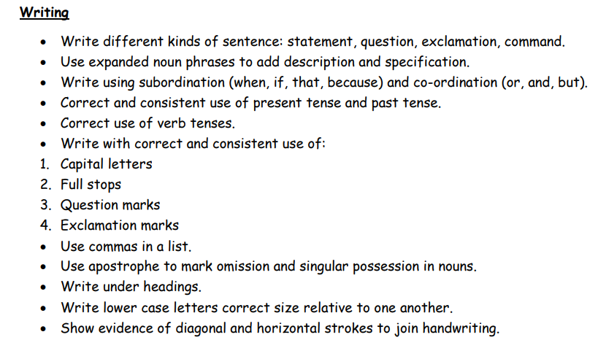
Curriculum expectations
By end of yr 2 children are expected to be able to:
English..

Slide 15
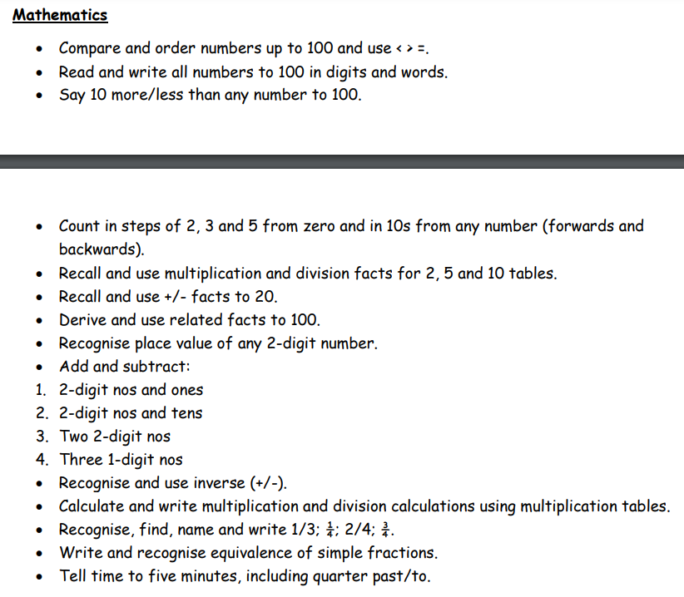
Curriculum expectations

Slide 16

Home – school partnership
These are our ambitions for your children:
Supporting your child with home learning helps reinforce what they have learned in school and gives them more opportunities to succeed.
Celebration Assembly
Parents will be invited if child has received an award.

Slide 17
Home Learning
READING - Please hear your child read EVERY night. Please sign the reading record book.
TIMES TABLES – Please encourage your child to practise time tables as much as possible. It really does help!

Slide 18

Thank you for listening, any questions?

