Slide 1
Read Write Inc. Phonics
Parents’ Meeting
Storytimes
Notes:
Approximately 20 minutes is needed for this session.
Notes are provided to help you lead the presentation.
Notes in italics are for your attention only.
This bitesize parent session is best used alongside an assembly where the children show off a story they know well or parents join a class storytime so you can show them how to bring bedtime stories alive.
Provide copies of ‘ten top tips for reading stories to your children’ from the Portal for each parent.

Slide 2
Children who never have a story read to them, who never hear words that rhyme, who never imagine fighting with dragons or marrying a prince, have the odds overwhelmingly against them.
Maryanne Wolf
Notes:
Read quote.

Slide 3
What makes children happy?
Read for fun on most days
Share meal times and talk together
Cut down on TV viewing
Do things together – visit local places: farms, parks, museums
Teach their children new skills and knowledge - cooking, drawing, music, sport
Listen to each other
Notes:
The Good Child Report from York University in 2016 sent the same message for the third year running – there is nothing new, surprising or difficult in helping children to be happy. The report shows that the happiest children come from families who:
Click and read each point.

Slide 4





Repeated readings
Again! Again!
Children are wired to thrive on repetition
Notes:
Stories provide a wealth of language we don’t use in everyday talk.
The more stories, poems and nursery rhymes children know well, the more easily they will be able to understand what they read, when they can read.
Children thrive on repetition.
Take Sophie who is 2 ½ years old.
She begs for her favourite stories to be read over and over again.
The more her mum repeats the story, the more the story ‘belongs’ to Sophie.
Sophie ‘reads’ it, copying the special emphasis and actions that her mum used every time she read the story to her.

Slide 5
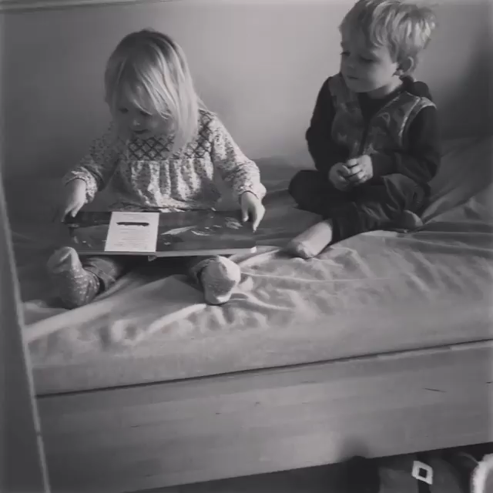
Room on the Broom
Notes:
Let’s watch Sophie ‘read’ ‘Room on the Broom’. Play film.

Slide 6
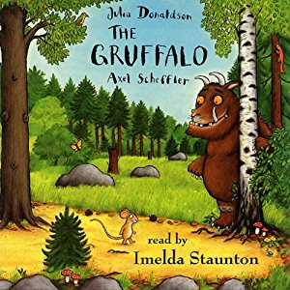

Storytimes
Notes:
In our school:
We make time to read stories every day.
We have key stories that the children hear over and over again. (Mention some favourites from your school)
We help children to learn words and phrases from the story (Demonstrate some key phrases your children know or will know off by heart)

Slide 7
Storytime at home
Read to your children every day
Ask lots of questions and share opinions
Notes:
One of the most important things you can do as a parent at home is read to your child.
This helps develop an enjoyment for stories and the motivation for learning to read themselves.
Loving stories is important because children who love stories want to read stories for themselves. Children who read a lot become better readers.
Ask questions and share opinions about what you read to engage them in discussion, get them thinking about what they read and develop vocabulary.

Slide 8
10 things your child learns when you read aloud stories and poems every day
Sustain attention
Appreciate rhythm and rhyme
Build pictures in their minds from the words on the page
Understand humour and irony
Use new words and phrases in different contexts - and later in writing
Learn new vocabulary and knowledge of the world
Think about characters’ feelings and use appropriate voices
Follow a plot with all its twists and turns
Understand suspense and predict what’s about to happen next
Link sentences and ideas from one passage to the next
Notes:
Look at all these things you child will learn when you read aloud stories and poems, - without any teaching!
Click each point and read.

Slide 9
Top Tips - Storytime
Make it a treat
Make it a special quiet time
Show curiosity
Read story once without stopping
Chat about the story
Avoid testing with questions
Link to other stories and experiences
Read favourites over and over again
Use different voices
Love the book
Notes:
Here are our ten top tips for Storytime at home.
Make it a treat – introduce each new book with excitement.
Make it a special quiet time – cuddle up!
Show curiosity in what you’re going to read.
Read story once without stopping so they can enjoy the whole story. . If you think your child might not understand something say something like ‘Oh I think what’s happening here is that…”
Chat about the story e.g. I wonder why he did that? Oh no, I hope she’s not going to…
Avoid asking questions to test what they remember.
Link to other stories and experiences you have shared e.g. this reminds me of…
Read favourites over and over again – encourage your child to join with the bits they know. Avoid saying ‘not that story again!’
Use different voices – be enthusiastic!
Love the book – read with enjoyment.
I will give you a handout with these tips when you leave today.

Slide 10
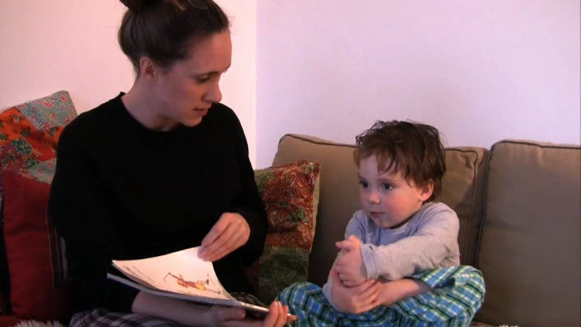
We’re going on a bear hunt
Notes:
Here’s two year-old Mylo enjoying ‘We’re going on a bear hunt’ with his mum, Natalie.
Watch storytime video.
By reading stories aloud, Mylo’s mum is bonding with him through books - forming a link between reading and love.
No distractions, no technology to get in the way.
Because she loves the book, Mylo mirrors that love.
He is learning to sustain attention with his mum

Slide 11
Be a ‘talk-a-lot’ family
Talk to your child as much as possible
Use new and ambitious vocabulary
Build interesting sentences together
Notes:
Research shows that the number and range of words parents use to speak to their children predicts their success at school.
Use every opportunity to talk to your child throughout the day – meal times, travelling to school, playing together etc.
Our typical spoken language tends to reuse the same words: sad, happy, nice, nasty, cross, little, big, run.
Young children soak up words incredibly quickly, much more quickly than we are able to, so don’t hold back.
As adults, we know thousands of words we can share with children – each one of us is a walking thesaurus!
Try to use a range of words and phrases with similar, but slightly different, shades of meaning (synonyms).
Encourage your children to use these words for themselves.
Build interesting sentences with your child e.g. what a miserable and gloomy day! Would you like a crunchy apple for snack?

Slide 12
What can you do?
1. Read the same stories aloud again and again
2. Read with enthusiasm – love each story
3. Use a range of vocabulary with your child

