Slide 1
UNICEF/Helin

Slide 2
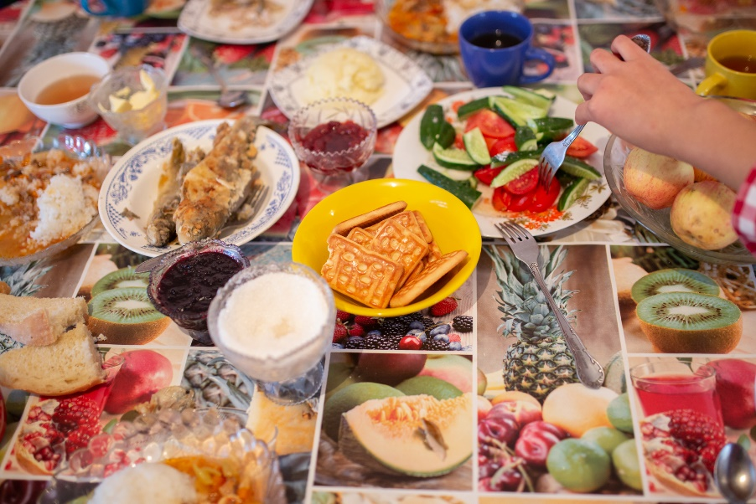

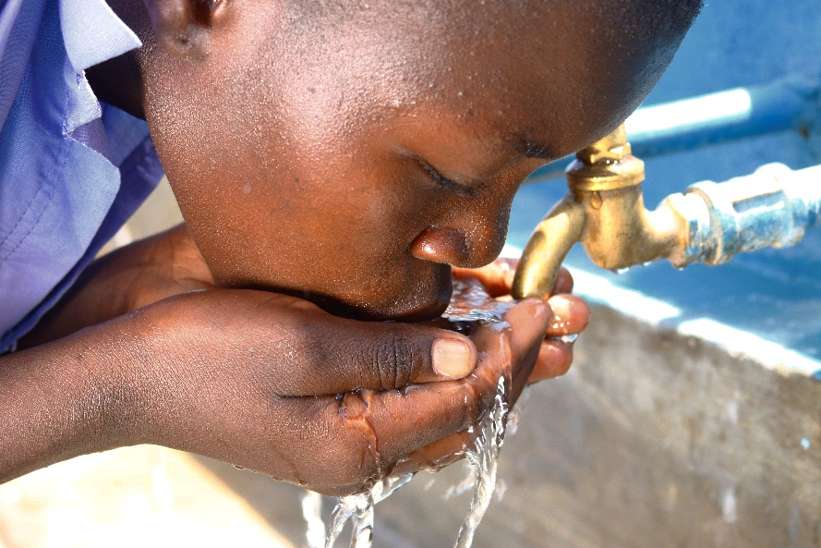
Guess the Article
These pictures are a clue to this week’s article.
Can you guess how they are linked together?
Discuss your ideas with someone in your house.
UNICEF/Zhanibekov
Wikimedia Commons
UNICEF/Adriko

Slide 3
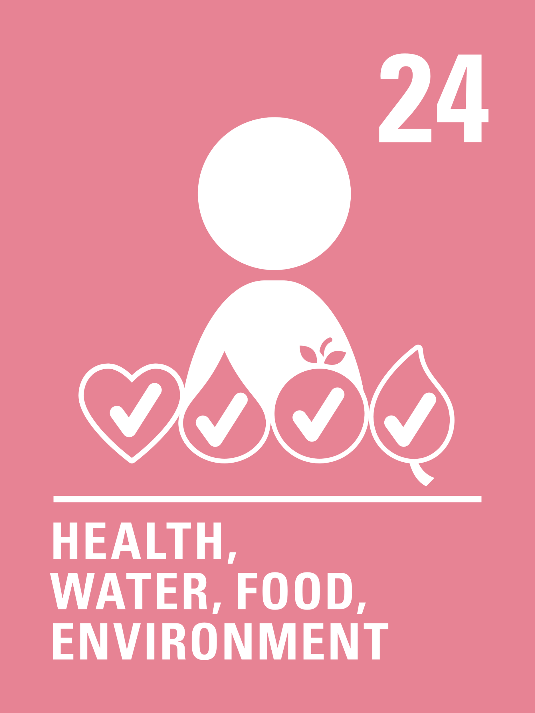
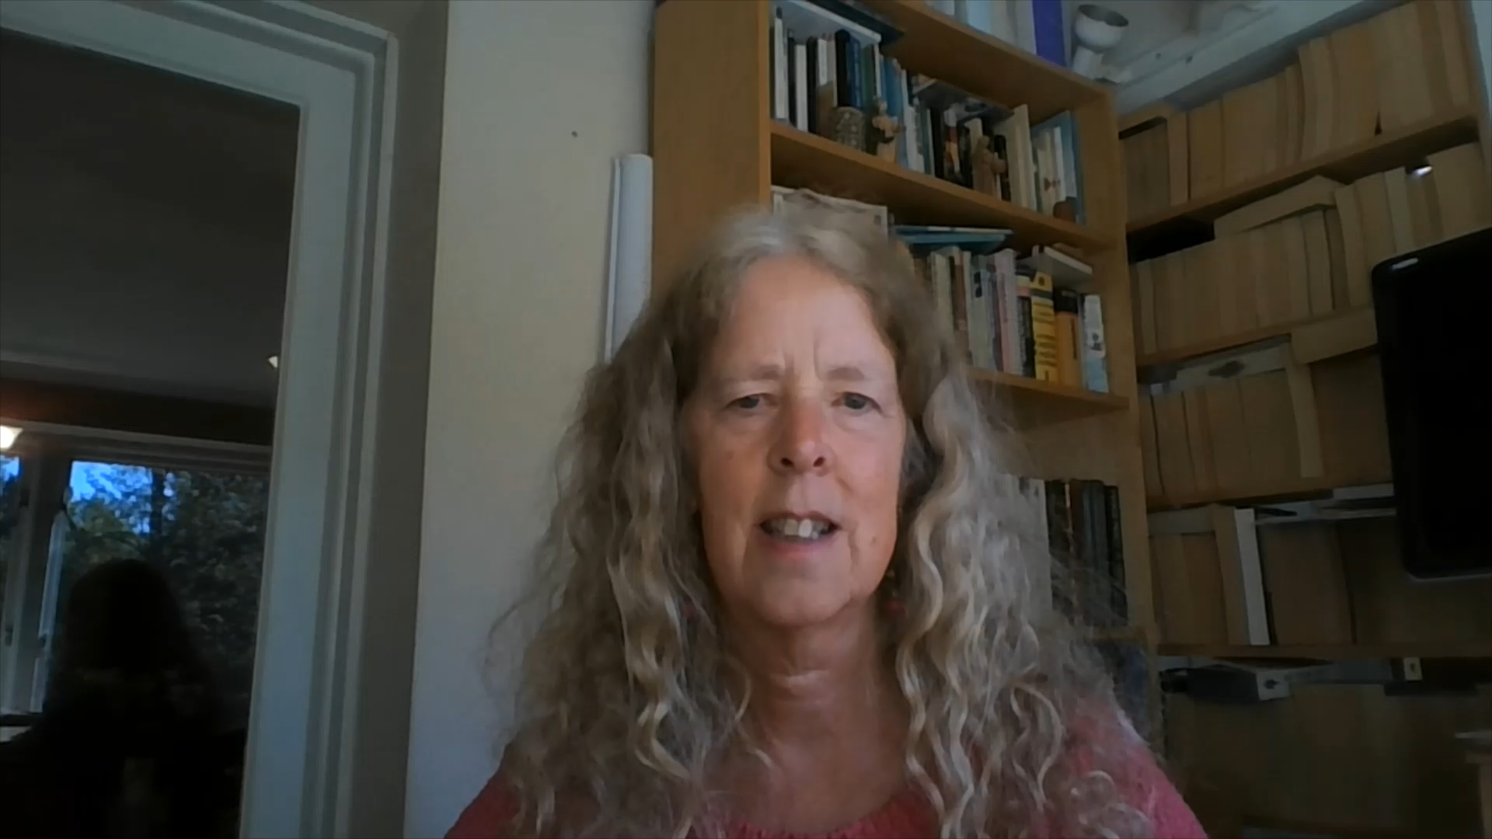
Introducing… Article 24
Frances introduces Article 24 – Health Care
Article 24 – Health Care - ensures that every child has the right to the best possible health.
Governments and leaders of countries must provide good quality health care, clean water, nutritious food, and a clean environment and education on health and well-being so that children can stay healthy.
Richer countries must help poorer countries achieve this.

Slide 4
What do you need to be healthy?
How do we stay healthy?
Compare your thoughts with the next slide.

Slide 5
How many of these did you get?
Enough Sleep – We all need at least 8 hours sleep every night
Nutritious Food – fruit and vegetables
Water – at least a litre a day
Good hygiene – keeping clean, particularly your hands
Exercise
A clean place to live
Feeling safe, secure and respected
Health care - To see a doctor or a nurse when you need to and to be vaccinated against diseases

Slide 6




Activity time
Draw pictures of people who help us to stay healthy and safe. What are their jobs?
Make a list or draw pictures of different types of exercise.
All these activities are related to…
Set up an obstacle course for your family to do.
Read Coronavirus: a book for children and talk about what you are doing as a family to keep healthy during this time.
Primary

Slide 7


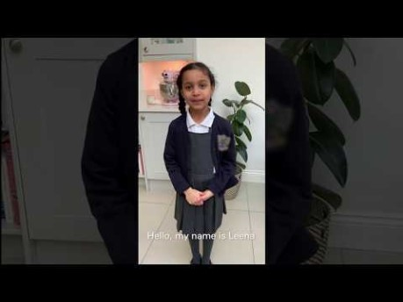

Activity Time
The new hospitals being built are called Nightingales. Who are they named after and what did this person do to enable the right to good quality healthcare?
Have you taught your family to wash their hands carefully? Watch this video on YouTube.
Could you create your own video linked to Article 24?
Invent a recipe for a healthy snack.
Choose 10 items of food from your kitchen, can you sort them into healthy/not so healthy?
Primary

Slide 8

What have you learned?
Spend a few minutes thinking about these questions.
What do you do to respect your right and other people’s right to be healthy?
What job does the woman in the picture do? How does she help us ?
How can we show our appreciation for them? Why is this important?
Have you taken part in ‘Clap for Carers’? What else could you do to show you care?
Write down your answers or talk to people in your home.
Wikimedia Commons

