Slide 1
Phonics Workshop for parents

Slide 2
Welcome and Aims
Phonics Screening Check
Let’s Practise
Terminology
Phonics to Support Reading
Phonics to Support Writing
Websites

Slide 3
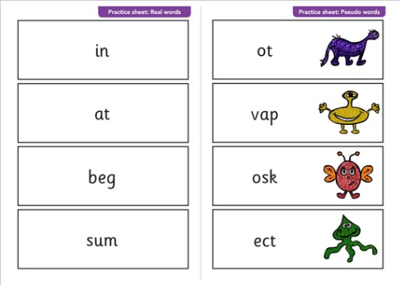
Phonics Screening Check
Don’t worry!
Practise in class
Read 40words
Real and pseudo (alien) words
Checks blending skills and the graphemes learnt
Week commencing 10th June 2019

Slide 4
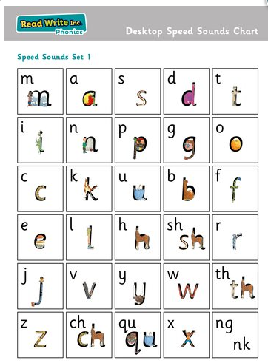
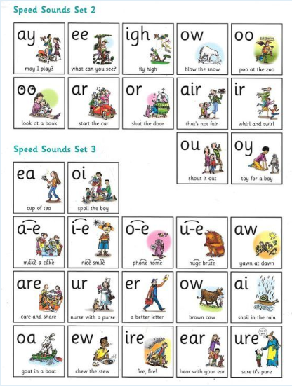
Let’s practise our phonics

Slide 5

Split Digraphs
A diagraph (two letters that make one sound) that have been split up by another letter.

Slide 6
Sound Buttons can help us!
Dot for singles letters
- Dash for digraphs or trigraphs (2 or 3 letters working together)
A curve for a split digraph

Slide 7
Quick practise
How many sounds are in these words? Show us on your fingers.
cat
dog
sheep
snake
time
coats
jumper
blackbird

Slide 8
Phonics Terminology
Phoneme – a unit of sound
Grapheme- written representations of phonemes
Blend- putting sounds together
Segment- breaking words into sounds (Fred Talk)
Digraph- two letters representing one sounds (ai)
Trigraph – three letters representing one sound (igh)
Sound buttons-dots and dashes to support

Slide 9

Phonics to Support Reading
Confident readers decode words and understand words
Say each sound and blend together
Need to notice digraphs within words
Need to notice split digraphs
Say sound correctly (pure sounds)
Be careful blending adjacent consonants

Slide 10
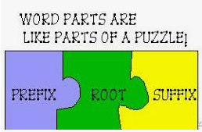
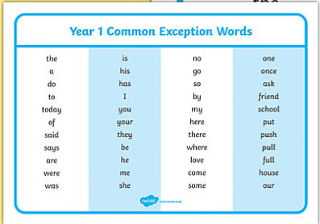
Phonics to Support Reading
Break longer words into syllables-chunking
Recognise common
suffixes e.g ing,ly, est, ed
Move on to reading without sounding out too often
Quickly recognise
Year 1 words

Slide 11
Useful websites
• www.phoncsplay.co.uk
• http://www.bbc.co.uk/cbeebies/shows/alphablocks
• http://www.topmarks.co.uk/Interactive.aspx?cat=40
• http://www.ictgames.com/literacy.html
• http://www.familylearning.org.uk/phonics_games.html

Slide 12
Thank You!

