Slide 1


Wigan Complex Safeguarding Team
Child Exploitation
Parents & Carers Awareness

Slide 2


Aim of the training
Overview & increased awareness of Child Exploitation – Online and in the community
Insight into what’s happening locally – what do you need to know as a parent
How to protect your child – Guidance, links
Who can you ask for help and advice?
Please look after yourself – take time out if you need to
If ONLINE – be mindful of content/ who can overhear…

Slide 3
Complex Safeguarding Team
Dedicated Multi-Agency Complex Safeguarding Team based at Wigan Police station including professionals from Social Care, Police, Health, Youth Justice with support from Housing, Targeted Services & Locala Sexual Health.
Complex Safeguarding Team looks at every aspect of Child Exploitation (CE) from prevention, identification and early intervention, to arrest and conviction, with a focus on help and support for young victims and those at risk of CE.
The main objective is to ensure that there is consistent service for young people in relation to CE across all ten districts of Greater Manchester and that the standard of service is at the very least good, if not excellent in all ten district.

Slide 4
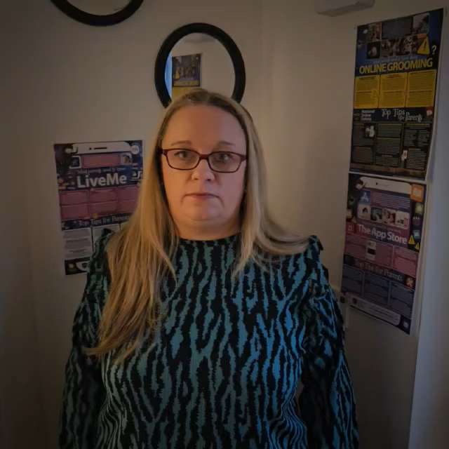
Tricia Dawber
Complex Safeguarding Team
Parent Support Worker

Slide 5
What is Child Exploitation?
Children up to age 18
Grooming, coercion, manipulation, threats – Children do not always recognise what is happening – boyfriend, girlfriend, friend….
Perpetrators – all ages and all backgrounds
Child Exploitation can happen in various ways –
  Sexual exploitation – Grooming a child into sexual activity – online or in person
  Criminal Exploitation – Exploiting a child into criminal activity

Slide 6








What are the risks?

Slide 7
Primary Age children..
Research from Ofcom found that almost one in five (19 per cent) children aged three to five use social media independently, while 40 per cent of children under 13 have a social media profile
44% of 5–10-year-olds have their own mobile phone
38% of children age 5-7 said they would trust a person online based on how they look.
one in four 8–9-year-olds are using social media despite age restrictions, typically set at 13 years
25% of children age 6-9 did not know that what they post online could be seen by people they did not know
81% use a tablet to go online
In 2023 almost two thirds (63%) of young people reported they had viewed pornography

Slide 8
Children’s Commissioners
Report 2023 & 2025
In 2023 almost two thirds (63%) of young people reported they had viewed pornography online. In 2025 that number had increased to 70%
Some respondents reported to seeing it by age 6 or younger
27% reported to have seen it by age 11
The most common way respondents saw pornography was by accident; 59% reported finding it this way. This has increased by 23% since 2023.
1 in 10 nine-year-olds are reported to have seen pornography

Slide 9
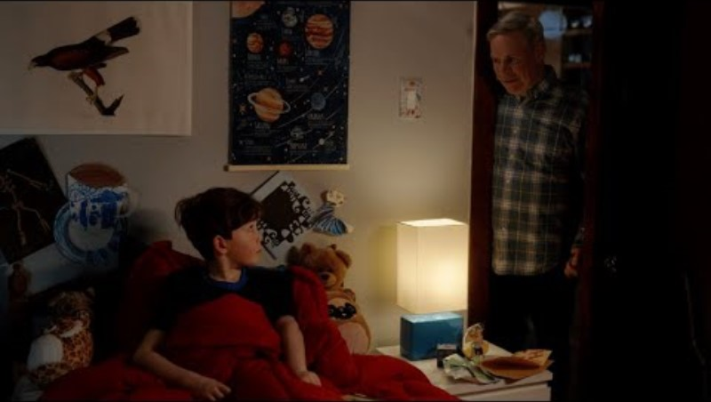
Notes:
Smartphone Free Childhood US - "Let's Change The Norm“
https://www.youtube.com/watch?v=h_xwJ5u9I8o&t=54s

Slide 10
What are the risks involved
Harassment or online bullying (“cyber bullying”) on the part of your young person or others’
Posting personal/sensitive information about themselves that:
could be used to embarrass or manipulate them;
Could be used to track there where abouts making them a target for sexual predators (Child Sexual Exploitation).
Damage to reputation or future prospects because of young people’s own behaviour or that of their peers –
Spending too much time online, losing a sense of balance in their activities, which is why parents need to be engaged and monitoring internet use.
Exposure to inappropriate content (in appropriate pop ups, adverts, age restricted sites, pornography).
Potential for inappropriate contact with strangers inappropriate adults, inappropriate peers.
(parents / carers need to ensure that social networking does not lead to offline contact unapproved by them).
As a parent / carer you are responsible for your young person if they use certain applications YOU use them, it is the best way to educate your self and stay in the KNOW.

Slide 11
‘’Children are exposed to various forms of harmful content online, which simply wouldn’t be allowed to cross their paths in the ‘real’ world. This includes sexualised, pornographic imagery, violent or gory content, material depicting self harm, and anonymous trolling’’
Rachel de Souza, Childrens Commissioner (2022)
‘’The serious threat of child sexual abuse facilitated by the internet is an urgent problem which cannot be overstated’’
Professor Alexis Jay (2020)

Slide 12

Please consider screen time
Screen Addiction is real!
Growing evidence that screen time causes increased anxiety, sleep disturbances, concerns around mental health and impaired learning.
In the UK, statistics show a significant rise in children's screen time, with nearly 25% of young people exhibiting smartphone use consistent with behavioural addiction,
Research from Ofcom found that almost one in five (19 per cent) children aged three to five use social media independently, while 40 per cent of children under 13 have a social media profile despite restrictions.
One in four 8 to 9-year-olds who game online report interacting with unknown individuals. Parental concerns remain high, with three in four worried about exposure to age-inappropriate content.

Slide 13
Online Grooming / CSE
Online, it is easier for people with these intentions to pretend to be someone they’re not, like a friend, mentor, boyfriend or girlfriend. They can even pretend to be a completely different person and hide who they really are. Someone who is grooming others online might do this to build trust with them before asking them to do something sexual.
Children may not disclose for many reasons…
  Shame/ embarrassment/ guilt
  Fear from the perpetrator
  Fear of getting into trouble themselves
- Convicted paedophile Alexander McCartney had over 3500 known victims worldwide– only 4 reported it to authorities.
Alexander McCartney: How police snared the catfish killer - BBC News
https://www.youtube.com/watch?v=VPXA7SO8Vo0&t=74s

Slide 14
Online Criminal Exploitation
Perpetrators can use online platforms as a way to criminally exploit young people by coercing them into criminal activity and then monitoring and controlling their movements.
Location tracking: Organised crime groups track the location of children and young people through apps to coerce their behaviour and blackmail them into criminal activity. This is sometimes known as remote mothering.
Money laundering: Young people’s online bank or game accounts can be used to hold or ‘clean’ money from criminal activity. This is sometimes known as ‘squaring’.
Online safety Act 2023: Online Safety Act: explainer - GOV.UK
The Online Safety Act 2023 (the Act) is a new set of laws that protects children and adults online. It puts a range of new duties on social media companies and search services, making them more responsible for their users’ safety on their platforms.

Slide 15
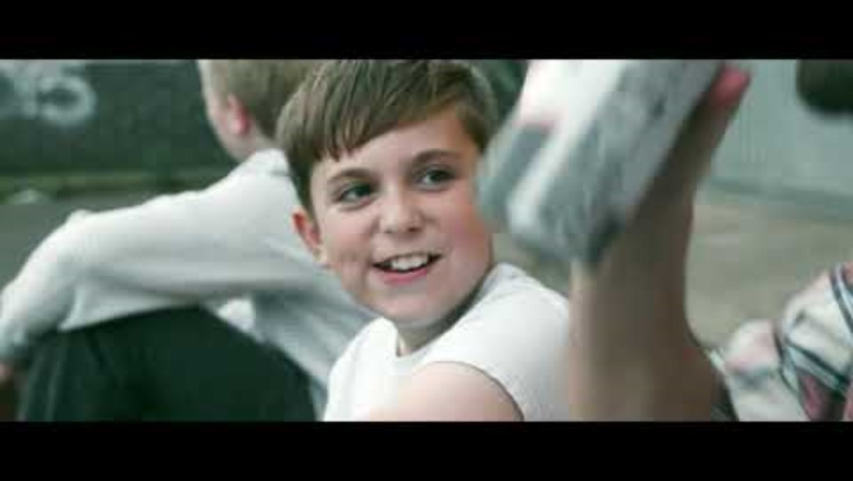
Alfie’s Story

Slide 16

What to look out for..
Having unexplained gifts, money, mobile phones etc
Distressed/ out of the norm behaviour
Secretive / Addictive
Drugs/ alcohol
Missing from Home or regularly coming home late
Having unknown ‘boyfriend’ / ‘girlfriend’ / online ‘friends’
Perceived inappropriate sexual behaviours

Slide 17
Parent/Carer Responsibility
Internet
Parents and carers have a primary responsibility to ensure that their own children use the internet safely.
We need to protect our children online as much as we do offline.
Due to the ever-changing world in technology, parents and children going online together from an early age helps develop ongoing conversations about appropriate use of technology.
Children of all age groups inhabit a world that seamlessly flows between on and offline. In order to thrive in both, they need the protection of their safe adults.

Slide 18
Taking responsibility: Tips/Advice
Devices to be used only in the family area where they can be supervised
You can set up their phone/tablet with appropriate applications and parental controls, so your child will need to seek your permission before making any downloads.
Use privacy settings wherever they exist to keep their information private
Make sure your child has not got any personal information online. (Phone number, address, school, any pictures that display their school uniform).
Always check your child’s activity/history online and take an interest in what they do. Talk to your child about safety.
Let your child know that sending or receiving inappropriate images/videos, is a criminal offence.
Check their friends list regularly. With your supervision only let your child talk to family and friends they actually know offline.
Ensure your child is a good online friend and encourage positive communication.
Remember most online applications are 13+ years

Slide 19
Things to think about..
Implement family rules around the devices, use a visual so your child can view it daily
Think about the amount of time spent on devices, screen addiction is on the increase
Set up parental controls on all devices they use.
You set passwords/numbers so your child needs to ask for access, do not give your child your password/number.
Research applications and make sure they are age appropriate.

Slide 20

What are parental controls?
Parental controls allow you to block and filter upsetting or inappropriate content. They work across your Wi-Fi, phone network, individual apps and devices. Parental controls can help you to:
Plan what time of day your child can go online and how long for
Create content filters to block apps that may have inappropriate content
Manage the content different family members can see.
Home Broadband and Wifi -Home internet providers can offer parental controls for your family. Speak to your provider
Games Consoles - On many consoles there are parental controls which allow you to manage which features are available to your child. On some devices you can:
Turn off chat functions to stop your child from talking to people they don't know
Restrict games based on age . turn off in-game purchases or set a limit.
Icon for settings - click on this icon and it will take you to security

Slide 21
Mobiles, Tablets and Computers - All mobiles, tablets and computers have parental control settings, which can differ between devices, these include:
allowing or disallowing in-game or in-app purchases
settings such as location settings and what information your child is sharing
wellbeing settings to help with limiting screen time.

Slide 22
Aps and Online Services - Many social media, apps and online services such as film and TV streaming services have features such as:
content filters
chat filters
privacy settings
in-app purchase settings.
You can find out about these features by looking in the settings on each app or take a look at their website for more information. They might be called settings, family features, privacy, or security.

Slide 23
Support for you: Organisations that can help with online information and safety
Speak to your child’s school – All schools promote online safety
CEOP (Child Exploitation Online Protection) Home | CEOP Education (thinkuknow.co.uk)
Childline Online and mobile safety | Childline also has lots of information about online and mobile safety that will help you and your child.
National Online Safety | Keeping Children Safe Online in Education
NSPCC https://learning.nspcc.org.uk/safeguarding-child-protection

Slide 24

Other people children can talk to:
No matter how hard we try, there may be things that children won’t open up to us about; so it’s important that we give them other options.
That could be:
Another safe adult, family member, e.g. aunt, older cousin etc.
A teacher or member of the pastoral team in school
Childline on 0800 1111 or visiting the Childline website.
CEOP (Child Exploitation Online Protection) Home | CEOP Education (thinkuknow.co.uk)

Slide 25
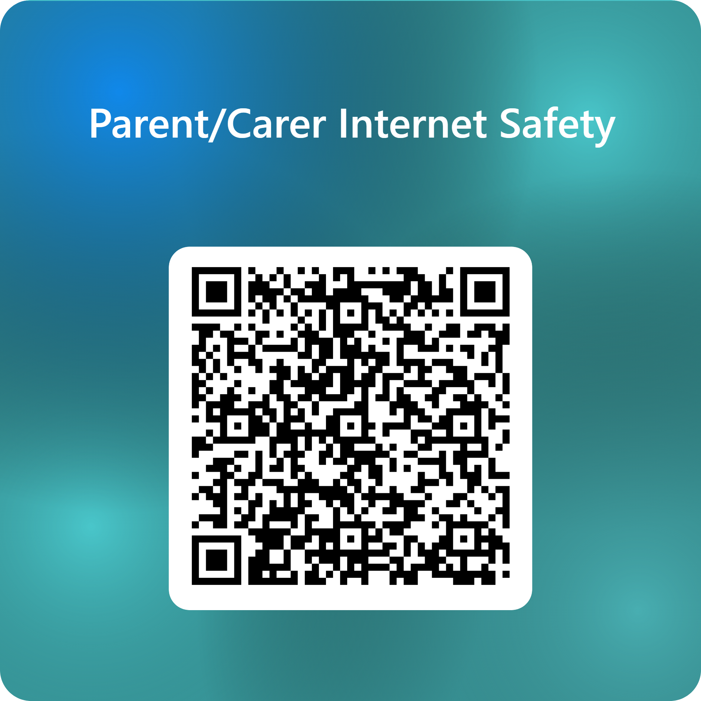
I hope the information has been helpful and it supports you to keep your children safe online.
Could I please ask you to take 5mins of your time to give your honest opinion of the information received.
Just scan the QR code this will take you to a feed back questionnaire.
"Safety is not a gadget but a state of mind.“
- Eleanor Everet

Slide 26

Any Questions?

Slide 27
Resources/ further support
Child Exploitation Online Protection www.ceop.police.uk
Barnardos: www.barnardos.org.uk
NSPCC email: help@nspcc.org.uk tel:0808 800 5000
Trapped Campaign: https://www.programmechallenger.co.uk/resources/trapped/
Children’s Society: https://www.childrenssociety.org.uk/
Working Together to Safeguarding Children: https://assets.publishing.service.gov.uk/government/uploads/system/uploads/attachment_data/file/942454/Working_together_to_safeguard_children_inter_agency_guidance.pdf

Slide 28

Resources/ further support
Children and technology: Age-appropriate usage advice | NSPCC
Keeping children safe online | Barnardo’s
Children-nudification-tools-and-sexually-explicit-deepfakes-April-2025.pdf
We need to act now on young people creating AI indecent imagery, before it’s too late - University of Birmingham
Key messages from research | CSA Centre
Embargoed-Sex-is-kind-of-broken-now-Children-and-Pornography.pdf
‘A lot of it is actually just abuse’- Young people and pornography | Children's Commissioner for England
Children and young people who engage in technology-assisted harmful sexual behaviour | NSPCC Learning

Slide 29
Resources/ Training:
Child Exploitation Online Protection www.ceop.police.uk
Barnardos: www.barnardos.org.uk
NSPCC email: help@nspcc.org.uk tel:0808 800 5000
Trapped Campaign: https://www.programmechallenger.co.uk/resources/trapped/
Children’s Society: https://www.childrenssociety.org.uk/
Working together to Safeguarding Children – https://assets.publishing.service.gov.uk/government/uploads/system/uploads/attachment_data/file/942454/Working_together_to_safeguard_children_inter_agency_guidance.pdf

Slide 30

GM – It’s Not Okay
The ‘It’s not okay’ website & campaign has been put together by Project Phoenix
Raise awareness of child sexual exploitation
Help people recognise the signs
Encourage people to report it
Provide support to victims and those most at risk
http://www.itsnotokay.co.uk/
Follow/Like us
NB. The accounts do not have ‘it’s’ in them.
Facebook: www.facebook.com/notokayGM
Twitter: www.twitter.com/notokayGM
#itsnotokay

