Slide 1





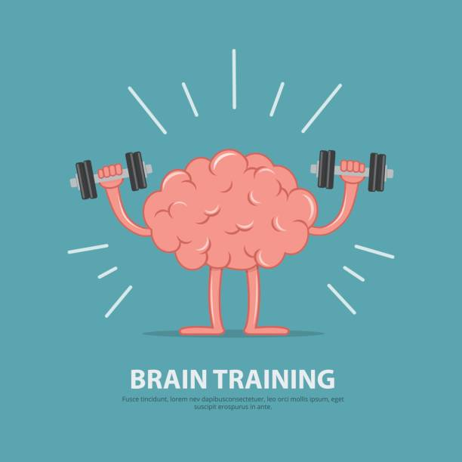
HEALTHY MIND

Slide 2
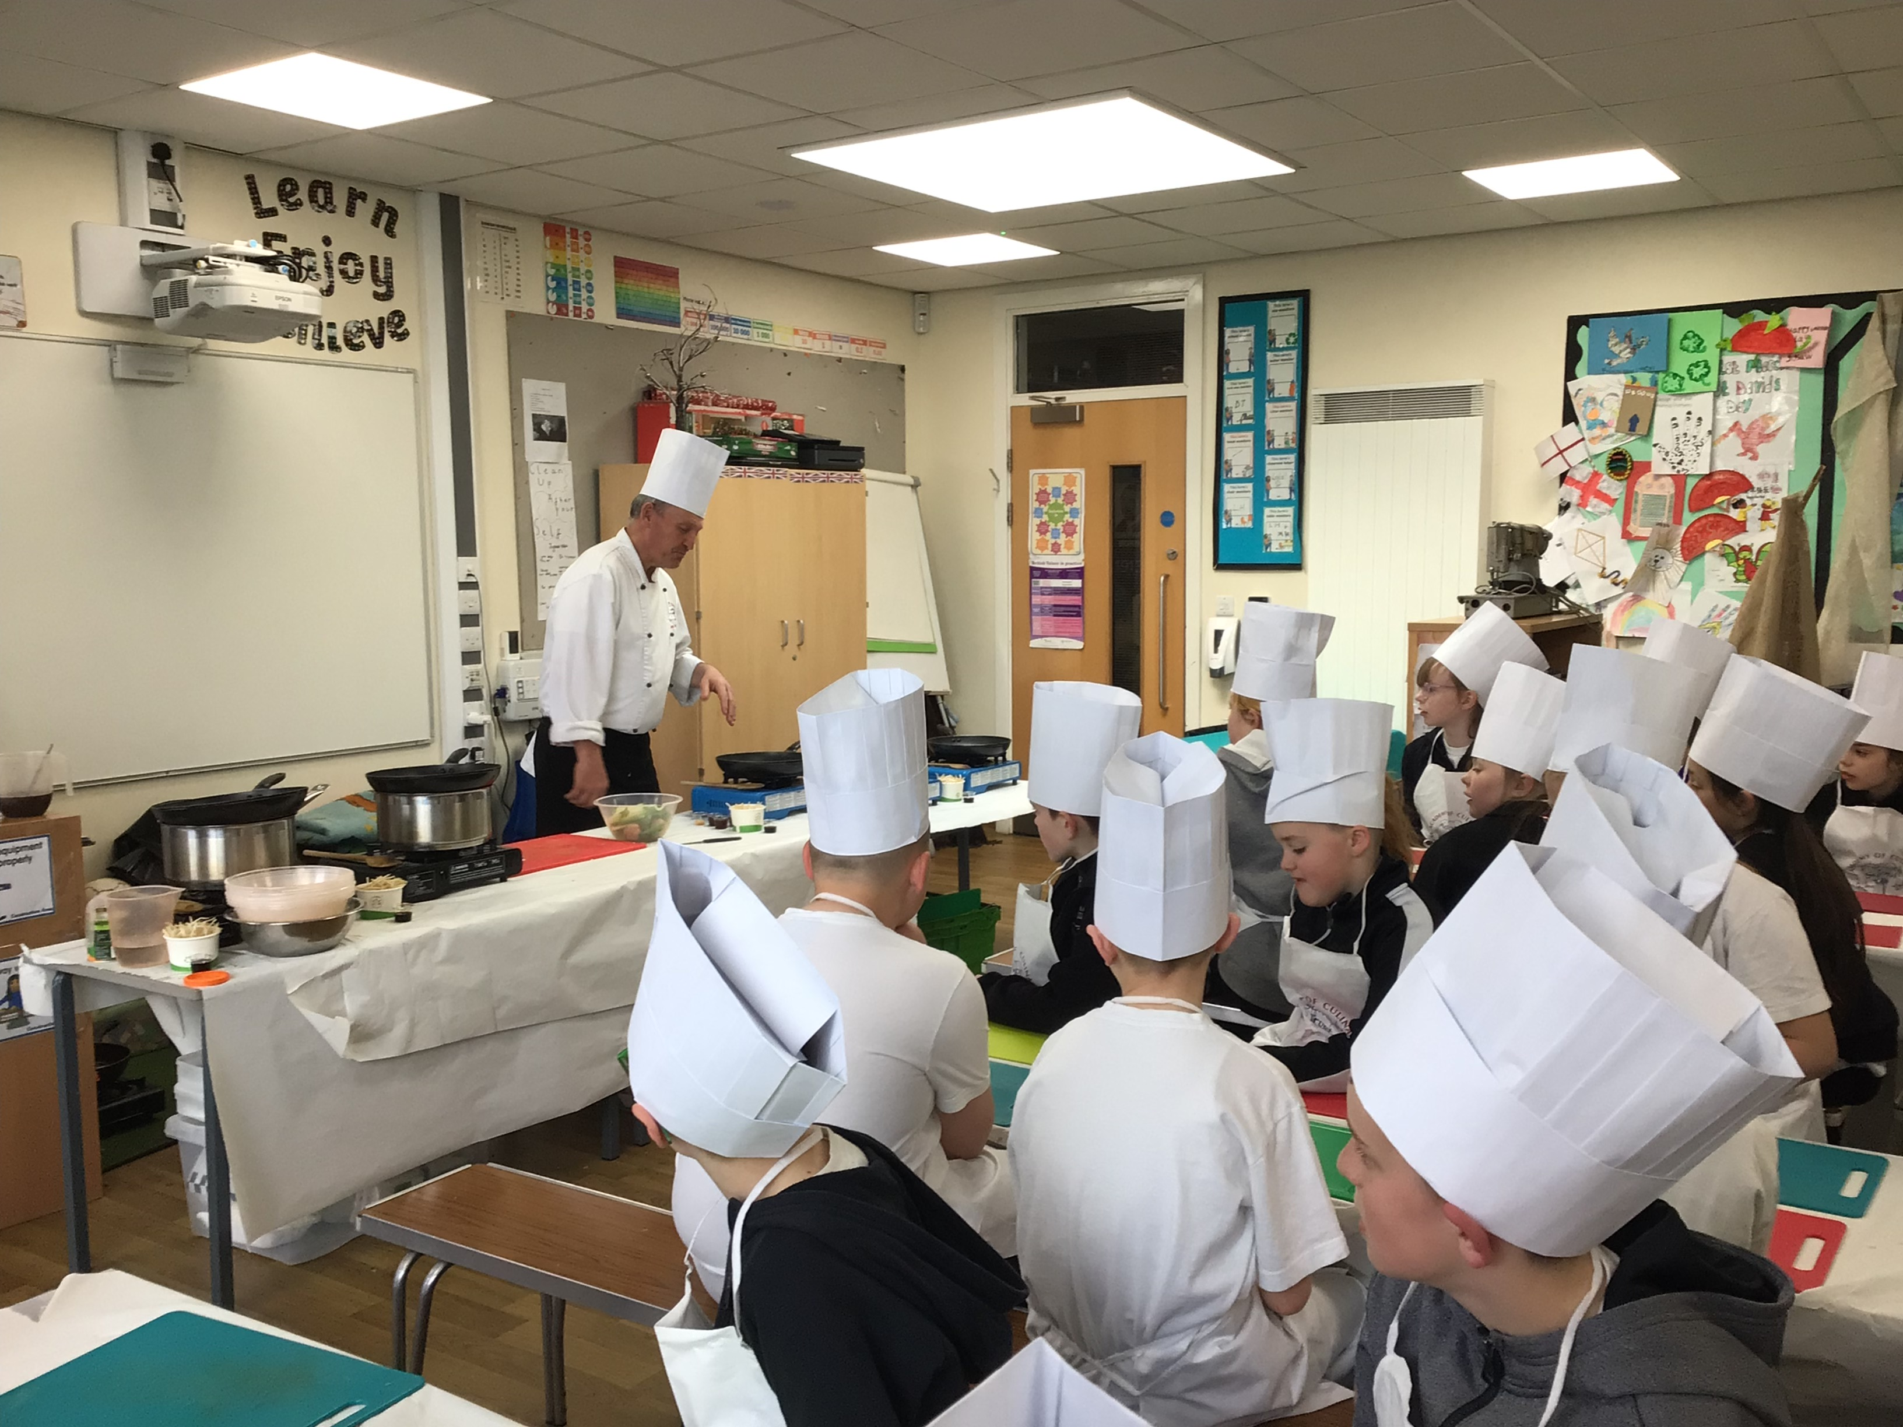
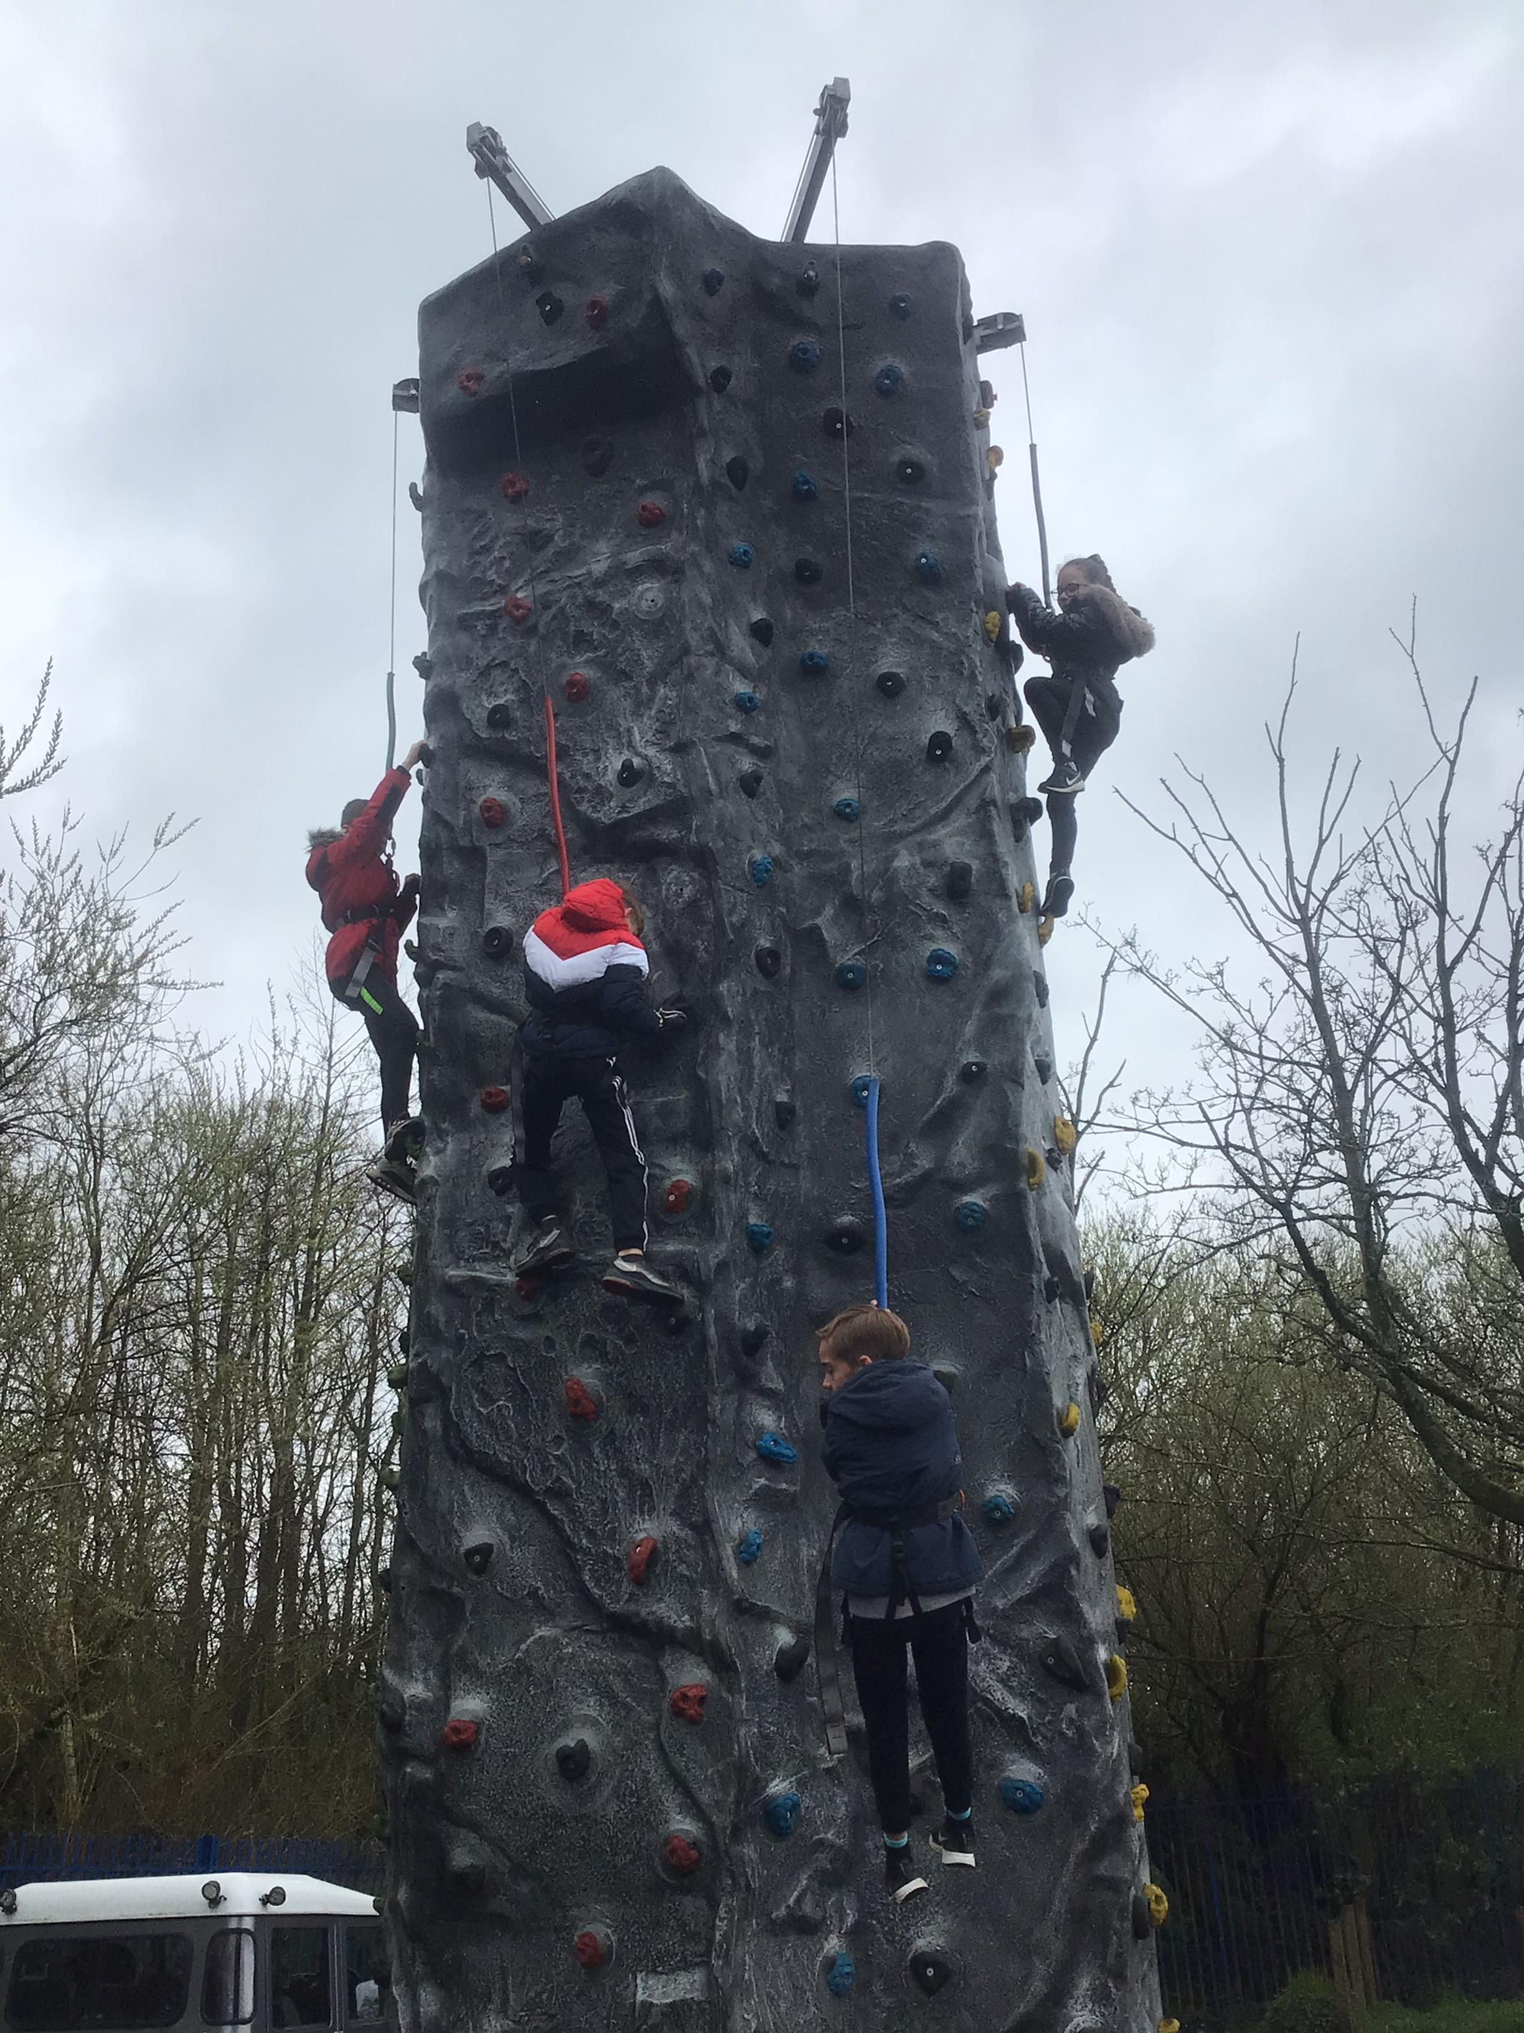
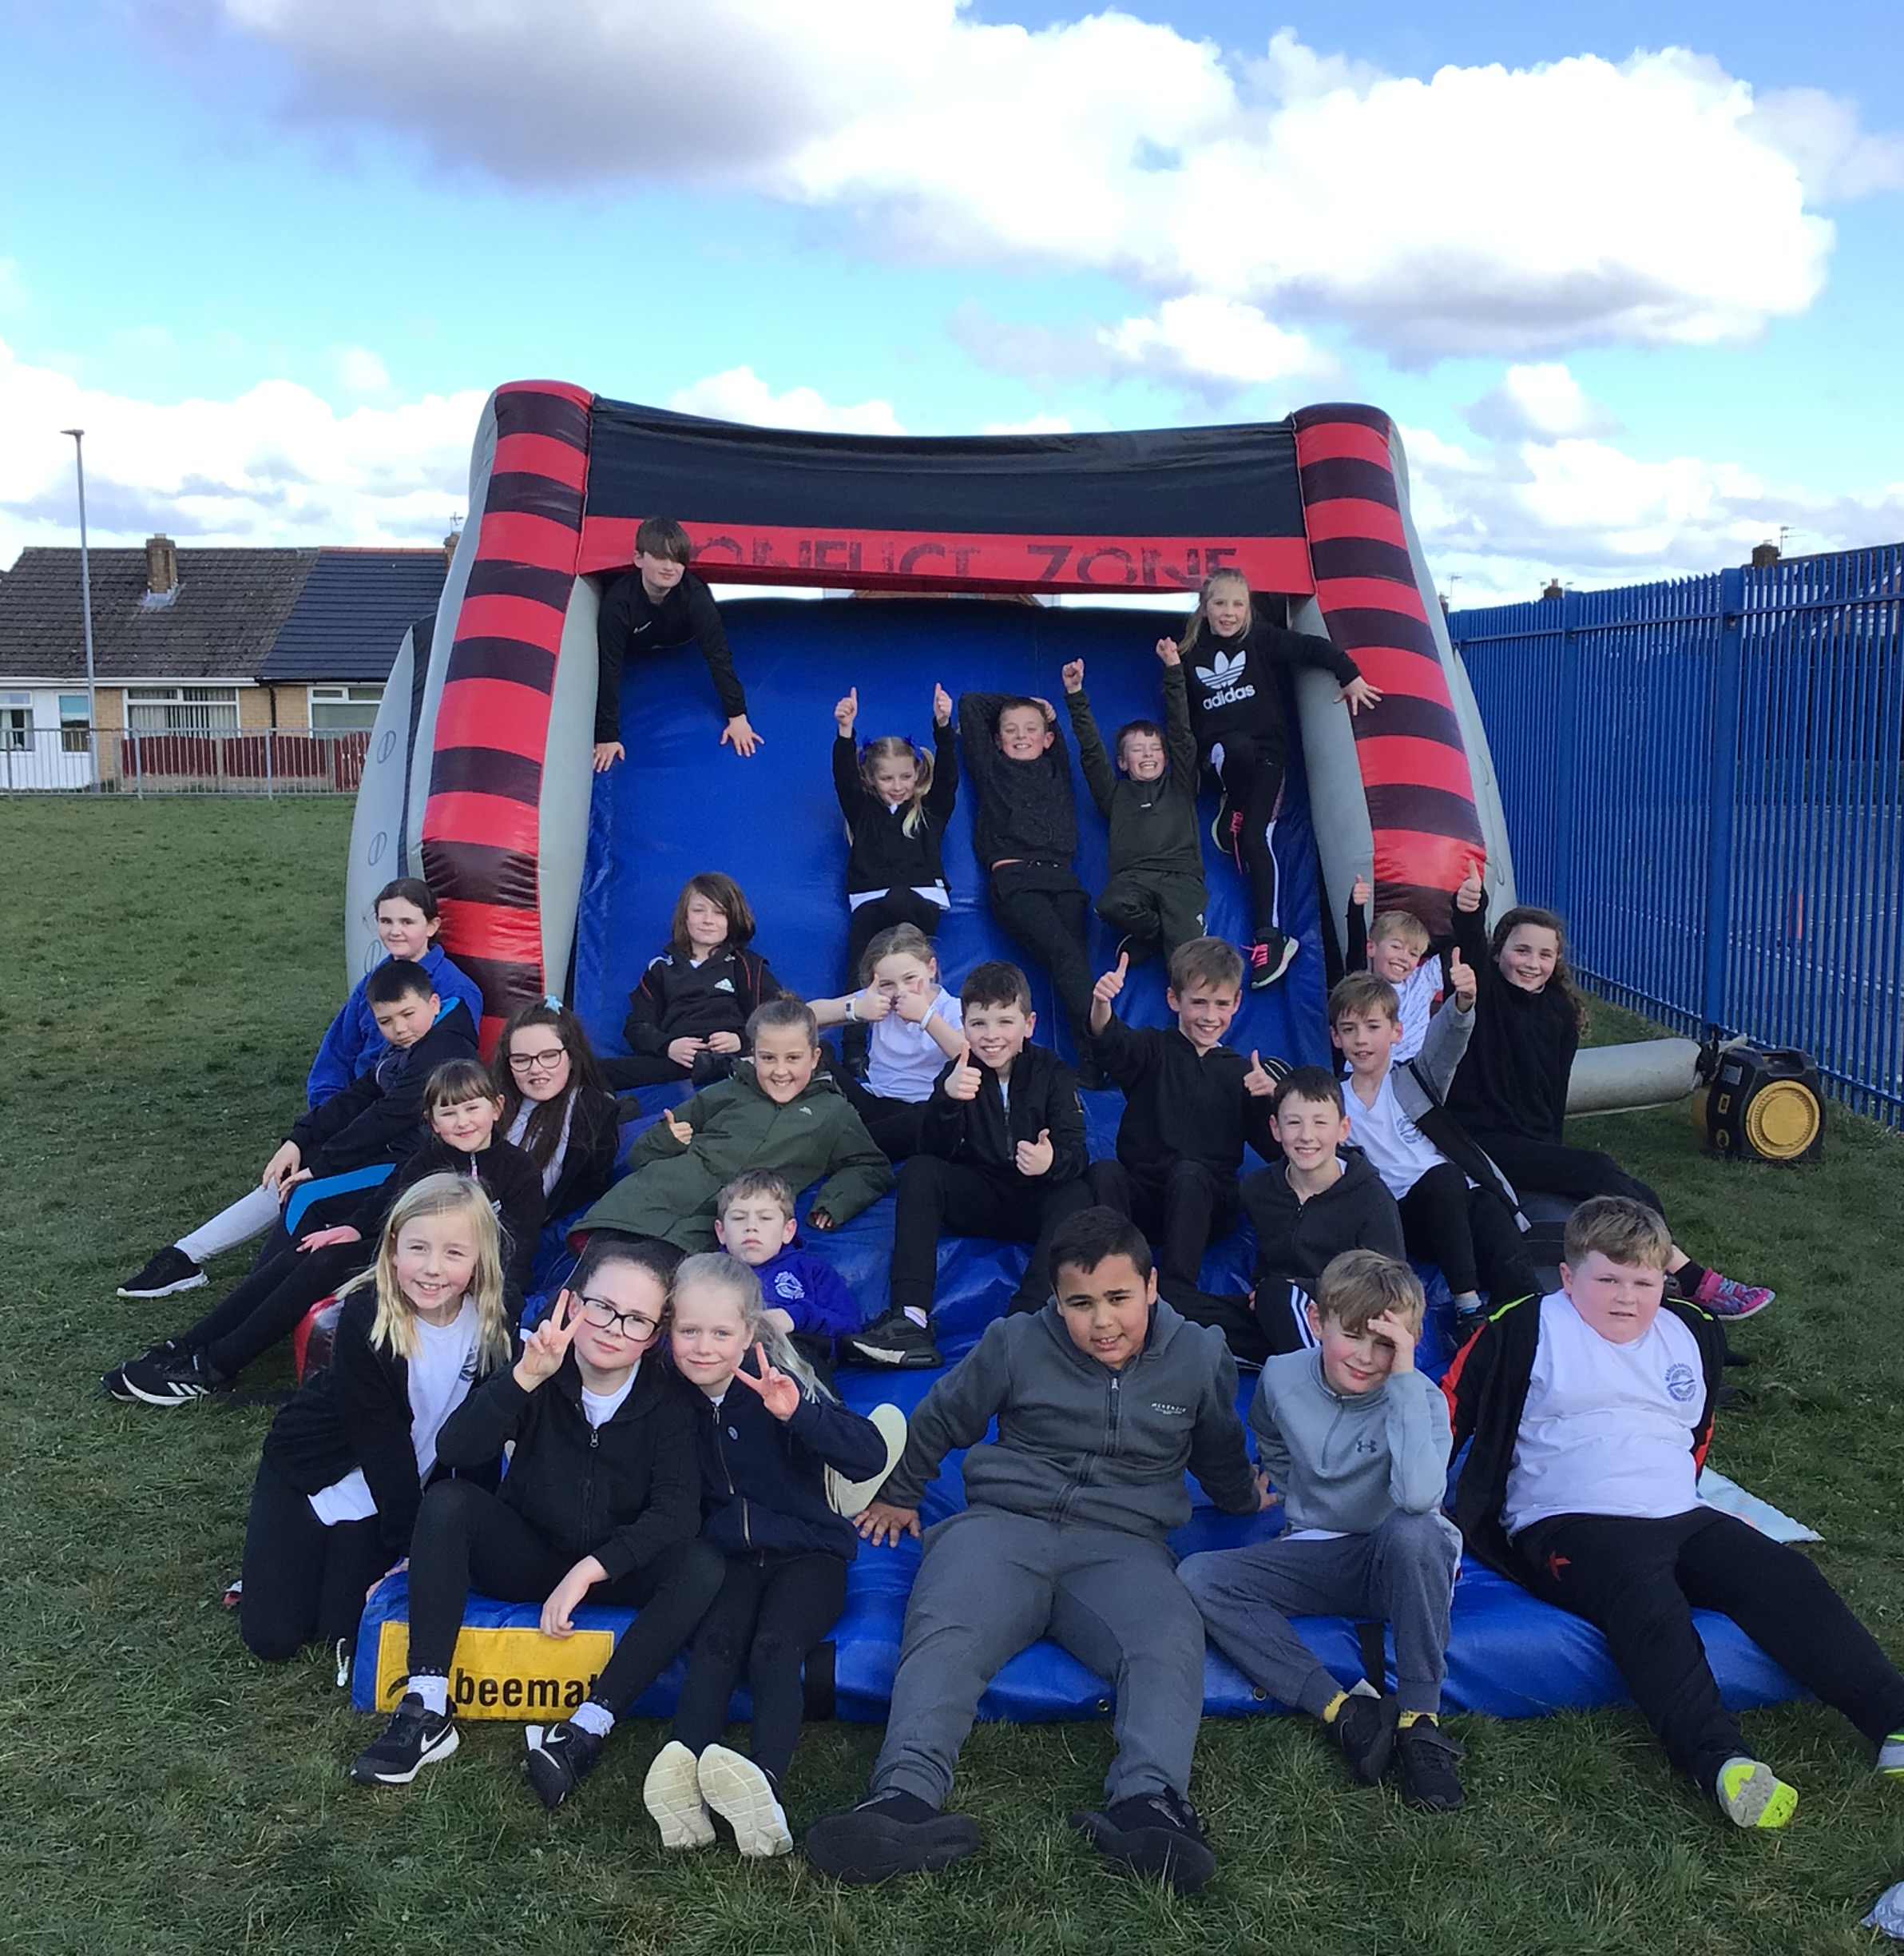
Healthy Living Week
Our healthy living week was a tremendous success.
We had activities throughout the week to help to support us having a healthy body, a healthy mind and to show us that eating healthy food does not have to be boring!
Every pupil in school took part in all the activities which included; a fantastic climbing wall, an inflatable assault course, visitors to give special assemblies on personal health & hygiene, sports activities, yoga & mindfulness sessions and the Royal Academy of Culinary Arts did Healthy street food cooking sessions with every class.
The week ended with our sponsored walk/run jog event, where Children in Reception, Year 1 & 2 walked/jogged/ran the distance of 2km. Children in Year 3 & 4 walked/jogged/ran the distance of 3km and children in Year 5 & 6 walked/jogged/ran the distance of 5km.
The whole week was funded by school and our brilliant PTA.

Slide 3
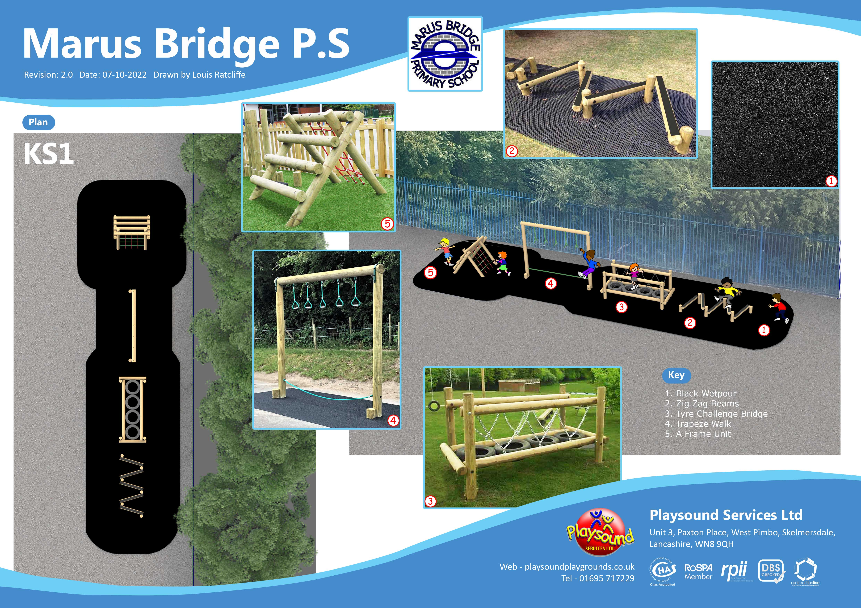
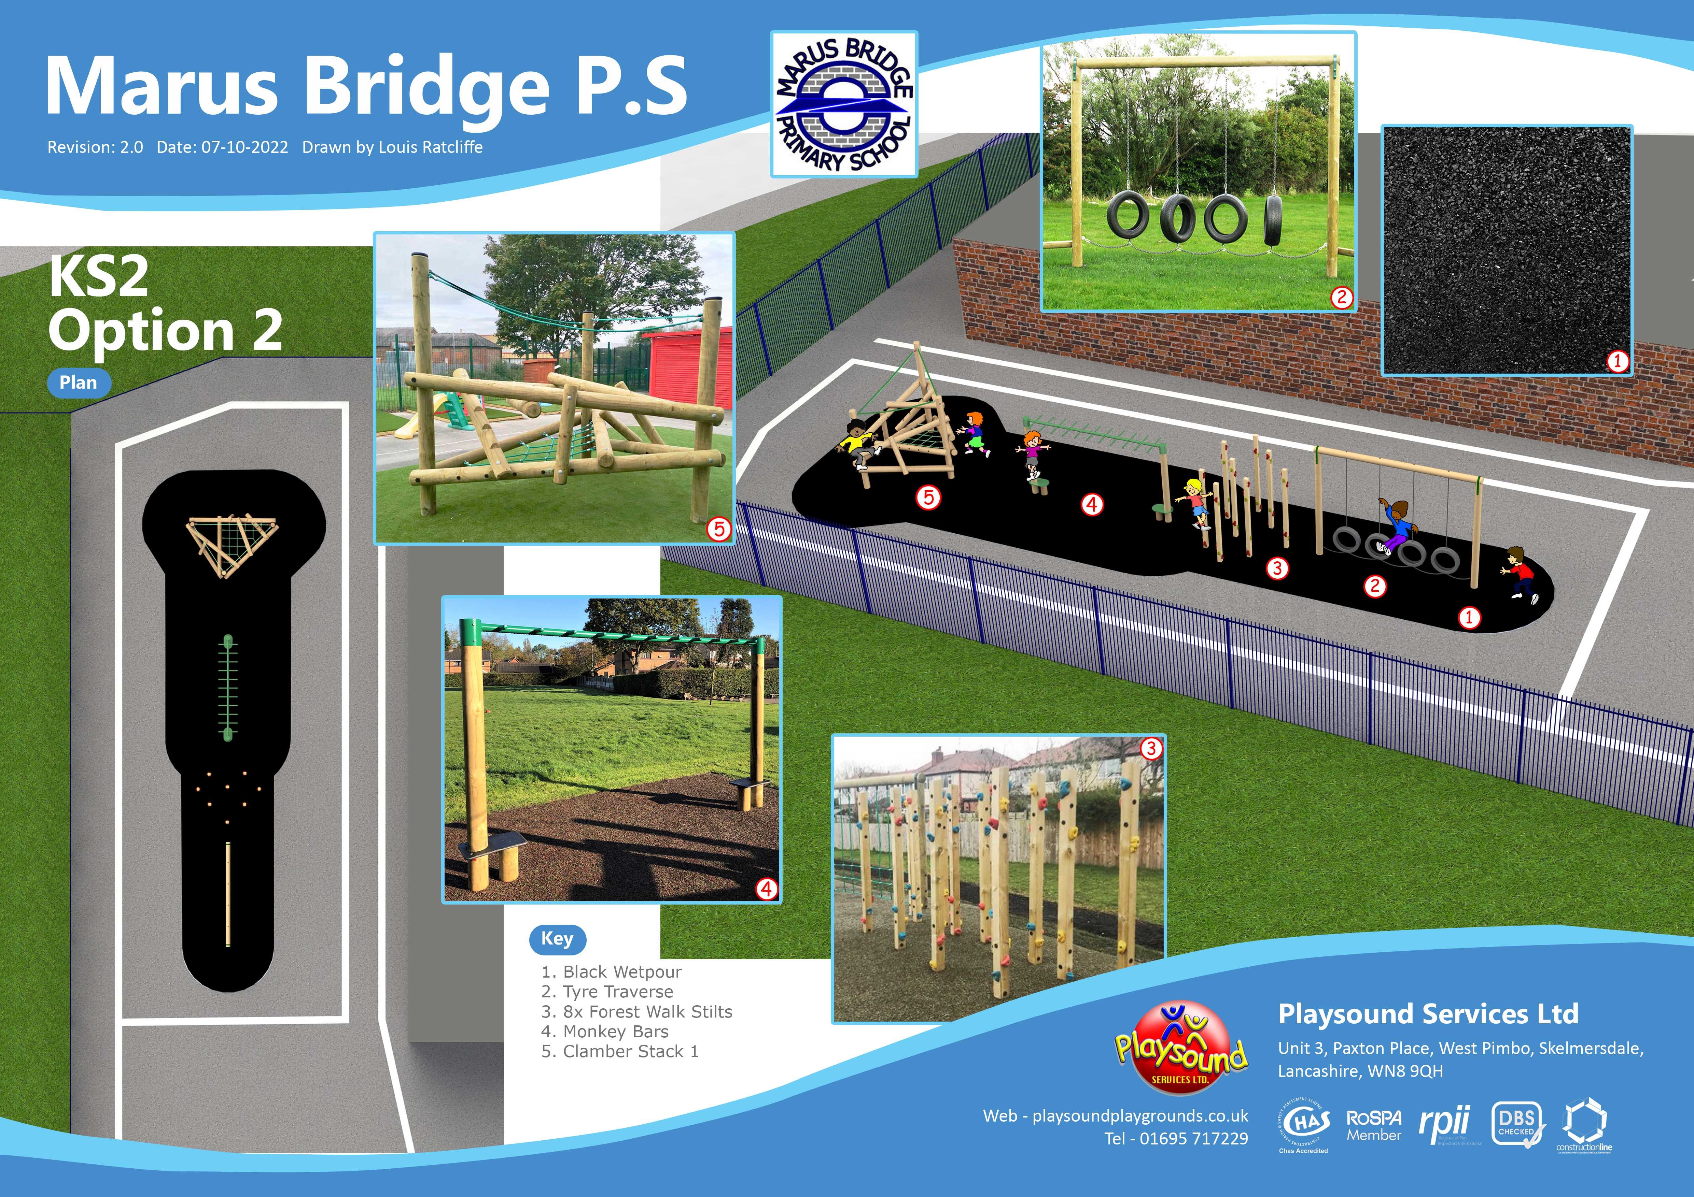

Healthy Living Week
Our sponsored walk/run/jog event raised lots of money to buy new trim trails on the KS1 & KS2 playgrounds.

Slide 4

Our PSHE lessons help to teach us about a balanced, nutritious diet and the importance of choosing the right foods to stay healthy.
Our food tech lessons encourage us to try foods we may not have tasted before and how to prepare healthy meals & snacks.
We are soon going to have a brand new after school healthy cooking club, set up and ran by Mrs Burrows – our healthy eating champion.

Slide 5

Healthy Heroes
Our Healthy Heroes scheme encourages everyone to bring a healthy lunchbox or to choose a healthy option from the lunch menu each day.
Every pupil who does this gets a raffle ticket to go into the Healthy Heroes lunchbox.
Two winners - 1 from KS1 & 1 from KS2- are drawn from the raffle each week and win a prize for being a healthy hero!
Pupils in KS1 get a portion of fresh fruit or vegetable every day and pupils in KS2 can bring a healthy snack to eat at breaktimes.
All pupils are encouraged to bring a water bottle and have access to fresh drinking water to stay hydrated throughout the day.

Slide 6
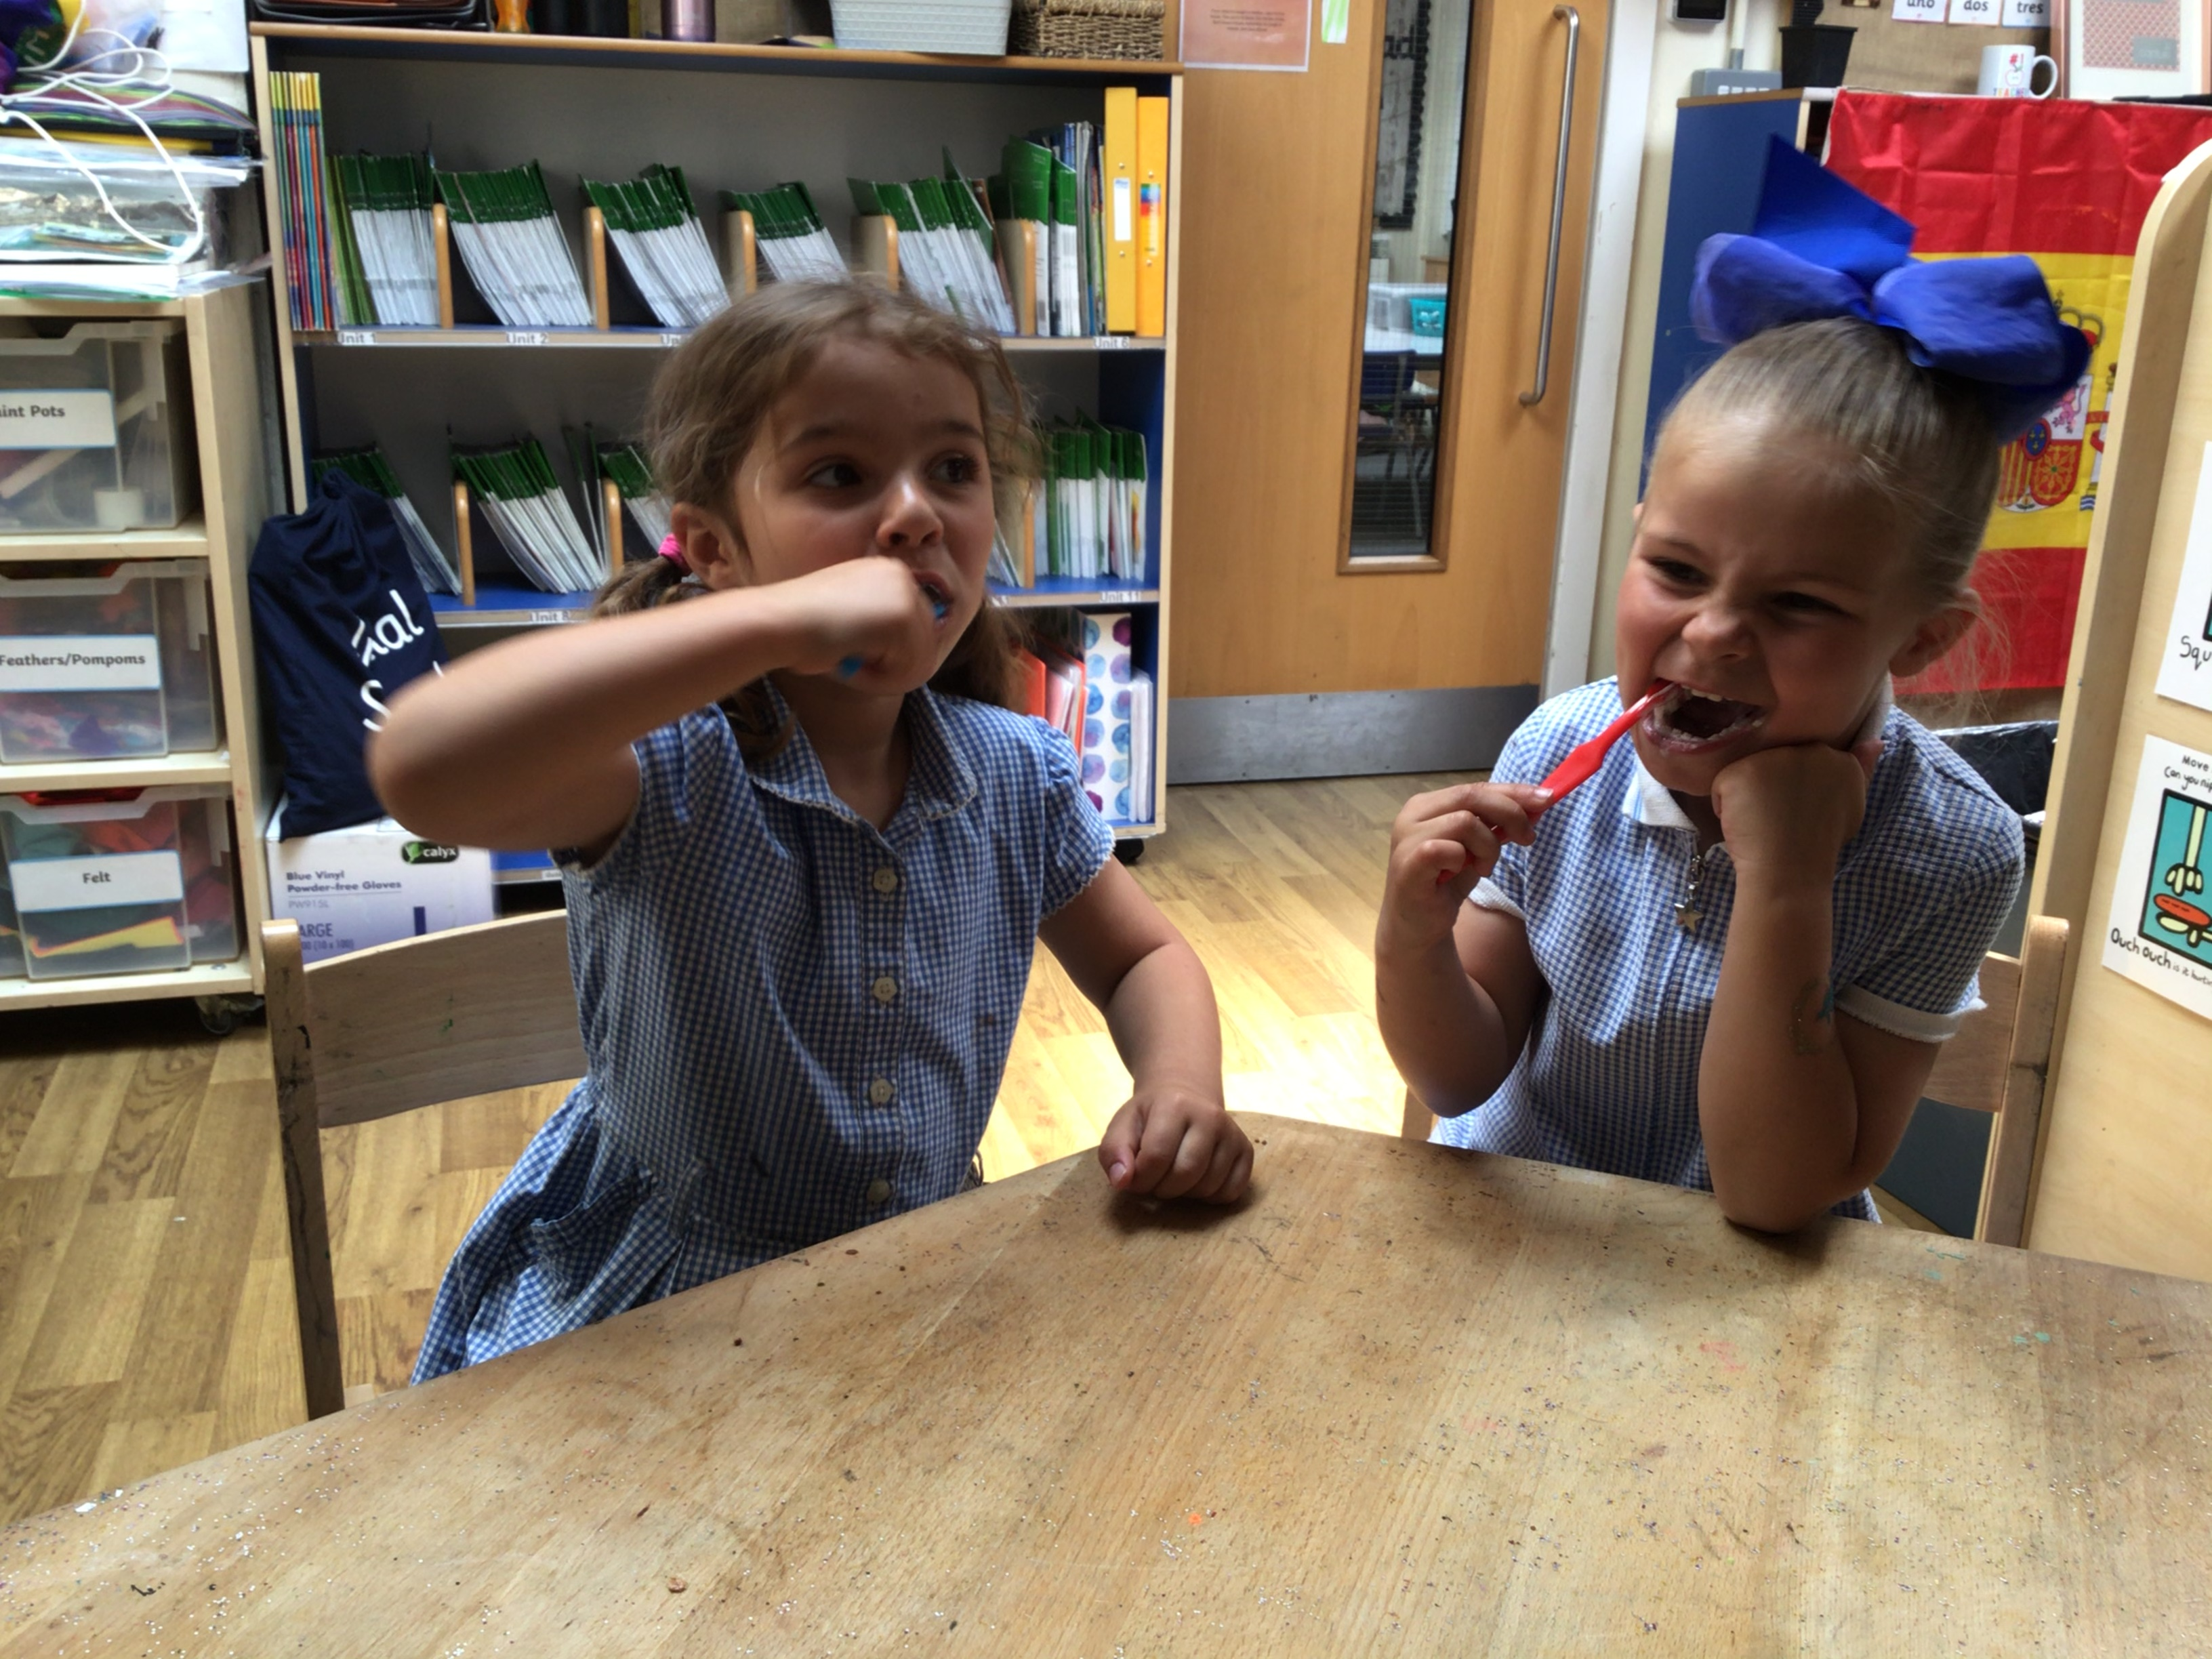
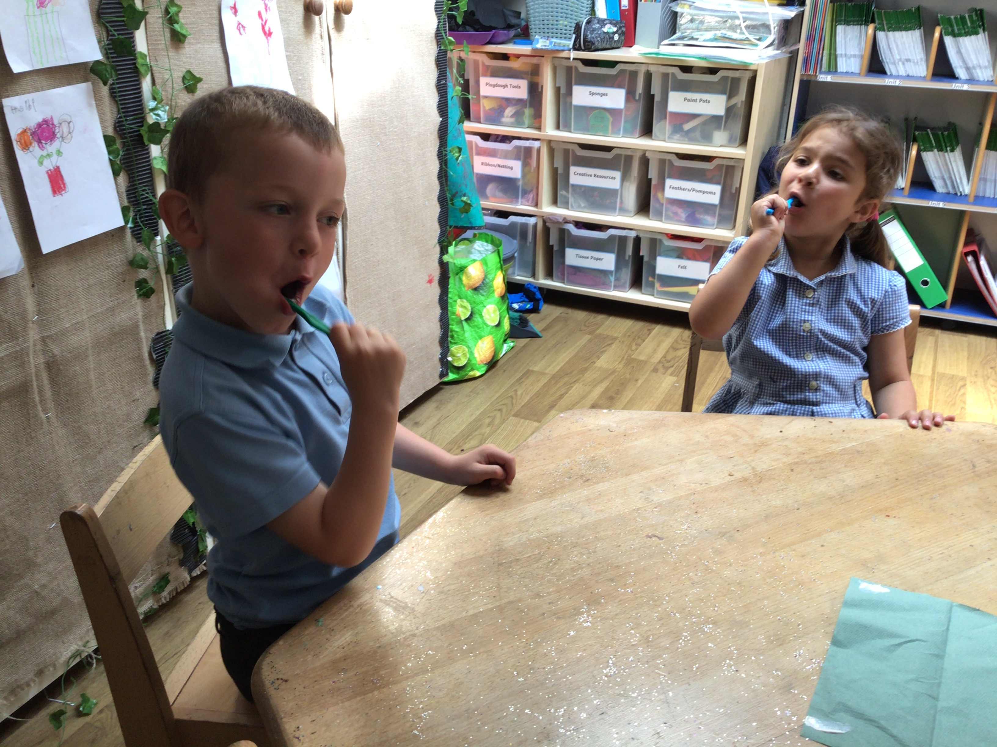
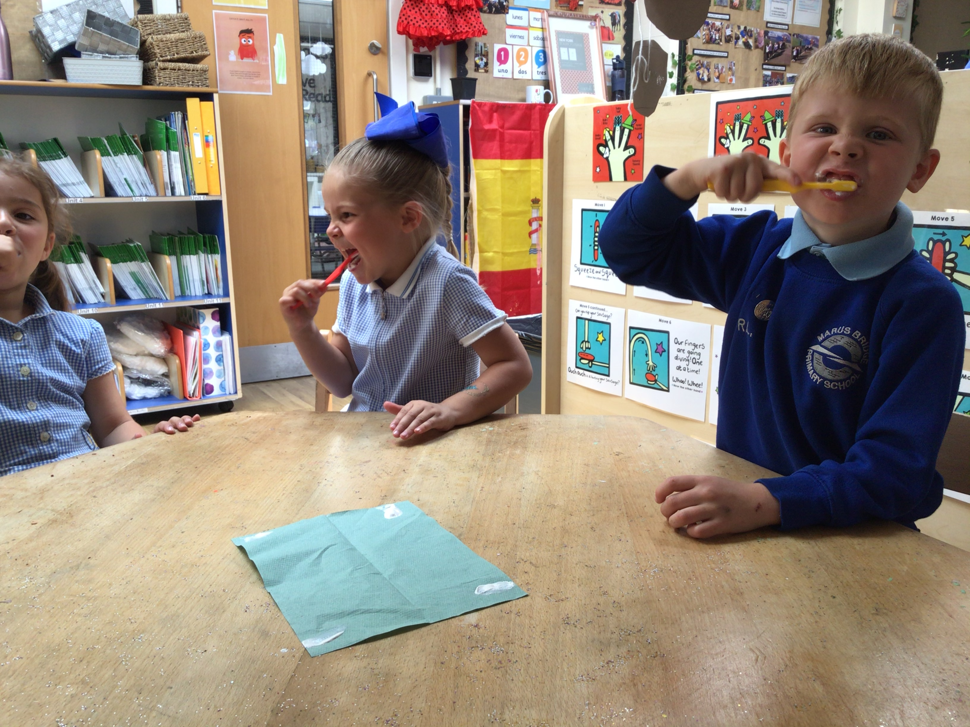

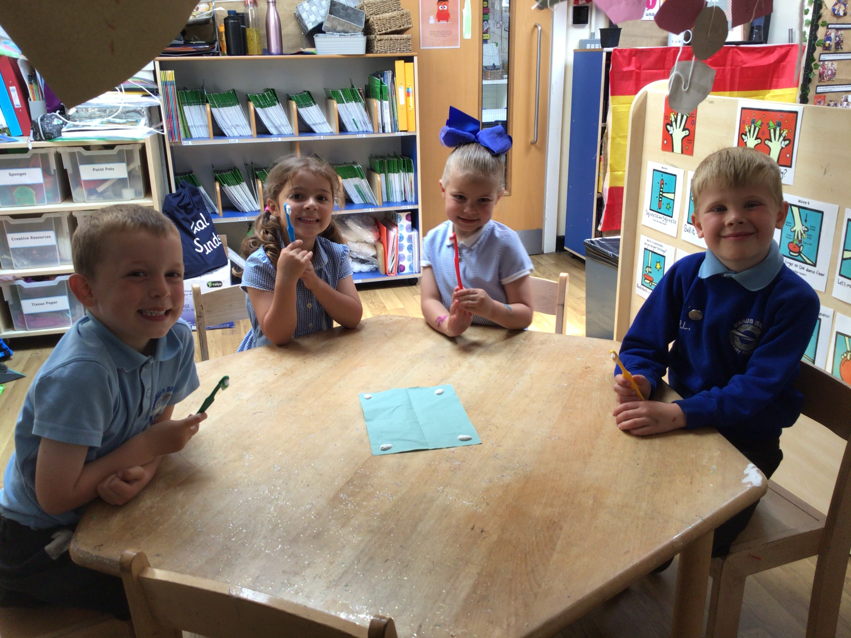
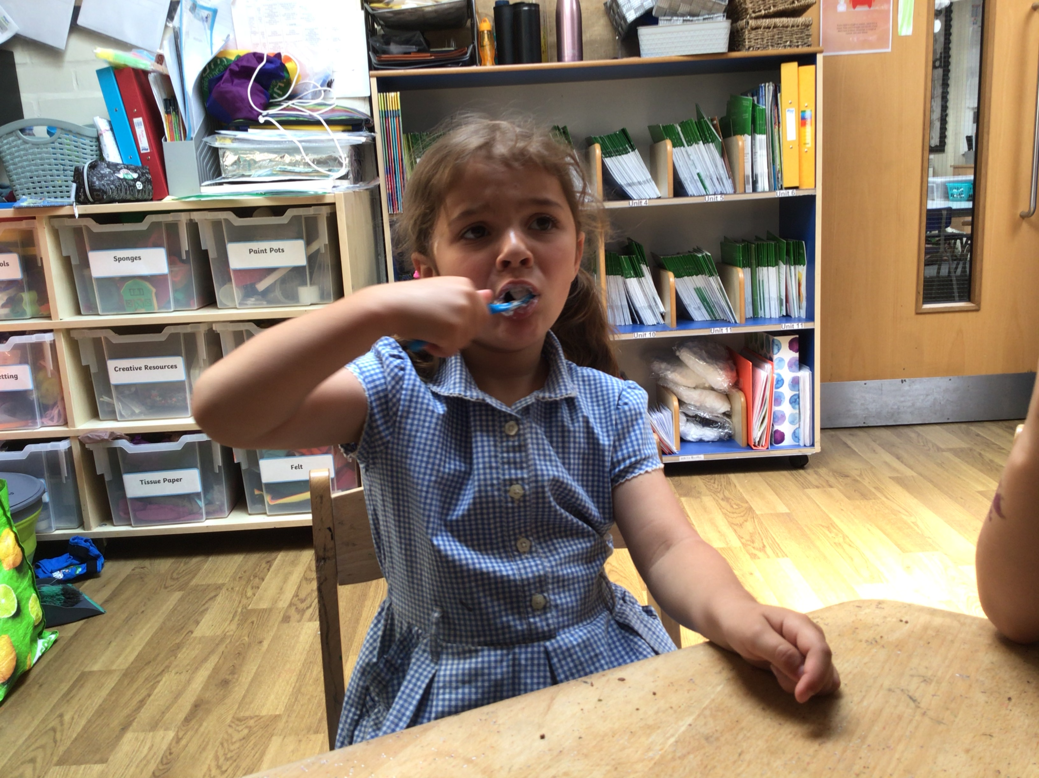

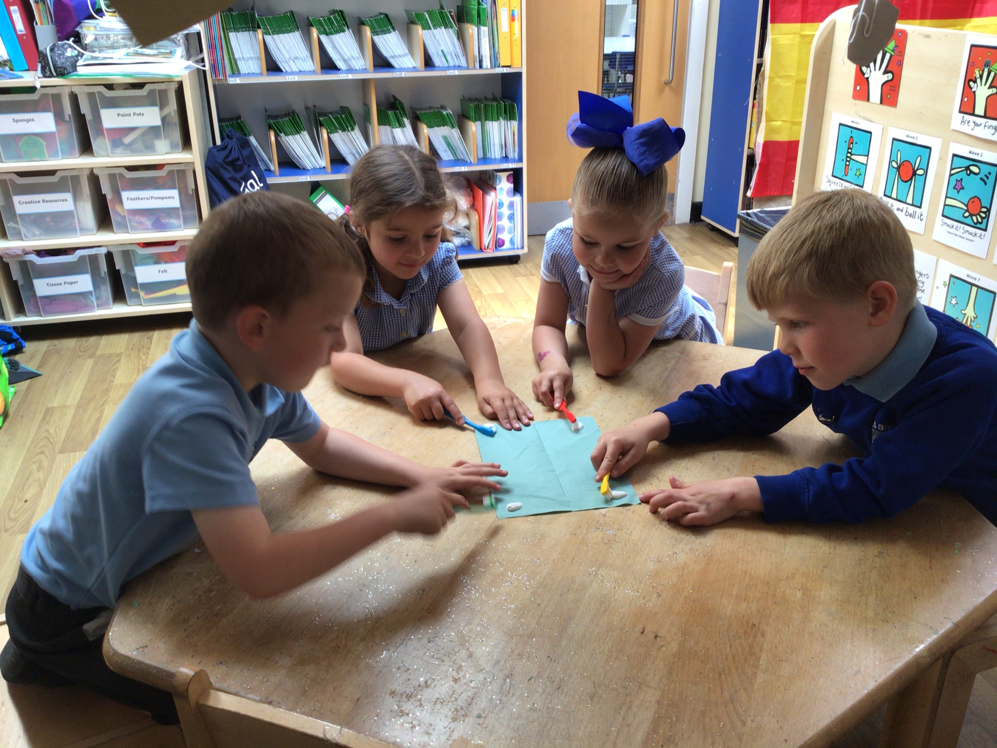
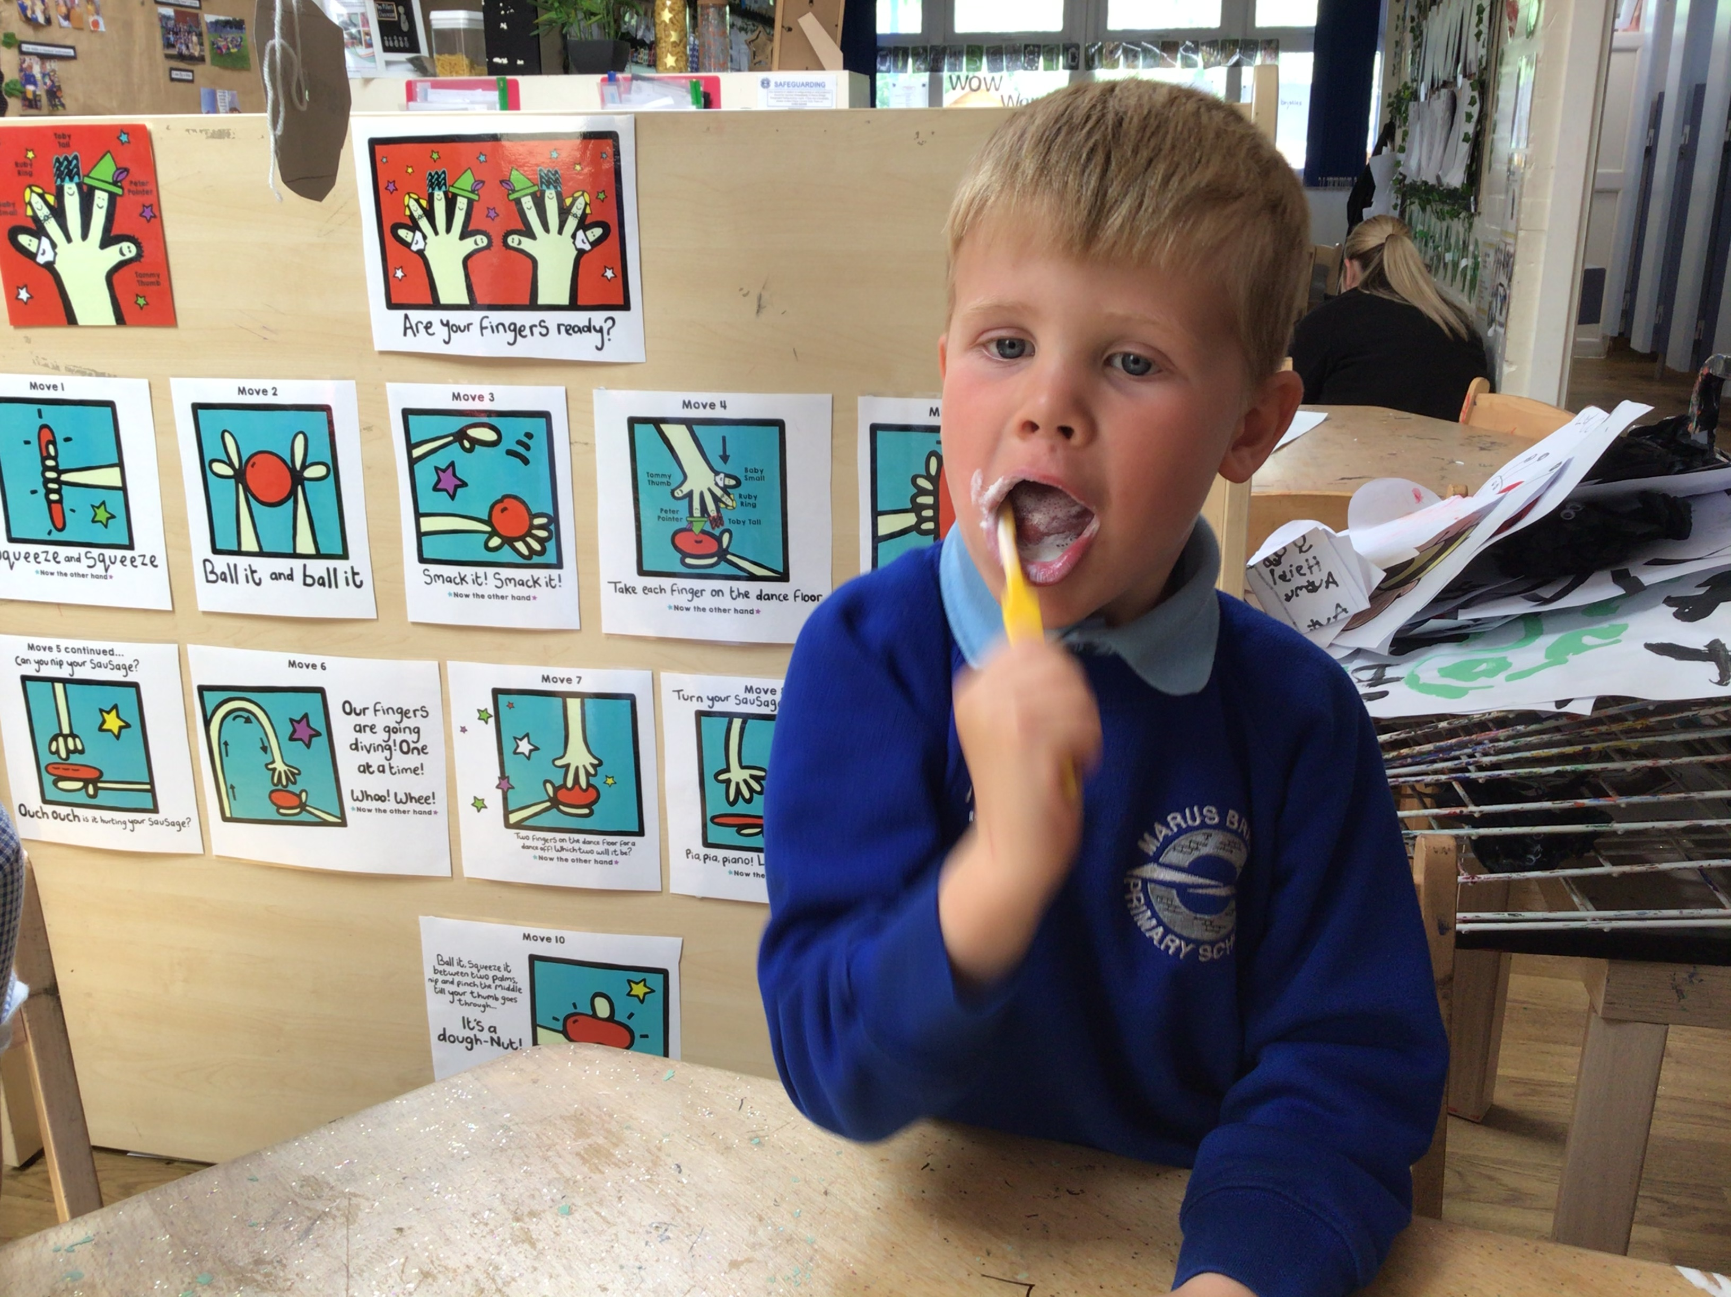
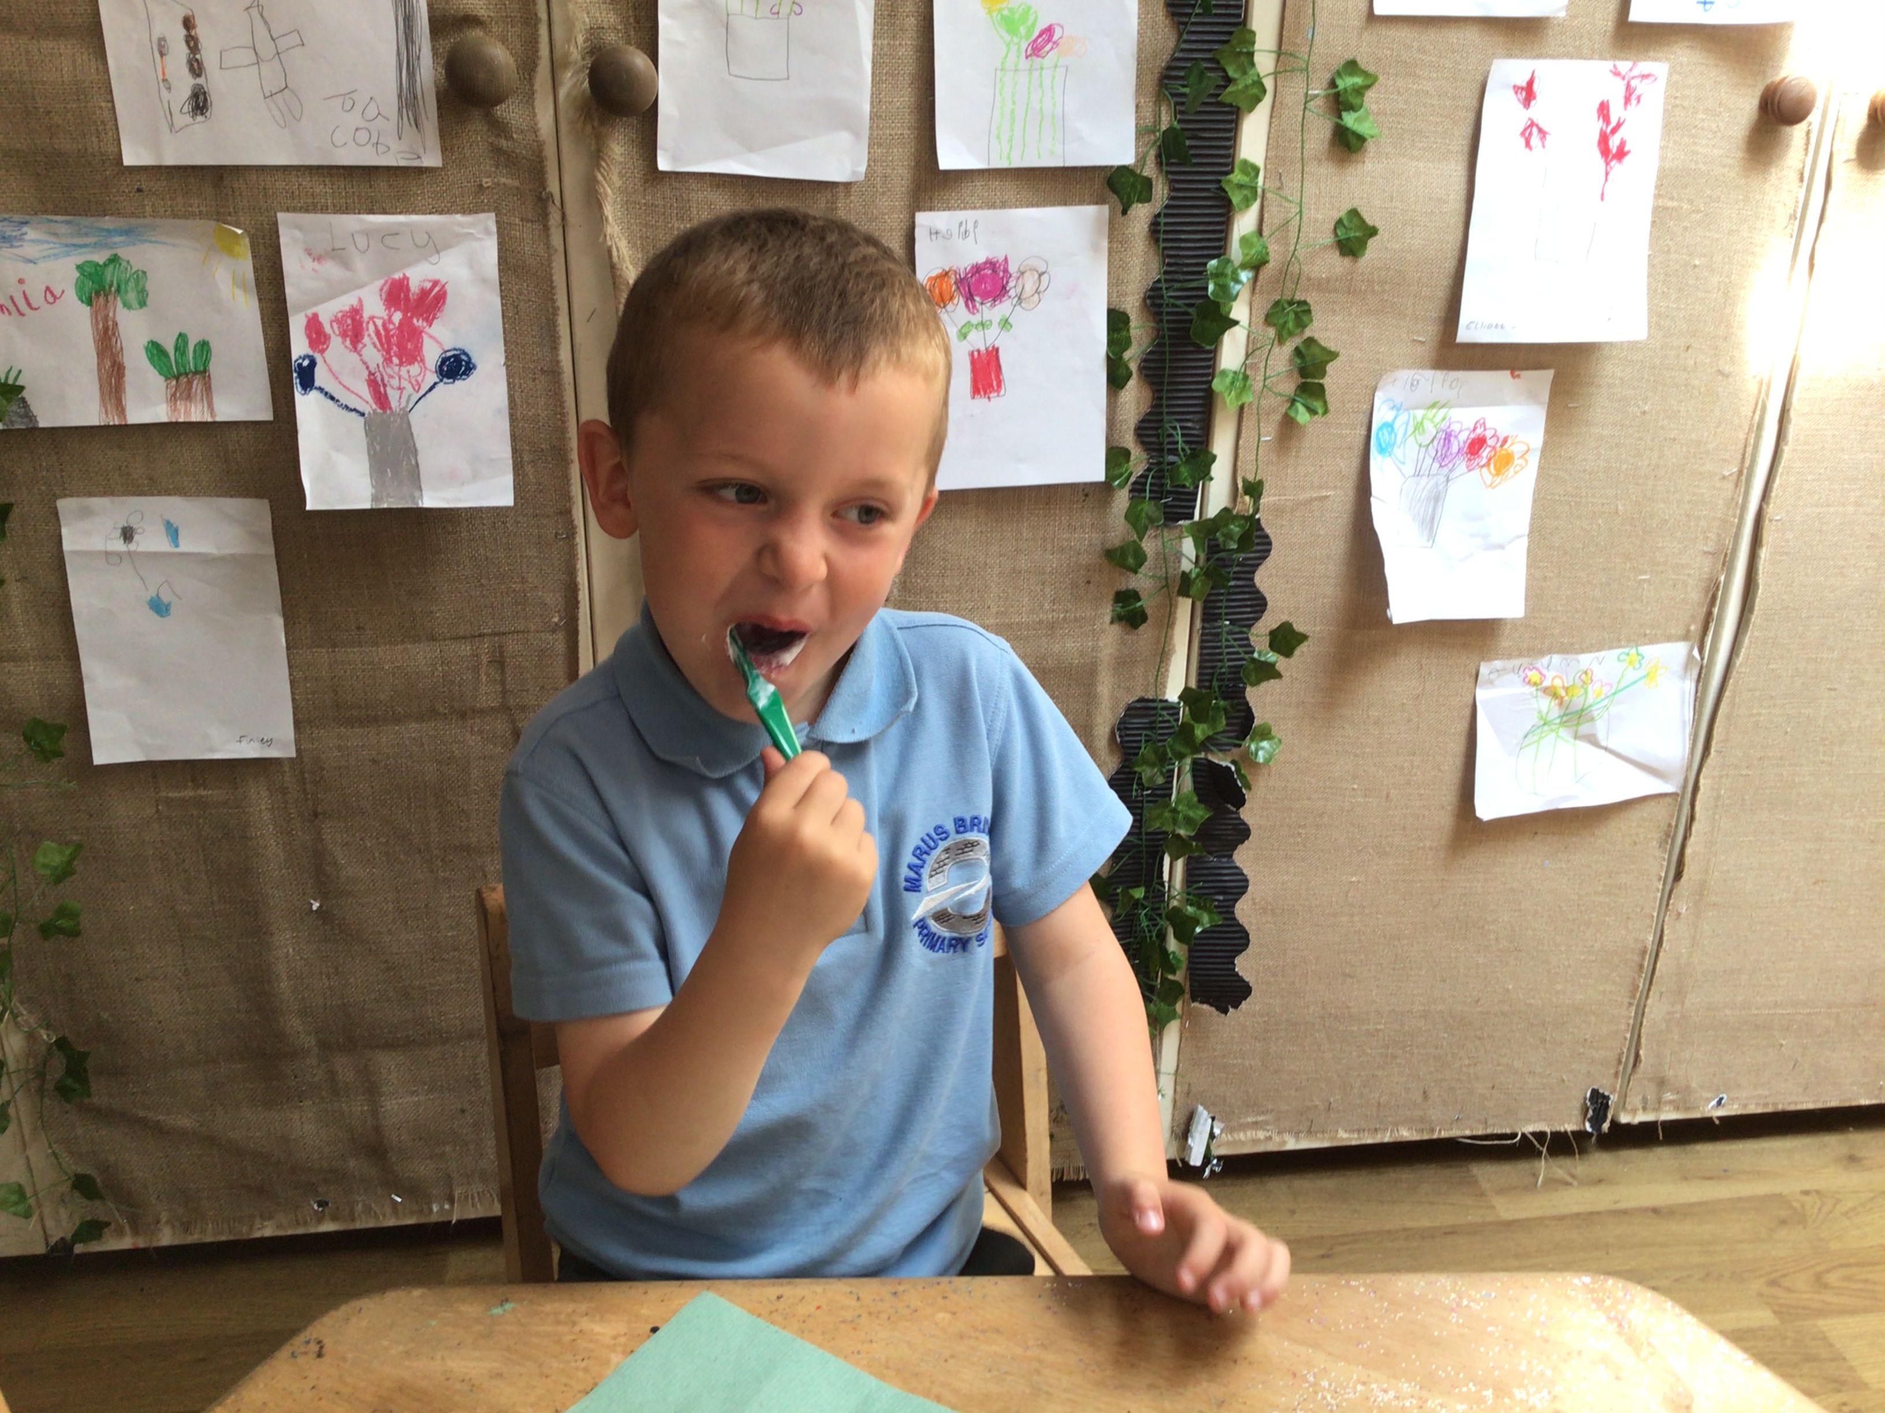
Let’s get Brushing!
We learn about being healthy at Marus Bridge right from the start of school in reception.
The pupils brush their teeth every day after lunchtime.

Slide 7
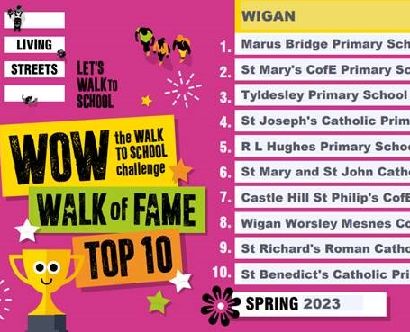

Living Streets – Walk to school challenge.
We have been active members of the Living Streets Travel Tracker programme for many years.
Pupils log daily journeys to school on the system. The WOW Travel Tracker also confirms which pupils have walked enough to earn a badge each month
Every single pupil in school logs their way of travel every morning.
For Spring term, we topped the Walk of Fame league table for Wigan!

Slide 8

P.E Lessons
Every pupil takes part in a minimum of 2 hours of P.E per week, one of which is provided by an external provider who is an expert in their field. We have a varied programme of study which enables every pupil to study two sports in every half term. Alongside this, we have also embedded the daily mile into part of our day-to-day timetable to give children another opportunity to get moving every day!

Slide 9

After School
Competition
We pride ourselves on our dedication to take part in inter- school competitions. We are members of the WOWs football and netball leagues which means we are always competing in numerous matches outside of schools.
We also compete in many other sporting competitions, through the ‘School Games programme’, ensuring an equal entry to competitive, participation and inclusion events.
We are very excited to take part in Town Sports at the end of June and our KS2 pupils are already in training!
As well as our PE lessons, we can also take part in our jam-packed extracurricular offer, something we are very proud of!
At our school, every year group from Y1 – 6 is offered a sports-based club after school, completely free of charge! This gives every pupil the chance to have an equal opportunity to access a free sports club.
Each club changes half termly because teachers listen to the voice of pupils and try their best to provide clubs the pupils are interested in.

Slide 10


We have PSHE lessons every week which teaches us lots about our mental health. We focus on different emotions and explore how to control and deal with negative emotions in a positive way.
We also learn a lot about lifestyle choices, living a healthy life and the importance of a how having a good night's sleep helps us to improve our mental health and become better learners.

Slide 11
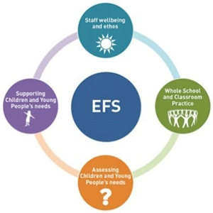
Emotionally Friendly Schools
We are committed to supporting the wellbeing and mental health of the whole school community.
We are in the process of being assessed for The Emotionally Friendly Schools (EFS) bronze award.
The programme is a flexible, whole school approach to improving children and young people’s mental health and emotional wellbeing for primary schools.
The programme aims to provide our school with the best proven methods, tools and support to help nurture happy, successful children by identifying and responding to their broad emotional needs.
The EFS programme focuses on four areas within the school setting which contribute to the emotional health and well-being of the school community
Staff well-being and school ethos
Whole school and classroom practice
Assessing Needs
Supporting individual children

Slide 12

Another way in which we promote healthy lifestyles is through our close links with the Wigan Council ‘Let’s Get Movin’ team’.
Pupils in EYFS, Y1 & Y4 received a 12-week healthy living workshop from the team.
We also loved getting involved in the ‘Aprils Active 60’ campaign which saw all pupils from EYFS to Y6 take part in 60 active minutes in school and at home every day! We had so many pupils take part in this, which was fantastic.
Lastly, Bikeabilty will be visiting our school this month to work with our Y6s. This is the government's national cycle training programme which we hope will give our pupils the skills they need to feel confident to cycle where possible.

Slide 13


