Slide 1


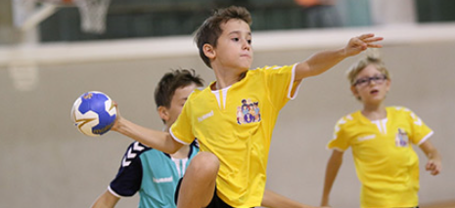


SUMMER TERM IN YEAR 5
We hope you’ve all had a lovely Easter break and are ready for the summer term! As always, our home/school partnership is important, and your continued support is invaluable - thank you for the support you have given your child so far this year. Below you will find information on what your child will be learning during the summer term and how best to continue to support your child in their final term of Year 5.
Topics we are learning about:
Summer 1:
History – The Tudors
Science – Our Changing World: Life Cycles & Plants.
Summer 2:
Geography – The Grand Canyon
Science – Human Growth
For more information on every subject please look at our class page on the website and our Long-Term Plan.
PE days remain the same:
Y5CB Monday and Wednesday
Y5LB Wednesday and Thursday
Please ensure your child has the correct kit and is able to take out their own earrings.
We will be learning to play cricket and practising our athletics skills in preparation for Sports Day in the first half term and then playing football and rounders in Summer 2.
Homework:
Homework remains the same for this term as follows:
English – Reading is expected to be done four times per week and noted in your child's planner. They can fill this in themselves and you can initial next to this entry. If your child has read four or more times in a week, they are given a raffle ticket and entered into a draw to win a book each half term!
Spelling – given out on a Friday and learned for a test the following Friday. These are the common exception words.
Maths – Maths homework recapping what we have been learning that week. Set Friday, to be returned the following Friday.
Times Tables Rockstars - children should practise for at least 30 minutes over the week. This is crucial to their learning in maths. We've seen a tremendous improvement last term – please try to keep up the momentum at home and thank you for your support so far with this :)
Trips and Visits:
20th May afternoon – Sports Day
21st & 22nd May – London trip.
10th July – All Y5 are visiting Dean's Trust for the day. No cost involved. More information to follow nearer the time.
Bridge Builders:
Please use summer term to complete any Bridge Builder activities that you have not done so far.
Please upload evidence to the
activity set on Seesaw.
Tudor Project!
Children, please don't forget to complete your Tudor Project over the Easter holidays. See separate letter.
Please bring them in on Monday 27th April.

