Slide 1


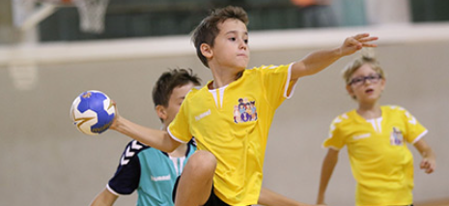
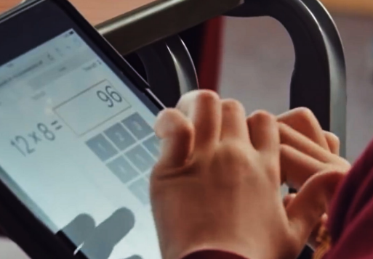
SUMMER TERM IN YEAR 4
We hope you’ve all had a lovely Easter break and are ready for the summer term! Below you will find information on what to expect this term in Year 4. As always, our home/school partnership is important, and your continued support is invaluable - thank you for the support you have given your child so far this year. Below you will find information on what your child will be learning during the spring term and how best to continue to support your child in their final term of Year 4.
Topics we are learning about:
Summer 1:
History – The Normans
Science – Living Things and Habitats
Summer 2:
Geography – Mapping Wigan
Science – Classification
For more information on every subject please look at our class page on the website and our Long-Term Plan.
PE days remain the same:
Y4 Carver – Tuesdays and Thursdays
Y4 Hurst – Thursdays and Fridays
Please ensure your child has the correct kit and is able to take out their own earrings.
We will be learning to play cricket and practising our athletics skills.
Trips and Visits:
Monday 20th April – Tatton Park (history trip)
Haigh Hall Orienteering Trip – Date TBC (Summer 2)
Homework:
Homework remains the same for this term as follows:
English – Reading is expected to be done four times per week and noted in your child's planner. They can fill this in themselves and you can initial next to this entry. If your child has read four or more times in a week, they are given a raffle ticket and entered into a draw to win a book each half term!
Spelling – given out on a Monday and returned the following Monday practising our weekly sound. There are 5 spellings to learn for a weekly test.
Times Tables Rockstars - children should practise for at least 30 minutes over the week. This is to help prepare them for the national multiplication check which they will complete in June. We've seen a tremendous improvement last term – please try to keep up the momentum at home and thank you for your support so far with this :)
Bridge Builders:
This half term be focusing on our value of determination. Our friendship bridge builder is:
“I can practise regularly to improve at a new skill/hobby (E.g., brass, art work, riding a bike, bat & ball skill.)”
Please upload evidence to the
activity set on Seesaw.
Summer Brass Concert
At the end of Y4, the children will do one final performance on their brass instruments. The date for the concert will be released soon.

