Slide 1

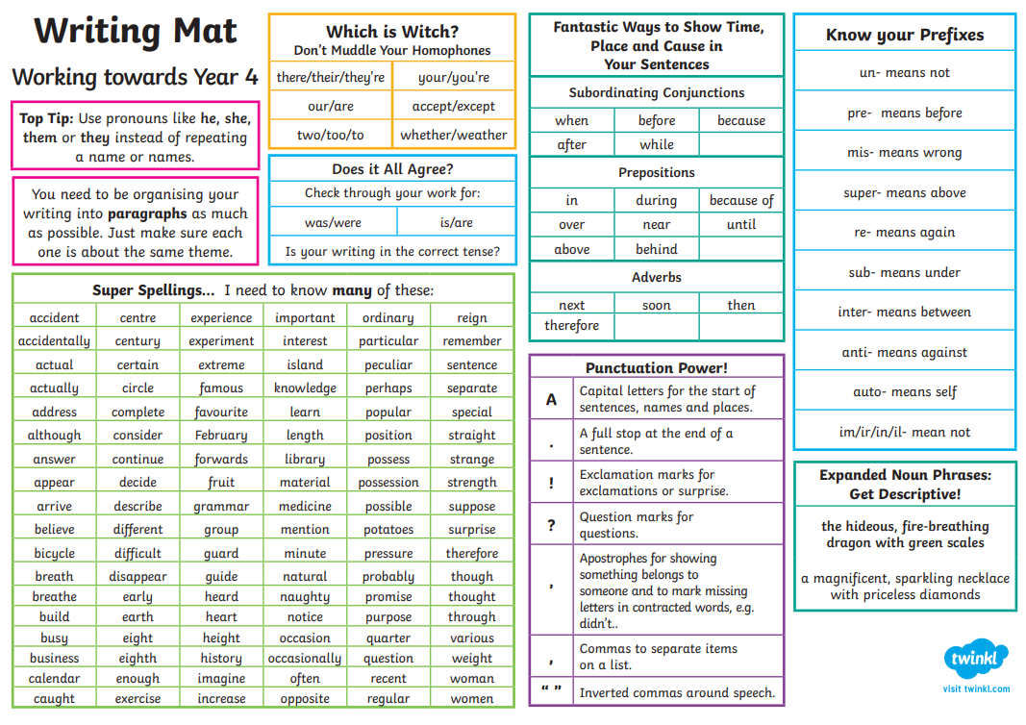

Year 4 Writing Mat
Working towards Year 4

Slide 2

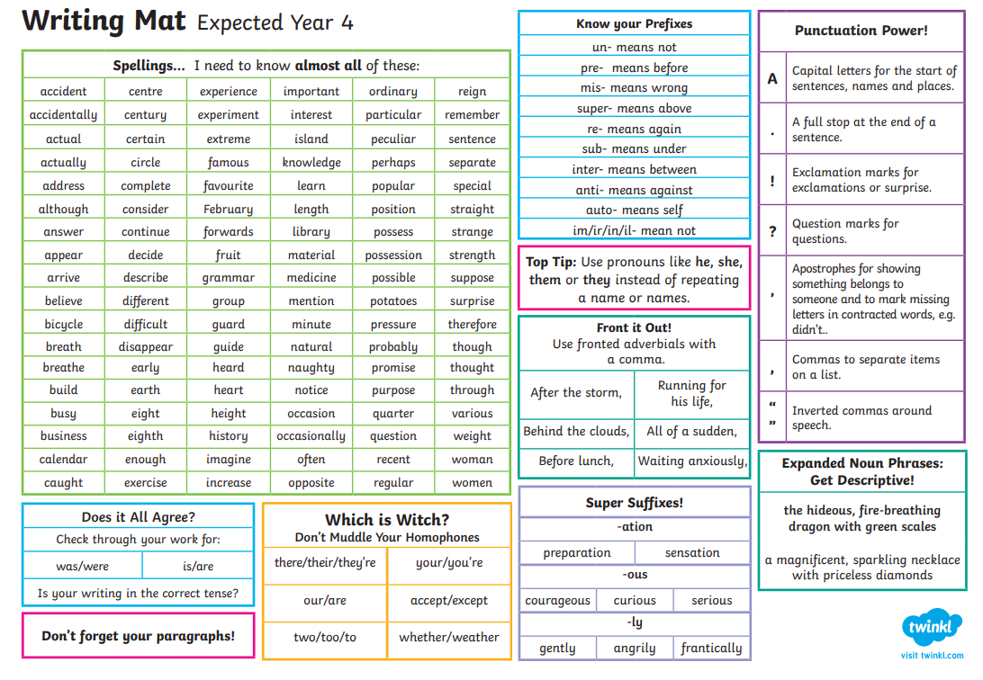
Expected Year 4

Slide 3

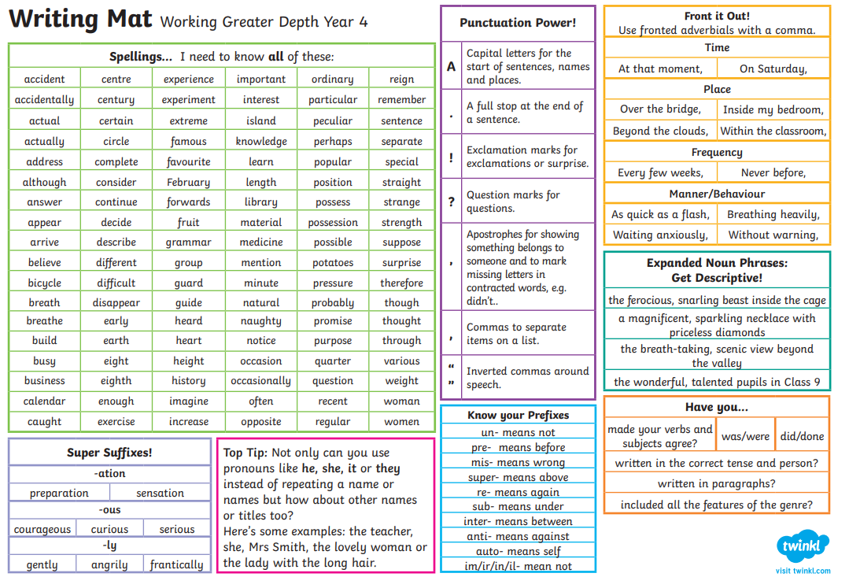
Year 4 Working at Greater Depth

