Slide 1
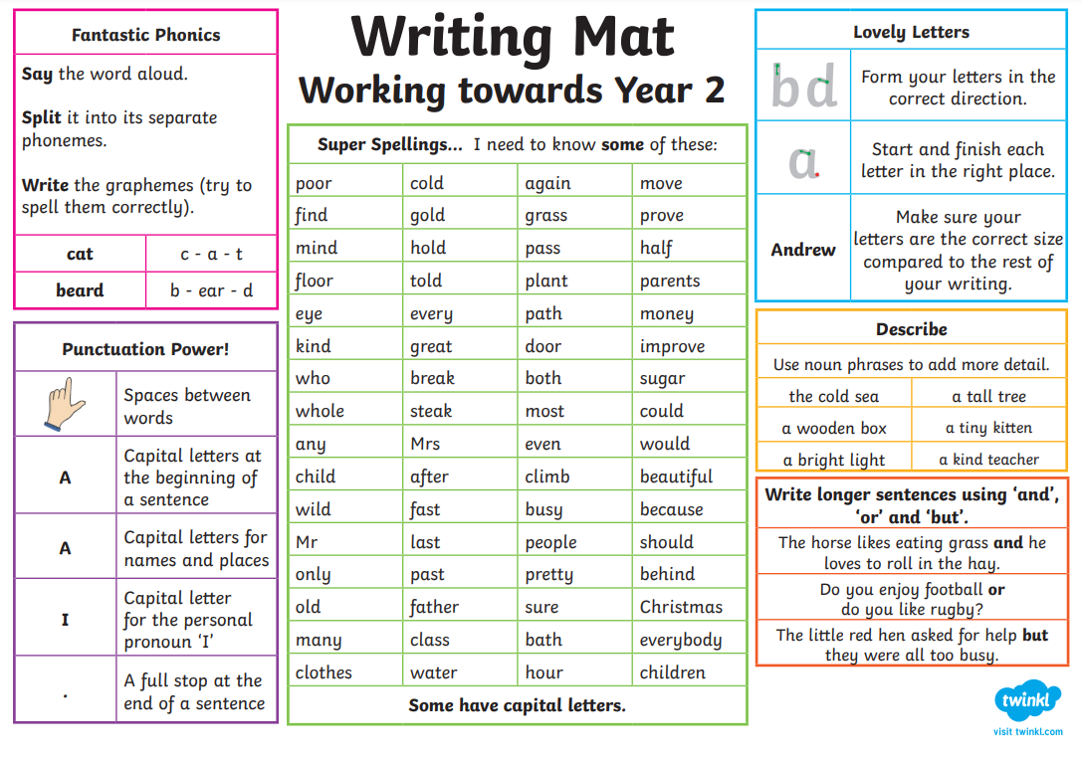


Working Towards Year 2

Slide 2
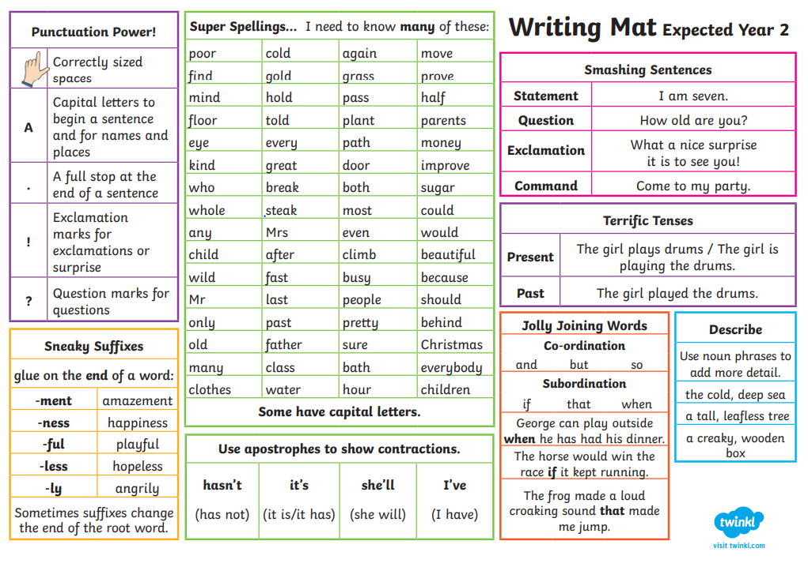

Year 2 Expected

Slide 3
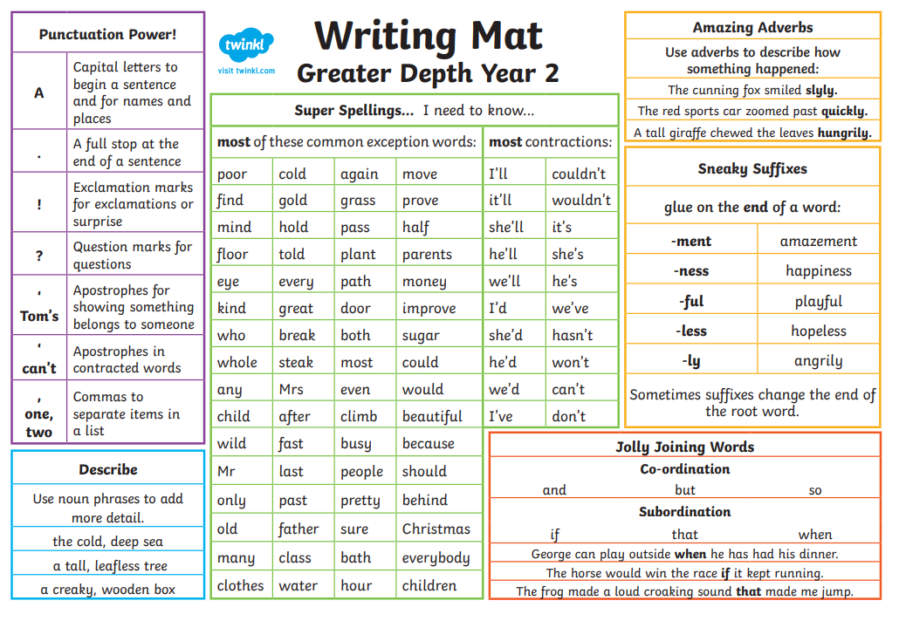
Year 2 Greater Depth

