Slide 1

Year 5 Information
Notes:
Make booklet
Year 5/6 statutory spellings
Curriculum maps
Questions to ask when reading
Open websites school run, bbc bitesize, duo lingo

Slide 2

Year 5 Staff
Miss Broderick teaches Monday, Tuesday and Wednesday, with PPA (teacher planning time) every other Monday afternoon.
Miss Fox teaches Thursday and Friday (TA’s on the other days)
Miss Jordan will be our teaching assistant on a Tuesday, Wednesday and Thursday.
Mrs Marciniak will teach Music for 45 minutes on Wednesday afternoons.

Slide 3
Reading Expectations
It is essential that your child reads to an adult or independently at home, every day, for at least five minutes. Please ensure you communicate with us, and comment on their reading, in their Homework Diary Book.
Reading books need to be in school each day.
Please note that reading “fluency” is speed and accuracy. Not just reading “well”. In Year 5, they should be able to read 160 words a minute.
Every term, we will do an accelerated reader test which will advise your child on what books they should be reading.

Slide 4
How to help your child read
Set good practice for reading: well-lit area, with the book supported and steady in front of them, as quiet and distraction free as possible.
Visit the library together
You can get lots of ideas from this website- https://www.booktrust.org.uk/books-and-reading/tips-and-advice/reading-tips/
Read to them often (in English or your home language). This helps them to learn to listen for extended periods of time. Ask them questions about what you are reading to encourage good comprehension.
Listen to audio books to help build their vocabulary
Set aside time every day for them to read to you and build into your home routine.

Slide 5
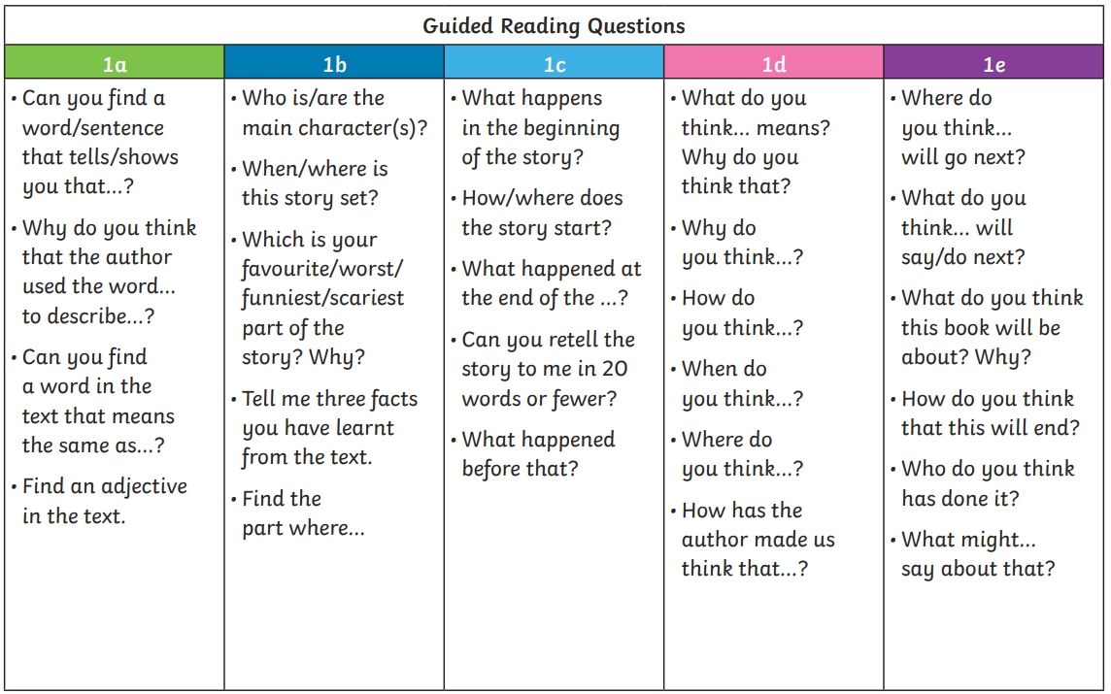

Slide 6
In School, On Time
It is essential that your child is on time and comes to school every day. Lessons start at 9am - some children will be accessing interventions before lessons too to help their learning.
There might be occasions when your child is sick but if the illness is mild, we encourage you to send them in with some medicine and we will monitor them during the day.
Good attendance is considered to be less than 10 days off in a year.
If your child has more than 19 days off in a year, they are classed as a Persistently Absent child, and they will be monitored by the local authority.
Apart from ensuring they don’t miss out on learning, being in school is important for developing friendships with other children. It also teaches children good habits for when they are older and start to work.
Being on time, is equally important – children get embarrassed and anxious if they have to walk into a classroom after the lesson has started. Term-time holiday will not be authorised. If your child has 5 or more days absent, you will be fined by the Local Authority.
You will receive an email at the end of each half-term sharing your child’s attendance. You will also be able to check on the Arbor Parent App.

Slide 7
Home Learning
Please see the Year 5 Key Skills document for what you can be focusing on at home each half-term in addition to weekly homework.
Weekly homework will be:
Reading everyday and recording this in reading logs which will be checked.
Times Tables – this will be monitored through the pupil’s engagement and accuracy on Times Tables Rock Stars.
Spellings on Spelling Shed – monitored for completion and accuracy each week. They are to be practiced a minimum of 3 times before Friday.
Children will each have a punch card where they will be able to collect hole punches for completing their homework. This is a reward system to try and motivate them to engage.
Key life skills:
Being able to tie shoelaces and ties
Being able to tell the time on an analogue clock (school clocks are not digital)
Being able to get changed/dressed quickly
Spelling Shed and Times Tables Rockstars Log ins will be sent home and/or stuck into reading journals in September.

Slide 8
How you can be involved:
Thankful Thursdays (once a half-term)
Sports Day
Parent Assembly (once a half-term)
Parents evening
Reading the newsletter
Checking website for the curriculum information and supporting this learning at home
Being on time
Supporting reading

Slide 9
Year 5 Curriculum Maps
https://www.stbenedicts.cheshire.sch.uk/page/year-5/126856

Slide 10
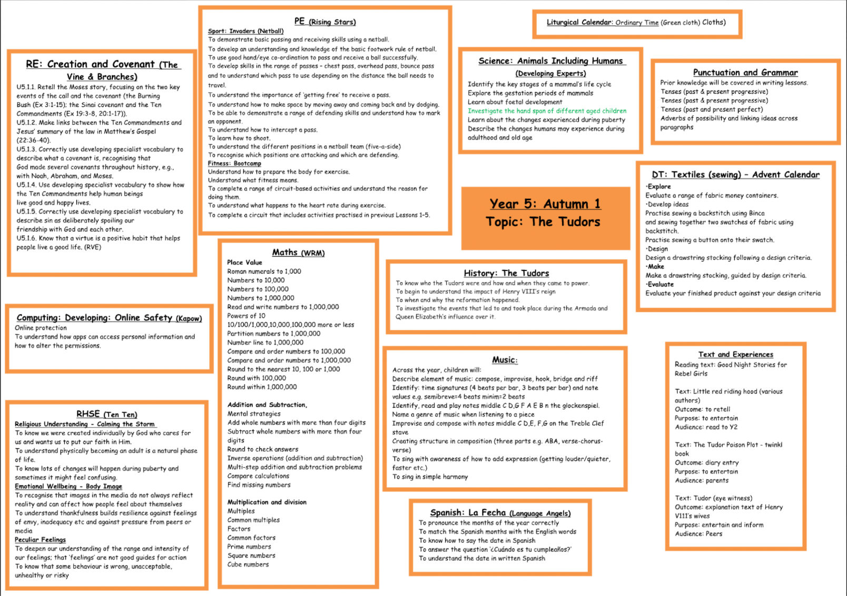

Slide 11
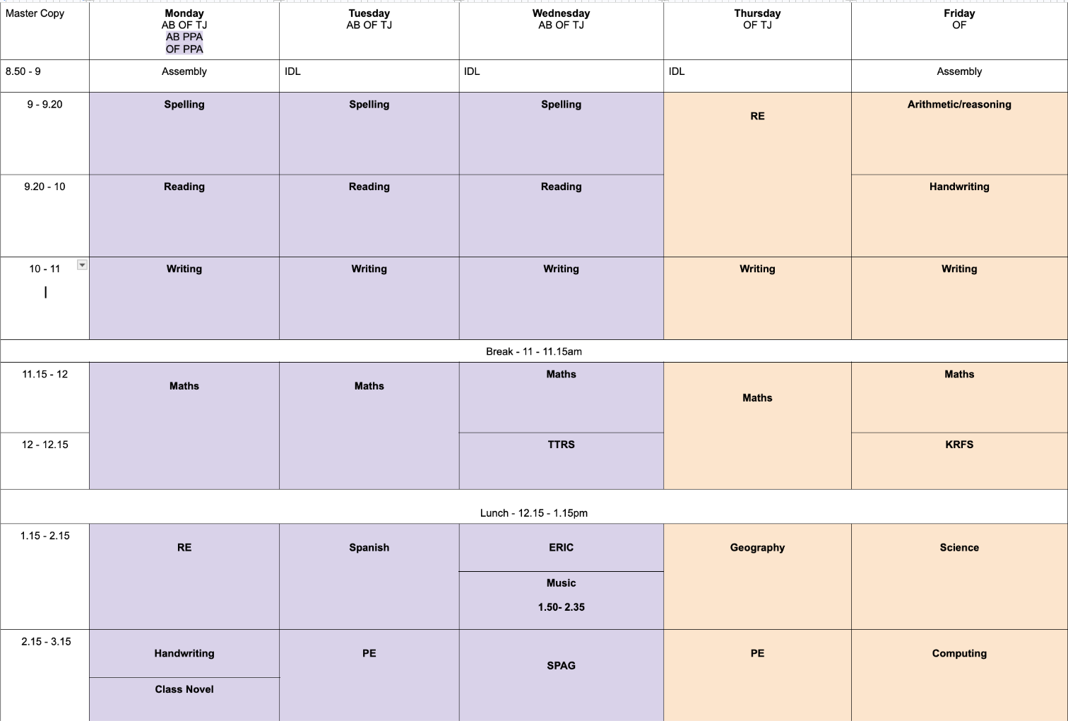
Y5 Timetable

Slide 12
Key events this year
Autumn 1 – Lowry Artist Workshop. An artist will visit Year 5 for the day in school and create some pieces of art inspired by L.S Lowry with them (cost approx. £10).
Autumn 2 - School Pantomime (15th Dec)
Spring 1 – Styal Mill. Pupils will either walk from school or be dropped off there. (Cost approx. £10) TBC
Spring 2 – Robin Wood 3 day activity Residential (Cost approx. £300)
Summer 2 – Synagogue (potentially) and Sports Day - 24th June
Assessments are done in Spring 1 – January and Summer 2 -June. In Year 5 they complete 6 assessments. Spelling, Punctuation and Grammar, Reading, Arithmetic, Reasoning 1 and Reasoning 2.

Slide 13
Uniform
Please make sure that all your child’s clothes and belongings are clearly named so that if they are misplaced, they can be returned.
The children should wear their winter uniform from the start of the Autumn term until the end of the Spring term. They can wear their summer uniform throughout the Summer term.
We would appreciate your support in ensuring the children wear the correct school uniform as outlined on the school website and in the class procedures letter - no leggings!
Jewellery should not be worn to school. If you choose to send your child with earrings – they must be studs and should be removed or taped up for PE
Children should wear suitable school shoes at all times and bring a coat to wear during playtimes all year round.
Long hair must be tied back.

Slide 14
PE
The children will have their PE lessons on Tuesdays and Thursdays
The school PE kits should be worn to school on these days or plain black. Not branded or own clothes.
Black tracksuits bottoms and the black and green hoodie should be worn in the winter.
Trainers can be worn on PE days only
Earrings should be removed or covered and long hair, tied back
Please support your child in learning how to tie their trainer laces.

Slide 15
Snacks
Pupils should bring in a healthy snack from home. Please note that no nuts or nut products are allowed in school. This includes Nutella, Kinder Buenos, Reese’s, peanut butter, chocolate hazelnut breakfast bars
Chocolate or sweets are not allowed for their snack.
Snacks are eaten at break time, which is only 15 minutes, so please do not send a lot of food.
Unhealthy snacks are allowed, but not essential, each Friday.
Children must bring a named bottle of water into school. This will be kept in the classroom for them to access throughout the day.
Fizzy drinks and juice are not permitted.

Slide 16
Rewards
Children who are spotted behaving in a respectful manner will be added to the class Respect wall. If a child is on the Respect wall all week, they will receive a certificate in assembly and a prize.
Each child is in one of six school houses. Children can win house points for their house by showing respect, good work and general good behaviour.
Each half term, the house with the most tokens wins a prize, e.g. a chocolate fountain party or pizza party.

Slide 17
Website and Contacts
There is more information for parents on the school website: https://www.stbenedicts.cheshire.sch.uk The weekly school newsletter is a great source of information and is emailed to parents every Friday.
Please keep your eye on the school media for what school has been getting up to.
In the morning, messages can be passed to teachers via the person on the gate (often Mrs McGuire) or through the office. If you would like to speak to us in person, please leave a message for us to call you or wait until we have finished sending the children home at the end of the day.

