Slide 1

Year 3 Information

Slide 2

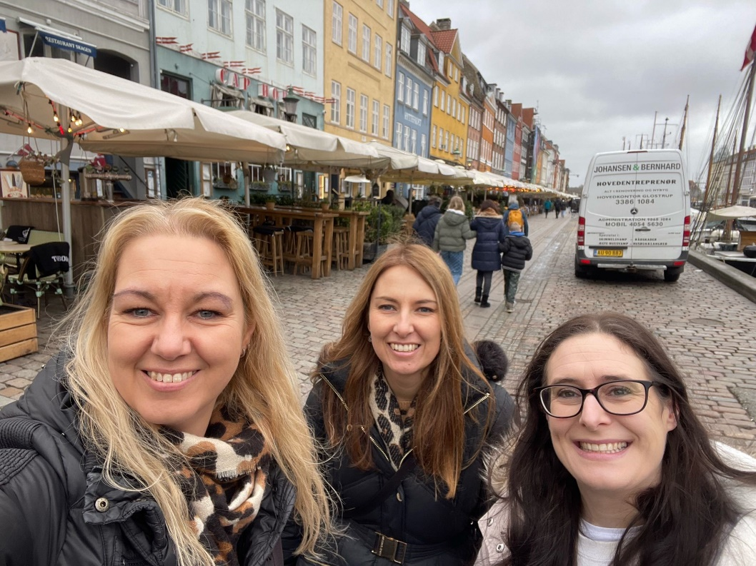
Mrs Nixon, Mrs McBride & Mrs Burwood

Slide 3
Y3 staff
Mrs McBride teaches Monday & Tuesday. Mrs Burwood teaches Wednesday, Thursday and Friday, with PPA (teacher planning time) scheduled on Friday afternoon after lunch.
Mrs Nixon is our class teaching assistant, working Monday-Friday.
Mrs Nixon covers Mrs Burwood’s PPA on Friday afternoon from lunch.

Slide 4
Reading and Homework expectations
It is essential that your child reads to an adult at home, every day, for at least ten minutes. Please ensure you communicate with us, and comment on their reading, in their Homework diaries.
Reading books need to be in school each day even if they have not been finished.
We have a special reading reward system for the children. Every time they read, they get a smiley face on their Starbooks loyalty card. When they have 8 smiley faces, they get to choose a mini figurine animal and their name goes into a draw for a prize at the end of each half term.

Slide 5
How to help your child read
Read to them often (in English or your home language). This helps them to learn to listen for extended periods of time. Ask them questions about what you are reading to encourage good comprehension. This is even true in KS2.
Listen to audio books to help build their vocabulary
Set aside time every day for them to read to you and build into your home routine.
Set good practice for reading: well-lit area, with the book supported and steady in front of them, as quiet and distraction free as possible.
Look at the picture on the front of the book and discuss what they think the book is about.
Ask them different style questions during their reading. You can find examples of questions at:
https://www.literacyshedblog.com/uploads/1/2/5/7/12572836/ks2_reading_vipers.pdf
Visit the library together
You can get lots of ideas from this website
https://www.booktrust.org.uk/books-and-reading/tips-and-advice/reading-tips/

Slide 6
In School, On Time
It is essential that your child is on time and comes to school everyday.
There might be occasions when your child is sick but if the illness is mild, we encourage you to send them in with some medicine and we will monitor them during the day.
Good attendance is considered to be less than 10 days off in a year.
If your child has more than 19 days off in a year, they are classed as a Persistently Absent child and they will be monitored by the local authority.
Apart from ensuring they don’t miss out on learning, being in school is important for developing friendships with other children. It also teaches children to good habits for when they are older and start to work.
Being on time, is equally important – children get embarrassed and anxious if they have to walk into a classroom after the lesson has started.
Term-time holiday will not be authorised. If your child has 5 or more days absent, you will be fined by the Local Authority.

Slide 7
Home Learning
Daily reading (at least five times per week)
Number bonds/times tables on TT Rockstars at least three times per week
Spellings using SpellingShed at least three times per week.
Additional ‘key skills’
Links for TT Rockstars and SpellingShed will be kept inside the front of your child’s reading record book.
Number bonds to 10 and 20 https://www.topmarks.co.uk/maths-games/hit-the-button | Number bonds to 50 and 100 https://www.topmarks.co.uk/maths-games/hit-the-button
3, 4, 6 and 8 times tables including division (use TT Rockstars) | Practise handwriting so that the letter g, p, j, f, y, q fall below the line. Practise handwriting so that letters b, d, h, k, l are taller than the other letters.
Practise writing sentences using an adjective: e.g. The abandoned house stood alone on the lane. | Practice writing sentences using an adverb: e.g. Silently, the old man gazed at the beauty of the forest.
In addition, in History we are learning about the Stone Age. It would be great if your child could find facts about the Stone Age to share in class.

Slide 8
How you can be involved
Thankful Thursdays (once a half-term)
Sports Day
Parent Assembly (once a half-term)
Class assembly – 22nd April 2026 @9am
Parents evening
Reading the newsletter
Checking website for the curriculum information and supporting this learning at home
Being on time
Supporting reading
Being one of our Mystery Readers in the summer term

Slide 9
Key events this year
On Wednesday 22nd October, we will be going to Tatton Park for The Stone Age Experience. Every year this proves a popular and educational filled trip.
On Friday 24th October, we will be going to the CAFT centre with the whole school.
On Thursday 19th March to Friday 20th March 2026, we will be going on a residential trip to The Catalyst centre in Widnes. The children experience their school first residential, and it is a great way to introduce them to staying away from home. We leave school after lunch, participate in two workshops, explore the science activities and then sleep in the observatory. We return to school in time for lunch the next day.
Our class assembly will take place on Wednesday 22nd April and will be about our trip to The Catalyst Centre.
In December and June, we do NFER tests in Maths, Comprehension, Grammar and Spelling. These are conducted to monitor how the children are doing and highlight any areas we need to work on with the children.

Slide 10
Uniform
Please make sure that all your child’s clothes and belongings are clearly named.
The children should wear their winter uniform from the start of the Autumn term until the end of the Spring term. They can wear their summer uniform throughout the Summer term.
We would appreciate your support in ensuring the children wear the correct school uniform as outlined on the school website and in the class procedures letter.
Jewellery should not be worn to school. If you choose to send your child with earrings – they must be studs.
Children should wear suitable school shoes at all times and bring a coat to wear during playtimes.
Long hair must be tied back.

Slide 11
PE
This term, the children will have their PE lessons on Mondays and Fridays.
The school PE kits should be worn to school on these days (Not Reception children)
Black tracksuits bottoms and the black and green hoodie should be worn in the winter.
Trainers can be worn on PE days only

Slide 12
Snacks
If you wish, your child can bring in a healthy snack from home. Please note that no nuts, chocolate or sweets are allowed for their snack. Parents can also sign up for their children to have toast.
Snacks are eaten either just before or just after break. We only have a small window of time so please do not send your child with lots of food.
Unhealthy snacks are allowed, but not essential, each Friday.
Children must bring a named bottle of water into school. This will be kept in the classroom for them to access throughout the day.
Fizzy drinks and juice are not permitted.

Slide 13
Rewards
Children who are spotted behaving in a respectful manner will be added to the class Respect wall. If a child is on the Respect wall all week, they will receive a certificate in assembly and a reward
Each child is in one of six school houses. Children can win tokens for their house by showing respect, good work and general good behaviour.
Each half term, the house with the most tokens wins a prize, e.g. some fun activities with one of our sports coaches.

Slide 14
First Holy Communion
We will be sending an email out in October asking parents to sign their children up for the sacramental programme.
We will require a copy of your child’s baptismal certificate, and your child will need to have been baptised a Catholic.
The programme will begin in January.
Mass of Enrolment – Sunday 18th January 2026
First Reconciliation – Thursday 7th May (in school time)
First Holy Communion – Saturday 6th June @11:30am

Slide 15
Website and Contacts
There is more information for parents on the school website: https://www.stbenedicts.cheshire.sch.uk The weekly school newsletter is a great source of information and is emailed to parents every Friday.
Please keep your eye on the school website for regular updates about what we have been doing in class.
In the morning, messages can be passed to teachers via the person on the gate (often Mrs McGuire) or by the person on the class door. If you would like to speak to us in person, please leave a message for us to call you or wait until we have finished sending the children home at the end of the day.

Slide 16
Information from you
Please check that we have your child’s medication in school, e.g. inhalers
Please consider getting your child’s eyes checked by an optician.
Is there anything we need to know about your child?

