Slide 1

Year 2 Information

Slide 2

Year 2 staff
Mrs Grace teaches Monday, Tuesday morning and Wednesday, with PPA (teacher planning time) scheduled on Tuesday afternoon after lunch.
Mrs Marciniak teaches Tuesday afternoon, Thursday and Friday.
Mrs Case is our teaching assistant and supports the children in our class Monday – Friday.

Slide 3
Reading and Homework expectations
Reading books need to be in school each day even if they have not been finished.
Reading books are changed on Monday, Wednesday and Friday.
Ebooks will continue to be set on Fridays
Library book is changed weekly on a Tuesday.
Record in the reading record every day
The school expectation is that children read at least 5 times a week. We give a stamp for every day they read and at the end of the week, children with 5 stamps that week get a prize from the box.

Slide 4
How to help your child read
Read to them often (in English or your home language). This helps them to learn to listen for extended periods of time. Ask them questions about what you are reading to encourage good comprehension. This is even true in KS2.
Listen to audio books to help build their vocabulary
Set aside time every day for them to read to you and build into your home routine.
Set good practice for reading: well-lit area, with the book supported and steady in front of them, as quiet and distraction free as possible.
In Year 2 we will focus on comprehension of the text. Ask your child questions about what they have read and to show the answer in the text as this is a key skill they will use throughout the year.
Visit the library together
You can get lots of ideas from this website
https://www.booktrust.org.uk/books-and-reading/tips-and-advice/reading-tips/

Slide 5
In School, On Time
It is essential that your child is on time and comes to school everyday.
There might be occasions when your child is sick but if the illness is mild, we encourage you to send them in with some medicine and we will monitor them during the day.
Good attendance is considered to be less than 10 days off in a year.
If your child has more than 19 days off in a year, they are classed as a Persistently Absent child and they will be monitored by the local authority.
Apart from ensuring they don’t miss out on learning, being in school is important for developing friendships with other children. It also teaches children to good habits for when they are older and start to work.
Being on time, is equally important – children get embarrassed and anxious if they have to walk into a classroom after the lesson has started. We utilise the mornings to practise retrieval of key learning, give feedback and deliver interventions – it is important that all children have access to this.
Term-time holiday will not be authorised. If your child has 5 or more days absent, you will be fined by the Local Authority.
You will receive an email at the end of each half-term sharing your child’s attendance. You will also be able to check on the Arbor Parent App.

Slide 6
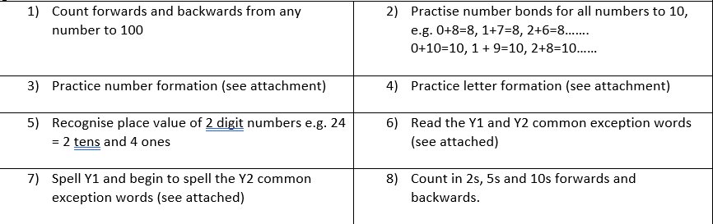
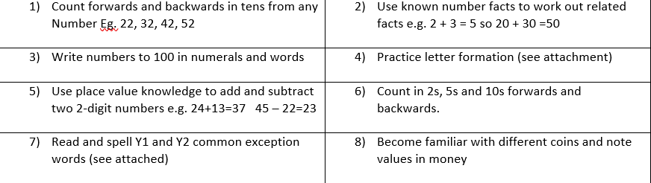
Home Learning
Passwords for Spelling Shed, Collins Ebooks and Numbots will be stuck on the inside of their new reading record.
Key Skills Autumn 1
See the document on the Y2 page on the website
Key Skills Autumn 2
See the document on the Y2 page on the website

Slide 7
Home Learning
Comprehension written activity - consolidate those key skills needed to ensure children are understanding what they are reading and retrieving the answer from the text.
Passwords for Spelling Shed, Collins Ebooks and Numbots are stuck on the inside of their new reading record.
Reading 5 times a week and each time recorded in the reading record
We will include on the weekly newsletter what the children have been learning during the week and useful links which will support your child’s learning in the topic we are covering that particular week.

Slide 8
How you can be involved
Reading at home every night and sending record in every day
Thankful Thursdays (once a half-term)
Sports Day
Parent Assembly (once a half-term)
Parents evening
Reading the newsletter
Checking website for the curriculum information and supporting this learning at home
Being on time
Supporting reading

Slide 9
Year 2 Curriculum Overview and maps
St Benedict's Catholic Primary School: Year 2 (stbenedicts.cheshire.sch.uk)
7773966 (stbenedicts.cheshire.sch.uk)
7773969 (stbenedicts.cheshire.sch.uk)
7773967 (stbenedicts.cheshire.sch.uk)
Microsoft Word - Curriculum Map Year 2 Spring 2.docx (stbenedicts.cheshire.sch.uk)
7773968 (stbenedicts.cheshire.sch.uk)
7773970 (stbenedicts.cheshire.sch.uk)

Slide 10
Monday | Tuesday | Wednesday | Thursday | Friday
8.50-9.10am Handwriting (Caps) Class Reading | Register | Register | Register | 8.50-9.10am Assembly
 | 9am-9.30am Practise reading MG/JC/VB/TJ | 9am-9.20am Phonics LW Wk 2 day 2 | 9am-9.20am Phonics LW Wk 2 day 3
9.15 – 9.40am Practise reading MG/JC/SB/TJ | 9.35-10am Phonics | 9.25-10am Reading comprehension MG/JC | 9.25-10am Reading comprehension AM/JC NN | 9.15-9.40am Practise Reading AM JC SB VB
9.40-10-10am |  |  |  | 9.40 – 10.10am Phonics – spelling test
10.10-10.45am Maths | 10am-10.45am Maths | 10am-10.45am Maths | 10am-10.45am Maths | 10.10-10.45am Maths
Break 10.45am – 11am
11.00-12noon Writing | 11.00-12noon Writing | 11.00-12noon Writing | 11.00-12noon Writing | 11-12noon Writing
Lunch 12-1pm
1.00 – 2.00pm Geography | 1.00 – 2.00pm Science | 1.00-2.00pm RE | 1.00pm – 2.00pm RE | 1.00 – 1.45pm ICT
Break 2-2.15pm |  |  | 2.00 – 2.45pm RSHE Zone of regulation: | Break
2.15 – 2.45pm Retrieval maths | 2.15 -3.00pm PE (External) Gymnastics | 2.15-3.00pm Number bonds/Times tables |  | 1.45pm – 2.30pm PE
2.45pm- 3.30pm Assembly | 3.00pm – 3.30pm Number bonds / Times tables Class reading | 3.00-3.30pm Singing / PR group Singing Assembly | 2.45 – 3.30pm Liturgical Prayer | 2.30 – 3.15pm Grammar / Hometime things

Slide 11
Key events this year
School Trips
In Year 2, during Autumn 2, we will learn about the Great Fire of London. Ranger Dan will visit our school and provide a rich learning experience to consolidate the children’s learning. The children learn how to make a wall with wattle and daub and most excitingly, observe the quick spread of fire through our very own London.
In Summer 1 , Year 2 will visit Knowsley Safari Park to deepen their knowledge and understanding of living things from around the world and the habitats they live in . The children learn about the importance of conservation and protecting the world we live in. The Sea Lion show is an insightful teaching tool to raise awareness of the dangers of pollution in our seas.
Nativity
Year 2 lead our school Nativity in December. All children will have a role and a chance to shine as they take to the stage to retell the story of Christmas. Year 1 and Reception support the Nativity in song.

Slide 12
Key events this year
Test and assessments throughout the year
The children will have a weekly spelling test on a Friday which reinforces key spelling patterns and common exception words that develop more fluency in writing .
Before Christmas , the children will complete reading, spelling and maths assessments to inform teachers next steps for learning and any misconceptions that your child might need addressing.
In the Summer term, the children will take the non statutory KS1 SATS assessments which help school identify next steps for all children’s learning.

Slide 13
Uniform
Please make sure that all your child’s clothes and belongings are clearly named.
The children should wear their winter uniform from the start of the Autumn term until the end of the Spring term. They can wear their summer uniform throughout the Summer term.
We would appreciate your support in ensuring the children wear the correct school uniform as outlined on the school website and in the class procedures letter.
Jewellery should not be worn to school. If you choose to send your child with earrings – they must be studs.
Children should wear suitable school shoes at all times and bring a coat to wear during playtimes.
Long hair must be tied back.

Slide 14
PE
The children will have their PE lessons on Tuesdays and Fridays.
Children wear their PE uniform to school on these days.
The school PE uniform or black hoodie, black polo shirt and black joggers
Please ensure you inform us if your child has an inhaler before sports.

Slide 15
Snacks
A school snack (fruit or veg) will be provided, free of charge, at morning breaks, but if you wish, your child can also bring in a healthy snack from home. Please note that no nuts, chocolate or sweets are allowed for their snack.
Snacks are eaten at break time, which is only 15 minutes, so please do not send a lot of food .
Unhealthy snacks are allowed, but not essential, each Friday.
Children must bring a named bottle of water into school. This will be kept in the classroom for them to access throughout the day.
Fizzy drinks and juice are not permitted.

Slide 16
Rewards
Children who are spotted behaving in a respectful manner will be added to the class Respect wall. If a child is on the Respect wall all week, they will receive a certificate in assembly and a prize
Each child is in one of six school houses. Children can win tokens for their house by showing respect, good work and general good behaviour.
Each half term, the house with the most tokens wins a prize, e.g. a chocolate fountain party or pizza party.

Slide 17
Website and Contacts
There is more information for parents on the school website: https://www.stbenedicts.cheshire.sch.uk The weekly school newsletter is a great source of information and is emailed to parents every Friday.
Please keep your eye on the school website for regular updates about what we have been doing in class.
In the morning, messages can be passed to teachers via the person on the gate (often Mrs McGuire) or by the person on the class door. If you would like to speak to us in person, please leave a message for us to call you or wait until we have finished sending the children home at the end of the day.

Slide 18
Please complete the parent feedback form

