Slide 1

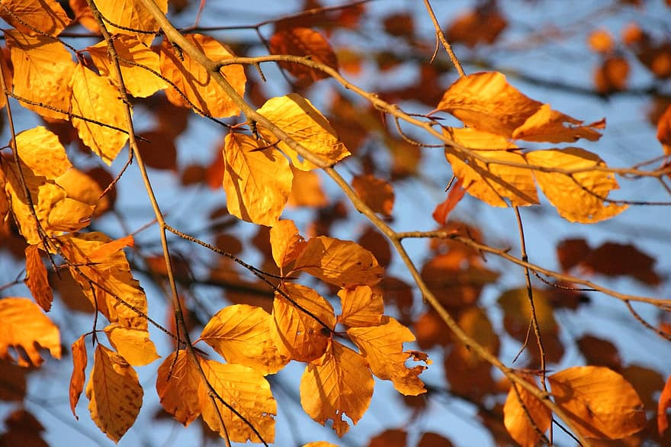
Year 1 Learning Narrative - Autumn 2026
R.E.
This term our key question will be 'What does it mean to belong to a faith or belief community?'.
PE
Our focus this term is Running and Playing Games. We will learn different running techniques and apply these skills to play a range of different games.
English
Our first text this term will be ‘Oi Frog’. Our second text this term will be ‘How do you feel?’.
Our focus for both of these texts will be constructing simple sentences both orally and in writing, and using capital letters, full stops and finger spaces.
Computing
Our Key Question is ‘How can technology help us?’. We will explore technology within our classroom, and practice our basic computer skills, for example using a mouse and typing on a keyboard.
Science
Our Key Question this term is ‘What are bodies and what can they do?’ We will compare humans and animals, sort them into different groups, and explore our senses.
We will also learn about the diets of different animals including omnivores, carnivores and herbivores.
Geography
This term we will be studying the local area. We will be exploring how Cranbrook has changed and grown over the last 10 years.
Art
We will be exploring the work of Andy Goldsworthy, and our Key Question will be ‘How to manipulate a range of materials to create a sculpture.’
Maths
This term we will be looking at Place Value within 10. We will also run our Mastering Number program alongside this.

Slide 2
Year 1 Welcome Letter
Sparrows
Mr Graham - Teacher
Mrs Newton, Miss Johnson - Teaching Assistants
Robins
Mrs James - Teacher
Mrs Dogan, Miss Grogan- Teaching Assistants
What do I need to bring to school everyday?
A water bottle
A raincoat
Book bags every Wednesday and Friday.
Please keep toys and precious items at home to keep them safe.
PE
PE will be every other Thursday when the class are not in Forest.
Both classes will have PE every Friday afternoon.
Forest School
Forest School will run on Tuesday afternoons throughout the year. Children will need to come to school dressed in their forest clothes on these days. Robins and Sparrows classes will participate on alternate Tuesdays.
Please ensure they have wellies, long-sleeved tops and long trousers, waterproofs and suitable warm clothing as appropriate for the weather.
Home Learning
Children will bring their reading book home every Wednesday for a ‘celebratory read’. Children will have read their book 3 times at school with an adult and are bringing it home to share their success with you.
Children will soon be given a Numbots login. This is an app that can be downloaded at home, and it is a great resource for helping children secure their number fluency.

