Slide 1
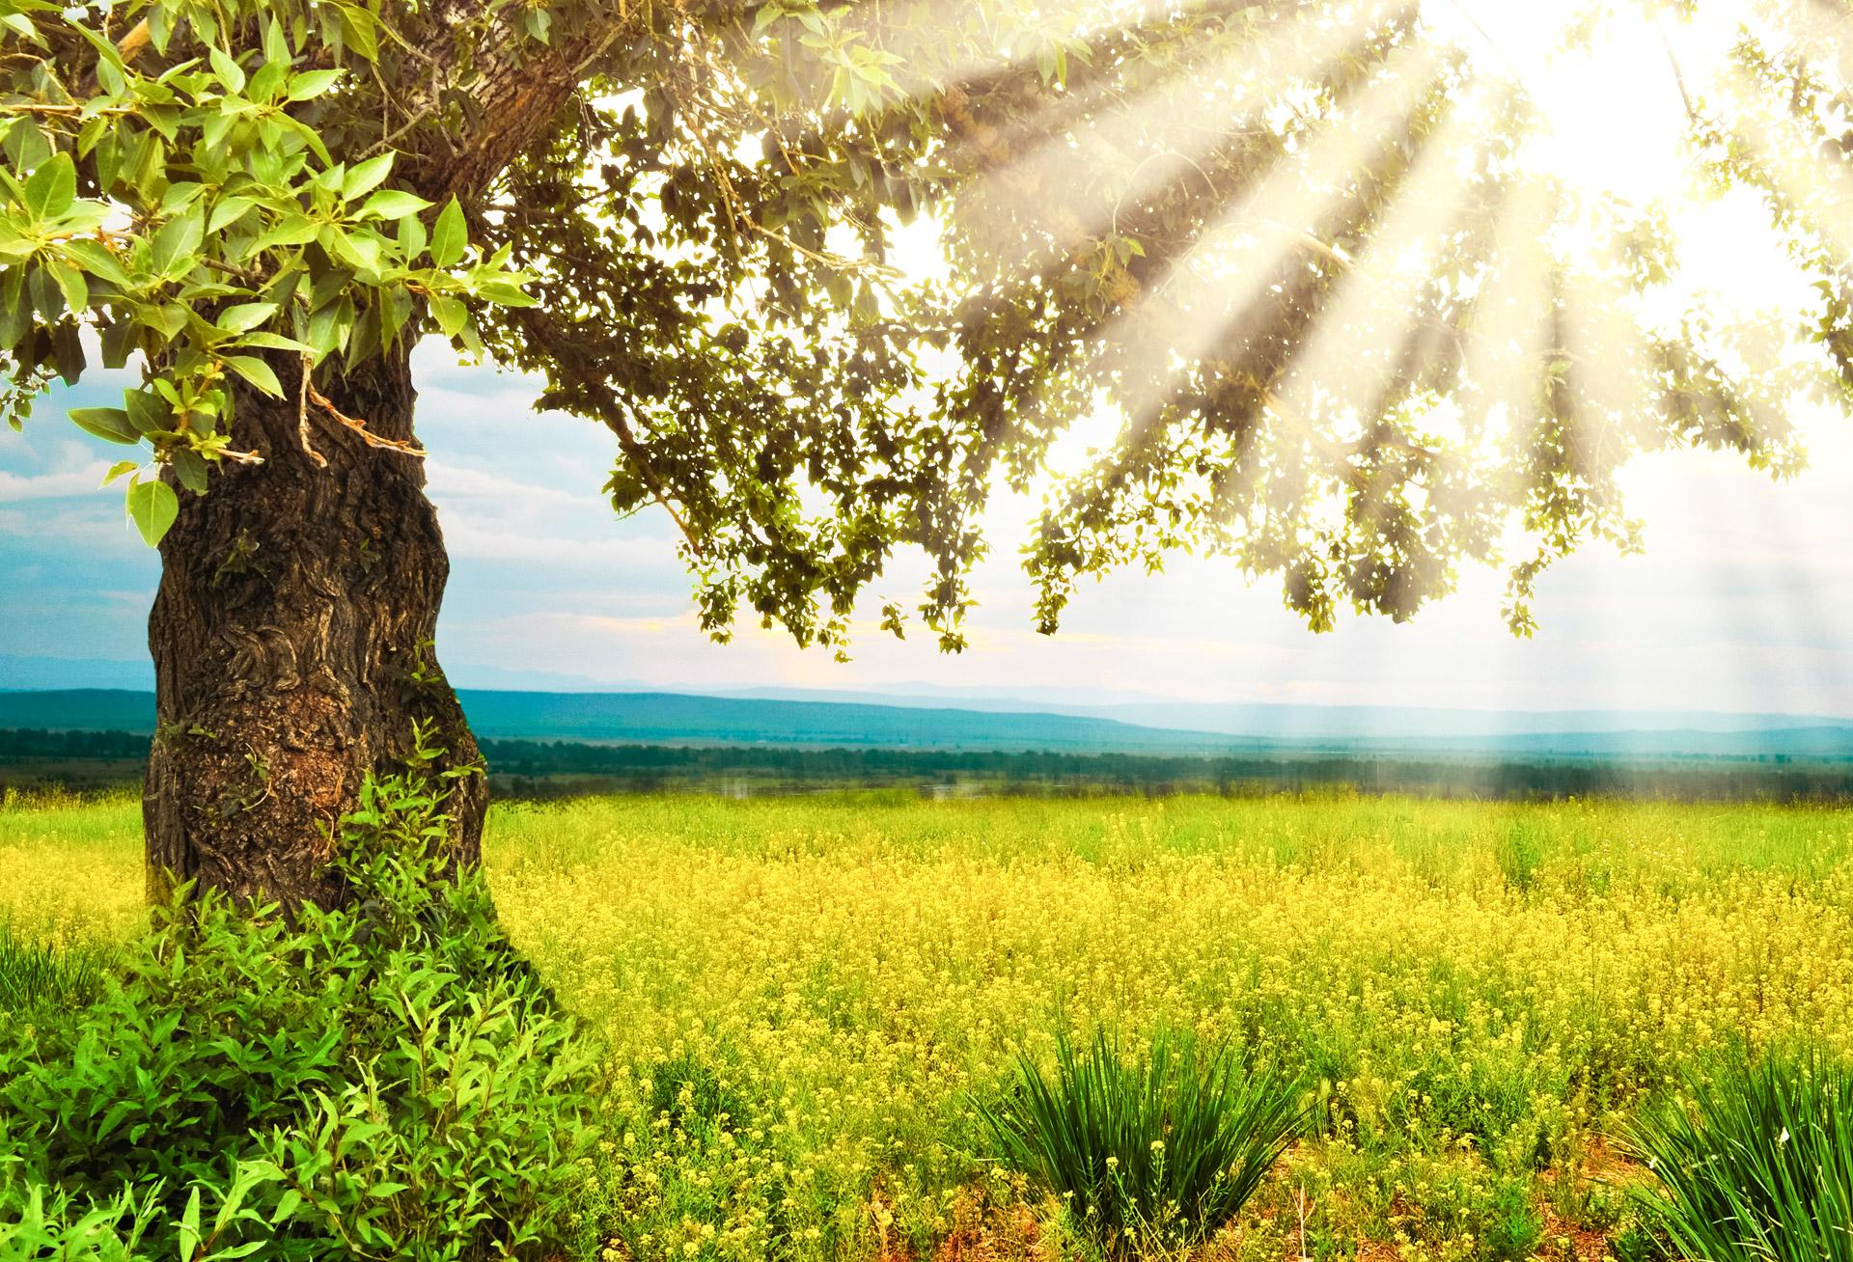

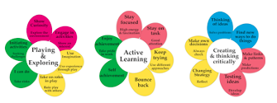





Learning Narrative Summer Term – Year 2
Science
We are reading…
Focus – Animals including humans
Key Question: What do animals and humans need to thrive?
What do animals and humans need to survive?
Do all animals need the same things to survive?
What do offspring need to survive and thrive?
How do animals change as they grow into adults?
What do humans need to live a healthy lifestyle?
Focus: Plants
Key Question: How do we keep plants alive?
How can we make sure our seeds turn into healthy plants?
What is happening to our seeds?
What is the life cycle of a plant?
What is seed dispersal?
Music
Penguins
Stella and the Seagull
The Bog Baby
Fairytale character Biography
Music that makes you dance
How does music shape the way we live?
History
Key Question: Why does farming matter?
What is farming?
What is the journey of food from farm to plate?
When was farming introduced in Great Britain?
How did the agricultural revolution change farming in Great Britain?
What is farming in Great Britain like today and how does it compare to the past?
Art
Art
Focus –Aboriginal Australian Art
What is aboriginal art?
Which painting techniques are used in aboriginal art?
What are dreamtime stories and how are they represented in art?
Creating using aboriginal styles and techniques.

Slide 2





R.E
Geography
R.H.S.E
What makes some places sacred to people of faith?
What makes some places sacred to people of faith? (Islam, Judaism, Christianity)
What places / buildings are special to me?
Which buildings / places of worship are sacred to Christians?
Which buildings / places of worship are scared to Jewish people?
Which buildings / places of worship are sacred for
Muslims?
How are buildings/places of worship for different religions similar and different and why are they important in different communities?
Who is a Muslim and how do they live?
What is Ramadan and how is it observed by Muslims?
What is Salah?
Which values are important to Muslims and Christians and how are they similar?
Computer safety
Our world
A world without judgement
Fire safety
Comparing Australia and England
Where is Australia?
What are the features of Australia’s landscape?
What are the features and landmarks of England?
How are England and Australia similar?
What is native to the Daintree Rainforest?
Why do people visit the Daintree Rainforest?
DT
Computing
Focus - Food: Preparing Fruit and Vegetables
Which different types of fruits and vegetables do we know and where do they come from?
What will you include in your product? (Healthy wraps)
Which utensils will you use to prepare each food item?
What did you think of your final product?
Focus – Presentation
Interactive Images
How can I make my image interactive?
Focus – Digital Literacy
Staying safe online
PE
Gymnastics: Linking
Rackets, bats and balls
Games for understanding
Team building

