Slide 1
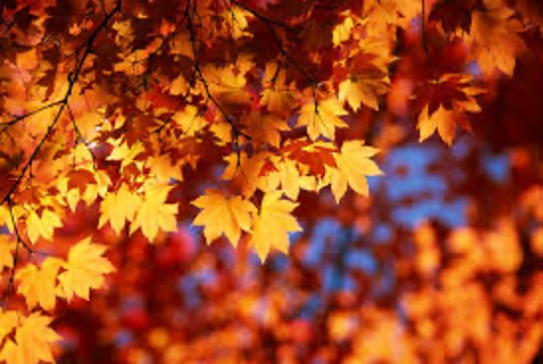
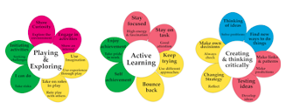

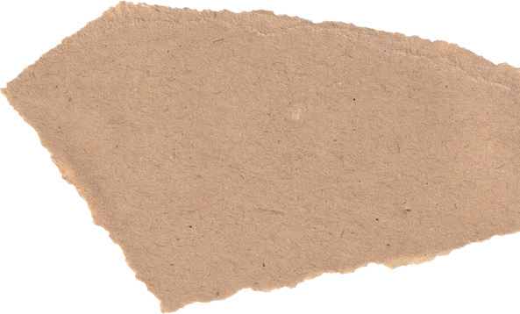




Learning Narrative Autumn Term – Year 3
Science
We are reading…
The Iron Man
The Lion The Witchand The Wardrobe
How do things work and change in our world?
Focus – Rocks
Key Question: How are rocks different?
Name the three naturally occurring rocks: o Igneous rock - Rock that has been formed from magma or lava. o Sedimentary rock - Rock that has been formed by layers of sediment being pressed down hard and sticking together. You can see the layers of sediment in the rock. o Metamorphic rock - Rock that started out as igneous or sedimentary rock but changed due to being exposed to extreme heat or pressure. • Use these words to discuss the properties of rocks: hard, soft, permeable, impermeable, durable (meaning resistant to weathering), high density, low density. Density measures how ‘bulky’ the rock is (how tightly packed the molecules are). • Physical properties of some rocks are as a result of their formation • Soils are made from rocks and organic matter • Fossils are formed when things that have lived are trapped within sedimentary rock • Fossils provide evidence that living things have changed over time
Focus –Forces and Magnets
A force is a push or a pull • The movement of the object on a surface is affected by the texture of that surface eg ice leads to more movement • A magnet attracts magnetic material such as iron and nickel • A magnet has two poles (north and south) which are the strongest past of magnet • Bringing two like poles together (eg north pole and north pole) causes the magnets to repel each other bringing to opposite poles (eg north and south pole) together causes them to attract • The force of magnetism is a non-contact force (ie the magnet does need to touch the object it attracts) • Many other forces are contact forces (eg pushing open a door)
Music
History
Let your spirit fly
Glockenspiel stage 1
How have historical events and people impacted on our society?
- Stone Age times humans lived in small groups and used stone and bone to make tools.
- These hunter-gatherers were almost always moving (nomadic) to find food.
- As the weather warmed, food became more plentiful so there was no need to keep moving and instead they build permanent homes near land they could farm.
- Work began on Stonehenge during the Stone Age and the last changes were made in the early Bronze Age.
- Bronze Age people used large wooden boats to cross the English Channel and the North Sea to trade with other settlements.
- Iron ploughs called ards were much more efficient than bronze or wooden ploughs and this meant more land could be used for growing food.
- Iron Age people, such as the Celts, were excellent farmers. Surplus food was stored and used in times of drought and famine or to be traded.
- Celtic language and culture are still present today, particularly in parts of Ireland, Wales and Scotland.
- Iron weapons made fighting between tribes more common so Iron Age hill forts were designed to provide protection to villagers and local farmers and to keep enemies out.
- The Iron Age in Britain was from approximately 800 BC until the Roman Conquest of 43 AD.
Computing
Focus – Computer Networks
Key Questions: How do computer networks work?
Focus – Presentations
Key Questions: How can I use technology to make my comic digital?
Art
Focus – Jewellery
Key Question: Can I follow a design to make my own piece of jewellery based on famous pieces I have learnt about?
KQ1 – Can I describe the colours and designs of ancient jewellery?
KQ2 – How can I create my own unique gemstones using pattern and colour combinations?
KQ3 – Can you talk about the appearance of famous jewellery and create your own pendant?
KQ4 – Can you create your own bracelet using patterns and materials?
KQ5 – Can I use specific skills to make a broach of my own?
KQ6 – Can I follow a design to make my own piece of jewellery?

Slide 2




R.E
Geography
R.H.S.E
How does R.E help to promote mutual respect and tolerance of people with different world views?
Focus – Christianity
Key Question: What do Christians learn from the creation story?
KQ1: What do Christians believe about creation?
KQ2: What happened after the 7 days of creation?
KQ3: What do the stories of creation and the fall tell us about God?
KQ4: What can we all do to help protect the world and keep it as god intended it?
KQ5: Is the Christian version of creation the only one?
KQ6: Who was to blame for Adam and Eve leaving the Garden of Eden?
Focus – Christianity
Key Question: What is it like for someone to follow God?
KQ1: What is it like for someone to follow God?
KQ2: What Bible stories reflect people following God’s word?
KQ3: Why is the story of Noah’s Ark read and shared by Christians and Jewish people?
KQ4: What is faith?
KQ5: How was Abraham challenged by God?
KQ6: How do the stories from the Old Testament show how, if people have faith in God, their lives will be enriched?
How does the geography of a place influence where and how people live?
Location
Name and locate the equator, northern hemisphere, southern hemisphere, the tropics of Cancer and Capricorn, Arctic and Antarctic Circle.
Know that there are different time zones in Europe and relate them to the map of the globe.
Europe
Europe is located completely in the northern hemisphere and mainly in the eastern hemisphere.
Europe borders the Arctic Ocean in the north, the Atlantic Ocean in the west and the Mediterranean Sea in the south.
A continent, the western part of a larger landmass called Eurasia.
European languages can be split into a number of groups: Romance
languages (such as French, Italian and Spanish); Germanic languages (such
as German and English) and the Slavic languages (such as Russian, Bulgarian and Polish).
It has over 50 countries
The second smallest continent in size but the third largest in population (742 million)
About 10 per cent of the world's population lives in Europe.
The highest population density, which means the largest number of people per square kilometre or mile.
The three largest countries are: Russia, Ukraine and France.
The Vatican City is the smallest country in Europe and in the world.
Keeping/Staying safe
Keeping/Staying healthy
Relationships
PE
French
DT
Fundamentals
Ball skills
Golf
Gymnastics
I’m learning French:
Ca-Va
Numbers and colours
Focus –Mechanisms Levers and Linkages
Key Question: What is the difference between a lever and a linkage?
KQ1 - What existing products show oscillating and reciprocating movement?
KQ2 - What skills do I need in order to make my own linkage and lever example?
KQ3 - Does my design meet the needs of the user?
KQ4 - What are the key stages in assembling my product?
KQ5 - Is there anything that I would change in my design based on feedback?

