Slide 1
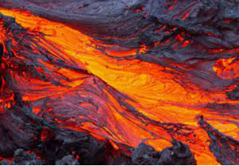
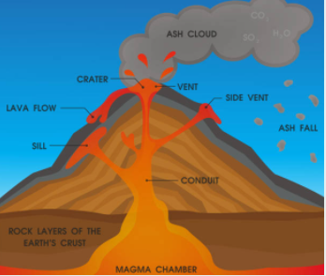
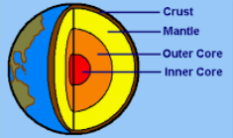
Why do volcanoes erupt?
Vocabulary
earthquake | A violent shaking of the ground caused by the Earth’s tectonic plates grinding against each other as they move.
erosion | When rock and land is worn away by natural forces such as water or wind.
igneous | A type of rock that forms when molten rock (lava) cools and turns back into a solid.
lava | Molten rock once it has come out of a volcano during in an eruption
magma | Molten rock when it is still under the surface of the Earth. It is found in the mantle
magnitude | A measure of how big an earthquake is at its source, represented by a number on the Richter scale
mantle | One of the layers of the Earth. It is found below the crust.
metamorphic | A type of rock that forms deep underground. It is igneous or sedimentary rock that has been changed by the heat and pressure underground
sedimentary | A type of rock that forms from compressed (squashed) sand, mud, pebbles and organic matter.
tectonic plates | Large, moving pieces of rock which fit together like a jigsaw puzzle. Together they form the surface of the Earth, the Earth’s crust.
tsunami | A very large wave in the ocean that is caused by an earthquake or volcanic eruption under the sea.
volcano | A weak spot in the Earth’s crust, which sometimes erupts, sending out lava, ash and gases. Over time their shape builds to be cone like.
Tectonic plates
fit together like a jigsaw.
Lava is liquid rock. It is yellow because it is so hot.
The centre of the Earth is called the core.
There are 3 main types of rock which are formed under different conditions.

