Slide 1
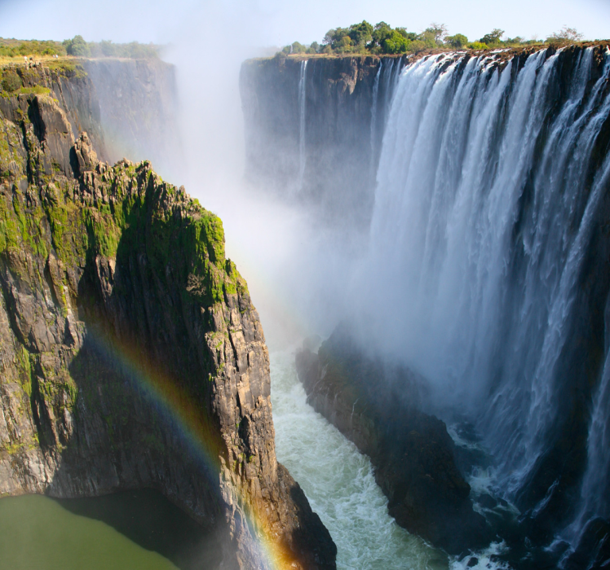
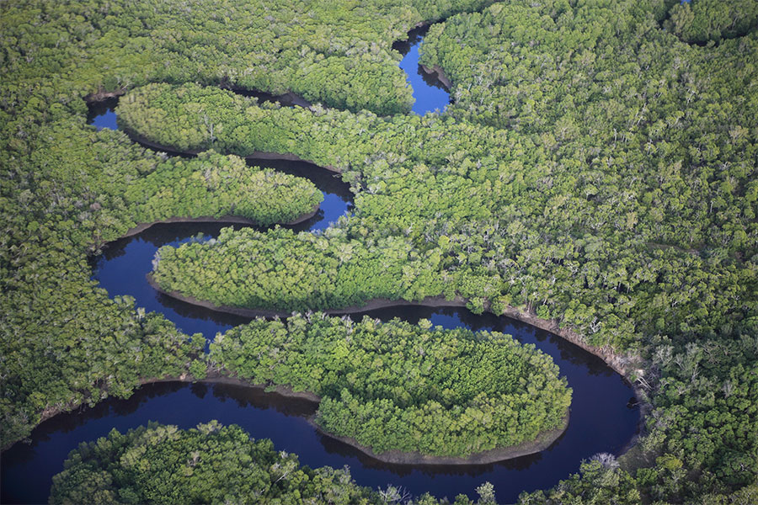
Victoria falls and
Zambezi river
By
Marcie and April

Slide 2
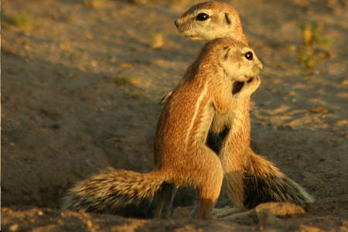
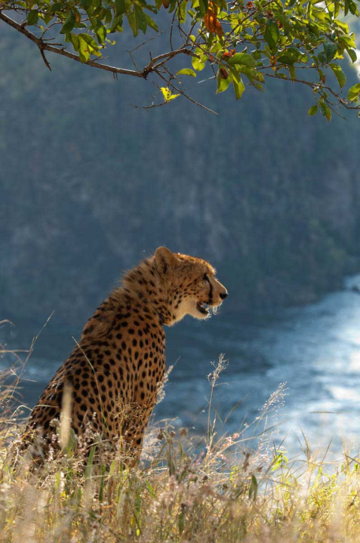
Victoria falls animals
These are prarie
dogs, they live in victoria falls
This is a cheetah, it lives in victoria falls

Slide 3
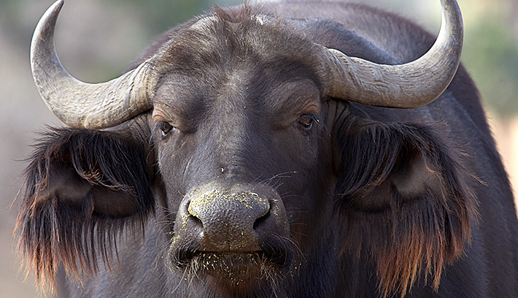
Large animals
Along the river numerous animals can be found. Along the shore Crocodiles and hippopotamus are abundant. Large animals such as elephants, lions, zebras, giraffes, and buffalo can be found near the river in many areas.

Slide 4
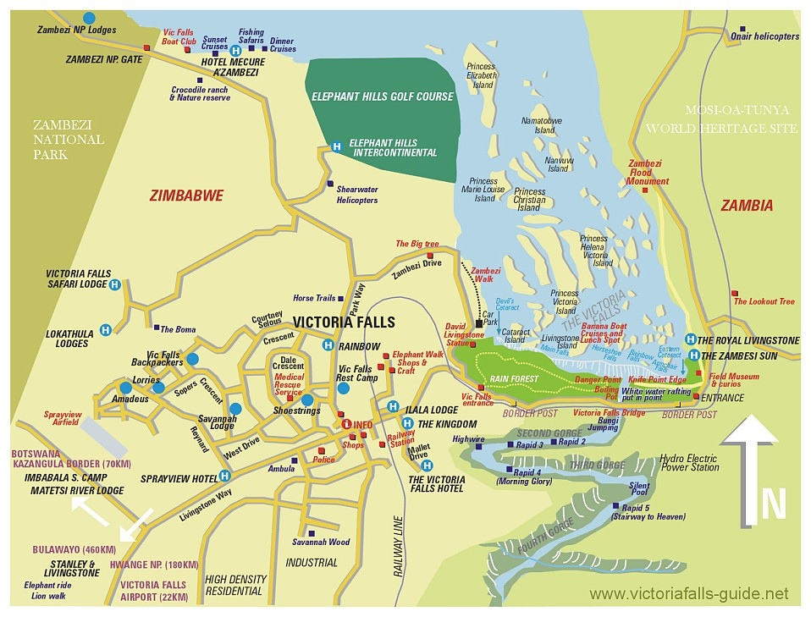
This is a map to show where victoria falls is.

Slide 5
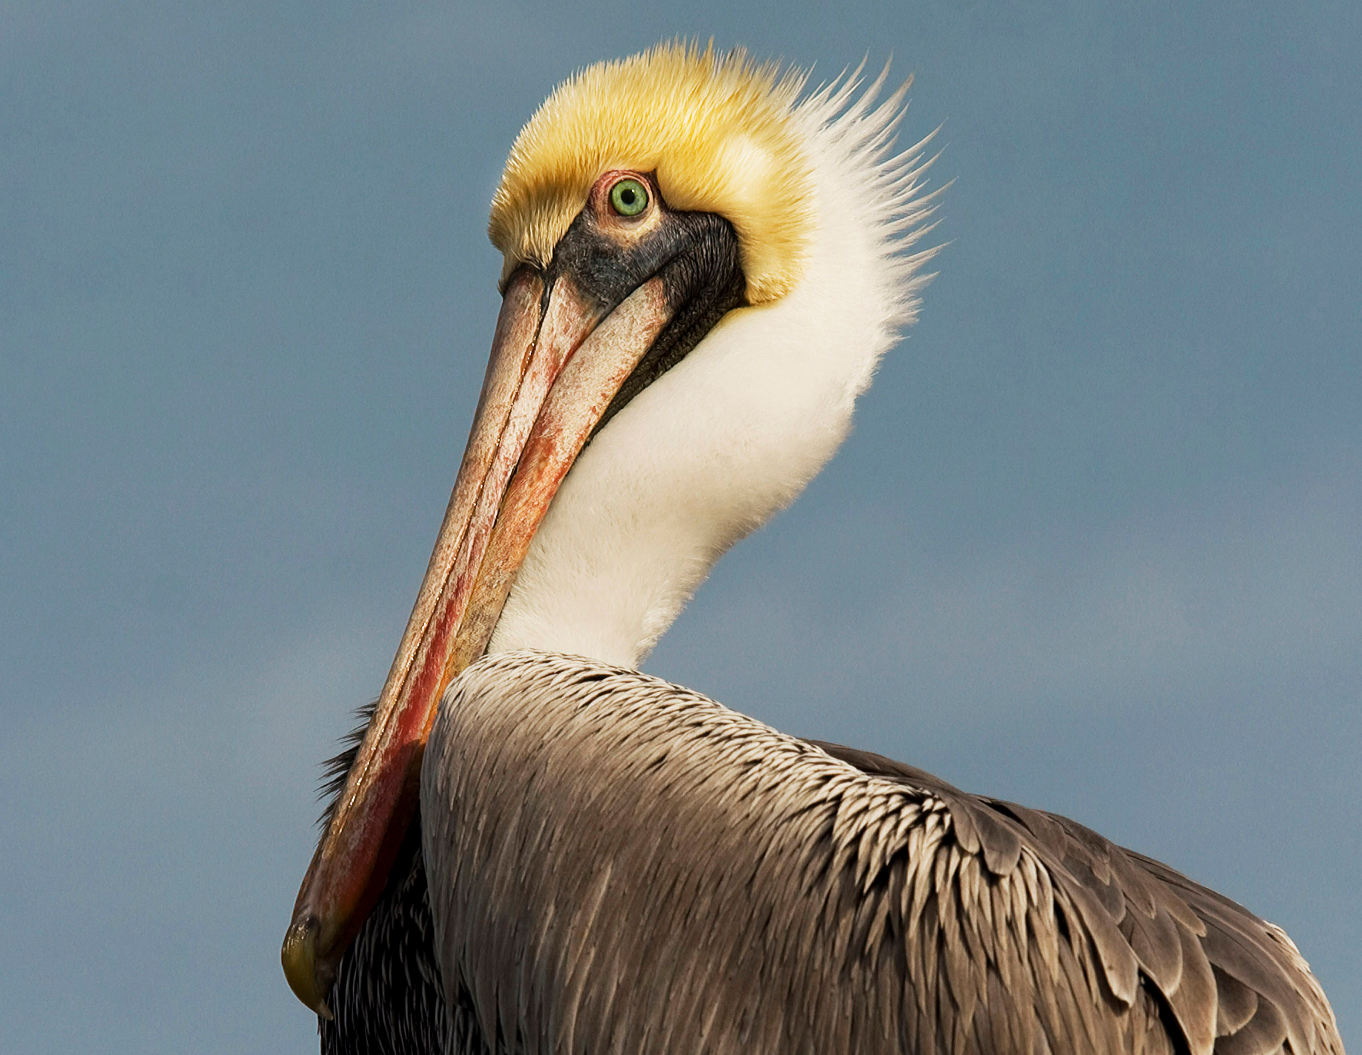
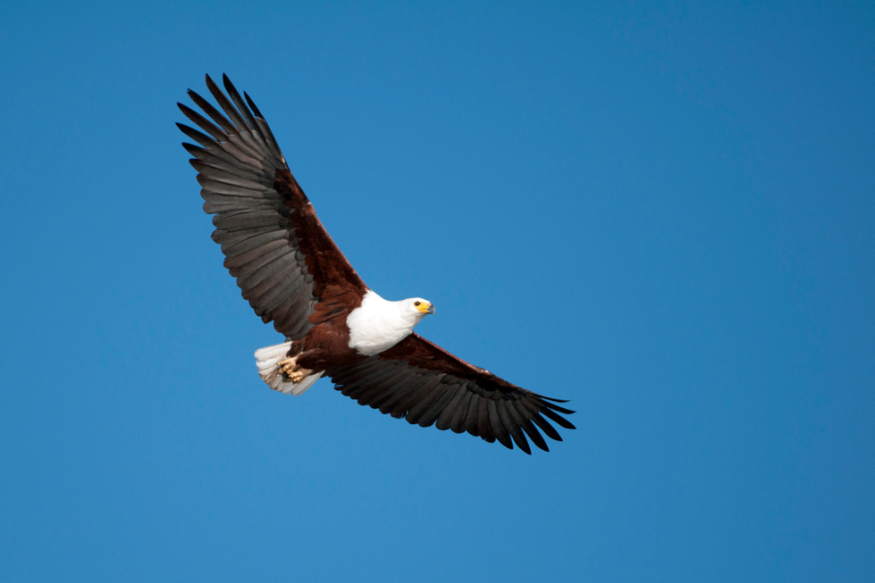
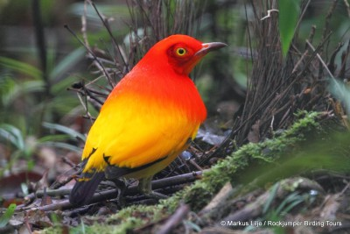
Birds
Numerous birds can be spotted along the river including pelicans, egrets, and African fish eagles.

Slide 6
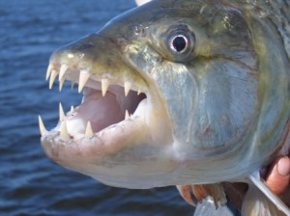
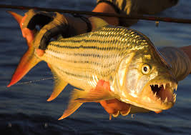
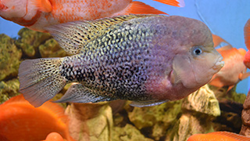
Fish
Many species of fish can be found in the river including yellowfish, catfish, tigerfish, and cichlids.

Slide 7
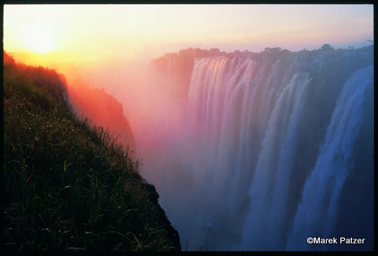
Facts about Victoria falls and Zambezi river
Fact 1
Victoria Falls on the Zambezi River is located on the border between the countries of Zambia and Zimbabwe in the continent of Africa.

Slide 8
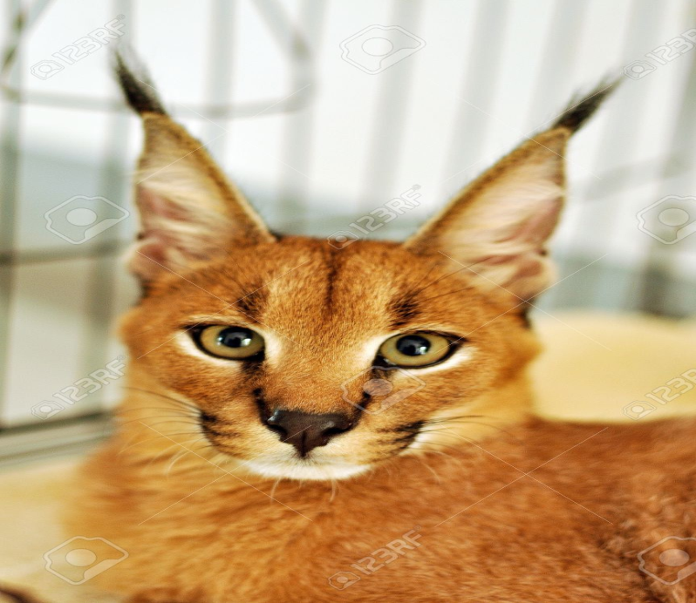
Fact two
Victoria falls
Living In the Victoria falls are small cats such as the caracal and sevral are rare all through the wild.

