Slide 1
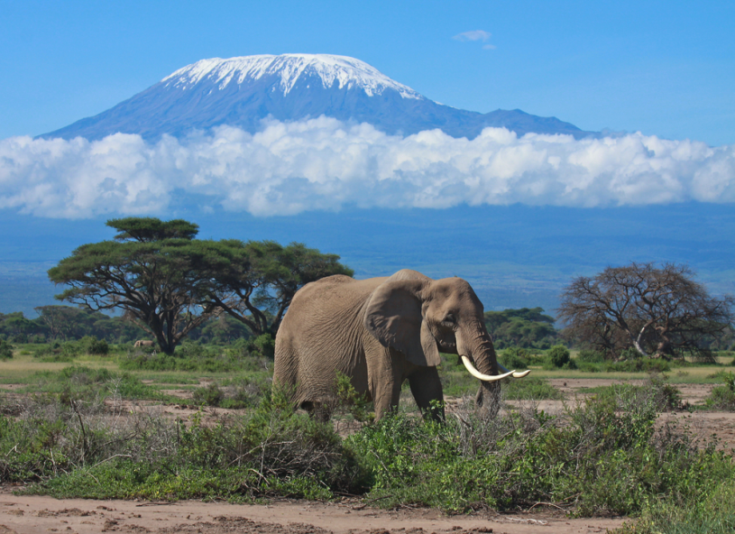
Mount Kilimanjaro
By harry and frank

Slide 2
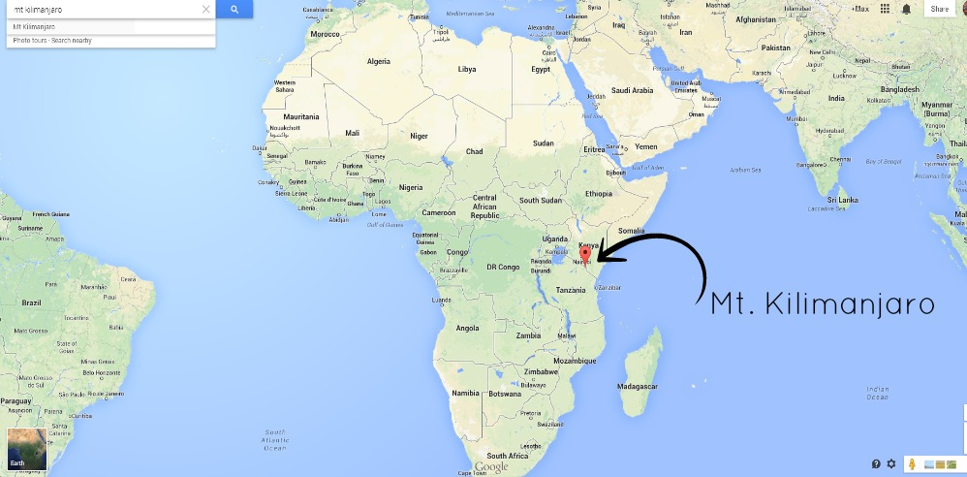
Mount Kilimanjaro is Africa’s highest mountain and one of the world’s most iconic peaks.

Slide 3
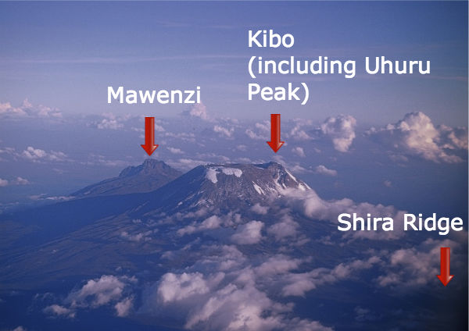
Mount kilimanjaro is 5,895 metres high!
NO seriously!!!!

Slide 4
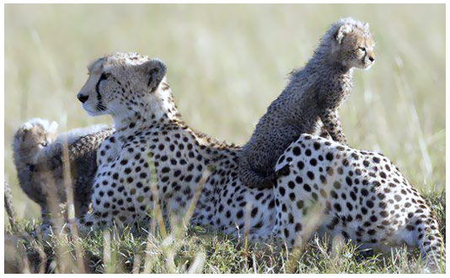
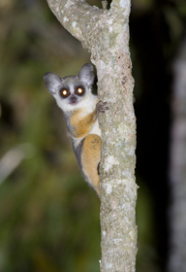
Animals
Cheetahs are the fastest land animals on earth but not the fastest
bush baby or bushbaby, name for several small, active nocturnal primates of the Galagidae family, found in forested parts of Africa. Bush babies are also called galagos.

Slide 5
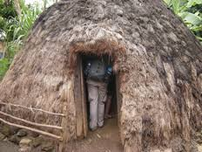
Chagga tribe
If you are sick you expect to get spat on 80 times and blown up each nostril by the doctor
There are 1m chagga tribe and ate the third largest tribe in tanzania
They live in vihambas

